Slide 1
Create, Invest, Protect your Community
The Open Social Web

Slide 2
What Humans Want
Communicate
Build Communities
Protect our Communities

Slide 3
The Problem Online
The platforms we use to communicate are controlled by people that don’t have our best interest in mind.
The platforms we use to build communities are controlled by people that don’t have our best interest in mind

Slide 4
The Answer: The Open Social Web
Build your communities based on your values
All of your content in one place
You don’t need a new platform every single time
It all Interconnects

Slide 5
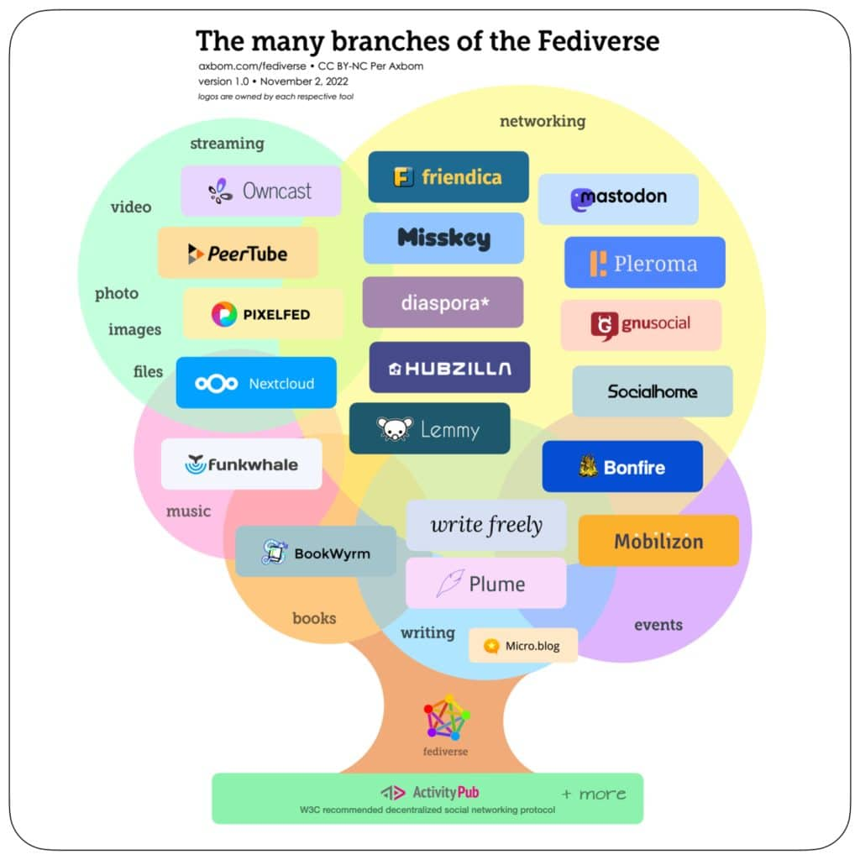
Bandcamp: Bandwagon
Facebook: Friendica
MeetUp: Mobilizon, Gancio
Reddit: Piefed, Lemmy
Twitter: Bonfire, Mastodon
TikTok: Loops
Twitch: Owncast, Peertube
Wordpress: Ghost, Wordpress
Youtube: Peertube

Slide 6
YOURS
Open source
Hosted by you
Changed by you
Build your own, extend existing software
NO LOCK-IN! Data can be exported from one and imported to another.
ALL OF IT IS YOURS!

Slide 7
Cost?
BT Free, my company, is a nonprofit. Btfree.org for more info and donations.
We charge nothing. You own everything.
We’re here to HELP.
BT Free currently runs TubeFree.org (Peertube) for $30/month.
BT Free currently runs Owncast for Ozoned for $15/month.
  Example of Owncast: https://tv.theindiebeat.fm/

Slide 8
The Pitfalls
You OWN this home. You don’t rent it. So maintenance, upkeep, etc matters.
This is an emerging tech with bugs. But they’re bugs the communities are working to resolve TOGETHER.
Bandwidth prices might come into play with larger communities or very active communities. Talking thousands of users.
The more you use it, the more content you put out there, the more it could cost.

