Slide 1
Spermatozoids
Deep Learning and Visual Representations final course project.
Fedor Chervinskii, Vitaly Pavlenko
Skoltech 2015

Slide 2

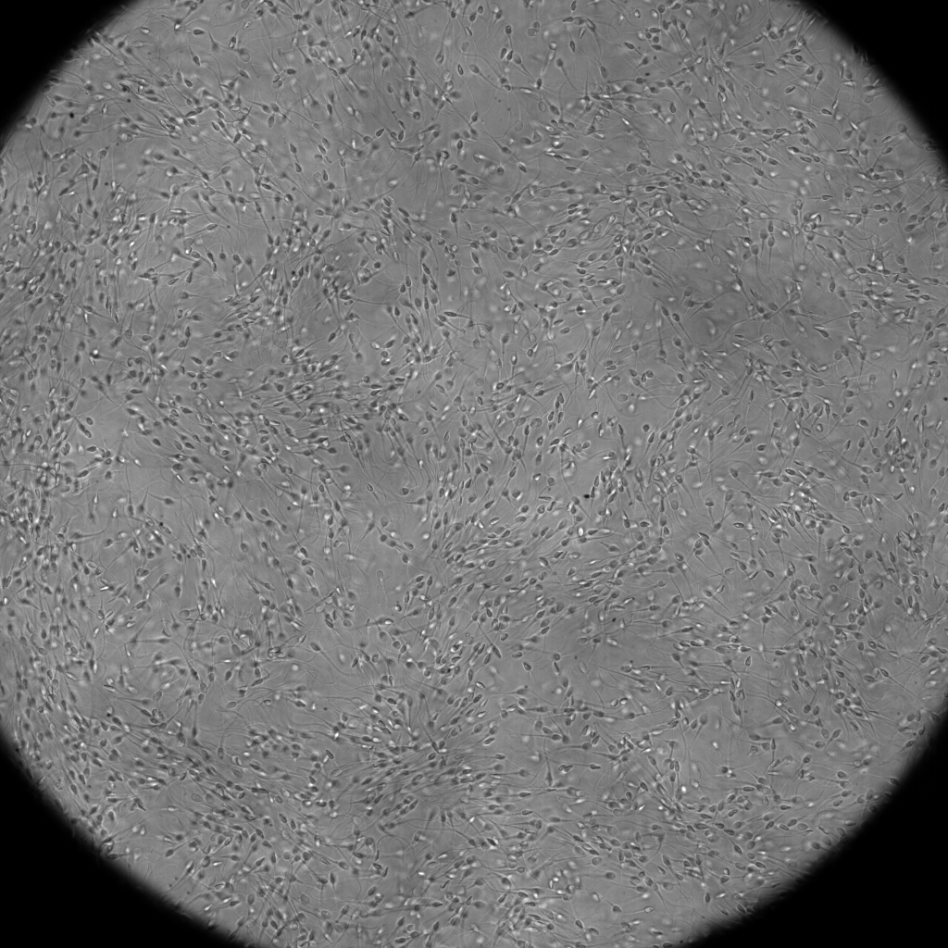
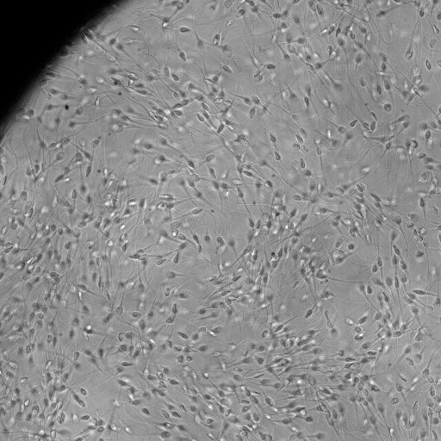
from Wikipedia:
— A spermatozoon (pronounced /ˌspɜrmætəˈzoʊən/, alternate spelling spermatozoön; plural spermatozoa; from Ancient Greek: σπέρμα "seed" and Ancient Greek: ζῷον "living being") is a motile sperm cell, or moving form of the haploid cell that is the male gamete. A spermatozoon joins an ovum to form a zygote. (A zygote is a single cell, with a complete set of chromosomes, that normally develops into an embryo.)
Task - to detect single cell position and orientation.

Slide 3
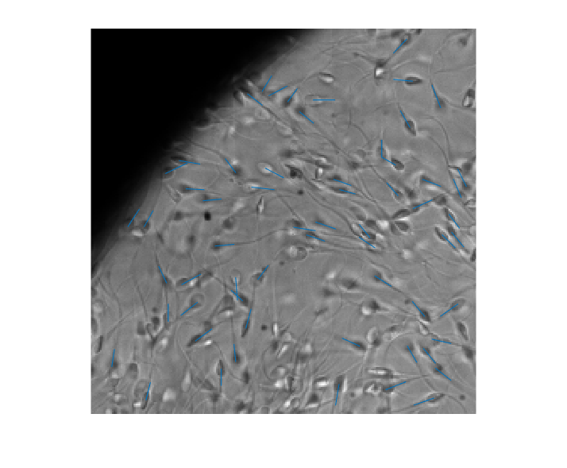

Workflow
label patches
augment the data
train CNN to detect single cell on a patch
train another CNN to distinguish different orientations
evaluate performance on raw images with a lot of cells

Slide 4
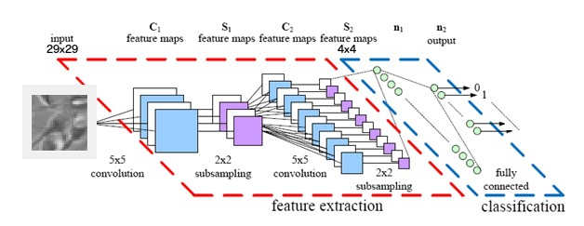
Architecture
Hint: we can implement fully connected layer as convolutional with n1 1x1 filters

Slide 5
Convolutional architecture
Training:
matrix(29, 29) :
vector(1, 2) : [0.9 0.1]
Testing:
matrix(1024, 1024) :
matrix(250, 250, 2)
for orientation: matrix(250,250,num_orient_classes)

Slide 6

Detection
Output: probability of a certain pixel to be a center of a cell

Slide 7
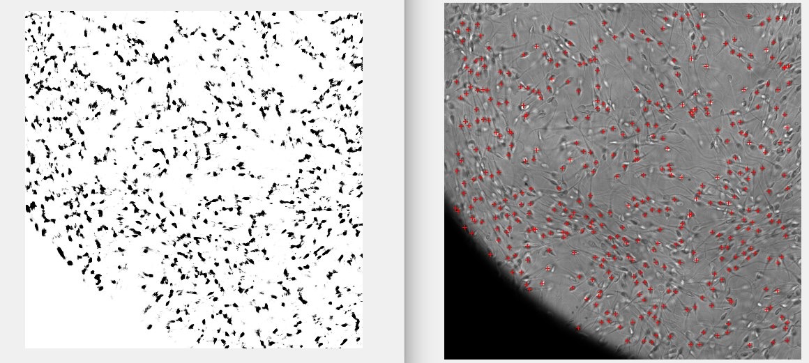
Detection

Slide 8
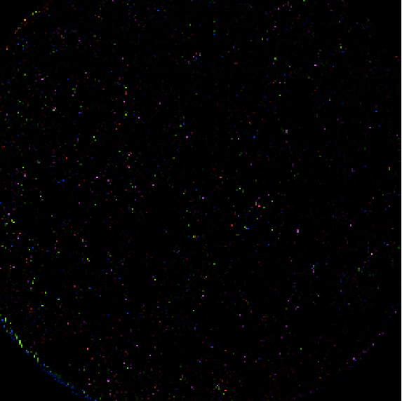

Orientation classification
Output: probability of a certain pixel to be a center of a cell, oriented by a certain angle
orientation map

Slide 9
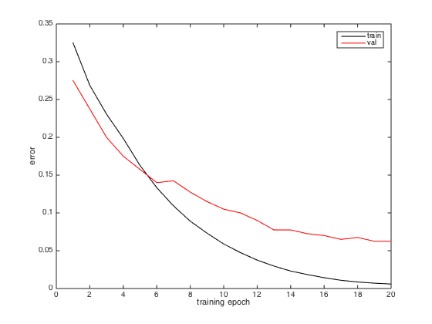
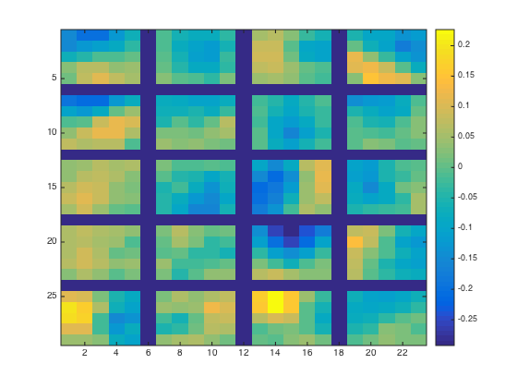
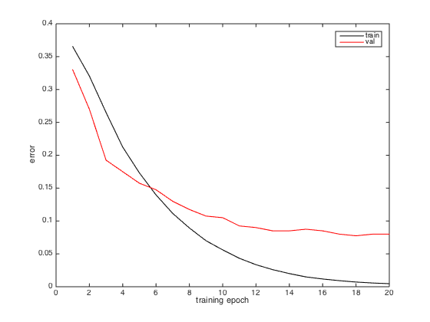
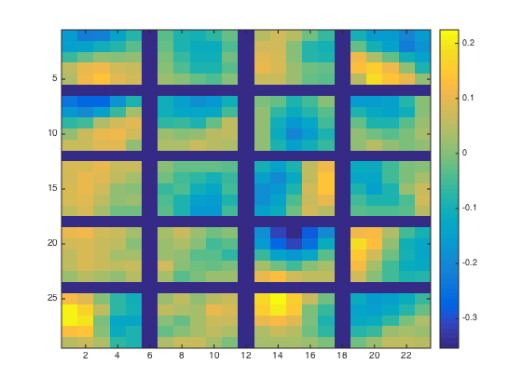
Results
4 classes
10 classes
convergence
1 conv layer filters

Slide 10
Acknowledgments
Victor Lempitsky and Skoltech CV group - supervision
Vasily Kantsler - data and task
Maté library (https://github.com/victorlempitsky/Mate) - implementation

Slide 11
Thank you!

