Slide 1

FEDORA BY THE NUMBERS
January 2016
Remy DeCausemaker and Matthew Miller
Notes:
Gigantic thanks to Stephen Smoogen for working extra in the midst of an otherwise busy time to get us these updated stats! Also, Ralph Bean for the Fedmsg work. FPL mattdm also put in major work to make this presentation happen. Kudos to all of them.

Slide 2
Fedora Linux Had A Very Productive, Tremendous Year….
With the releases this year of Fedora 22 and Fedora 23, Fedora stakeholders should be proud of themselves with the quality of Fedora releases/support continuing to go up while driving a lot of new innovation and success into Linux.
— Phoronix
Notes:
http://www.phoronix.com/scan.php?page=news_item&px=Fedora-2015-Top-News

Slide 3
Fedora found its groove again with Fedora Next and turned out its most impressive releases to date. More than just a great release though, the Fedora Project feels re-energized, like Fedora suddenly remembered what it was and where it was going. That's great news for Fedora fans, but it's also great news for RHEL and its many derivatives.
— The Register
Notes:
http://www.theregister.co.uk/2016/01/14/year_of_linux/
(Wait! That's not numbers. You promised numbers!)

Slide 4
The Section of the Presentation
Which Features
Numbers About Fedora Downloads and
Update Server Connections
Notes:
There's gonna be numbers about other stuff too. But let's start here!

Slide 5

Notes:
Disclaimer! Numbers are Hard! We don't do any invasive tracking, so these numbers are based on what we can observe, which has many shortcomings.
Best to think of the Y axis as “magical connection numbers” rather than in absolutes. Still tells us some useful things,though….
By FabSubeject (Own work) [CC BY-SA 3.0 (http://creativecommons.org/licenses/by-sa/3.0)], via Wikimedia Commons https://commons.wikimedia.org/wiki/File:Dinosaur_Park_Ghandhinagar.jpg

Slide 6
Notes:
This is the all-time history of Fedora connection stats.
At least, as far back as we have it — mid 2007.
The Y axis probably doesn't mean anything.
It's based on connections to our update server (which is before the mirrors and tells systems which mirror to use)
counts a single IP address at least once a day.
Not all systems check in daily — many don't check in at all.
Highly influenced by availability of broadband.
Also, NAT and short DHCP leases complicate the picture.
Also, if a university or somewhere manually configures systems to use a local mirror, those don't get counted.
Really hard to read! Don't worry — here's some breakdowns….

Slide 7
Notes:
Here, we've lumped various releases into groups.
At the left, dark blue — the oldest releases we track.
Light blue: Fedora 8, which was and still is weirdly popular for reasons we can't really explain
Purple: the middle years. Slow upward trend, leveling off
Red: The down times. Won't dwell on this, but — systemd, GNOME 3, other finger pointing. F15 never exceeded F14 in popularity. Slow downward trend.
Yellow: F20, year-long cycle, successful but didn't change the curve
Green: the “Fedora.next” releases: now we're talking!
Total users finally going up (and steeply)
Also note that more users of older releases converted

Slide 8
Notes:
Here's all that distilled to just two lines.
Green line is the total
Blue points are the peak for each individual release.
Interestingly, this almost always comes right before the next release — we generally see steady accumulation of users of each release right up until its replacement is ready

Slide 9
Notes:
This is an up-and-coming metric… in Fedora 21 and newer, NetworkManager checks if it can get to our servers to see if the Internet is working.
The red line goes up more slowly than the green line because upgraders don't necessarily get this new configuration – only new installs.
So, only of mild interest now, but will be more useful as everyone shifts over to newer releases

Slide 10
Notes:
Okay, so, now we're looking at actual download numbers.
We're not sure how these correlate to use, because one CD/USB stick could be used for a whole install fest or server room — or could just go in the trash.
We have made a considerable effort to filter out bots, webcrawlers, and just plain junk. We're reasonably confident that these are decent numbers.
Bottom line: about 200,000 downloads a month, with over 100,000 coming in weeks with a new release.
A little concerned that F23 is down from F22 is down from F21, but note that upgrades don't need an installer download

Slide 11
Notes:
Here we see Fedora Server, Workstation, Cloud, and Atomic separately, as percentage.
Note netinstall was added for Workstation in F22. Before that, users were asked to start with Server and convert if they needed that.

Slide 12
Notes:
In addition to editions, we have… all this other stuff.
Spins: desktop technology showcases
Labs: collections of software for a use-case
We tried to make a pie chart, but it was even worse, so…. Breakdown currently is about:
67% Workstation
14% Server
4% KDE
3% LXDE
3% Cloud
2% XFCE
2% MATE
2% Cinnamon
1% Atomic
1% Security
1% SoaS

Slide 13
Notes:
A detailed look at the Spins. KDE is the most popular, and interestingly got a jump with the F22 release — we attribute this to changes in the web design.

Slide 14
Notes:
Here's the breakdown by system type. The vast majority of users are interested in x86_64.
32-bit Intel architecture is higher than we'd expected… problematic because it's hard to maintain that kernel
ARM is the little line at the top. (The place where it dips? That's the time between F21 and F22, when ARM downloads didn't have a good “home” on the websites. Now we have http://arm.fedoraproject.org/
Other archs are negligible

Slide 15
Notes:
Here's a different view, going back to the update server connection stats. This goes back way a decade rather than two years – you can see basically the parallel to the last slide over at the right, where x86_32 is flat.l
Again, there's ARM breaking through at the top. Interestingly, the percent of update connections is a little higher than the percentage of downloads, probably because of “download once, install multiple”
Arm64 line is too small to see — the raw numbers are in the double-digit. Other archs are negligible

Slide 16
Notes:
EPEL is Fedora packages rebuilt for RHEL and CentOS
Very, very popular!
Ties CentOS and Fedora communities together in a really nice way — room for more, here!

Slide 17
A Brief Diversion Into External Numbers
Notes:
It's really hard to get meaningful competitive data
Most “What Linux do you prefer?” surveys are on Linux enthusiast sites, which really skews the results
Distrowatch is clearly nonsensical…..
Reddit surveys are…. Reddit surveys
Google Trends just indicates the general downward trend of Linux as a percentage of things that people on the Internet care about

Slide 18
Notes:
This is from programmer's Q&A site Stack Overflow. Surveyed about 28,000 users, the majority of which are software developers
about a third describe themselves as “full-stack web developers”
about an sixth are students; two-thirds work full time
Global responses (biased towards english)
Linux numbers roughly 20% previous two years too

Slide 19
Notes:
First time they have a breakdown of which Linux.
This is not a really happy number… but it's not terribly surprising given the marketing resources Canonical has put into Ubuntu
Developers are the key target for Fedora Workstation, so one goal is to really grow this number. (Discuss Fedora.next three-edition marketing strategy here.)

Slide 20
The Fedora Project Is More Than
Just an Operating System
(And so, here are some numbers about that.)

Slide 21
How Big Is the Fedora Contributor Community?

Slide 22
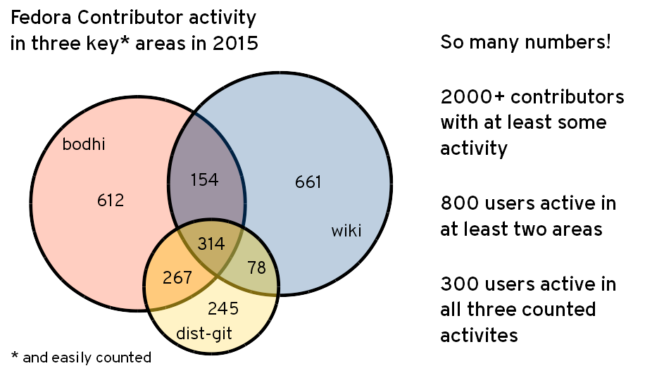
Notes:
Fedmsg – explain the bus
And, some actions on the bus are clearly the result of a user doing something active
So, we're counting some of those.
Particularly, we're counting messages that also require contributors to be logged in to Fedora Account System, which means we can count on usernames being the same across all three (IRC, mailing lists, and askbot don't have this constraint
Explain the particular three things (bodhi, dist-git, and wiki)
It'd be lovely to think of this as representing packaging, qa, and docs teams, but wiki isn't really docs. Also, be clear on what we AREN'T messuring
Dist-git has rpmspec files. Every change to rpm.
Bohdi – update system for qa activity. Not release activity.
We use wiki for test matrices, not just docs Fedora changes, ambassador events, lots of project activity
[

Slide 23
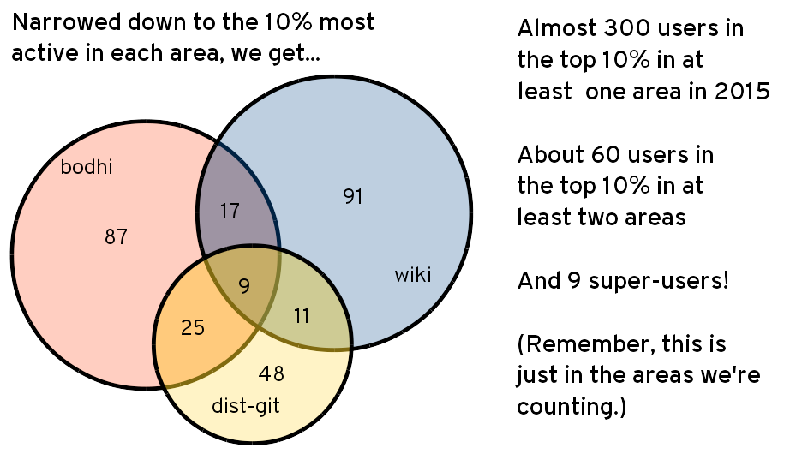
Notes:
Here, we took the top 10% by activity over all of 2015.
This 10% — about 300 people — are responsible for about two-thirds of the overall activity.
(we think that's a pretty good number, really — the core group is not small, and it's not 10% doing 90% of the work.)

Slide 24
Let's break that down a little more...
Notes:
(or skip to slide 32 if you don't wanna)

Slide 25
Notes:
Okay, so, this takes a little explaining, but it's not really all that complicated – trust me.
This is the count of people who provided feedback for pending security or bugfix updates, by week. It's a count of people, not of level of activity, so if one person did a lot of work, they're only counted once. So, if the top line is 140, it means that in that week, 140 different people participated.
The color breakdown explores contributor activity level. We counted the total activity over each quarter, and sorted people into buckets based on that, so you can see how much of the activity comes from people who do this all the time, and how much comes from casual contributions
The yellow + green together are the “top 10%” from the venn diagram. You can see that it's roughly 30 people each week, plus another 40-120.
Also note Trend over time — pretty constant.

Slide 26
Notes:
So, this shows the percentage of comments each week which come from which group of people. Here, we're counting each feedback action, not just each person once.
You can see that the top 1% — about 5 people each week — provide about 30% of the overall feedback, and the next 9% another 40%, so that's 70% done by the core, engaged group. (That's about 30 people weekly, but annually that core top 10% is actually about 140 individuals…so not everyone in the annual top is in the top every week. This is probably a good thing!)
It'd be nice to get the blue and red up … more “crowd-sourcing” … Talk about bodhi 2, if we have time (i.e. fine grained karma per bugzilla ticket, and other features.

Slide 27
Notes:
Okay, so, same thing for dist-git. Number of people each week who are active in making changes to a fedora package.
Note that the scale is different from the Bodhi chart, with a max of 300 instead of 150 — there more than twice as many different people each week.
What are the big drops? Christmas!
That 10% plus the next 40% adds up to a little under 30% of the total packaging work (as measured in commits). And, then, there's about 15% that made just one small change — but there average about 30 such changes a week!
There were about 900 different people counted in 2015. On the average week, we see a little over 200 of them — so, about a quarter of our packagers are active weekly. And about 50 people are pretty much active all the time.
Again, pretty flat over time. (And a lot more constant than Bodhi)

Slide 28
Notes:
Okay, by percent. What are the big spikes here? Mass rebuilds! That's release engineering at work.
On a typical week where there's not a spike due to a mass rebuild or similar:
the top 1% make about 25% of the changes
and the next 9% make up 40%
So, this has the same basic pattern of about two-thirds done by the top 10%

Slide 29
Notes:
Everyone probably has the point by now.
Again, we've got the Christmas downtime.
The relatively low activity by casual contributors isn't surprising because the Fedora Wiki is really mostly a workspace for active contributors, not end-user documentation, so we expect different usage patterns than from a crowd-sourced documentation wiki

Slide 30
Notes:
Yep. Top 1% makes 20% of the edits, and the top 10% together makes 60%. The bottom 50% make up just about 5%.

Slide 31
Okay, enough of that.

Slide 32
Let's wrap up with a few slides showing some other random numbers!
Notes:
Not really random, but there are a few more interesting numbers to talk about that we've just started exploring — mostly one slide each rather than in series'.

Slide 33
Notes:
Red dots are the months in which we had new Fedora OS releases. Factor those out and there's still a strong upward trend. Or, just look at attention in those months, which is also on the rise
The Magazine is strictly targeted at end users, with intentionally little inward-facing conversation (to avoid scaring people). Created to address two problems: 1) search results not coming up with Fedora answers 2) hard to get the press excited.
This seems to be working!

Slide 34
Notes:
Okay, so this is some stats-gathering I'm trying out. Refinements on this coming in future reports. Right now, just shows the Fedora devel mailing list — our main engineering/technical list. I'll add more later. And, I'd like to do similar analysis for the fedmsg data shown previously.
The graph shows how many new users appear each month, and then categorizes them by how many future months they appear in.
So, the dark blue users show up but go away. The red/orange line in the middle is people who are around for a little but, but don't become highly active. (Note that it's any future month – could be May 07 and then January 13, for some reason.)
The yellow shows people who appear and then stick around. Obviously this drops off at the right side of the chart, which is simply because there haven't been that many months yet.
Another caveat – I haven't filtered out bots and automatic posts, yet.
I think the bottom line here is that we've got basically ongoing new users throughout the history of the project. I'm taking this as a baseline — a goal is to make that “Core” yellow group start trending upwards.

Slide 35
Notes:
We use Internet Relay Chat a lot. (Plug Hubs here!)
This is our main “high bandwidth” mechanism of collaboration.
This is ripe for mining for interesting metrics, but we've really just started looking at it. We can apply the same metrics as for the bodhi/dist-git/wiki stats, and while IRC nicks aren't always FAS names, people can provide volunteer that info, so we can do some mapping
Also interesting to look at the same new-vs-older numbers as with mailing lists
For now, consider that we're averaging between 3 and 4 meetings per day — 1331 in 2015, which is up from 1068 in 2014

Slide 36
Notes:
In general, about 200 people participate in elections for the Fedora Engineering Steering Committee, and that's been basically true for all time.
This is a pretty low turnout compared to eligible voters… it seems closer to the count of very active contributors… which isn't necessarily a bad thing — if it is those active contributors voting

Slide 37
Notes:
I didn't script this — well, I started that way, and then I did a lot of LDAP queries by hand to check everyone else. That's pretty tedious, so I just went through the top 300 that comprise roughly the top 10% of each area.
Really, truly a community project. (With a big RH investment!)
(“Sneaky” users — often old-school Fedora contributors now hired by Red Hat. Not really sneaky. Often either had existing community identity, or, like me, a system already set up for filtering the massive mailing list inflow)
Of course, again, this isn't all of the activity — it's just that which is easy to count and easy to attribute. But I think it makes a pretty decent sample.

Slide 38
So…. Questions?
Presentation by Matthew Miller, Fedora Project Leader, and Remy DeCausemaker, Fedora Community Lead. Super extra amazing thanks to Stephen Smoogen and Ralph Bean on the Fedora Infrastructure team. Thanks to them, no Bothans died to bring you this information.
Become a statistic! Get Fedora Workstation, Fedora Cloud, or Fedora Server from
http://getfedora.org/
or join the project via
http://whatcanidoforfedora.org/

