Slide 1
Moscow neighborhoods
Fedor Malyshev

Slide 2
Business Problem
If you are looking to open café, shop, or rent apartment, you may be interested where in the city there are places similar to those that you know?
For example, you love atmosphere, people and venues of some district and want to rent an apartment here, but supply of apartments is too narrow and you should explore other places.
You can explore the city on your own, but maybe you would like to have some recommendations.

Slide 3
Possible Solutions (1)
There are two ways, how we can make such recommendations:
1. Clearly ask the customer about his/her preferences: what venues are important to be in the proximity, density of this venues, and so on
The first way is not simple, because we should ask many questions people can find difficult to answer.

Slide 4
Possible Solutions (2)
The second way:
2. Make recommendations based on what we know he/she like
To pursue the second way, we need to somehow cluster districts, based on data we know about them.
I like to solve this problem for my home city, Moscow, Russia.

Slide 5
Data
To build the clustering algorithm, we will leverage following data:
List of Moscow districts
Foursquare data about venues in the district: name, category, address, coordinates, rating

Slide 6
Algorithm
For each district in the Moscow city, obtain coordinates of centers of the districts (longitude, latitude) by Nominatim service
For each district, get 100 most popular venues located within 1000 meters from the center of the district by Foursquare API.
Exclude districts with less than 20 venues (less than 20 venues aren’t sufficient for further clustering).
Calculate frequency of occurrence of each venue category for each district
Based on the top 10 most common venue categories, cluster districts (K-means clustering algorithm, K=3).

Slide 7
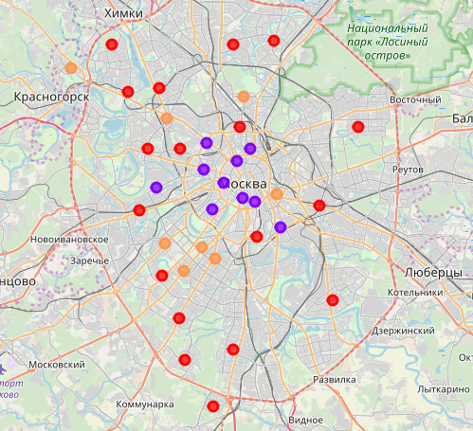
Results
Let's show districts labels on the map of Moscow. Label color defines the district's belonging to a particular cluster:

Slide 8
Results (cont.)
Looking at the map, people who know Moscow city can clearly identify the following qualitative categories:
the first cluster (purple) – central prestigious districts (with 2 exceptions)
the second cluster (orange) – non-central high quality districts
the third cluster (red) – dormitory areas
This confirms that our clustering algorithm makes sense!
So, we for any district (in a resulting dataset), we can say what others districts of the city similar to it.

Slide 9
Discussion
There are some data issues, that limit effectiveness of the algorithm:
1. Insufficient data on Foursquare. From practice, to obtain reliable results of clustering, we should consider only districts with more than 20 venues. For Moscow, 84 out of 120 districts have 20 or less venues on Foursquare, and we should exclude these districts from consideration

Slide 10
Discussion (cont.)
2. Redundant categorization of venues on Foursquare. For example, there are venues with categories Restaurant, Middle Eastern Restaurant, Caucasian Restaurant, Asian Restaurant, Varenyky restaurant, and so on. For an algorithm, these are separate categories, although by the matter of fact they represent one category - restaurant.
To overcome this issue, we can combine Foursquare's categories into more broad groups before clustering.

Slide 11
Conclusion
The algorithm allow us to cluster city districts.
To obtain reliable results, it's important to check that data is sufficient and well prepared, and carefully select parameters of the algorithm (radius of districts, number of clusters, minimum number of venues to consider the district).

