Slide 1

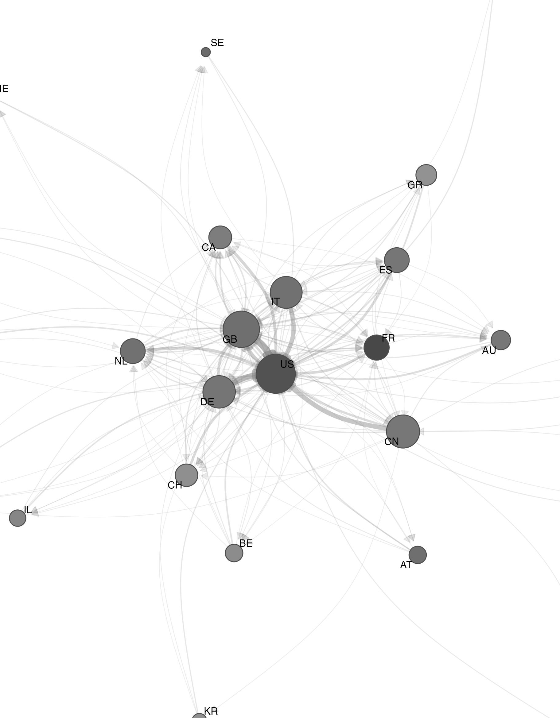
Geographic citation insularity in DH
EADH 2026 · University of Groningen
Notes:
Good morning. This is a talk about a simple question with an awkward answer: when Digital Humanities scholars write a reference list, how much of it is from their own country?

Slide 2
Does DH cite globally?
Do DH scholars cite their own country more than they should — and is that changing?
Fiormonte 2012
Anglophone and Western-European power structures shape DH scholarship
Galina Russell 2014
Geographic and linguistic unevenness of DH research output
Risam 2019
Digital knowledge production reproduces global inequality
Evidence so far: qualitative, or counts of conference submissions. Two bibliometric studies — Tang et al. 2017, Spinaci et al. 2022 — neither at citation level.
Notes:
DH describes itself as international by design. For over a decade critics have said the practice doesn't match the description: Fiormonte on Anglophone and Western European dominance, Galina Russell on the geographic and linguistic skew of output, Risam on how digital knowledge production reproduces global inequality.
Most of that evidence is qualitative, or counts where conference submissions come from. Only two studies have looked at DH bibliometrically at scale — Tang and colleagues in 2017, Spinaci, Colavizza and Peroni in 2022 — and neither asked the citation-level question. So that's what we did. Three questions: how much do DH scholars cite their own country; how much of that is more than you'd expect given how much each country publishes; and is it changing between 2007 and 2025.

Slide 3
Insularity in one slide
A citation is insular when the citing paper and the cited paper share at least one author country.
Raw self-citation is meaningless alone: big producers cite themselves because there is more to cite. So compare with what chance predicts —
expected = a country’s share of everything cited
DE · FR
US · DE
insular
Excess
observed − expected, in percentage points
citing
cited
“Any overlap” rule. The stricter majority rule (> 50 % of citing countries) tells the same story at lower levels.
Ratio
observed ÷ expected — how many times more insular than chance
Significance: 1,000-round permutation — shuffle country labels on the cited side, keep the citation graph, ask whether the real value is extreme.
Notes:
One definition, then one correction.
The definition: a citation is insular when the citing paper and the cited paper share at least one author country. That's the "any overlap" rule. A paper from Germany and France citing a paper from the US and Germany counts, because Germany is on both sides. [There's a stricter majority rule too — more than half the citing countries must appear on the cited side — and everything I'll show holds under it, just with lower numbers.]
The correction: raw self-citation is meaningless on its own. The US produces the most DH work, so US authors cite US work partly because there's so much of it. So for every country we compute an expected rate — its share of everything that gets cited — and compare. Two numbers carry the talk from here: excess, observed minus expected, in percentage points; and ratio, observed over expected, which tells you how many times more insular a country is than chance. We test excess with a thousand-round permutation: shuffle the country labels on the cited side, keep the citation graph, see if the real value is extreme.

Slide 4
Two corpora
01
Journals
02
ADHO conference
Spinaci et al. list — 19 Exclusively-DH journals — plus “digital humanities” in any title or abstract
OpenAlex API → ~17,600 works, 2000–2025
Every reference followed; cited-work countries fetched
58,655 citation pairs with country on both ends
63 countries with ≥ 100 citations
Index of DH Conferences (CMU): abstracts and affiliations, but no reference links
Reference strings extracted from full text, parsed with AnyStyle
Matched offline against an OpenAlex snapshot: DOI → exact title → fuzzy ≥ .95
11,645 resolved (27 %) → ~5,000 citation edges
ADHO annual conference and its predecessors only
Same measures. Same null model. Applied to both.
Notes:
Two corpora, built the same way at the end but very differently at the start.
The journal corpus follows Spinaci et al.: every work since 2000 in the 19 journals they classify as exclusively DH, plus anything anywhere that says "digital humanities" in its title or abstract. About 17,600 works from OpenAlex. For each one we take every author country, follow every reference, fetch the cited work's countries. That leaves 58,655 citations with country on both ends, 63 countries with at least a hundred each.
The conference corpus is the new part. The Index of DH Conferences at Carnegie Mellon gives us the abstracts with affiliations, but no machine-readable references. So we pulled reference strings out of the full text, parsed them with AnyStyle, and matched them — offline, against a local OpenAlex snapshot, because the search API kept timing out — by DOI, then exact title, then a very conservative fuzzy match. We accept 27 percent of references. That's precision over recall: a wrong match corrupts a country count; a miss just shrinks the sample. About five thousand citation edges survive, and we keep only the ADHO annual conference and its predecessors, so we're not mixing in venues that are national by construction. [I'll come back to what that filtering does to the sample.]
Same measures, same null model, applied to both.

Slide 5
Everyone is insular
Country | N cit. | Observed | Expected | Excess | Ratio
US | 9,646 | .60 | .29 | +31 pp | 2.1×
GB | 8,111 | .38 | .12 | +27 pp | 3.3×
CN | 6,449 | .30 | .04 | +26 pp | 7.4×
FR | 3,294 | .36 | .03 | +32 pp | 10.7×
FI | 1,489 | .31 | .01 | +30 pp | 31.2×
AT | 1,414 | .28 | .01 | +27 pp | 27.9×
30 / 30
countries above chance
p < .001 · all with ≥ 100 citations
Structural, not a US quirk.
By excess: France and the US lead, 31–32 points above expectation.
By ratio: Finland 31×, Austria 28×, Greece 23× — the US just 2×. Small, cohesive national communities amplify most.
Notes:
First result. Every single country cites itself more than chance. Not most — all thirty with enough data, all below p of 0.001. This is structural, not a US quirk.
But look at the two lenses. By excess, the leaders are France and the US, both around 31–32 points above expectation. The US cites itself 60 percent of the time against an expected 29. By ratio, it's a different list: Finland at 31 times chance, Austria 28, Greece 23. The US is at 2.
Same phenomenon, different shape. Big producers have a lot of insularity in absolute terms because there's a lot of domestic work to cite. Small countries have a domestic pool of one or two percent of the field and still send a quarter or a third of their citations into it. That's where insularity is most amplified — small, cohesive national communities, national-language scholarship, a handful of dominant groups.

Slide 6
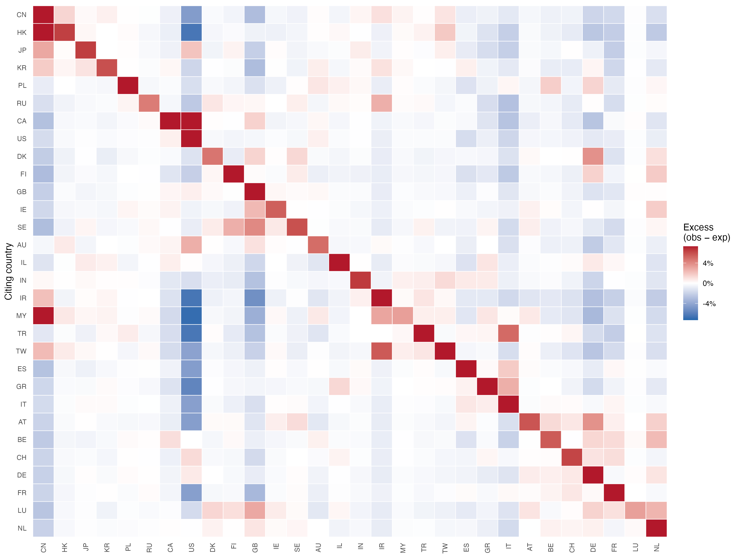
Who cites whom?
The diagonal
Red all the way down: every country cites itself above chance.
The US column
Mostly blue. Most countries cite the United States below its share — and keep those citations at home.
Regional blocks
East Asia top-left; the German-speaking countries and the Netherlands bottom-right.
Cell = observed − expected citation share · top 30 countries · N = 58,655
Notes:
The same null model, applied to every pair. Each cell is observed minus expected share; red is more than chance, blue is less.
Two things to see. The diagonal is red all the way down — that's slide 5 again. And the US column is mostly blue. Most countries cite the United States less than its share of the field would predict. They're not spending those citations on some third country; they're spending them on themselves. You can also see the regional blocks — East Asia top-left, the German-speaking countries and the Netherlands bottom-right. Hold on to the blue US column; it matters in two slides.

Slide 7
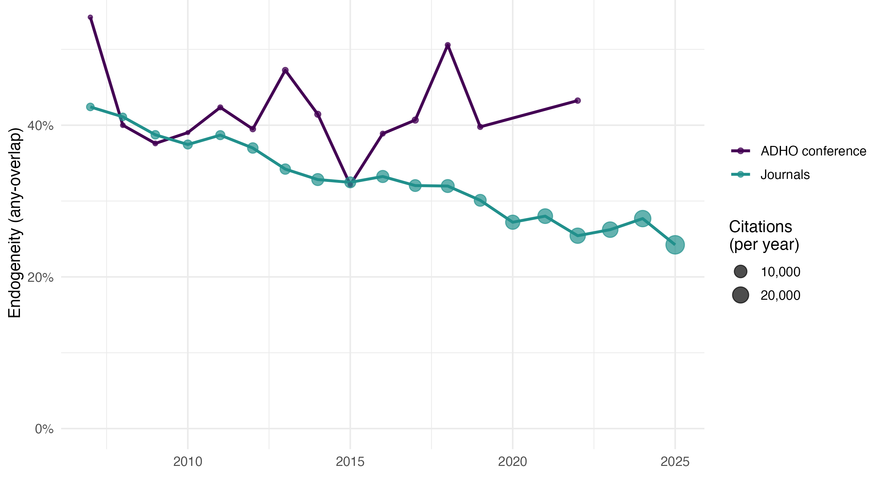
Journals open up. The conference doesn’t.
Journals
42 % → 25 %
2007 → 2025. Only the US decline is significant on its own (−1 pp / year).
ADHO conference
≈ 42 %, flat
No trend to find. DHd tracks it at 40 %.
Any-overlap self-country citation rate by year. Conference yearly n is small — read the level, not the wiggles.
Notes:
This is the slide I'd like you to remember.
The teal line is the journal corpus. Insularity falls from roughly 42 percent in 2007 to about 25 percent in the most recent years. Country by country, only the US decline is statistically significant on its own — about one point a year — but the direction is nearly universal. The journal literature is, slowly, internationalising.
The purple line is the ADHO conference. Same measure, same null model. It sits at about 42 percent and stays there. It's noisier, because the yearly samples are smaller, but there is no downward trend to find. The German-language DHd — the only regional series with enough resolved citations to measure — is at 40 percent, right beside it.
So the field's flagship international venue shows none of the opening-up the journals show. One reading: a conference is a live, co-located event, and you write the abstract for the people you'll see in the room. Another: what gets into the proceedings and what gets into a journal are shaped by different review cultures. We can't separate those with this data. What we can say is that "DH is becoming more international" is true of one venue type and not the other.

Slide 8
Is this DH, or just science?
Benchmark: Wu, Huang, Lu, Saxena & Traag (2026), arXiv 2604.01602 — 39 M OpenAlex publications, 95 countries, 2000–2022
 | Wu et al. — all science | This study — DH | Verdict
Method | Bayesian gravity model: country-pair preference, net of distance and city volume | Share-based null model + 1,000-round permutation test | Different estimator
Domestic preference | Strong, every country, persistent 2000–2022 | Strong, every country: 30 / 30, p < .001 | Agrees
Orientation to the US | Most countries cite the US above expectation | Most countries cite the US below expectation | DH deviates
Trend | Distance effect on citation tiny and shrinking; country bias does not fade | Journals fade, 42 % → 25 %; the conference doesn’t | Conference matches; journals don’t
Comparable in sign, not in magnitude: a model coefficient versus a share ratio.
Notes:
A natural objection: maybe all of this is just what citation looks like everywhere. Fortunately there's a very recent benchmark. Wu, Traag and colleagues published in April a study of 39 million OpenAlex publications, 95 countries, 2000 to 2022 — all of science — fitting a Bayesian gravity model that estimates a country-pair citation preference after controlling for distance and for how much each city publishes. Different estimator, same data source, same country logic. Their preference score is a model coefficient; our ratio is a descriptive quantity. They agree in direction, not in units — so read this table as does the sign match, not does the number match.
Row two: they find strong domestic citation preference in every country. So do we. Universal insularity is a science-wide fact, not a DH pathology.
Row three is where DH breaks from the pattern. In their data most countries cite the US above expectation — a shared orientation toward the American literature. In DH, that's the blue column: most countries cite the US below expectation. [Whether that's the humanities generally or DH specifically, we can't yet say; their four domains are physical, social, life and health sciences, and the humanities aren't broken out.]
Row four: they find the effect of distance on citation is tiny and shrinking, but country bias itself does not fade over two decades. Our conference corpus looks like that. Our journal corpus doesn't — it's shedding insularity faster than science at large. So the interesting DH result isn't that it's insular; it's that one half of it is stopping.

Slide 9
Caveats & next steps
Caveats
Next
Conference network is reconstructed: a reference must be parseable, in OpenAlex, and carry country — skews English-language and recent
Per-series is effectively ADHO vs DHd; other regional series resolve to nothing
Keyword search favours work that calls itself DH
Full counting inflates multi-country papers
Country ≠ language ≠ culture
Same pipeline on History, Literature, Sociology, Political Science — is DH distinctive?
Fit Wu et al.’s preference model on the DH corpus: is the US-column difference field or method?
Push conference resolution past 27 %: ~3,000 references sit in the 0.85–0.95 review band
Notes:
Caveats, quickly. The conference network is reconstructed from text, so three filters compound: a reference has to be parseable, present in OpenAlex, and carry country metadata. That tilts the conference sample toward English-language, recent, well-formatted work — which cuts against exactly the multilingual and Global South questions we care about. Treat the conference line as indicative. Only ADHO and DHd clear the citation floor; every other regional series resolves to nothing. On the journal side: the keyword search favours work that calls itself DH; full counting inflates multi-country papers; and country is a rough proxy for language and culture.
Next: we're benchmarking DH against History, Literature, Sociology and Political Science with identical methods. And the cleanest way to settle whether the US-column difference is field or method is to fit Wu et al.'s preference model on our corpus — that's in progress.

Slide 10
Three things to take home
01
Geographic self-citation in DH is universal and significant — and most amplified in small national communities, not large ones.
02
DH journals have been shedding it for twenty years: 42 % → 25 %.
03
The ADHO conference hasn’t: flat at ≈ 42 %.
github.com/fedormyskin/OpenAlex-DH-analysis
code · data · conference reference-matching pipeline
Notes:
Three things. Geographic self-citation in DH is universal and significant, and it's most amplified in small national communities, not the large ones. DH journals have been shedding it for twenty years. The ADHO conference hasn't. Code, data and the conference-matching pipeline are in the repository. Thank you.

