Slide 1
Mechanism Design
Alex Nesterov
Fedor Sandomirskiy
Laboratory of Game Theory and Decision Making

Slide 2
What is MD?
Game theory
Rules of interaction (institutional environment) are given. What would be the outcome?
Mechanism Design
Inverse problem: How to design the rules to achieve the desired outcome?
Applications:
1990s: Auctions
2000s: Large centralized markets (job markets, school choice)
2010s: Mechanisms on micro-level (allocation of resources or tasks)

Slide 3
Goals of designer. Examples:
Economic efficiency
or optimizing a numerical objective (revenue, social welfare)
Fairness
providing all agents equal opportunities
Robustness with respect to strategic behavior of agents
aka strategy-proofness, incentive compatibility, non-manipulability
The goals are incompatible
Usually:
Notes:
The most universal goal is economic efficiency, which roughly means that the outcome of a mechanism could not be improved, a similar goal is maximization of a numerical objective like social welfare or revenue of a seller in case of auctions

Slide 4
Social choice
aka voting

Slide 5
Why is voting relevant to our course?
Basic democratic procedure. Interesting by itself
The most general problem of MD: preference aggregation
Agents have preferences on possible outcomes of a mechanism
A mechanism selects an outcome taking preferences into account
Example:
job markets: outcome=(matching between employees and employers)
auctions: outcome=(who gets the good; specification of payments)

Slide 6
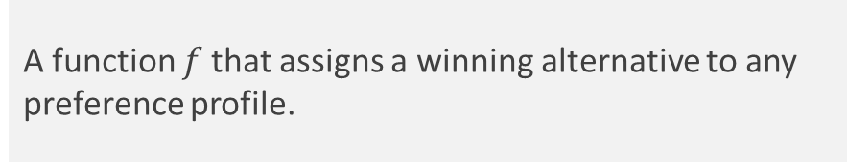
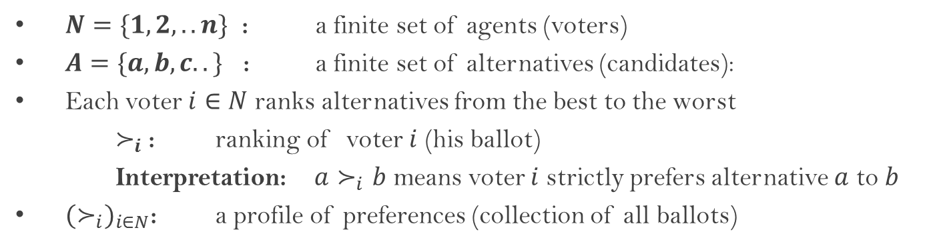
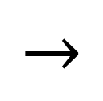
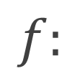
The model
$N=\{1,2,..n\}$ : a finite set of agents (voters)
$A=\{a,b,c..\}$ : a finite set of alternatives (candidates):
Each voter $i∈N$ ranks alternatives from the best to the worst
$≻_{i}$: ranking of voter $i$ (his ballot)
Interpretation: ${a≻}_{i}b$ means voter $i$ strictly prefers alternative $a$ to $b$
${(≻_{i})}_{i∈N}$: a profile of preferences (collection of all ballots)
1 | 2
a | c
b | b
c | a
Direct mechanism aka social choice function
A function $f$ that assigns a winning alternative to any preference profile.
$$f:$$
$$→$$
c

Slide 7
Examples of voting rules
and difficulties of the theory

Slide 8
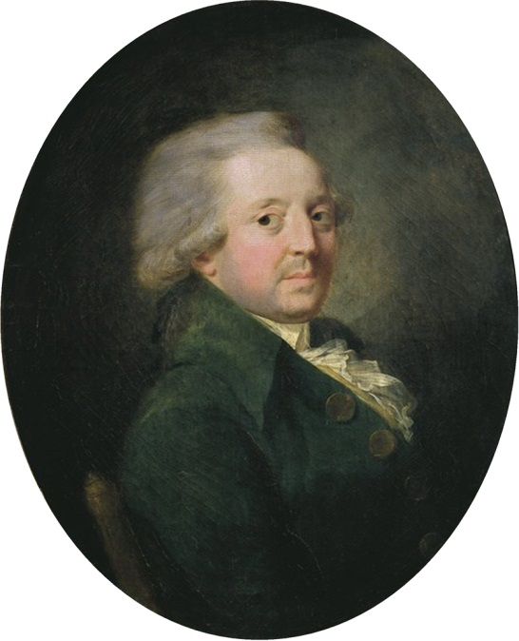
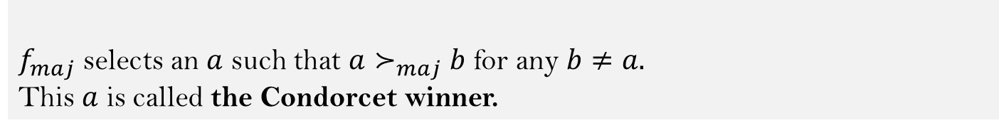
Majority could be irrational…
Example 1: the majority rule
Marquis de Condorcet (1743-1794)
First formal analysis of voting procedures
Leading role in the French revolution
Ancient idea: select an alternative that is the best from the majority’s point of view
Preferences of majority: $a≻_{maj}b$ if a majority of voters prefers $a$ to $b$
The majority rule
$f_{maj}$ selects an $a$ such that $a≻_{maj}b$ for any $b≠a.$
This $a$ is called the Condorcet winner.
Bad news: For $\left|A\right|>2$ the Condorcet winner may fail to exist

Slide 9

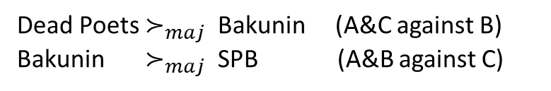
Example 1: the majority rule
Preferences of the majority:
Andrey | Boris | Claire
Dead Poets | Bakunin | SPB
Bakunin | SPB | Dead Poets
SPB | Dead Poets | Bakunin
Dead Poets $≻_{maj}$ Bakunin (A&C against B)
Bakunin $≻_{maj}$ SPB (A&B against C)
The best cafeteria is Dead Poets and SPB is the worst. Agree?
SPB${ ≻}_{maj}$ Dead Poets (B&C against A)
Condorcet paradox:
Majority may have irrational (i.e., non-transitive) preferences.
Corollary: no Condorcet winner
Remark:
If a non-binary decision is made by the sequence of pairwise comparisons, the results depend on the sequence (see historical examples in С. Николенко “Теория экономических механизмов”).

Slide 10
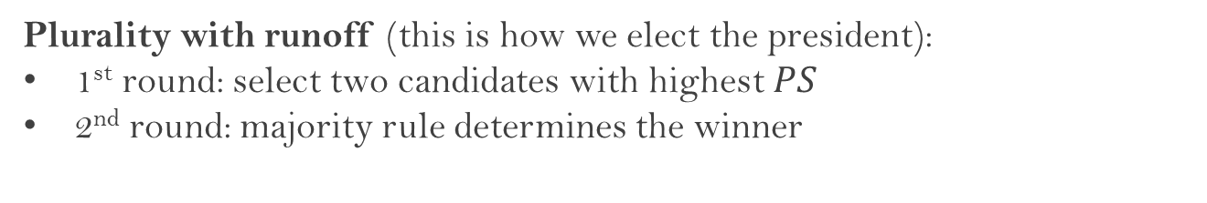
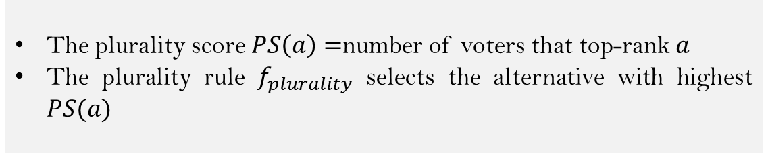
Example 2: the plurality rule
The most widespread voting rule with many flaws
How the plurality rule works:
The plurality score $PS\left(a\right)=$number of voters that top-rank $a$
The plurality rule $f_{plurality}$ selects the alternative with highest $PS(a)$
Plurality with runoff (this is how we elect the president):
1st round: select two candidates with highest $PS$
2nd round: majority rule determines the winner

Slide 11

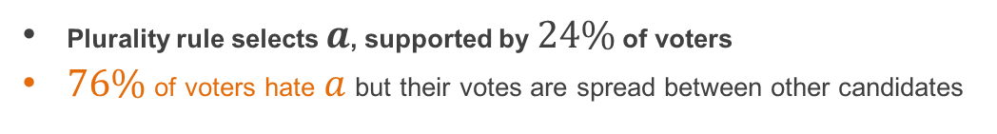
Example 2: the plurality rule
Plurality rule favors candidates with extreme views and few supporters:
24% | 20% | 18% | 17% | 21%
a | c | d | e | f
b | b | b | b | b
c | f | c | d | e
d | e | f | c | d
e | d | e | f | c
f | a | a | a | a
24% | 20% | 18% | 17% | 21%
a | c | d | e | f
b | b | b | b | b
c | f | c | d | e
d | e | f | c | d
e | d | e | f | c
f | a | a | a | a
Eric Maskin
Nobel prize 2007 for
foundations of Mechanism Design
Works at HSE Moscow
Plays flute
Fights against the plurality rule
This is how Donald Trump won the primaries (New York Times, April 28, 2016)…
Plurality rule selects $a$, supported by $24\%$ of voters
$76\%$ of voters hate $a$ but their votes are spread between other candidates

Slide 12
Example 2: the plurality rule
It is easy to vote strategically:
24% | 20% | 18% | 17% | 21%
a | c | d | e | f
b | b | b | b | b
c | f | c | d | e
d | e | f | c | d
e | d | e | f | c
f | a | a | a | a
24% | 20% | 18% | 17% | 21%
a | c | d | e | e
b | b | b | b | b
c | f | c | d | f
d | e | f | c | d
e | d | e | f | c
f | a | a | a | a
The last group of voters benefits from reporting $e$ instead of their sincere top-choice $f$
Why strategic voting is bad:
The ballots no longer reflect the real preferences of the society
Everybody should make a complex strategic decision trying to predict how other people will vote
The outcome becomes uncertain (depends on strategic skills and ability to coordinate)

Slide 13
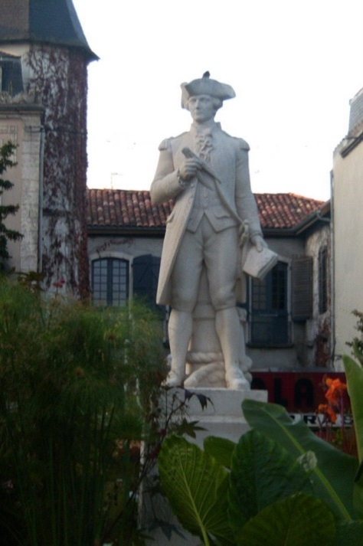
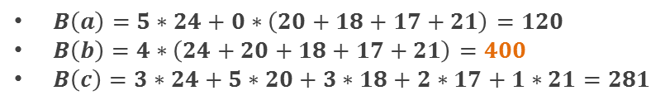
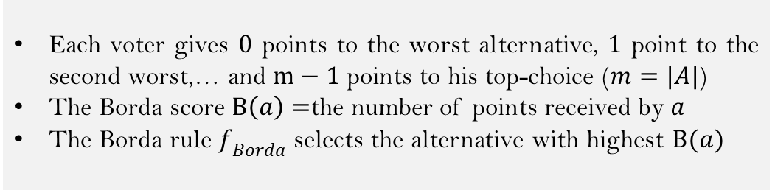

Example 3: the Borda rule
How the Borda rule works:
chevalier de Borda (1733-1799)
Each voter gives $0$ points to the worst alternative, $1$ point to the second worst,… and $m−1$ points to his top-choice ($m=|A|$)
The Borda score $B\left(a\right)=$the number of points received by $a$
The Borda rule $f_{Borda}$ selects the alternative with highest $B(a)$
24% | 20% | 18% | 17% | 21% | points
a | c | d | e | f | 5
b | b | b | b | b | 4
c | f | c | d | e | 3
d | e | f | c | d | 2
e | d | e | f | c | 1
f | a | a | a | a | 0
$B\left(a\right)=5∗24+0∗\left(20+18+17+21\right)=120$
$B\left(b\right)=4∗\left(24+20+18+17+21\right)=400$
$B\left(c\right)=3∗24+5∗20+3∗18+2∗17+1∗21=281$
Candidate $b$ wins!
Pros: finds a compromise
Cons: is manipulable

Slide 14
Normative approach to mechanisms

Slide 15
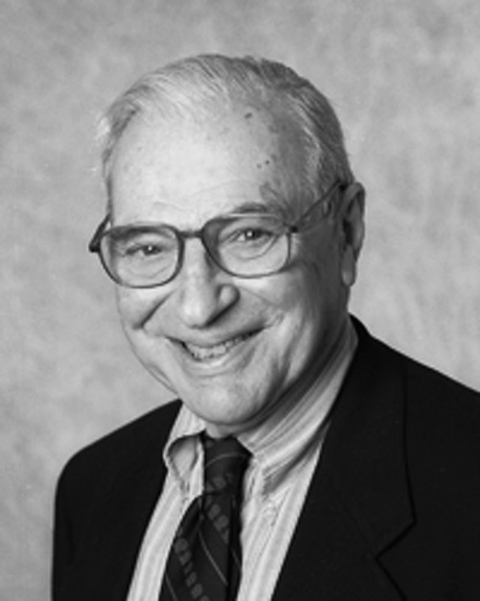
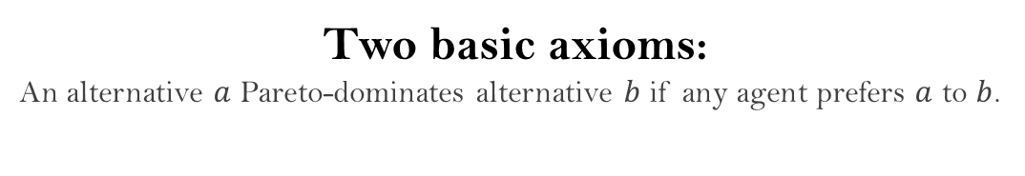
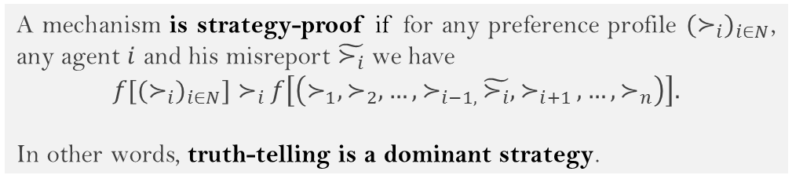
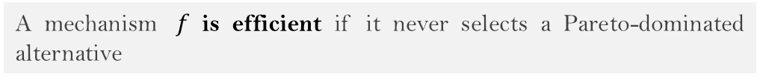
Normative approach
The idea of normative approach:
Kenneth Arrow (1921 – 2017)
Nobel prize 1972 for contributions to welfare economics and general equilibrium theory
The founder of modern social choice
To characterize mechanisms by desired properties (axioms).
Two basic axioms:
An alternative $a$ Pareto-dominates alternative $b$ if any agent prefers $a$ to $b$.
Efficiency:
A mechanism $f$ is efficient if it never selects a Pareto-dominated alternative
Strategy-Proofness (aka non-manipulability or incentive compatibility)
A mechanism is strategy-proof if for any preference profile ${(≻_{i})}_{i∈N}$, any agent $i$ and his misreport $\tilde{≻_{i}}$ we have
$f[{(≻_{i})}_{i∈N}]$ $≻_{i}$ $f\left[\left(≻_{1},≻_{2},…,≻_{i−1, }\tilde{≻_{i}},≻_{i+1 },…,≻_{n}\right)\right].$
In other words, truth-telling is a dominant strategy.

Slide 16
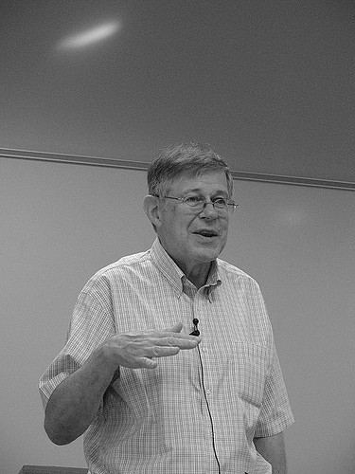

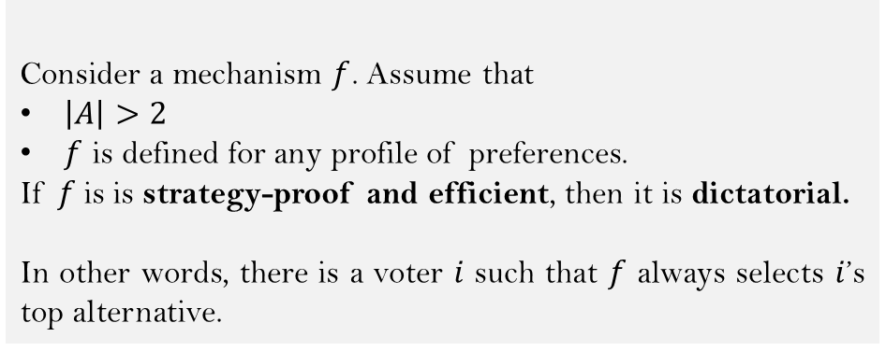
Gibbard-Satterthwaite theorem
Alan Gibbard
Theorem (Gibbard (1973), Satterthwaite (1975))
Consider a mechanism $f$. Assume that
$\left|A\right|>2$
$f$ is defined for any profile of preferences.
If $f$is is strategy-proof and efficient, then it is dictatorial.
In other words, there is a voter $i$ such that $f$ always selects $i$’s top alternative.
Mark Satterthwaite
So, it is impossible to find a reasonable non-manipulable mechanism

Slide 17
How to escape G-S impossibility?
Domain restriction. A classic approach.
Idea: define a mechanism only on preference profiles with some special structure.
Single-peaked preferences: today
Mechanisms with money (VCG): third lecture
Complexity of manipulations. Algorithmic Mechanism Design approach.
Idea: a mechanism is manipulable, but how hard is to find a manipulation?
at the end of the course
Weakening normative requirements. Implementation theory (E. Maskin)
Idea: Nash equilibrium instead of dominant strategies
will not touch

Slide 18

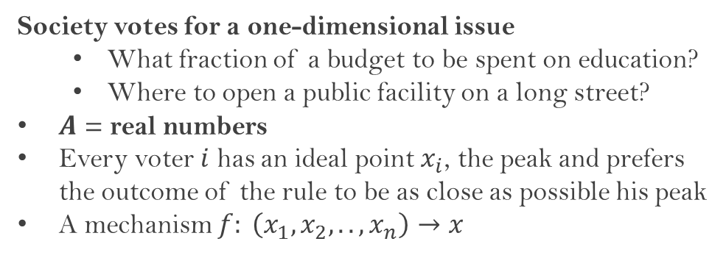
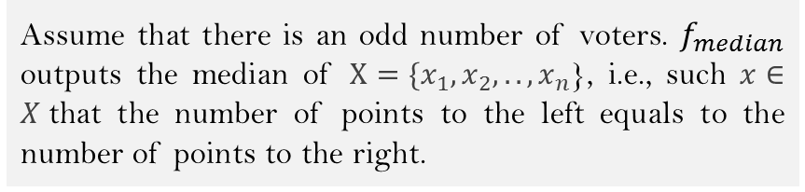
Single-peaked domain
Society votes for a one-dimensional issue
What fraction of a budget to be spent on education?
Where to open a public facility on a long street?
$A$ = real numbers
Every voter $i$ has an ideal point $x_{i}$, the peak and prefers the outcome of the rule to be as close as possible his peak
A mechanism $f: \left(x_{1},x_{2},..,x_{n}\right)→x$
Herve Moulin
World-leading scientist in Game Theory, Mechanism Design, Social Choice
Heads our laboratory
Will read the last three lectures of the course
Guess a strategy-proof mechanism!
The median rule:
Assume that there is an odd number of voters. $f_{median}$ outputs the median of $X=\{x_{1},x_{2},..,x_{n}$}, i.e., such $x∈X$that the number of points to the left equals to the number of points to the right.

Slide 19
Useful links
Karlin, Anna R., and Yuval Peres. Game theory, alive. Vol. 101. American Mathematical Soc., 2017. http://homes.cs.washington.edu/~karlin/GameTheoryBook.pdf
Николенко, С. И. (2009). Теория экономических механизмов.
Do not look for it on http://gen.lib.rus.ec/
Handbook of Computational Social Choice. Felix Brandt, Vincent Conitzer, Ulle Endriss, Jérôme Lang, and Ariel D. Procaccia. Cambridge University Press, 2016. http://procaccia.info/papers/comsoc.pdf
Moulin, H. (1991). Axioms of cooperative decision making (No. 15). Cambridge university press.
Do not look for it on http://gen.lib.rus.ec/
Voting mechanisms online:
Pnyx (Technische Universität München): https://pnyx.dss.in.tum.de/
RoboVote (Carnegie Mellon): http://www.robovote.org/
Fedor Sandomirskiy, fsandomirskiy@hse.ru
Room 404, office hours: Thursday 12-13 PM

