Slide 1
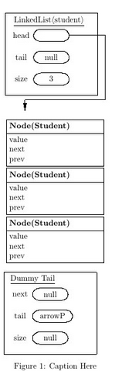

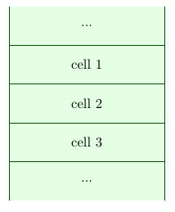

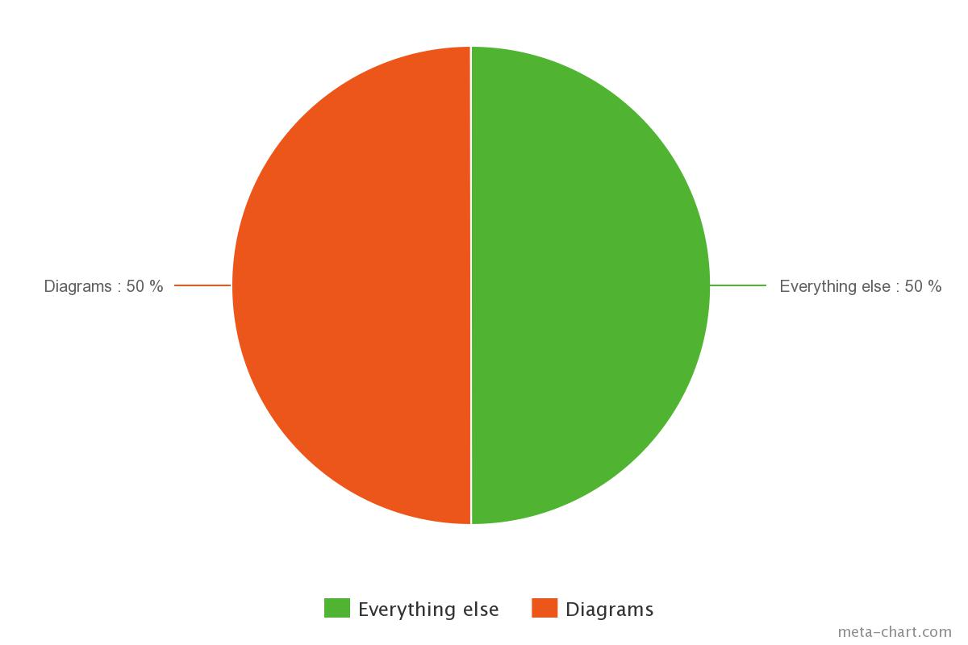

Open Source Text Books
Jovaughn Chin, Matthew Douglass, and Eugene Fedotov
Mentor: Dr. Bergmann
Open Source TextBooks should be encouraged to promote Open Source Knowledge, in a sense of sharing knowledge free of price. No more $300+ College textbooks for students.
Costs of Self-Publishing a Book
Contribution to the aid of easing the use of producing graphics for the Open Source Community, thus encouraging Open Source Book Production:
Source: http://www.the-efa.org/res/rates.php, 4/22/15 Assume 5 pages/hour. 83,756 words/250 words per ms = 336 pages. Note: 1 manuscript page = 250 words
Editing, developmental
Fact Checking
Total = already at $5,000.
Collection Package: aid in the visualization of Data Structures and Objects in the Theory of Computer Science, as well as, being flexible enough to accept any object(text,pictures,or any graphics) as input and customize to the user's desire.

