Slide 1

Open Source Textbooks
MATTHEW DOUGLASS -- EUGENE FEDOTOV -- JOVAUGHN CHIN

Slide 2
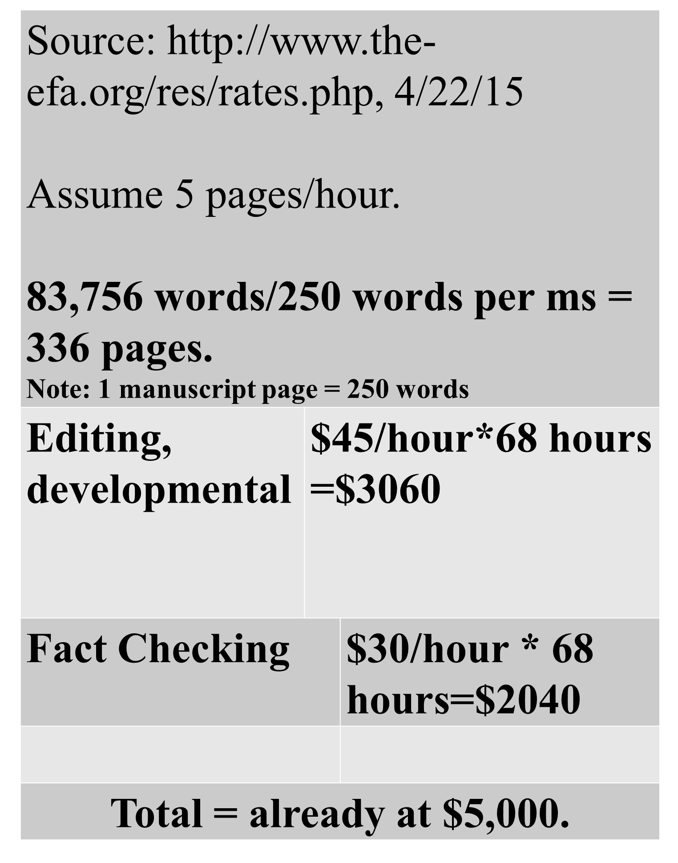
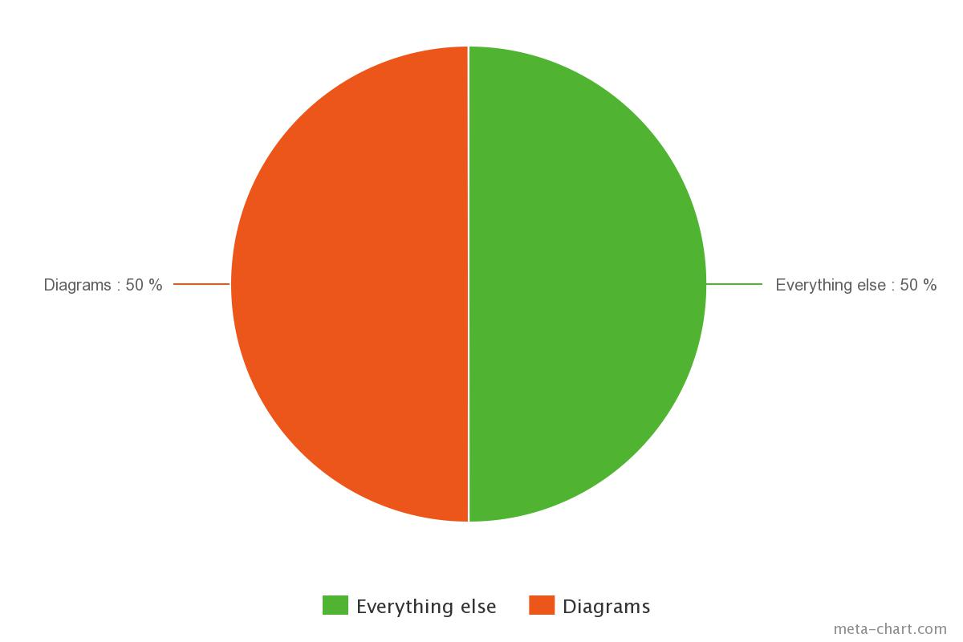
Costs of Self-Publishing a Book
Source: http://www.the-efa.org/res/rates.php, 4/22/15

Slide 3
Objective
Tackle one of the main obstacles to the production of open source textbooks, which lies in the process of generating figures and diagrams.
This project attempts to establish a standard in LaTeX graphic production for various common place computer science diagrams.

Slide 4
Collection Package
Aid in the visualization of Data Structures and Objects in the Theory of Computer Science, as well as, being flexible enough to accept any object(text,pictures,or any graphics) as input and customize to the user's desire.

Slide 5
Package Major Features
Arrays
Linked Lists
Hashmaps
Stacks, Queues
Class diagrams
Object diagrams

Slide 6
Sub-Features
Scalability
The ability for the diagrams to scale to either the page or to other objects around the diagram
Color Scheme
The diagrams will have the ability to have the color changed
Links
The support of links within a document to ease the transition to certain content.

Slide 7
Package Tutorial
Package Document

Slide 8
Limitations

Slide 9
A Package for Everything
Will provide documentation on bugs and solutions.
Will make it easier to get everything from one place.
No need to worry about downloading multiple files.

