Slide 1

Cybersecurity
Department
Protecting the digital foundation of railway infrastructure
Prague | 14 September 2026
Správa železnic
Notes:
[Sources]
- Internal source: Prezentace_ÚKB_0v2.pptx, title slide
[/Sources]

Slide 2
Our mission
Cybersecurity as an integral part of railway infrastructure governance
Protect the shared digital infrastructure that supports railway operations
NÚKIB
KII
SŽT
Critical infrastructure
National coordination
Embedded governance
Security of the shared infrastructure perimeter
Communication with the Czech cybersecurity authority
Cybersecurity is part of Railway Telematics
Management perspective: cybersecurity protects operational continuity, trust and safe modernization.
Notes:
[Sources]
- Internal source: Prezentace_ÚKB_0v2.pptx, slides 2–3
[/Sources]

Slide 3
Security Transformation Portfolio
Identity & Access Security
Multi-Factor Authentication (MFA)
Privileged Access Management (PAM)
Identity Management (IDM)
Network & Perimeter Protection
Next Generation Firewall (NGFW)
Network Segmentation
new DMZ Architecture
DDoS Protection
Threat Detection & Response
Security Information and Event Management (SIEM)
Extended Detection & Response (XDR)
Data Protection
Data Loss Prevention (DLP)
Strategic Objective Reduce cyber risk, increase operational resilience, and establish a modern security architecture for both IT and operational technology environments.
Outcome: stronger identity security, improved threat detection, enhanced infrastructure resilience, and protection of critical railway services.
Notes:
[Sources]
- Internal source: Prezentace_ÚKB_0v2.pptx, slides 2–3
[/Sources]

Slide 4
Operating model
Three complementary capabilities under a single cybersecurity function
01
02
03
Security Architecture
Governance & Risk
SOC & Incident Response
Security requirements for projects
Internal security testing
Security monitoring
Implementation of security controls
Corrective measures and assurance
Incident handling and penetration testing
IT, communications and telecom standards
ISMS, asset and risk management
Vulnerability analysis and access approval
Clear separation of design, assurance and operations enables independent control while maintaining fast coordination.
Notes:
[Sources]
- Internal source: Prezentace_ÚKB_0v2.pptx, slides 3, 5, 7 and 9
[/Sources]

Slide 5
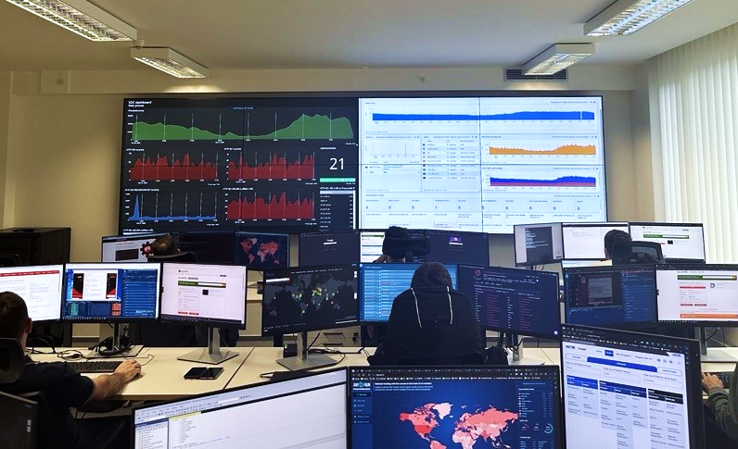
24/7 Security Operations Centre
Continuous monitoring and coordinated incident response across shared infrastructure
24/7
service
6
monitoring tools
TF-CSIRT
listed member
Operational monitoring environment
Core responsibilities
Detect attacks and malicious activity
Analyse vulnerabilities and compromised systems
Coordinate and resolve security incidents
Notes:
[Sources]
- Internal source: Prezentace_ÚKB_0v2.pptx, slides 9–11
[/Sources]

Slide 6
Priorities for a railway infrastructure manager
Strengthening cyber resilience across enterprise IT and operational technology
Secure-by-design investment
Embed security requirements in construction, technology and digitalisation projects.
1
IT/OT risk convergence
Extend governance, visibility and controls to operational technology environments.
2
Operational resilience
Use continuous monitoring, incident response and recovery preparedness to protect service continuity.
3
Regulatory readiness
Keep policies, standards and methodologies aligned with cybersecurity obligations.
4
Potential exchange topics: railway IT/OT monitoring, incident cooperation, supply-chain security and resilience exercises, vibecoding governance, drone security
Notes:
[Sources]
- Internal source: Prezentace_ÚKB_0v2.pptx, slides 5, 7, 9, 12–14; exchange topics are editorial suggestions for delegation discussion
[/Sources]

Slide 7

Thank you
time for your questions..
Let’s connect..
https://www.linkedin.com/in/fedurca/
Prague | 14 September 2026
Správa železnic
Notes:
[Sources]
- Internal source: Prezentace_ÚKB_0v2.pptx, title slide
[/Sources]

