Slide 1
Baddy
Design and implementation of mobile applications [093212] – PROF. Luciano baresi
Marini Gabriel Raul
Morreale federico

Slide 2

What is?
Baddy is a social platform that comes from the need of elders to find someone that can take care of them.
The goal is to provide to the next generation of old people, but also the current one, an application that allows to find a caregiver near their place and interact with her.

Slide 3



How?
The technology stack we have used involves a mobile app developed with Flutter, a back-end that relies on Node.js and a layer of external services offered by Firebase.
+
+

Slide 4
Features
The features provided by the application are different according to the account type of the user, which can be:
Client
Caregiver

Slide 5
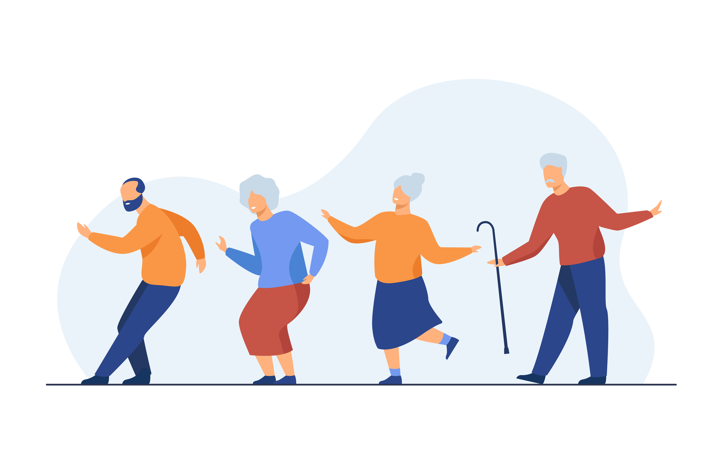
Client Features
A user registered as a customer can:
Scroll the list of the registered caregivers
Search the caregivers according to its city
View a specific caregiver profile
Leave a review on a caregiver profile

Slide 6

Caregiver Features
A user registered as a caregiver is a passive user which can:
Register to the system
View the reviews left by client users
Receive notification of a new review

Slide 7
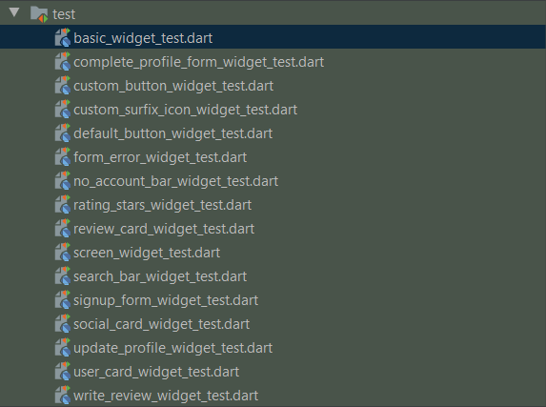
Development and Testing approach
We have followed a bottom-up development approach starting from independent and atomic components which were progessively integrated in more complex widgets and components
Each separable widgets was tested following the approach of Futter Widget tests

Slide 8
Now…
It’s demo time

