Slide 1
Dashboard Data of Airbnb in NYC
Fedy Rahmatullah

Slide 2
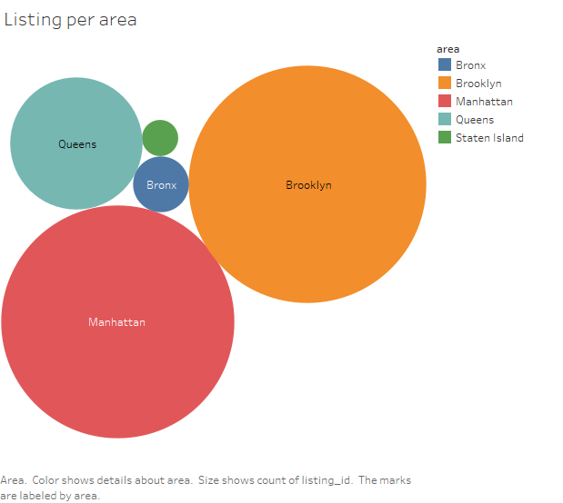

Slide 3


Slide 4
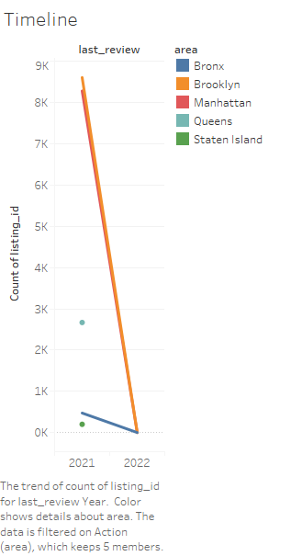

Slide 5
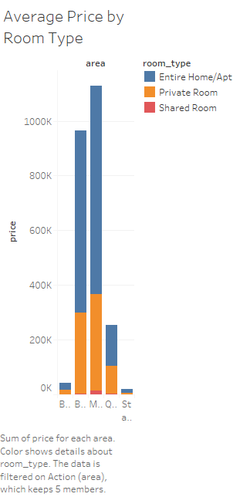

Slide 6
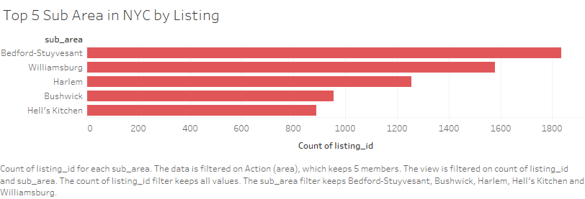

Slide 7
