Slide 1
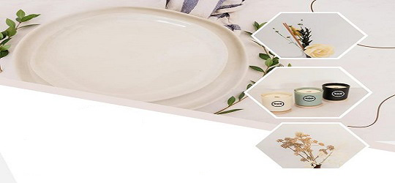

Federico Gajo Jr
Mini Project 1
SOS Website

Slide 2
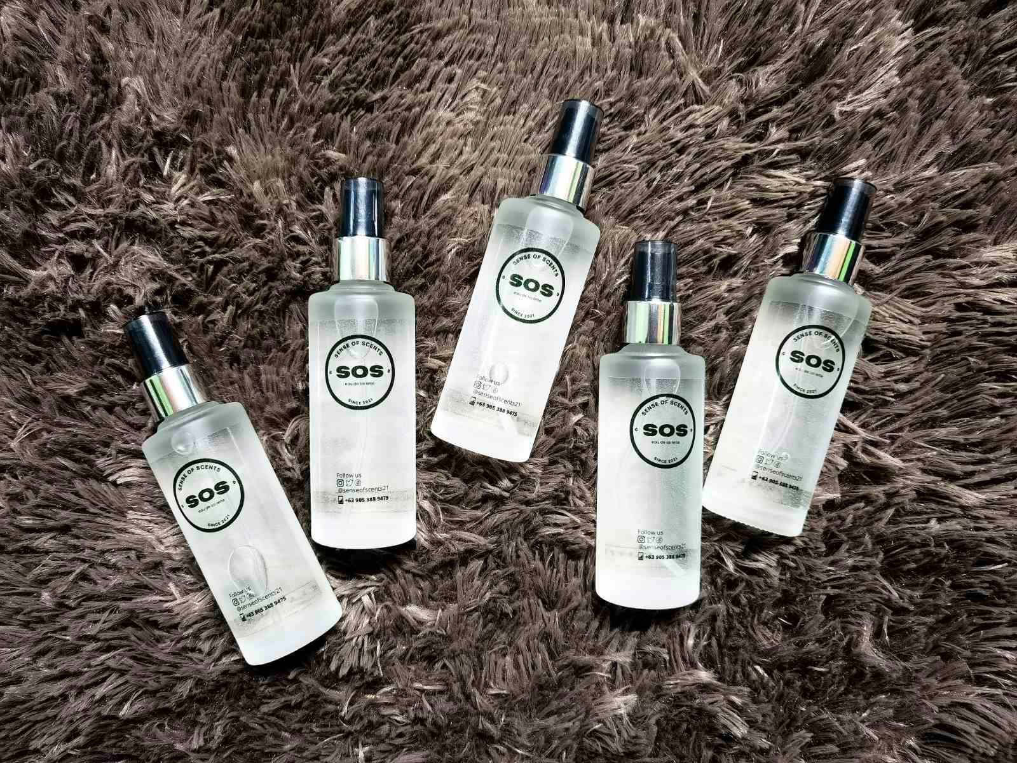
PROBLEM
No Website yet to publish and introduce their products

Slide 3
SOLUTION
I will create a website for their products so that they can easily introduce it to the market.

Slide 4
Project Objectives:
To introduce and encourage more people to use personalize organic perfume.

Slide 5


Target Users/Audience:
Gender: All Gender
Age: All ages
Location: Nationwide

Slide 6
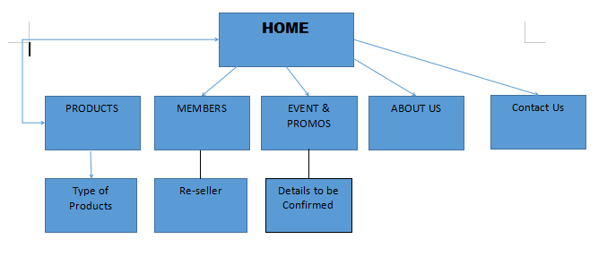
SITE MAP

Slide 7
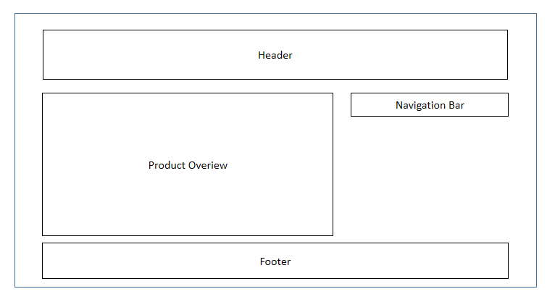
WIREFRAME

Slide 8

Thank You
Federico Gajo Jr

