Slide 1
Password Manager Vulnerabilities
By Phoebe Abbruzzese
LMG Security
Institute for Computing Research

Slide 2
What is a password manager?
- Store all your credentials and any sensitive information on an encrypted database
- Only need to remember one master password to gain access to all of your passwords
- Some offer more specific features like a password generator, dark web scanner, password sharing, etc.

Slide 3
Are password managers worth it?
- YES. They are much safer to the alternatives, such as reusing passwords or storing passwords on plaintext documents
- If your passwords are strong, unique, and long enough, you should not be able to remember all of your passwords by memory
- Accounts like email, online shopping, financial, and social media are especially important to make sure they are secure

Slide 4
How do password managers work?

Slide 5
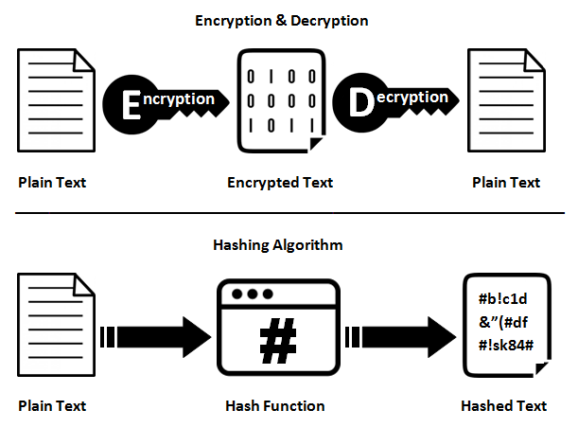

Slide 6
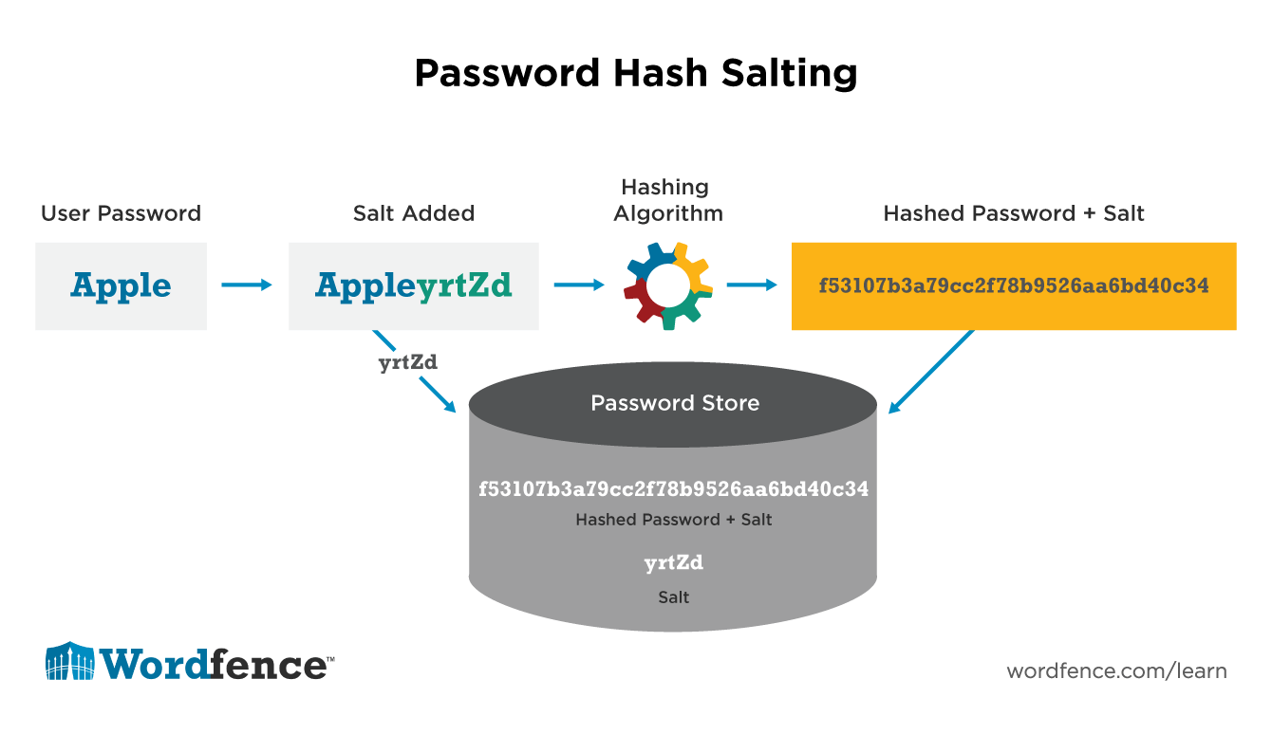

Slide 7
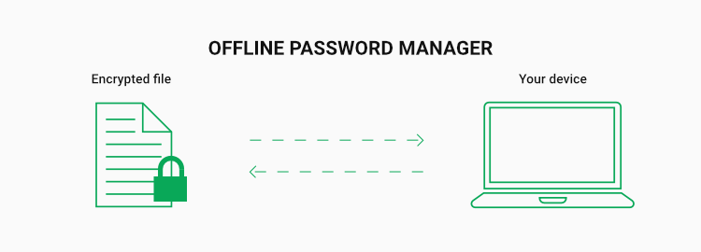
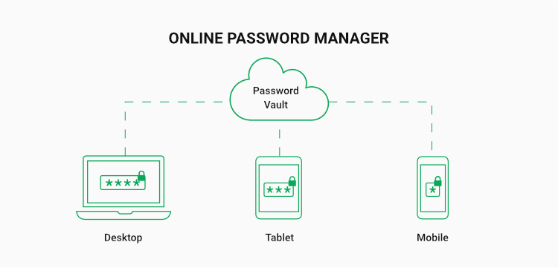

Slide 8
Past Vulnerabilities
- Incorrect auto-fill onto a malicious phishing website
- Not distinguishing between HTTP and HTTPS websites
- There has been issues where the browser version didn’t limit the number of guesses, which led to brute force issues
- Pin master passwords are much easier to bruteforce
- Url parsing vulnerabilities. LastPass had a url parsing bug where essentially code was only scanning for the first “@” symbol, so other knockoff websites/files could be created with the same initial url but hide other text behind a second @. It also needed to happen on the chrome extension
- Cross site request forgery (CSRF) and XSS. For example, a past CSRF vulnerability in RoboForm allowed attackers to update, delete, and add credentials to a user's database.

Slide 9

BeEF Attack
- BeEF is a module in Kali Linux that was several different attack features on browsers
- Essentially it is able to “hook” a browser if someone just clicks on a malicious link
- Wanted to test out the iframe injection and lastpass detection features
- Browsers have updated to stop most of BeEF’s features from working so ultimately this attack was not useful

Slide 10

Pyperclip Attack
- Most password managers have a clipboard feature that clears after a certain amount of time
- Stores everything the victim copies and pastes on a csv file, and emails the hacker everything on the file
- This is all done automatically without the victim knowing
- This was successful on any password manager that had a copy/paste feature
- This is not really the password manager’s fault, more of an issue with your computer itself
- The attacker would also need complete control of the victim’s computer to download to

Slide 11
Man in the Middle attack
- Anytime you visit a website, you use a router to get you to the internet and to that website
- Man in the middle attacks essentially trick both the router and victims computer that the attacker is the router, and internet traffic should also be forwarded through them
- Allows hackers to monitor/intercept requests and responses

Slide 12
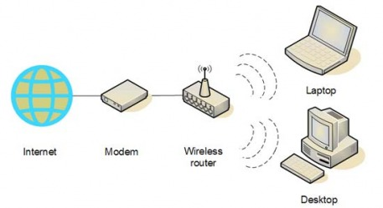
Man in the middle attack

Slide 13
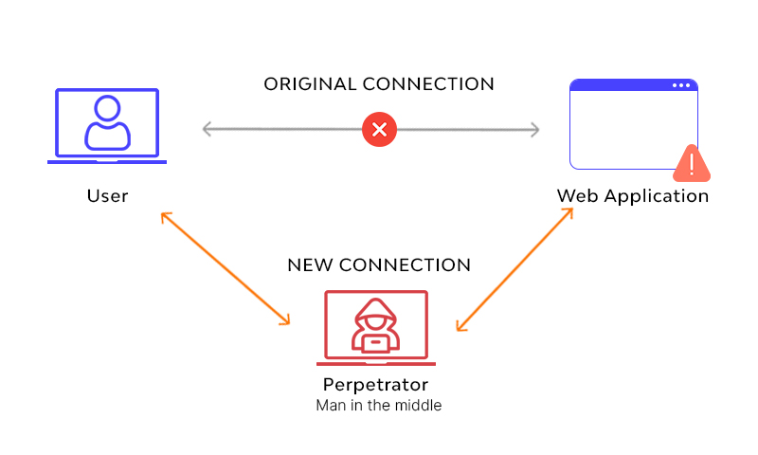
Man in the middle attack
Hacker using Burp Suite

Slide 14
Main Findings using MITM attack

Slide 15
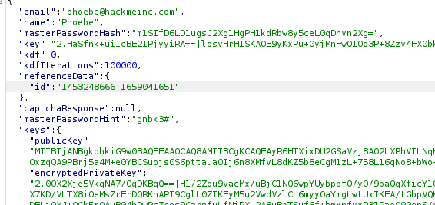
Bitwarden

Slide 16
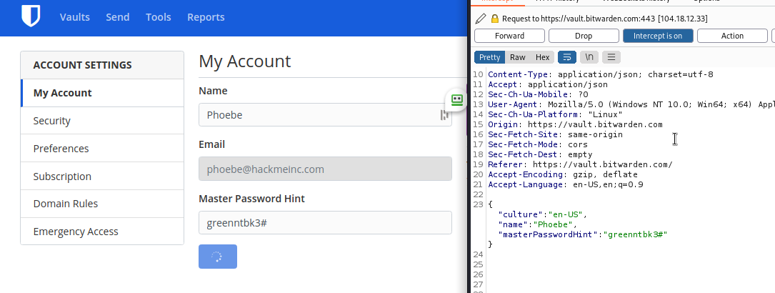
Bitwarden

Slide 17
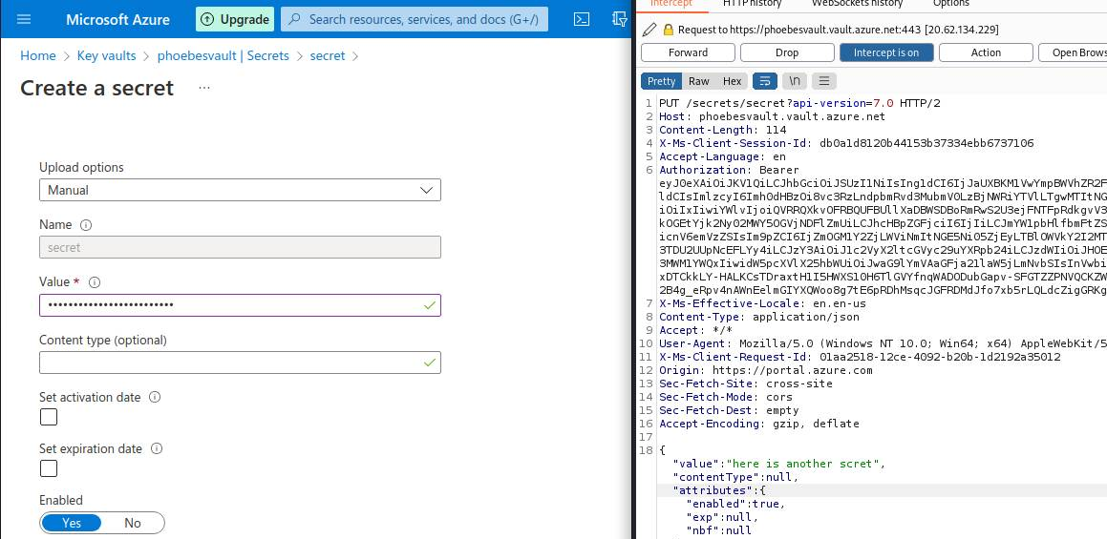
Azure

Slide 18
Conclusion
- Browser updates and app updates are important!
- More personal information should be encrypted
- Password managers, despite a few exceptions, are pretty safe and should be more widely used

Slide 19
Questions?

