Slide 1
Basic Cybersecurity Tips Everyone Should Know
By Phoebe Abbruzzese

Slide 2
How to identify a phishing email
- Sender uses a public domain or misspelled domain
- Spelling errors in the message
- Sense of urgency
- External links or documents
- Ask for some sort of personal information
Doesn’t matter how realistic it looks, be paranoid!

Slide 3

Examples

Slide 4
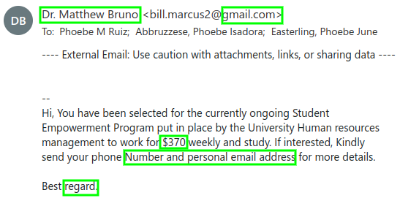

Slide 5
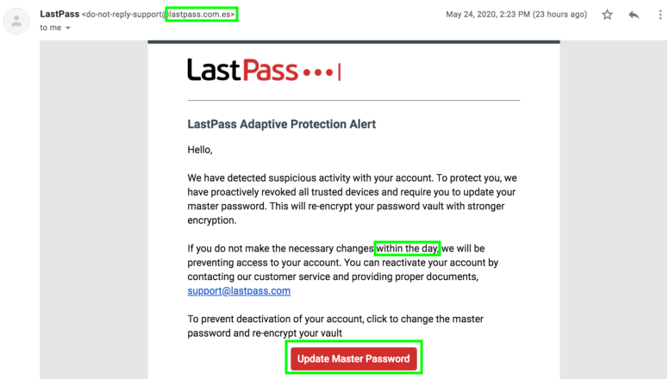
Image source: https://pberba.github.io/security/2020/05/28/lastpass-phishing/

Slide 6

Browsing websites
- Don’t click on random links or download things from not well known websites
- HTTPS is much more secure than HTTP
- Look for lock icon

Slide 7
Password security
- Passwords should be over 8 characters (use phrases to create longer memorable passwords!)
- Don’t include personal information like a pet’s name, etc.
- DON’T REUSE PASSWORDS
- Don’t store credentials on a plain text document or notes application
- USE MULTI-FACTOR AUTHENTICATION, especially on your email or other important accounts

Slide 8


Slide 9
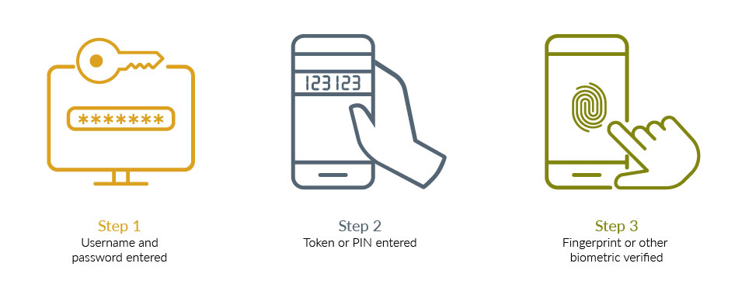
How Multi-factor Authentication works

Slide 10

Should you accept cookies?
- Cookies are used to store personal information
- Stored locally on your computer(?)
- Don’t accept on http websites or anywhere that seems fishy
- Common uses include ad tracking, login, track user count, shopping cart
- Be more careful with third party cookies
- Cookie stealing...
So…. it depends!

Slide 11
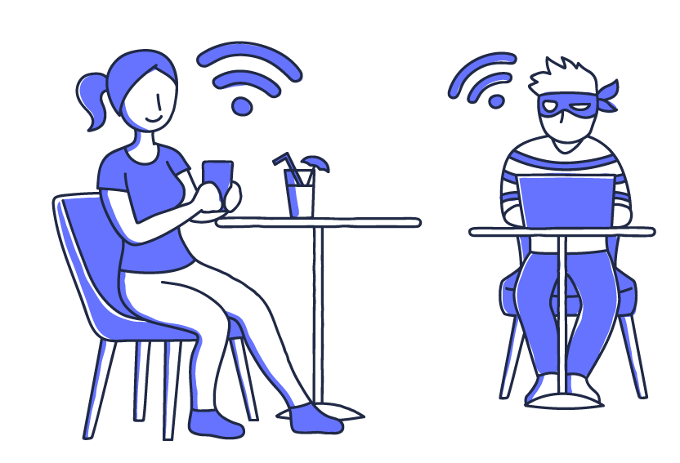
Using Public Wifi
- Don’t login into any website that would give away sensitive information, like email or bank account, or use a virtual private network so your data is encrypted
- Turn off sharing
- Make sure the wifi is legitimate before connecting

Slide 12
Questions?

