Slide 1
New Hampshire Traffic Stops
Bayleigh Logan, Nicholas Zylak, Phoebe Robinson, Shatrughan Sharma

Slide 2
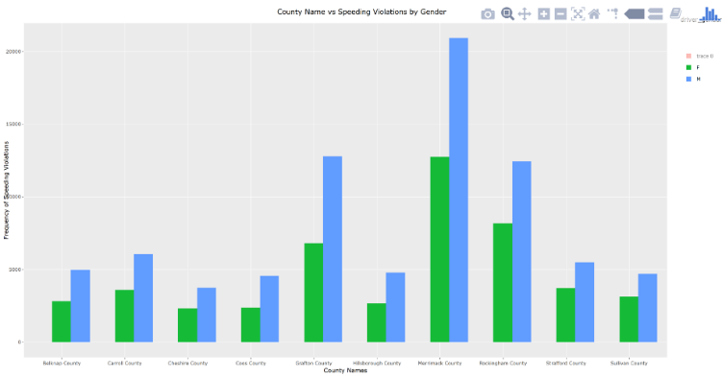
County vs. Speeding Violations
Merrimack has the highest frequent speeding violations by both males and females
Over 20,000
Hillsborough’s population is about triple the size of Merrimack
Overall, men are more likely to get a speeding violation than women in each county

Slide 3
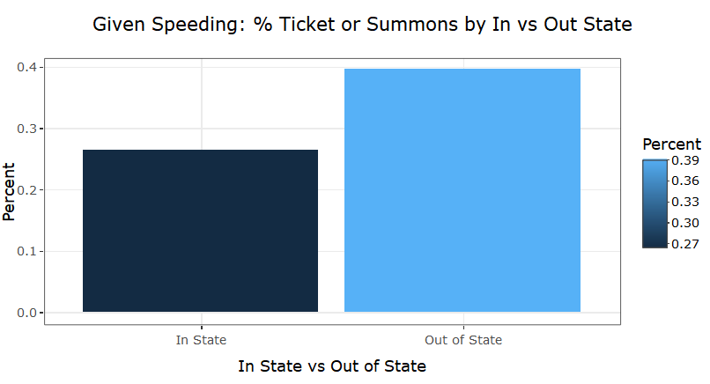
In State vs. Out of State
Group by “Speeding” , stop_outcome and out_of_state
Create one df For TRUE and one for FALSE: out_of_state (Count)
Divide “Ticket” and “Summons” totals by equivalent total stops
Converted list to data frame with new col for headings

Slide 4
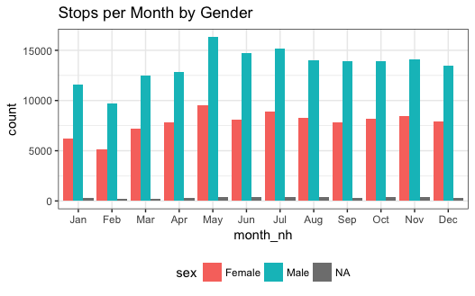
Most Popular Months
Summer and spring months have greater stop percentages
Men are more likely to get stopped than women, in any month

Slide 5
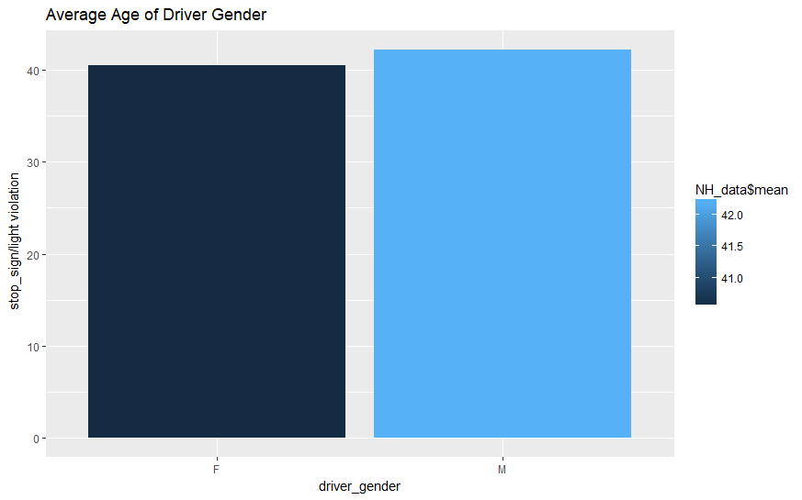
Stop Outcome by Gender
Average number: *Group by driver gender
Female – 40.5 *Violation is stop_sigh/light
Male – 42.2

Slide 6
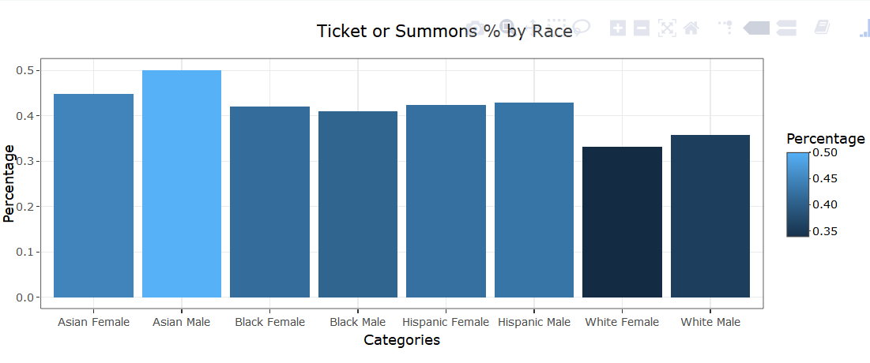
Ticket/Summons by Race
Filter by Tickets and Summons
Took New Dataset and Filtered by Each Combo
Stored Count’s in Variables
Took Overall Totals From Org. Data
5) Stored Those in Variables
6) Divide
7) Store Results in List
8) Convert List to Data frame

