Slide 1

OS for Database systems Concurrency and IPC
1
Seehwan Yoo Dankook University
Disclaimer: Some slides are borrowed from UC. Berkeley’s 2014 OS and system programming

Slide 2
목차
2
강의 개요
OS 이론 강의 (8/29~9/2)
OS 개론, 프로세스.
병렬성.
메모리, IPC.
+ mini 실습
+ mini 실습
+ mini 실습
파일시스템, 네트워킹. + mini 실습
클라우드 컴퓨팅 및 시스템 관리
OS 실습 강의 (9/19~9/23)
리눅스 개발 환경 구축 및 쉘 프로그래밍 (1d)
다중쓰레드 자료구조 실습 프로젝트 (2d)
AWS 실습 및 WordPress 기반 DB 실습 프로젝트 (2d)

Slide 3
Contents
3
Threads
Concurrency
SW synchronization
HW synchronization
synchronization primitives
spinlock, mutex
Some more practical problems and solutions

Slide 4
Traditional UNIX Process
4
Process: Operating system abstraction to represent what is needed to run a single program
Often called a “HeavyWeight Process”
Two parts:
Sequential program execution stream
Code executed as a sequential stream of execution (i.e., thread)
Includes State of CPU registers
Protected resources:
Main memory state (contents of Address Space)
I/O state (i.e. file descriptors)

Slide 5
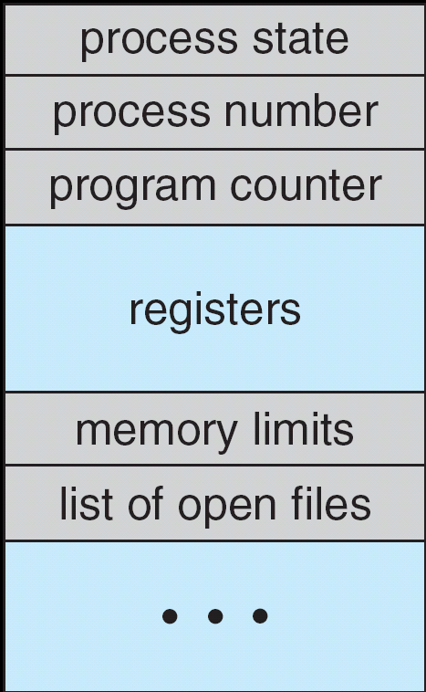
How do we Multiplex Processes?
5
The current state of process held in a process control block (PCB):
This is a “snapshot” of the execution and protection environment
Only one PCB active at a time
Give out CPU time to different processes (Scheduling):
Only one process “running” at a time
Give more time to important processes
Give pieces of resources to different processes (Protection):
Controlled access to non-CPU resources
Example mechanisms:
Memory Mapping: Give each process their own address space
Kernel/User duality: Arbitrary multiplexing of I/O through system calls
Process Control Block

Slide 6
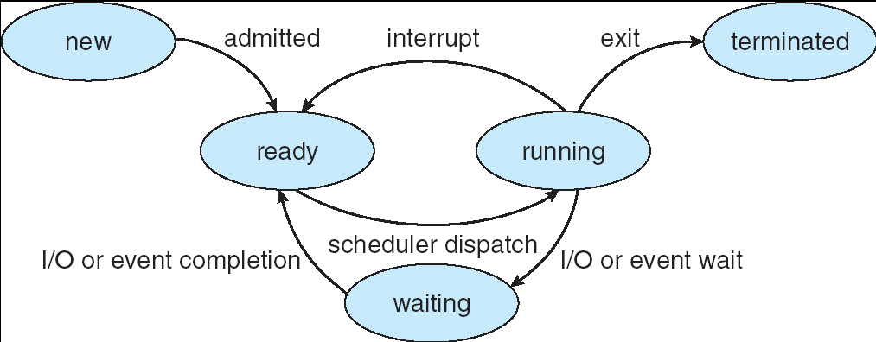
Lifecycle of a Process
6
As a process executes, it changes state:
new: The process is being created
ready: The process is waiting to run
running: Instructions are being executed
waiting: Process waiting for some event to occur
terminated: The process has finished execution

Slide 7
Process Control Block
7
The current state of process held in a process control block (PCB): (for a single-threaded process)
Process Control Block

Slide 8
Modern Process with Threads
8
Thread: a sequential execution stream within process (Sometimes called a “Lightweight process”)
Process still contains a single Address Space
No protection between threads
Multithreading: a single program made up of a number of different con current activities
Sometimes called multitasking, as in Ada …
Why separate the concept of a thread from that of a process?
Discuss the “thread” part of a process (concurrency)
Separate from the “address space” (protection)
Heavyweight Process ≡ Process with one thread

Slide 9
Threads
9
Independently schedulable entity
Sequential thread of execution that runs concurrently with other th reads
It can block waiting for something while others progress
It can work in parallel with others
Has local state (its stack) and shared state (static data and heap)

Slide 10
Thread State
10
State shared by all threads in process/addr space
Content of memory (global variables, heap)
I/O state (file system, network connections, etc)
Execution Stack (logically private)
Parameters, temporary variables
Return PCs are kept while called procedures are executing
State “private” to each thread
CPU registers (including, program counter)
Ptr to Execution stack
Kept in TCB ≡ Thread Control Block
When thread is not running
Scheduler works on TCBs

Slide 11
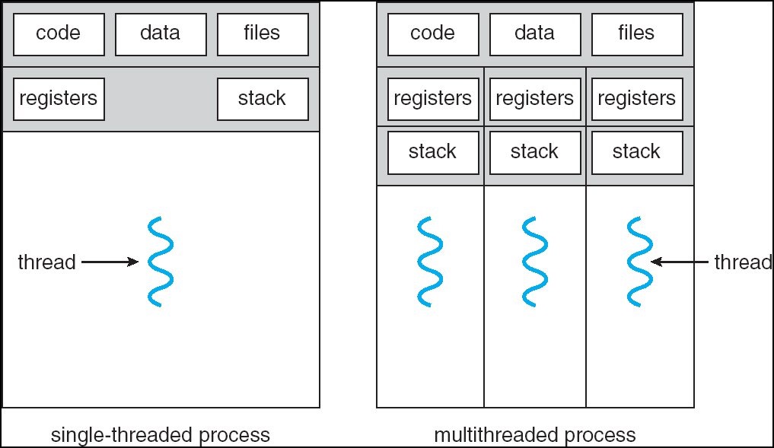
Single and Multithreaded Processes
11
Threads encapsulate concurrency: “Active” component
Address spaces encapsulate protection: “Passive” part
Keeps buggy program from trashing the system
Why have multiple threads per address space?

Slide 12
Examples multithreaded programs
12
Embedded systems
Elevators, Planes, Medical systems, Wristwatches
Single Program, concurrent operations
Most modern OS kernels
Internally concurrent because have to deal with concurrent requests by mul tiple users
But no protection needed within kernel
Database Servers
Access to shared data by many concurrent users
Also background utility processing must be done

Slide 13
Example multithreaded programs (con’t)
13
Network Servers
Concurrent requests from network
Again, single program, multiple concurrent operations
File server, Web server, and airline reservation systems
Parallel Programming (More than one physical CPU)
Split program into multiple threads for parallelism
This is called Multiprocessing
Some multiprocessors are actually uniprogrammed:
Multiple threads in one address space but one program at a time

Slide 14

















Putting it together: Process
14
(Unix) Process
A(int tmp) {
if (tmp<2) B();
printf(tmp);
Memory Stack
}
B() {
C();
}
C() {
A(2);
} A(1);
…
Resources
I/O State (e.g., file, so cket context s)
Stored in OS

Slide 15




Putting it together: Processes
15
Process 1 Process 2 Process N
Switch overhead: high
CPU state: low
Memory/IO state: high
Process creation: high
Protection
CPU: yes
Memory/IO: yes
Sharing overhead: high (involves at least a context switch)
Mem
.
IO
state
Mem
.
IO
state
Mem
.
IO
state
…
CPU
state
CPU
state
CPU
state
CPU s
ched.
OS
1 process at a time
CPU
(1 core)

Slide 16
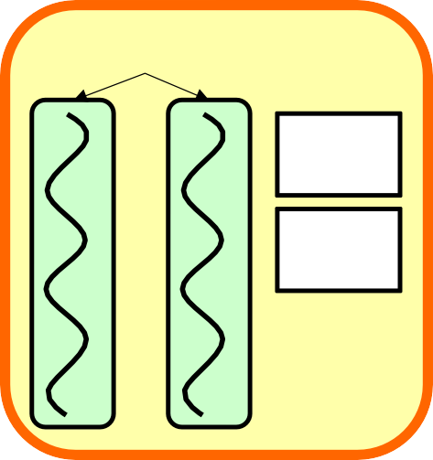
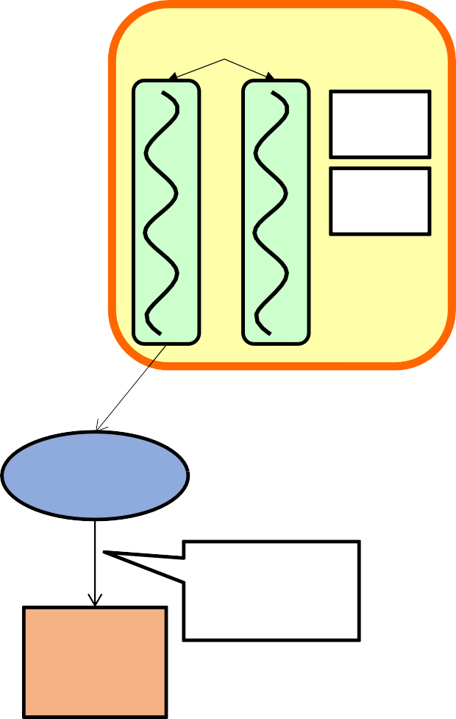
Putting it together: Threads
16
Process 1
threads
Process N
threads
Switch overhead: low (only CPU state)
Thread creation: low
Protection
CPU: yes
Memory/IO: No
Sharing overhead: low (thread s witch overhead low)
Mem
.
Mem
.
…
IO
state
…
…
IO
state
CPU
CPU
CPU
CPU
state
state
state
state
CPU s
ched.
OS
1 thread at a time
CPU
(1 core)

Slide 17


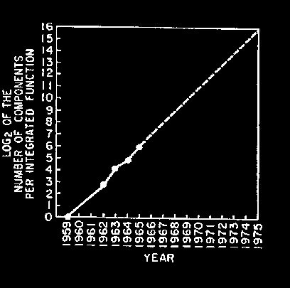
Technology Trends: Moore’s Law
17
Moore’s Law
2X transistors/Chip Every 1.5 years
Called “Moore’s Law”
Gordon Moore (co-founder of Intel) pr edicted in 1965 that the transistor den sity of semiconductor chips would dou ble roughly every 18 months.
Microprocessors have bec ome smaller, denser, and more powerful.

Slide 18
New Challenge: Slowdown in Joy’s law of Performance
18
VAX : 25%/
year 1978 to 1986
10000
3X
From Hennessy and Patterson, Computer Architecture: A Quantitative Approach, 4th edition, Sept. 15, 2006
RISC + x86 : 52%/
year 1986 to 2002
RISC + x86 : ??%/
year 2002 to presen t
??%/year
Joy’s Law: Perf ≈ 2^{(Year-1984)} MIPS
Performance (vs. VAX-11/780)
1000
52%/year
100
⇒ Sea change in chip design
10
: multiple “cores” or process
25%/year
ors per chip
1
1978 1980 1982 1984 1986 1988 1990 1992 1994 1996 1998 2000 2002 2004 2006

Slide 19
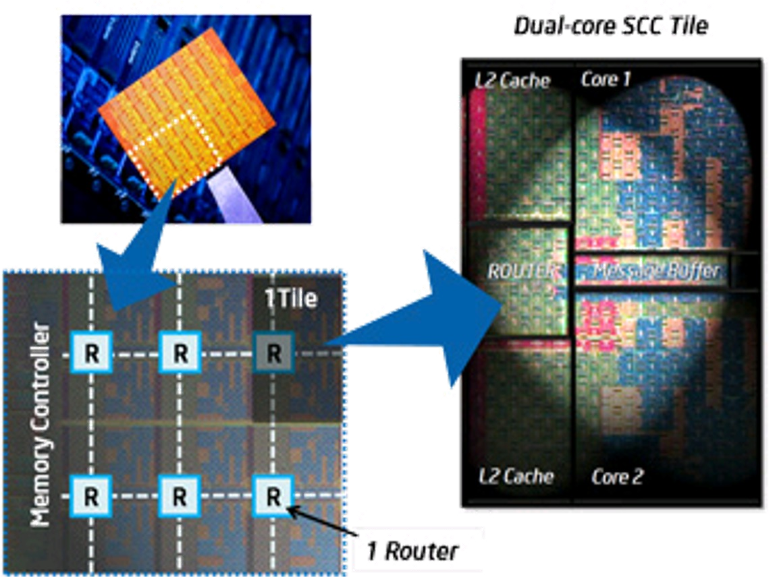

ManyCore Chips: The future is here
19
“ManyCore” refers to many processors/chip
64? 128? Hard to say exact boundary
How to program these?
Use 2 CPUs for video/audio
Use 1 for word processor, 1 for browser
76 for virus checking???
Parallelism must be exploited at all levels
Intel 80-core multicore chip (Feb 2007)
80 simple cores
Two FP-engines / core
Mesh-like network
100 million transistors
Intel Single-Chip Cloud Computer (August 2010)
24 “tiles” with two cores/tile
24-router mesh network
4 DDR3 memory controllers
Hardware support for message-passing

Slide 20
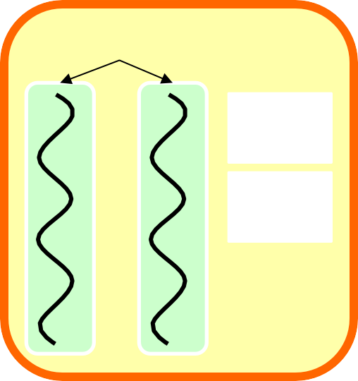
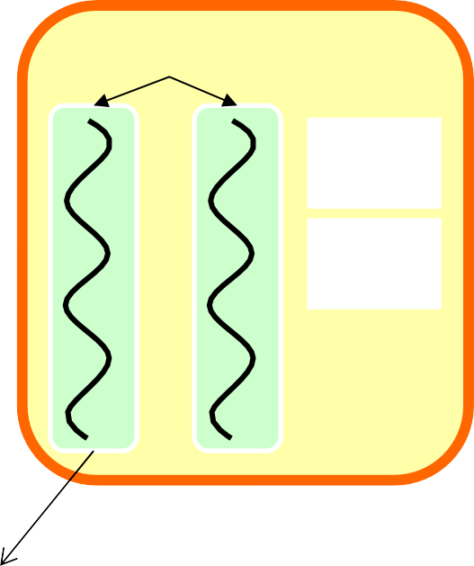




Putting it together: Multi-Cores
20
Process 1
threads
Process N
threads
Switch overhead: low (only CP U state)
Thread creation: low
Protection
CPU: yes
Memory/IO: No
Sharing overhead: low (thread switch overhead low)
Mem
.
Mem
.
…
IO
state
…
…
IO
state
CPU
CPU
CPU
CPU
state
state
state
state
CPU s
ched.
OS
4 threads at a time
core 1
Core 2
Core 3
Core 4
CPU

Slide 21
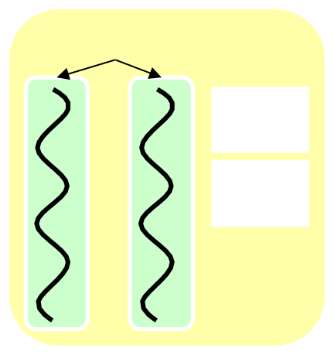
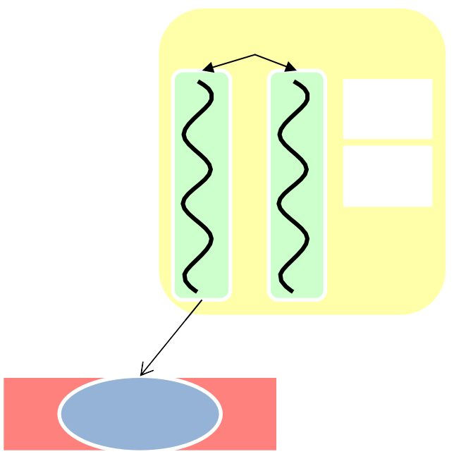
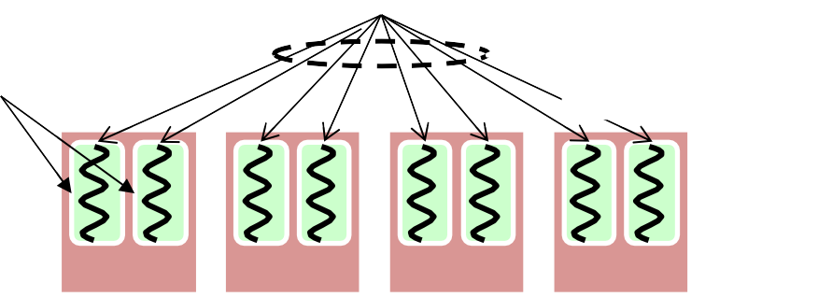
Putting it together: Hyper-Threading
21
Process 1
threads
Process N
threads
Switch overhead between hard ware-threads: very-low (done in hardware)
Contention for ALUs/FPUs may hurt performance
Mem.
Mem.
…
IO
state
…
…
IO
state
CP
CP
CP
CP
U
stat
U
stat
U
stat
U
stat
e
e
e
e
CPU s
ched.
OS
hardware-threads (hyperthreading)
8 threads at a
time
CPU
core 1
core 2
core 3
core 4

Slide 22


Memory Footprint: Two-Threads
22
If we stopped this program and examined it with a debugger,
we would see
Two sets of CPU registers
Two sets of Stacks
Stack 1
Stack 2
Address Space
Questions:
How do we position stacks relative to each other?
What maximum size should we choose for the stacks?
What happens if threads violate this?
How might you catch violations?
Heap
Global Data
Code

Slide 23
Thread Operations
23
thread_fork(func, args)
Create a new thread to run func(args)
pthread_create
thread_join(thread)
In parent, wait for forked thread to exit, then return
pthread_join
thread_exit
Quit thread and clean up, wake up joiner if any
pthread_exit

Slide 24
Thread Abstraction
24
Infinite number of processors
Threads execute with variable speed
Programs must be designed to work with any schedule
Programmer Abstraction Physical Reality
Threads
3 4 5
Processors
1 | 2 | 3 | 4 | 5
1 | 2 | 3 | 4 | 5
1 | 2
1 | 2
Running Threads
Ready Threads

Slide 25
Programmer vs. Processor View
25
Programmer’s View | Possible Execution | Possible Execution | Possible Execution
 | #1 | #2 | #3
. | . | . | .
. | . | . | .
. | . | . | .
x = x + 1; | x = x + 1; | x = x + 1 | x = x + 1
y = y + x; | y = y + x; | .............. | y = y + x
z = x +5y; | z = x + 5y; | thread is suspended | ...............
. | . | other thread(s) run | thread is suspended
. | . | thread is resumed | other thread(s) run
. | . | ............... | thread is resumed
 |  | y = y + x | ................
 |  | z = x + 5y | z = x + 5y

Slide 26
Possible Executions
26
Thread 1
Thread 2
Thread 3
Thread 1
Thread 2
Thread 3
a) One execution
b) Another execution
Thread 1
Thread 2
Thread 3
c) Another execution

Slide 27
Thread State
27
State shared by all threads in process/addr space
Content of memory (global variables, heap)
I/O state (file system, network connections, etc)
State “private” to each thread
Kept in TCB ≡ Thread Control Block
CPU registers (including, program counter)
Execution stack ­ what is this?
Execution Stack
Parameters, temporary variables
Return PCs are kept while called procedures are executing

Slide 28
Thread Lifecycle
28
Scheduler Resumes Thread
Thread Creation
Thread Exit
Init
e.g., sthread_create()
Ready
Running
e.g., sthread_exit()
Finished
Thread Yields/ Scheduler Suspends Thread
e.g., sthread_yield()
Event Occurs
e.g., other thread calls sthread_join()
Thread Waits for Event
e.g., sthread_join()
Waiting

Slide 29
Shared vs. Per-Thread State
29
Shared State
Per−Thread State
Per−Thread State
Heap
Thread Control Block (TCB)
Stack Information
Saved Registers
Thread Metadata
Thread Control Block (TCB)
Stack Information
Saved Registers
Thread Metadata
Global Variables
Code
Stack
Stack

Slide 30
Per Thread State
30
Each Thread has a Thread Control Block (TCB)
Execution State: CPU registers, program counter (PC), pointer to stack (SP)
Scheduling info: state, priority, CPU time
Various Pointers (for implementing scheduling queues)
Pointer to enclosing process (PCB)
Etc (add stuff as you find a need)
OS Keeps track of TCBs in protected memory
In Array, or Linked List, or …

Slide 31
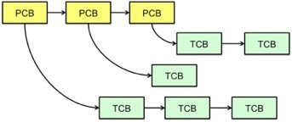
Multithreaded Processes
31
PCB points to multiple TCBs:
Switching threads within a block is a simple thread switch
Switching threads across blocks requires changes to memory and I/O address tables.

Slide 32
The Numbers
32
Context switch in Linux: 3-4 microsecs (Current Intel i7 & E5).
Thread switching faster than process switching (100 ns).
But switching across cores about 2x more expensive than within-co re switching.
Context switch time increases sharply with the size of the working set*, and can increase 100x or more.
* The working set is the subset of memory used by the process in a time window.
Moral: Context switching depends mostly on cache limits and the p rocess or thread’s hunger for memory.

Slide 33
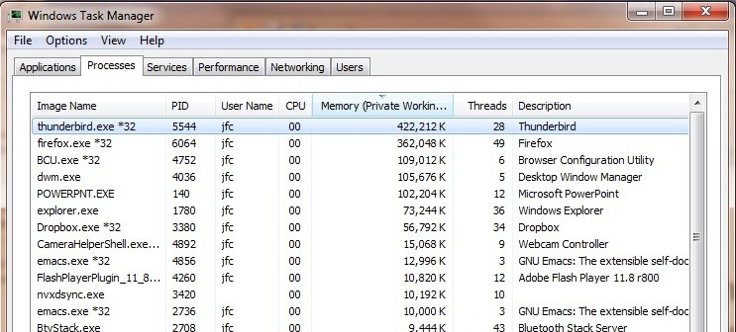
The Numbers
33
Many process are multi-threaded, so thread context switches may be either within-process or across-processes.

Slide 34
Threads in a Process
34
Threads are useful at user-level
Parallelism, hide I/O latency, interactivity
Option A (early Java): user-level library, within a single-threaded process
Library does thread context switch
Kernel time slices between processes, e.g., on system call I/O
Option B (Linux, MacOS, Windows): use kernel threads
System calls for thread fork, join, exit (and lock, unlock,…)
Kernel does context switching
Simple, but a lot of transitions between user and kernel mode
Option C (Windows): scheduler activations
Kernel allocates processors to user-level library
Thread library implements context switch
System call I/O that blocks triggers upcall
Option D: Asynchronous I/O

Slide 35
Classification
35
Real operating systems have either
One or many address spaces
One or many threads per address space
# threads Per AS: | One | Many
One | MS/DOS, early Macintosh | Traditional UNIX
Many | Embedded systems (Geo works, VxWorks, JavaOS ,etc) JavaOS, Pilot(PC) | Mach, OS/2, HP-UX, Win NT to 8, Solaris, OS X, An droid, iOS
# of addr sp
aces:

Slide 36
OS Archaeology
36
Because of the cost of developing an OS from scratch, most modern OSes have a long lineage:
Multics → AT&T Unix → BSD Unix → Ultrix, SunOS, NetBSD,…
Mach (micro-kernel) + BSD → NextStep → XNU →
Apple OSX, iphone iO
Linux → Android OS
CP/M → QDOS → MS-DOS → Windows 3.1 → NT → 95 → 98 → 2000 → X P → Vista → 7 → 8 → phone → …
Linux → RedHat, Ubuntu, Fedora, Debian, Suse,…

Slide 37




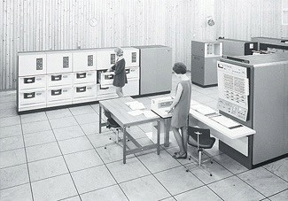
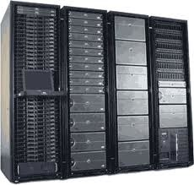










Dramatic change
37
Computers Per Person
Number crunchi ng, Data Storag e, Massive Servi ces,
Mining
1:10⁶
Mainframe
Mini
1:10³
Workstation
Productivity, Interactive
PC
1:1
Laptop
PDA
Cell
Streaming from
/to the physical world
10³:1
years
Mote!
The Internet of Things!
Bell’s Law: new computer class per 10 years

Slide 38
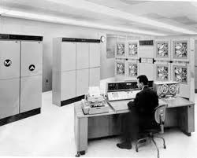
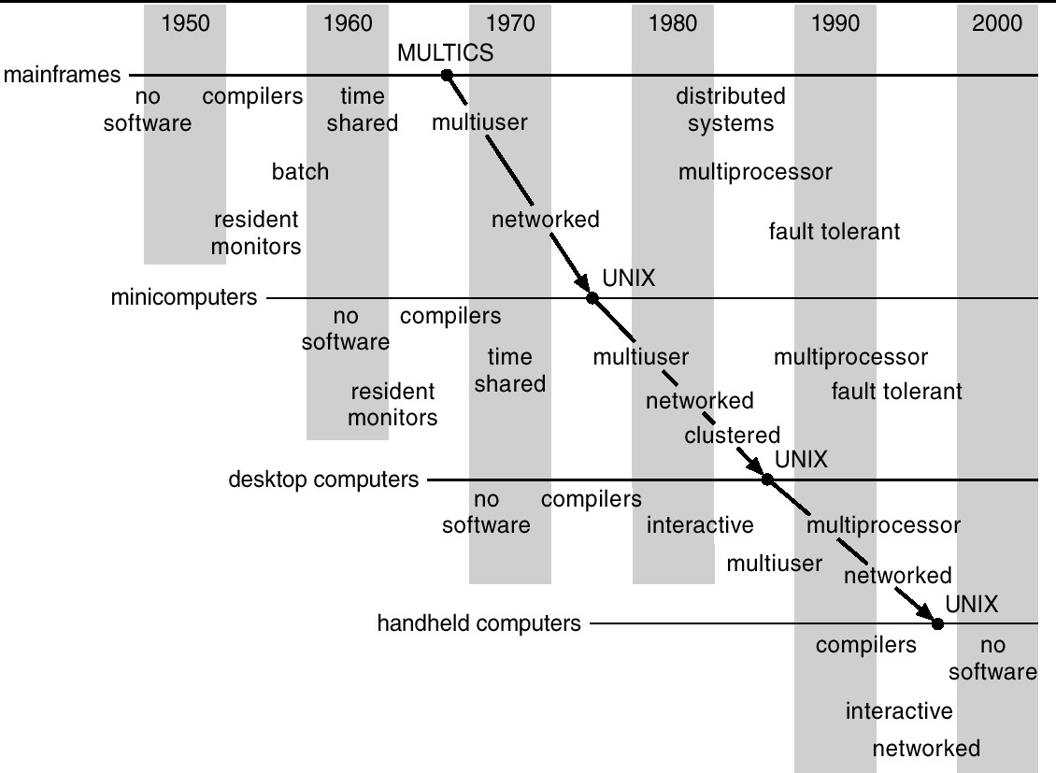
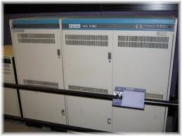


Migration of OS Concepts and Features
38

Slide 39
Threads Synchronization & SW solutions
39

Slide 40
When multiple threads are running
40
Access memory
Makes progress according to the scheduler
However, we don’t know when it will be scheduled out
Some threads cooperate with each other
Withdraw
You claim your money from your account
Deposit
You save your money into your account
Both threads need to update balance

Slide 41
Multiple threads in cooperation
41
Synchronization problem occurs
When multiple process are accessing shared variable
The shared variable should be mutually accessible
Only one process must complete operation before starting another operation

Slide 42
In-depth look of the synchronization problem
42
Withdraw(int amount)
{
if (balance < amount) return -ENOMONEY;
else balance -= amount; return balance;
}
Deposit (int amount)
{
balance += amount; Return balance;
}
Load r0, [&amount] Load r1, [&balance] cmp r1, r0
ble no_money // r1< r0 —> no money sub r1, r1, r0
Store r1, [&balance]
b func_end
Load r0, [&amount] Load r1, [&balance] add r1, r1, r0
Store r1, [&balance]
no_money:
mov r0, #-enomoney func_end:
mov pc, ra

Slide 43
There are some sensitive time instants
43
Computer (CPU) works with registers!
Before updating the value to memory, value is only on the registers
While, others can access the memory!
without knowing the fact that another is accessing the memory
Possibly, we can have wrong value
Balance = 100;
thread A
Deposit (50);
thread B
Withdraw (70);
Expectation? should be 80
100 + 50 – 70 = 80

Slide 44
In-depth look of the synchronization problem
44
Deposit (int amount)
{
balance += amount; Return balance;
}
Withdraw(int amount)
{
if (balance < amount) return -ENOMONEY;
else balance -= amount; return balance;
}
Load r0, [&amount] Load r1, [&balance] add r1, r1, r0
Store r1, [&balance]
Load r0, [&amount] // r0: 70 Load r1, [&balance] // r1: 100 cmp r1, r0
ble no_money // r1< r0 —> no money sub r1, r1, r0 // r1: 30
// scheduled out!
Store r1, [&balance] b func_end
no_money:
mov r0, #-enomoney func_end:

Slide 45
In-depth look of the synchronization problem
45
Deposit (int amount)
{
balance += amount; Return balance;
}
Withdraw(int amount)
{
if (balance < amount) return -ENOMONEY;
else balance -= amount; return balance;
}
Load r0, [&amount] // r0: 50 Load r1, [&balance] // r1: 100 add r1, r1, r0 // r1: 150
Store r1, [&balance]
// Yeah! we have more money!
// :>
// scheduled out
Load r0, [&amount] Load r1, [&balance] cmp r1, r0
ble no_money // r1< r0 —> no money sub r1, r1, r0
Store r1, [&balance]
b func_end
no_money:
mov r0, #-enomoney func_end:
mov pc, ra

Slide 46
In-depth look of the synchronization problem
46
Deposit (int amount)
{
balance += amount; Return balance;
}
Withdraw(int amount)
{
if (balance < amount) return -ENOMONEY;
else balance -= amount; return balance;
}
Load r0, [&amount] Load r1, [&balance] add r1, r1, r0
Store r1, [&balance]
Load r0, [&amount] Load r1, [&balance] cmp r1, r0
ble no_money // r1< r0 —> no money sub r1, r1, r0
Store r1, [&balance] // r1: 30
// OMG! we lost money!
…

Slide 47
Threads synchronization problem
47
Guarantee mutually exclusive access to the shared resource
usually memory access
Race condition
Occurs when multiple processes or threads read and write data items
The final result depends on the order of execution
the “loser” of the race is the process that updates last and will determine the final valu e of the variable
Critical section
code region (segment) that synchronization is required

Slide 48
A synchronization mechanism should provide
48
Mutual exclusion
only one thread should access at a time
all others should not access the shared variable at the same time
data integrity has to be guaranteed
result in correct memory value
Avoid deadlock
Somebody should make progress in the code
Deadlock: threads are alive, but nobody can make progress
All waits for another threads
Avoid starvation
Could be serviced in bounded-waiting time

Slide 49
Solution to synchronization problem
49
Read does not make problems (so far)
Set a flag (turn) to enter critical section
Let turn = 0 for A to enter CS
Let turn = 1 for B to enter CS
Check the other’s turn before entering the CS
When exit, reset turn for the other to enter

Slide 50
Example withdraw, deposit
50
A (int amount) { turn = 0;
while (turn == 1) ; Enter Critical Section turn = 1;
return balance;
}
B (int amount) { turn = 1;
while (turn == 0) ; Enter Critical Section turn = 0;
return balance;
}
mov r2, #0
store r2, [&turn] LOOP:
load r2, [&turn]
cmp r2, #1 beq LOOP
mov r2, #1
store r2, [&turn] LOOP:
load r2, [&turn]
cmp r2, #0 beq LOOP
load r0, [&amount] load r1, [&balance]
load r0, [&amount]
load r1, [&balance] add r1, r1, r0
store r1, [&balance]
…
store r1, [&balance]
mov r2, #0
store r2, [&turn]
mov r2, #1
TABA, OS for Database systems
store r2, [&turn]

Slide 51
Close, but… not an answer
51
Thread A:
mov r2, #0 // Schedule out store r2, [&turn]
LOOP:
load r2, [&turn] cmp r2, #1
beq LOOP
Thread B:
mov r2, #1
store r2, [&turn] LOOP:
load r2, [&turn] cmp r2, #0
beq LOOP
load r0, [&amount] load r1, [&balance] add r1, r1, r0
store r1, [&balance]
load r0, [&amount] load r1, [&balance]
…
store r1, [&balance]
mov r2, #1
store r2, [&turn]
mov r2, #0
store r2, [&turn]

Slide 52
Close, but… not an answer
52
Thread A:
mov r2, #0 // stopped here store r2, [&turn]
LOOP:
load r2, [&turn] cmp r2, #1
beq LOOP
load r0, [&amount] load r1, [&balance] add r1, r1, r0
store r1, [&balance]
mov r2, #1
store r2, [&turn]
Thread B:
mov r2, #1
store r2, [&turn] // Now turn= 1
// pass the condition LOOP:
load r2, [&turn] cmp r2, #0
beq LOOP
// We entered the CS!
load r0, [&amount] load r1, [&balance]
// Scheduled out at somewhere here!
…
store r1, [&balance]
mov r2, #0
store r2, [&turn]

Slide 53
Close, but… not an answer
53
Thread A:
mov r2, #0 // resume execution from here store r2, [&turn] // OMG! turn= 0
// pass the condition LOOP:
load r2, [&turn] cmp r2, #1
beq LOOP
// We also entered the CS!
load r0, [&amount] load r1, [&balance] add r1, r1, r0
store r1, [&balance]
// mutual exclusion is broken
mov r2, #1
store r2, [&turn]
Thread B:
mov r2, #1
store r2, [&turn] // Now turn= 1
// passed the condition LOOP:
load r2, [&turn] cmp r2, #0
beq LOOP
// We entered the CS!
load r0, [&amount] load r1, [&balance]
// Scheduled out at somewhere here!
…
store r1, [&balance]
mov r2, #0
store r2, [&turn]

Slide 54
Use additional variables, flags[2]
54
Deposit (int amount) { Withdraw (int amount) {
flag[0] = true; turn = 0;
while (turn == 1 && flag[1] == true) ;
Enter Critical Section flag[0] = false;
turn = 1; return balance;
flag[1] = true; turn = 1;
while (turn == 0 && flag[0] == true) ;
Enter Critical Section flag[1] = false;
turn = 0; return balance;
}
}
mov r3, #1 store r3, [&flag] mov r2, #0
store r2, [&turn]
mov r3, #1
store r3, [&flag+4] mov r2, #1
store r2, [&turn] LOOP:
load r2, [&turn]
cmp r2, #0 bne CS
load r3, [&flag] cmp r3, #1
beq LOOP
CS:
mov r2, #0
store r2, [&flag+4] mov r2, #0
store r2, [&turn]
LOOP:
load r2, [&turn] cmp r2, #1
bne CS
load r3, [&flag+4] cmp r3, #1
beq LOOP
CS:
mov r3, #0 store r3, [&flag] mov r2, #1
store r2, [&turn]

Slide 55
Does that guarantee mutual exclusion?
55
Thread A:
mov r3, #1
store r3, [&flag] // it’s safe cuz flag is not shared mov r2, #0 // schedule out!
store r2, [&turn] LOOP:
load r2, [&turn] cmp r2, #1
bne CS
load r3, [&flag+4] cmp r3, #1
beq LOOP
CS:
mov r3, #0 store r3, [&flag] mov r2, #1
store r2, [&turn]
Thread B:
mov r3, #1
store r3, [&flag+4] mov r2, #1
store r2, [&turn] LOOP:
load r2, [&turn] cmp r2, #0
bne CS
load r3, [&flag] cmp r3, #1
beq LOOP
CS:
mov r2, #0
store r2, [&flag+4] mov r2, #0
store r2, [&turn]

Slide 56
Does that guarantee mutual exclusion?
56
Thread A:
mov r3, #1 store r3, [&flag]
mov r2, #0 // stopped here
store r2, [&turn] LOOP:
load r2, [&turn] cmp r2, #1
bne CS
load r3, [&flag+4] cmp r3, #1
beq LOOP
CS:
mov r3, #0 store r3, [&flag] mov r2, #1
store r2, [&turn]
Thread B:
mov r3, #1
store r3, [&flag+4] // it’s safe cuz flag+4 is not shared
mov r2, #1
store r2, [&turn] // Now, turn=1
// pass 1st condition LOOP:
load r2, [&turn] cmp r2, #0
bne CS
// does not check 2nd condition load r3, [&flag]
cmp r3, #1 beq LOOP
CS:
// Entered CS
// schedule out during condition check mov r2, #0
store r2, [&flag+4]
mov r2, #0
store r2, [&turn]

Slide 57
Does that guarantee mutual exclusion?
57
Thread A:
mov r3, #1 store r3, [&flag]
mov r2, #0 // stopped here
store r2, [&turn] // Now turn = 0
// Pass 1st condition
LOOP:
load r2, [&turn]
cmp r2, #1 bne CS
// does not check 2nd condition
load r3, [&flag+4] cmp r3, #1
beq LOOP
CS:
// We also entered CS
// Mutual exclusion broken!
mov r3, #0 store r3, [&flag] mov r2, #1
store r2, [&turn]
Thread B:
mov r3, #1
store r3, [&flag+4] // it’s safe cuz flag+4 is not shared
mov r2, #1
store r2, [&turn]
LOOP:
load r2, [&turn] cmp r2, #0
bne CS
load r3, [&flag] cmp r3, #1
beq LOOP
CS:
// scheduled out
// We are in CS mov r2, #0
store r2, [&flag+4] mov r2, #0
store r2, [&turn]

Slide 58
Twisting the algorithm, yield first!
58
Deposit (int amount) { flag[0] = true;
turn = 1; // NOTE HERE!
while (flag[1] == true && turn == 1) ;
// NOTE the checking logic!
Enter Critical Section
flag[0] = false; return balance;
}
mov r3, #1 store r3, [&flag]
mov r2, #1
store r2, [&turn]
LOOP:
load r3, [&flag+4]
cmp r3, #1 bne CS
load r2, [&turn] cmp r2, #1
beq LOOP
CS:
mov r3, #0
store r3, [&flag]
// mov r2, #1
// store r2, [&turn]
Withdraw (int amount) { flag[1] = true;
turn = 0; // NOTE HERE!
while (flag[0] == true && turn == 0) ;
// NOTE the checking logic!
Enter Critical Section flag[1] = false; return balance;
}
mov r3, #1
store r3, [&flag+4]
mov r2, #0
store r2, [&turn] LOOP:
load r3, [&flag]
cmp r3, #1 bne CS
load r2, [&turn] cmp r2, #0
beq LOOP
CS:
mov r2, #0
store r2, [&flag+4]
// mov r2, #0
// store r2, [&turn]

Slide 59
Does that guarantee mutual exclusion?
59
Thread A:
mov r3, #1
store r3, [&flag] // it’s safe cuz flag is not shared mov r2, #1 // schedule out!
store r2, [&turn] LOOP:
load r3, [&flag+4] cmp r3, #1
bne CS
load r2, [&turn] cmp r2, #1
beq LOOP
CS:
mov r3, #0 store r3, [&flag]
// mov r2, #1
// store r2, [&turn]
Thread B:
mov r3, #1
store r3, [&flag+4] mov r2, #0
store r2, [&turn] LOOP:
load r3, [&flag] cmp r3, #1
bne CS
load r2, [&turn] cmp r2, #0
beq LOOP
CS:
mov r2, #0
store r2, [&flag+4]
// mov r2, #0
// store r2, [&turn]

Slide 60
Does that guarantee mutual exclusion?
60
Thread A:
mov r3, #1
store r3, [&flag] // it’s safe cuz flag is not shared mov r2, #1 // stopped here
store r2, [&turn] LOOP:
load r3, [&flag+4] cmp r3, #1
bne CS
load r2, [&turn] cmp r2, #1
beq LOOP
CS:
mov r3, #0 store r3, [&flag]
// mov r2, #1
// store r2, [&turn]
Thread B:
mov r3, #1
store r3, [&flag+4] // it’s safe cuz flag is not shared mov r2, #0
store r2, [&turn] // Now, turn = 0
// Can we pass branch condition?
// Process A set flag[0] = 1, turn = 0 LOOP:
load r3, [&flag] cmp r3, #1
bne CS
// Check 2nd condition load r2, [&turn] cmp r2, #0
beq LOOP
// Schedule out inside LOOP, checking condition CS:
mov r2, #0
store r2, [&flag+4]
// mov r2, #0
// store r2, [&turn]

Slide 61
Does that guarantee mutual exclusion?
61
Thread A:
mov r3, #1
store r3, [&flag] // it’s safe cuz flag is not shared mov r2, #1 // stopped here
store r2, [&turn] // Now, turn = 1
// Can we pass branch condition?
// Process B set flag[1] = 1, turn = 1 LOOP:
load r3, [&flag+4] cmp r3, #1
bne CS
load r2, [&turn] cmp r2, #1
beq LOOP
// Schedule out inside LOOP, checking condition
CS:
mov r3, #0
store r3, [&flag]
// mov r2, #1
// store r2, [&turn]
Thread B:
mov r3, #1
store r3, [&flag+4] // it’s safe cuz flag is not shared mov r2, #0
store r2, [&turn] // Now, turn = 0 LOOP:
load r3, [&flag] cmp r3, #1
bne CS
load r2, [&turn] cmp r2, #0
beq LOOP
// stopped inside LOOP, checking condition cmp r2, #0
beq LOOP
CS:
mov r2, #0
store r2, [&flag+4]
// mov r2, #0
// store r2, [&turn]

Slide 62
Does that guarantee mutual exclusion?
62
Thread A:
mov r3, #1
store r3, [&flag] // it’s safe cuz flag is not shared mov r2, #1 // stopped here
store r2, [&turn] // Now, turn = 1 LOOP:
load r3, [&flag+4] cmp r3, #1
bne CS
load r2, [&turn] cmp r2, #1
beq LOOP
// stopped inside LOOP, checking condition
CS:
mov r2, #0
store r2, [&flag]
// mov r2, #1
// store r2, [&turn]
Thread B:
mov r3, #1
store r3, [&flag+4] // it’s safe cuz flag is not shared mov r2, #0
store r2, [&turn] // Now, turn = 0
// stopped inside LOOP, checking condition
// Process A changed turn = 1, at somewhere LOOP:
load r3, [&flag] cmp r3, #1
bne CS
load r2, [&turn] cmp r2, #0
beq LOOP
// Now we enter CS due to turn flag
CS:
// Schedule out mov r2, #0
store r2, [&flag+4]
// mov r2, #0
// store r2, [&turn]

Slide 63
Does that guarantee mutual exclusion?
63
Thread A:
mov r3, #1
store r3, [&flag] // it’s safe cuz flag is not shared mov r2, #1 // stopped here
store r2, [&turn] // Now, turn = 1 LOOP:
load r3, [&flag+4] cmp r3, #1
bne CS
load r2, [&turn] cmp r2, #1
beq LOOP
// stopped inside LOOP, checking condition
// No check condition changed
// scheduled out inside LOOP, checking condition
CS:
mov r2, #0
store r2, [&flag]
// mov r2, #1
// store r2, [&turn]
Thread B:
mov r3, #1
store r3, [&flag+4] // it’s safe cuz flag is not shared mov r2, #0
store r2, [&turn] // Now, turn = 0 LOOP:
load r3, [&flag] cmp r3, #1
bne CS
load r2, [&turn] cmp r2, #0
beq LOOP
CS:
// Now we are in the CS
// stopped here mov r2, #0
store r2, [&flag+4]
// mov r2, #0
// store r2, [&turn]

Slide 64
Does that guarantee mutual exclusion?
64
Thread A:
mov r3, #1
store r3, [&flag] // it’s safe cuz flag is not shared mov r2, #1 // stopped here
store r2, [&turn] // Now, turn = 1 LOOP:
load r3, [&flag+4] cmp r3, #1
bne CS
load r2, [&turn] cmp r2, #1
beq LOOP
// stopped inside LOOP, checking condition
CS:
mov r2, #0
store r2, [&flag]
// mov r2, #1
// store r2, [&turn]
Thread B:
mov r3, #1
store r3, [&flag+4] // it’s safe cuz flag is not shared mov r2, #0
store r2, [&turn] // Now, turn = 0 LOOP:
load r3, [&flag] cmp r3, #1
bne CS
load r2, [&turn] cmp r2, #0
beq LOOP
CS:
// Now we are in the CS
// stopped here
// resume execution
// exit CS
mov r2, #0
store r2, [&flag+4]
// mov r2, #0
// store r2, [&turn]
// Now flag[1] changed
// scheduled out

Slide 65
Does that guarantee mutual exclusion?
65
Thread A:
mov r3, #1
store r3, [&flag] // it’s safe cuz flag is not shared mov r2, #1 // stopped here
store r2, [&turn] // Now, turn = 1
// stopped inside LOOP, checking condition
// enter CS due to flag[1] LOOP:
load r3, [&flag+4] cmp r3, #1
bne CS
load r2, [&turn] cmp r2, #1
beq LOOP
CS:
// Now, we enter CS mov r2, #0 store r2, [&flag]
// mov r2, #0
// store r2, [&turn]
Thread B:
mov r3, #1
store r3, [&flag+4] // it’s safe cuz flag is not shared mov r2, #0
store r2, [&turn] // Now, turn = 0 LOOP:
load r3, [&flag] cmp r3, #1
bne CS
load r2, [&turn] cmp r2, #0
beq LOOP
CS:
// exit CS
// turn changed mov r2, #0
store r2, [&flag+4]
// mov r2, #0
// store r2, [&turn]

Slide 66
Mutual exclusion algorithm
66
Peterson’s algorithm
work with two threads
variables: turn, flag[2] = {false, false}
P0:
flag[0] = true; turn = 1;
while (flag[1] && turn == 1) ;
ENTER_CS
flag[0] = false;
P1:
flag[1] = true; turn = 0;
while (flag[0] && turn == 0) ;
ENTER_CS
flag[1] = false;

Slide 67
Dekker’s algorithm
67
A more polite version
If you cannot enter the CS, then put your flag down
then compete again!
P0:
flag[0] = true;
while (flag[1] == true) { if (turn != 0) {
flag[0] = false;
while (turn != 0) ;
// wait until P1 completes job flag[0] = true;
// set flag to show willingness
}
} ENTER_CS
turn = 1;
flag[0] = false;
P1:
flag[1] = true;
while (flag[0] == true) { if (turn != 1) {
flag[1] = false;
while (turn != 1) ;
// wait until P0 completes job flag[1] = true;
// set flag to show willingness
}
} ENTER_CS
turn = 0;
flag[1] = false;

Slide 68
For more threads, rather than two
68
It is hard to design algorithms;
What makes synchronization so difficult?
Update the variable; live within only register
General solution for multi-process synchronization
Set the flag to enter CS
Test flag should also be protected!
Test flag
If we can protect test flag, we may do this
Lock (test_flag)
Enter CS
Unlock (test_flag)

Slide 69
lock(test_flag)/unlock(test_flag)
69
To ensure mutual exclusion, we must have some different approach
The following code will not work!
while (test_flag) ; test_flag = 1; Enter CS test_flag = 0;
LOOP:
Load r0, [test_flag]
Cmp r0, #0
Bne LOOP
Mov r1, #1
Store r1, [&test_flag]
CS:
Mov r1, #0
Store r1, [&test_flag]

Slide 70
Does that guarantee mutual exclusion?
70
Thread A:
LOOP:
load r0, [&test_flag] cmp r0, #0
bne LOOP mov r1, #1
// schedule out! store r1, [&test_flag]
CS:
mov r1, #0
store r1, [&test_flag]
Thread B:
LOOP:
load r0, [&test_flag] cmp r0, #0
bne LOOP mov r1, #1
store r1, [&test_flag]
CS:
mov r1, #0
store r1, [&test_flag]

Slide 71
Does that guarantee mutual exclusion?
71
Thread A:
LOOP:
load r0, [&test_flag] cmp r0, #0
bne LOOP mov r1, #1
// stopped here store r1, [&test_flag]
CS:
mov r1, #0
store r1, [&test_flag]
Thread B:
LOOP:
load r0, [&test_flag] cmp r0, #0
bne LOOP mov r1, #1
store r1, [&test_flag]
CS:
// enter CS
// and scheduled out mov r1, #0
store r1, [&test_flag]

Slide 72
Does that guarantee mutual exclusion?
72
Thread A:
LOOP:
load r0, [&test_flag] cmp r0, #0
bne LOOP mov r1, #1
// stopped here store r1, [&test_flag]
CS:
// we also enter CS
// mutual exclusion is broken
mov r1, #0
store r1, [&test_flag]
Thread B:
LOOP:
load r0, [&test_flag] cmp r0, #0
bne LOOP mov r1, #1
store r1, [&test_flag]
CS:
// entered CS
// and stopped here mov r1, #0
store r1, [&test_flag]

Slide 73
Architectural support for synchronization
73
Concurrent execution of multiple threads
New CPUs have atomic instructions
test-and-set instruction
does all the following things at once (with a single instruction)
load value in the memory to register (test)
store value in the memory (set)
Test-and-set example
test-and-set reg, [&flag]
Previous code would be like
LOOP:
test-and-set r0, [&test_flag]
cmp r0, #0
bne LOOP
CS:
Mov r1, #0
Store r1, [&test_flag]

Slide 74
Does that guarantee mutual exclusion?
74
Thread A:
LOOP:
test-and-set r0, [&test_flag] cmp r0, #0
bne LOOP
CS:
// enter CS
// scheduled out!
mov r1, #0
store r1, [&test_flag]
Thread B:
LOOP:
test-and-set r0, [&test_flag] cmp r0, #0
bne LOOP
CS:
mov r1, #0
store r1, [&test_flag]

Slide 75
Does that guarantee mutual exclusion?
75
Thread A:
LOOP:
load r0, [test_flag] cmp r0, #0
bne LOOP
CS:
// entered CS
// stopped here
mov r1, #0
store r1, [&test_flag]
Thread B:
LOOP:
load r0, [test_flag] cmp r0, #0
bne LOOP
// cannot enter CS
// because test_flag has been set by Process A
CS:
mov r1, #0
store r1, [&test_flag]

Slide 76
Does that guarantee mutual exclusion?
76
Thread A:
LOOP:
load r0, [test_flag] cmp r0, #0
bne LOOP
CS:
// entered CS
// stopped here
// resume execution mov r1, #0
// scheduled out!
store r1, [&test_flag]
Thread B:
LOOP:
load r0, [test_flag] cmp r0, #0
bne LOOP
// cannot enter CS
// because test_flag has been set by Process A
CS:
mov r1, #0
store r1, [&test_flag]

Slide 77
Does that guarantee mutual exclusion?
77
Thread A:
LOOP:
load r0, [test_flag] cmp r0, #0
bne LOOP
CS:
// entered CS mov r1, #0
// stopped here store r1, [&test_flag]
Thread B:
LOOP:
load r0, [test_flag] cmp r0, #0
bne LOOP
// Still, cannot enter CS
// because test_flag has been changed, yet
// scheduled out!
CS:
mov r1, #0
store r1, [&test_flag]

Slide 78
Does that guarantee mutual exclusion?
78
Thread A:
LOOP:
load r0, [test_flag] cmp r0, #0
bne LOOP
CS:
// entered CS mov r1, #0
// stopped here
// resume execution store r1, [&test_flag]
// now, we exit cs
…
// schedule out!
Thread B:
LOOP:
load r0, [test_flag] cmp r0, #0
bne LOOP
// Still, cannot enter CS
// because test_flag has been changed, yet
CS:
mov r1, #0
store r1, [&test_flag]

Slide 79
Does that guarantee mutual exclusion?
79
Thread A:
LOOP:
load r0, [test_flag] cmp r0, #0
bne LOOP
CS:
mov r1, #0
store r1, [&test_flag]
// now, we exit cs
…
// schedule out!
Thread B:
LOOP:
load r0, [test_flag] cmp r0, #0
bne LOOP
// Still, cannot enter CS
// because test_flag has been changed, yet
// resume execution
CS:
// now, we can enter CS
// and exit CS mov r1, #0
store r1, [&test_flag]

Slide 80
That is what we call spinlock
80
Lock variable (flag)
usually, shared structure has lock member variable
spinning for checking lock
consumes CPU cycles!
busy-waiting
Usage
lock(&shared_data.lock); CS
unlock(&shared_data.lock);
C implementation
void lock(lock_t * lock_var) {
while (test_and_set(lock_var)) ;
}
void unlock(lock_t * lock_var) {
*lock_var = 0;
}

Slide 81
Synchronization primitives
- Spinlocks & Mutex
81

Slide 82
Synchronization for more processes, rather than two
82
It is hard to design algorithm;
What makes synchronization so difficult?
Update the variable; live within only register
General solution for multi-process synchronization
Set the flag to enter CS
Test flag should also be protected!
Test flag
If we can protect test flag, we may do this
Lock (test_flag)
Enter CS
Unlock (test_flag)

Slide 83
lock(test_flag)/unlock(test_flag)
83
To ensure mutual exclusion, we must have some different approach
The following code will not work!
while (test_flag) ; test_flag = 1; Enter CS test_flag = 0;
LOOP:
Load r0, [test_flag]
Cmp r0, #0
Bne LOOP
Mov r1, #1
Store r1, [&test_flag]
CS:
Mov r1, #0
Store r1, [&test_flag]

Slide 84
Does that guarantee mutual exclusion?
84
Process A:
LOOP:
load r0, [&test_flag] cmp r0, #0
bne LOOP mov r1, #1
// schedule out! store r1, [&test_flag]
CS:
mov r1, #0
store r1, [&test_flag]
Process B:
LOOP:
load r0, [&test_flag] cmp r0, #0
bne LOOP mov r1, #1
store r1, [&test_flag]
CS:
mov r1, #0
store r1, [&test_flag]

Slide 85
Does that guarantee mutual exclusion?
85
Process A:
LOOP:
load r0, [&test_flag] cmp r0, #0
bne LOOP mov r1, #1
// stopped here store r1, [&test_flag]
CS:
mov r1, #0
store r1, [&test_flag]
Process B:
LOOP:
load r0, [&test_flag] cmp r0, #0
bne LOOP mov r1, #1
store r1, [&test_flag]
CS:
// enter CS
// and scheduled out mov r1, #0
store r1, [&test_flag]

Slide 86
Does that guarantee mutual exclusion?
86
Process A:
LOOP:
load r0, [&test_flag] cmp r0, #0
bne LOOP mov r1, #1
// stopped here store r1, [&test_flag]
CS:
// we also enter CS
// mutual exclusion is broken
mov r1, #0
store r1, [&test_flag]
Process B:
LOOP:
load r0, [&test_flag] cmp r0, #0
bne LOOP mov r1, #1
store r1, [&test_flag]
CS:
// entered CS
// and stopped here mov r1, #0
store r1, [&test_flag]

Slide 87
Architectural support for synchronization
87
Concurrent execution of multiple threads
New CPUs have atomic instructions
test-and-set instruction
does all the following things at once (with a single instruction)
load value in the memory to register (test)
store value in the memory (set)
Test-and-set example
test-and-set reg, [&flag]
Previous code would be like
LOOP:
test-and-set r0, [&test_flag]
cmp r0, #0
bne LOOP
CS:
Mov r1, #0
Store r1, [&test_flag]

Slide 88
Does that guarantee mutual exclusion?
88
Process A:
LOOP:
test-and-set r0, [&test_flag] cmp r0, #0
bne LOOP
CS:
// enter CS
// scheduled out!
mov r1, #0
store r1, [&test_flag]
Process B:
LOOP:
test-and-set r0, [&test_flag] cmp r0, #0
bne LOOP
CS:
mov r1, #0
store r1, [&test_flag]

Slide 89
Does that guarantee mutual exclusion?
89
Process A:
LOOP:
load r0, [test_flag] cmp r0, #0
bne LOOP
CS:
// entered CS
// stopped here
mov r1, #0
store r1, [&test_flag]
Process B:
LOOP:
load r0, [test_flag] cmp r0, #0
bne LOOP
// cannot enter CS
// because test_flag has been set by Process A
CS:
mov r1, #0
store r1, [&test_flag]

Slide 90
Does that guarantee mutual exclusion?
90
Process A:
LOOP:
load r0, [test_flag] cmp r0, #0
bne LOOP
CS:
// entered CS
// stopped here
// resume execution mov r1, #0
// scheduled out!
store r1, [&test_flag]
Process B:
LOOP:
load r0, [test_flag] cmp r0, #0
bne LOOP
// cannot enter CS
// because test_flag has been set by Process A
CS:
mov r1, #0
store r1, [&test_flag]

Slide 91
Does that guarantee mutual exclusion?
91
Process A:
LOOP:
load r0, [test_flag] cmp r0, #0
bne LOOP
CS:
// entered CS mov r1, #0
// stopped here store r1, [&test_flag]
Process B:
LOOP:
load r0, [test_flag] cmp r0, #0
bne LOOP
// Still, cannot enter CS
// because test_flag has been changed, yet
// scheduled out!
CS:
mov r1, #0
store r1, [&test_flag]

Slide 92
Does that guarantee mutual exclusion?
92
Process A:
LOOP:
load r0, [test_flag] cmp r0, #0
bne LOOP
CS:
// entered CS mov r1, #0
// stopped here
// resume execution store r1, [&test_flag]
// now, we exit cs
…
// schedule out!
Process B:
LOOP:
load r0, [test_flag] cmp r0, #0
bne LOOP
// Still, cannot enter CS
// because test_flag has been changed, yet
CS:
mov r1, #0
store r1, [&test_flag]

Slide 93
Does that guarantee mutual exclusion?
93
Process A:
LOOP:
load r0, [test_flag] cmp r0, #0
bne LOOP
CS:
mov r1, #0
store r1, [&test_flag]
// now, we exit cs
…
// schedule out!
Process B:
LOOP:
load r0, [test_flag] cmp r0, #0
bne LOOP
// Still, cannot enter CS
// because test_flag has been changed, yet
// resume execution
CS:
// now, we can enter CS
// and exit CS mov r1, #0
store r1, [&test_flag]

Slide 94
That is what we call spinlock
94
Lock variable (flag)
usually, shared structure has lock member variable
spinning for checking lock
consumes CPU cycles!
busy-waiting
Usage
lock(&shared_data.lock); CS
unlock(&shared_data.lock);
C implementation
void lock(lock_t * lock_var) { while (test_and_set(lock_var)) ;
}
void unlock(lock_t * lock_var) {
*lock_var = 0;
}

Slide 95
Slightly enhanced version
95
Test-and-set requires some complex hardware operation
bus locking
esp. when multiple CPUs
synchronize updating memory from one CPU
Code would be
OUT_LOOP:
test-and-set r0, [&test_flag]
cmp r0, #0
beq CS
IN_LOOP:
load r0, [&test_flag]
cmp r0, #0
beq OUT_LOOP
b IN_LOOP
CS:
mov r1, #0
Store r1, [&test_flag]
C implementation
void lock(lock_t * lock_var) {
while (test_and_set(lock_var)) { while (lock_var) ;
}
}
void unlock(lock_t * lock_var) {
*lock_var = 0;
}
Less use of test-and-set
esp. when Spinning inside loop
just looking at variable is enough

Slide 96
Locking and Interrupt masking
96
In uniprocessor system, what if
you own a lock, then asleep?
No body who waits for the lock cannot make progress!
What is good strategy?
When a process enters the critical section
or hold the lock
make the process run as quick as possible, so that
the process completes the job (or exit the critical section)
or release the lock
the lock holder would disable the interrupts
when it holds the lock
No timer interrupts,
result in no context switch
the lock holder ‘only’ can make progress!
works only with uniprocessor system, search for why (homework)

Slide 97
A better idea! than spinlock
97
why not sleep?
rather than checking the condition
A big difference between sleep and spin
consume (waste) CPU time for checking until the condition meet
For single CPU system, (uni-processor system)
If a process in spinlock loop, it will not be unlocked until
context switch happens, and lock holder process releases the lock
So, make the process sleep!
and awake it when the lock is released!
OS knows all!

Slide 98
Semaphore/ Mutex
98
OS services for process synchronization
guarantees mutual exclusive access to a resource
try lock,
if you get the lock, enter the critical section
if you cannot get the lock, sleep until another releases the lock
Semaphore
P() / V() operations
P() for entering the critical section
V() for exiting the critical section
Binary semaphore (mutex)
initial semaphore value = 1
P()
decrease semaphore value
enter CS when semaphore value > 0
V()
increase semaphore value

Slide 99
pthread API
99
POSIX is a standard programming interface in UNIX OS
pthread, posix thread library is one of the most popular thread library
When you compile the code, you need to link pthread library Use -lpthread or -pthread option
pthread_create / pthread_join
Create a new thread / wait until the thread finishes
pthread_mutex_lock(&lock) / pthread_mutex_unlock(&lock)
Acquire / release the lock variable

Slide 100
CondVar
100
Wait on the condition
Wait until the condition becomes false
Enter the critical section, holding the lock
Exit the critical section, awakening another waiting thread
pthread_cond_wait(cv, lock) / pthread_cond_signal(cv)
pthread_mutex_lock should be called before wait
pthread_cond_wait() should be called in a loop pthread_mutex_lock(lock);
while (!cond) { pthread_cond_wait(cv, lock);
}
// Enter CS
pthread_mutex_unlock(lock);

Slide 101
Some Considerations
101
What if
There is no mutex lock variable in the condition variable?
There is no loop in the condition variable?
There is no mutex unlock?
Who can wake up the sleeping thread?
When and how?

Slide 102
Some practical problems: producer-consumer with bounded buffer
102

Slide 103
Simple producer-consumer problem
103
Producer ­ consumer threads
Shared buffer with lock
Producer thread
Read in data from input to local buffer
Put the data on to the shared buffer
Consumer thread
Get data from the shared buffer to local buffer
Write the data to output
Mutex with shared buffer
Allows mutual exclusive access from producer or consumer
What if?
The shared buffer is full, and the producer gets the lock?
The shared buffer is empty, and the consumer gets the lock?

Slide 104
Producer-consumer with condvar
104
Producer ­ consumer threads
What if?
Shared buffer with lock, condition variable
Producer thread
Read in data from input to local buffer
Put the data on to the shared buffer
Consumer thread
Get data from the shared buffer to local buffer
The shared buffer is full, and the producer gets the lock?
The shared buffer is empty, and the consumer gets the lock?
Write the data to output
Mutex with shared buffer
Allows mutual exclusive access from producer or consumer
Check condition before enter the critical section
Check condition in a loop
Wake up the waiting threads, at completion time

Slide 105
Producer thread
105
Produce an element & ship it in the buffer
If the buffer is full, we cannot ship it
so, wait until the buffer is empty
wait until the condition is met! ­ condition variable
mutex_lock (lock)
while (!buffer_empty) {
cond_wait (cv, lock);
}
// in the CS
mutex_unlock (lock);

Slide 106
Consumer thread
106
Put out an element from the buffer
If the buffer is empty, we cannot get it
so, wait until the buffer is full
wait until the condition is met! ­ condition variable
mutex_lock (c_lock)
while (!buffer_full) {
cond_wait (cv2, c_lock);
}
// in the CS
mutex_unlock(c_lock);
cond_signal(cv);

Slide 107




single buffer case: single producer/consumer
107
single buffer,
synchronized with mutex and condition variable
two threads (P₁, C₁)
one reads a line from a file, the other puts it in the buffer
Design the (shared) buffer structure
pointer (and memory) to store the string (line)
buffer state (empty or full)
mutex lock for the buffer state change
condition variable for producer, consumer

Slide 108












What if multiple producer/consumer?
108
If there’s one shared buffer, one producer and one consumer can work
Even though multiple consumers exists, only one consumer can access the shared buffer
Instead of using single shared buffer, use multiple buffers!

Slide 109


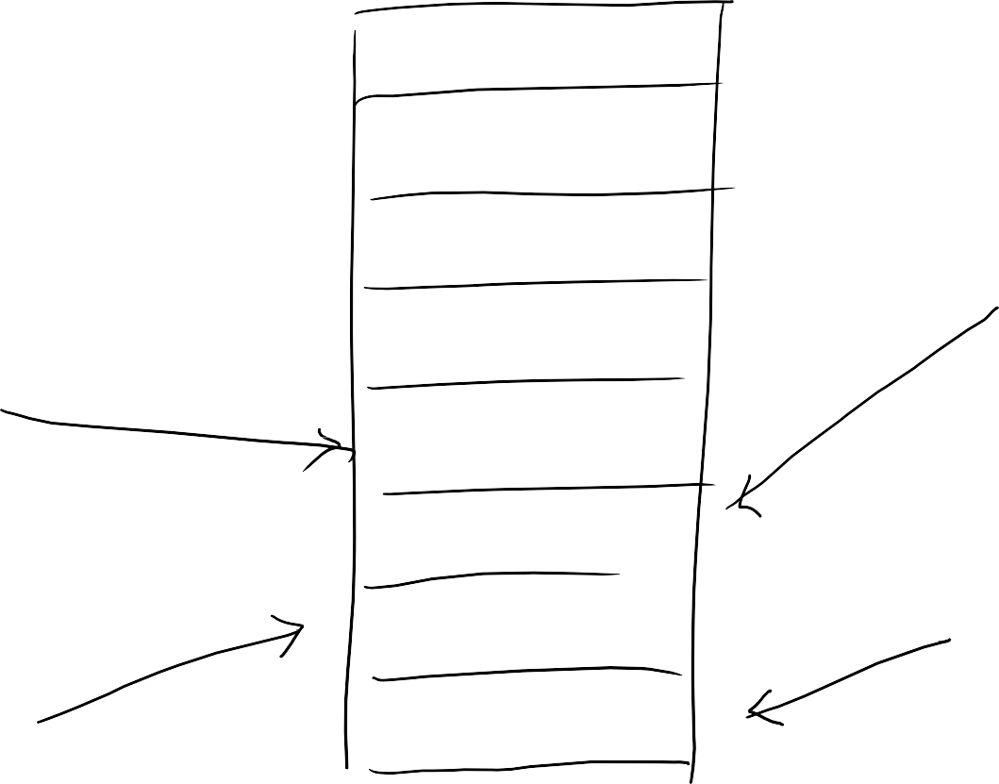







Extending shared buffer
109
Different threads can access to different buffers

Slide 110
Shared buffers access, to-do
110
Requires synchronization for
Determine who will access which buffer
Check whether the buffer is empty, or full
Goal of the problem
Process all the data, maximum throughput by concurrency
Make some proper assumptions
Producer should be fast as much as consumer (having similar number of producers and consumers)
If the number of buffers is limited, it is called as bounded-buffer

Slide 111










Prod-cons with bounded-buffers
111
Producer thread
Get the buffer index to use
Check the buffer state
Put data on the buffer
Mark the buffer full
Consumer thread
Get the buffer index to use
Check the buffer state
Get data from the buffer
Mark the buffer empty

Slide 112
prod-cons strategy
112
Multi-core concurrency strategy
To fully utilize the cpu cores
To make N producers, N consumers work
proper data structure to work with more threads
if you have single big lock, you can work with single thread (no more than 2 threads)
fine-grained lock vs. coarse-grained lock
producers-consumers balance
if producers take too long and much time, and consumer takes too short-
N producers ­ N consumers would not make sense;
More producers, less consumers ? / less producers, more consumers?
more concurrency, arbitrary orders of execution
consumers execution may not be the same with index
per-byte overhead vs. per-transaction overhead

Slide 113
Design the shared buffer
113
producers: reading files (10us~1ms)
consumers: printing out data / analysis for the buffer (0.x us)
reuse buffer (to avoid allocation)
increase the buffer size (to minimize per-transaction overhead)
introduce buffer structure
struct element {
byte buffer[4K];
int buffer_state; // fill or empty mutex_lock lock;
cond_var cv;
}
struct buffer {
struct element e[1024]; int p_index, c_index;
mutex_lock p_lock, c_lock;
}

Slide 114

Again, N producers – N consumers
114
Producer thread
Get the buffer index to use
Check the buffer state
Put data on the buffer
Mark the buffer full
Consumer thread
Get the buffer index to use
Check the buffer state
Get data from the buffer
Mark the buffer empty

Slide 115
Mini-lab.
115

