Slide 1

OS for Database systems Virtual Memory and IPC
1
Seehwan Yoo Dankook University
Disclaimer: Some slides are borrowed from UC. Berkeley’s 2014 OS and system programming

Slide 2
목차
2
강의 개요
OS 이론 강의 (8/29~9/2)
OS 개론, 프로세스.
병렬성.
메모리, IPC.
+ mini 실습
+ mini 실습
+ mini 실습
파일시스템, 네트워킹. + mini 실습
클라우드 컴퓨팅 및 시스템 관리
OS 실습 강의 (9/19~9/23)
리눅스 개발 환경 구축 및 쉘 프로그래밍 (1d)
다중쓰레드 자료구조 실습 프로젝트 (2d)
AWS 실습 및 WordPress 기반 DB 실습 프로젝트 (2d)

Slide 3
Contents
3
Address space
Segmentation & Base and Bound
Paging and mapping
Multi-level paging
TLB, Caching
Disk swapping
IPC, signal, shm, msg_q

Slide 4
Key OS Concept: Address Space
4
Program operates in an address space that is distinct from the physical memory space of the machine
0x000…
“virtual address”
“physical address”
Processor Memory
translator
0xFFF…

Slide 5


A simple address translation: B&B
5
code
0000… 0000…
code
Static Data
Static Data
heap
heap
stack
Base Address
stack
1000…
1000…
code
Program address
Static Data
heap
Can the programs touch OS?
Can it touch other pgms?
<
Bound
stack
0100…
1100…
FFFF…

Slide 6
Virtual Memory
6
Logical view of memory
Implementing per-process address space
Logical (memory) address != physical (memory) address
Independent memory for each process
Benefits
Easy of programming
Better protection
Free from physical limitation

Slide 7
Implementing Virtualization
7
Multiplexing
At one time, use this
At another time, use another
e.g.) Context switching
Indirection
Logical to physical mapping
Some hardware support
e.g.) Virtual memory

Slide 8
Multiplexing mapping memory
8
Flat facts
Physical memory address is fixed
Processes have to share them
Multiplexing memory is difficult
Too much!
Instead, mapping (indirection)
Controlled sharing (for communication)

Slide 9
Look into binary
9
Objcode of gcd
Disassembly of section .text:
0000004c <gcd>:
4c: 27bdffe0
addiu sp,sp,-32
00000000 <main>: |  | 50: | afbf001c | sw ra,28(sp)
0: 27bdffd0 | addiu sp,sp,-48 | 54: | afbe0018 | sw s8,24(sp)
4: afbf002c | sw ra,44(sp) | 58: | 03a0f021 | move s8,sp
8: afbe0028 | sw s8,40(sp) | 5c: | afc40020 | sw a0,32(s8)
c: 03a0f021 | move s8,sp | 60: | afc50024 | sw a1,36(s8)
10: 24021298 | li v0,4760 | 64: | 8fc30020 | lw v1,32(s8)
14: afc20018 | sw v0,24(s8) | 68: | 8fc20024 | lw v0,36(s8)
18: 34029387 | li v0,0x9387 | 6c: | 00000000 | nop
1c: afc2001c | sw v0,28(s8) | 70: | 14620004 | bne v1,v0,84 <gcd+0x38>
20: 8fc40018 | lw a0,24(s8) | …
24: 8fc5001c | lw a1,28(s8) | d8: | 8fc50020 | lw a1,32(s8)
28: 0c000000 | jal 0 <main> | dc: | 0c000000 | jal 0 <main>
2c: 00000000 | nop | e0: | 00000000 | nop
30: afc20020 | sw v0,32(s8) | e4: | 03c0e821 | move sp,s8
34: 03c0e821 | move sp,s8 | e8: | 8fbf001c | lw ra,28(sp)
38: 8fbf002c | lw ra,44(sp) | ec: | 8fbe0018 | lw s8,24(sp)
3c: 8fbe0028 | lw s8,40(sp) | f0: | 27bd0020 | addiu sp,sp,32
40: 27bd0030 | addiu sp,sp,48 | f4: | 03e00008 | jr ra
44: 03e00008 | jr ra | f8: | 00000000 | nop
48: 00000000 | nop | fc: | 00000000 | nop

Slide 10
Source code of gcd
10
Where is gcd() call in the binary?
void main()
{
int a = 0x1298; int b = 0x09387; int res;
res = gcd (a, b);
}
int gcd(int a, int b)
{
if (a==b) return a;
else if (a>b) return gcd(a-b, b);
else return gcd(b-a, a);
}

Slide 11
Why calling main?
11
GCD binary code
Disassembly of section .text:
0000004c <gcd>:
4c: 27bdffe0 50: afbf001c
addiu sp,sp,-32 sw ra,28(sp)
00000000 <main>:
0: 27bdffd0 | addiu sp,sp,-48
4: afbf002c | sw ra,44(sp)
8: afbe0028 | sw s8,40(sp)
c: 03a0f021 | move s8,sp
10: 24021298 | li v0,4760
54: | afbe0018 | sw s8,24(sp)
58: | 03a0f021 | move s8,sp
5c: | afc40020 | sw a0,32(s8)
60: | afc50024 | sw | a1,36(s8)
64: | 8fc30020 | lw | v1,32(s8)
68: | 8fc20024 | lw | v0,36(s8)
6c: | 00000000 | nop
14: afc20018 | sw | v0,24(s8)
18: 34029387 | li | v0,0x9387
1c: afc2001c | sw | v0,28(s8)
20: 8fc40018 | lw | a0,24(s8)
24: 8fc5001c | lw | a1,28(s8)
70: 14620004
…
bne v1,v0,84 <gcd+0x38>
d8: 8fc50020 lw a1,32(s8)
dc: 0c000000 jal 0 <main>
e0: 00000000 nop
28: 0c000000 jal 0 <main>
2c: 00000000 nop
30: afc20020
34: 03c0e821
38: 8fbf002c 3c: 8fbe0028 40: 27bd0030
44: 03e00008
48: 00000000
sw v0,32(s8) move sp,s8 lw ra,44(sp)
lw s8,40(sp) addiu sp,sp,48 jr ra
nop
e4: | 03c0e821 | move sp,s8
e8: | 8fbf001c | lw ra,28(sp)
ec: | 8fbe0018 | lw s8,24(sp)
f0: | 27bd0020 | addiu sp,sp,32
f4: | 03e00008 | jr ra
f8: | 00000000 | nop
fc: | 00000000 | nop

Slide 12
Linking & loading
12
At compile time, we cannot know target address of a function
Compile
Language translation from high-level PL. to low-level PL. (executable on CPU)
Linking
Resolving address of unknown symbol used in the program
Loading
Locating the code/data from permanent storage to memory (designated address)

Slide 13
After linking,
13
00400610 <main>:
400610:
400614:
400618:
40061c:
400620:
400624:
400628:
40062c:
400630:
400634:
400638:
40063c:
400640:
400644:
400648:
40064c:
400650:
4006b0: | 00402025 | move | a0,v0
4006b4: | 8fc50024 | lw | a1,36(s8)
4006b8: | 0c100197 | jal | 40065c
27bdffd0 afbf002c afbe0028 03a0f025
24021298
afc20018 34029387
afc2001c
8fc40018
8fc5001c
0c100197
00000000
afc20020
03c0e825
8fbf002c
8fbe0028 27bd0030
addiu sp,sp,-48
sw ra,44(sp)
sw s8,40(sp)
move s8,sp li v0,4760
sw v0,24(s8)
li v0,0x9387
sw v0,28(s8)
lw a0,24(s8)
lw a1,28(s8)
jal 40065c <gcd>
nop sw
<gcd>
4006bc:
4006c0:
<gcd+0x88>
4006c4:
4006c8:
4006cc:
4006d0:
4006d4:
4006d8:
4006dc:
<gcd>
4006e0:
00000000
10000008
nop
b 4006e4
00000000
8fc30024
8fc20020
00621023
00402025
8fc50020
0c100197
nop
lw v1,36(s8)
lw v0,32(s8)
subu v0,v1,v0
move a0,v0 lw
jal
v0,32(s8)
move sp,s8 lw ra,44(sp)
lw s8,40(sp)
a1,32(s8)
40065c
addiu sp,sp,48
00000000
nop
400654: 400658: | 03e00008 00000000 | jr ra nop | 4006e4: 4006e8: | 03c0e825 8fbf001c | move sp,s8 lw ra,28(sp)
 |  |  | 4006ec: | 8fbe0018 | lw | s8,24(sp)
0040065c <gcd>:
40065c:
400660:
4006f0:
4006f4:
27bd0020
03e00008
addiu sp,sp,32 jr ra
27bdffe0 afbf001c
addiu sp,sp,-32 sw ra,28(sp)

Slide 14
Logical view from CPU side
14
Per- process address space
M
e
m o r y
Thread context
CPU

Slide 15

MMU: A big picture
15
VA-PA translation hardware inside CPU
Physical Address Of memory
Virtual Address From Program
CPU
MMU

Slide 16
How OS is involved
16
OS sets up MMU
For different process, different address space different mapping (VA-PA)
Mapping table
VA-PA mapping
Will be addressed in paging

Slide 17
Memory manager with H/W support
17
Architectural support for OS
Base/bound registers for CRAY
OS sets up base & bound register
When context switches, base/bound registers are re-programmed (re-loaded)
Segmentation of Intel CPUs
Segments: part of program (code, data, stack)
Segment registers: point the starting address of segment
OS manages segments table

Slide 18
A slightly more detailed picture
18
Per- process address space
(virtual memory)
Physical Memory
VA
MMU
(Memory Management Unit) inside
CPU
PA
code
data

Slide 19
Base & Bound Segmentation
19

Slide 20
Limitation of B&B
→ only allows contiguous memory region
20
Logical addr. P1
P2
0
physical addr
0
P1
base & bound register
P1
0x1000
0x1000
0
P2
empty range: 0x1000~0x2000
0x2000
0x1000
P3
P3
0x3000
empty range: 0x3000~0x4000
0x4000
Fragmentation
total empty region size: 0x2000 = 8KB, however we cannot allocate P4, which has 5KB memory region

Slide 21
Limitation of B&B
→ only allows contiguous memory region
21
Logical addr. P1
P2
0
physical addr
0
P1
base & bound register
P1
0x1000
0x1000
0
P2
empty range: 0x1000~0x2000
0x2000
0x1000
0x1000
P1
P1
0x3000
0x2000
empty range: 0x3000~0x4000
0x4000
Fragmentation
total empty region size: 0x2000 = 8KB, however we cannot allocate P4, which has 5KB memory region

Slide 22
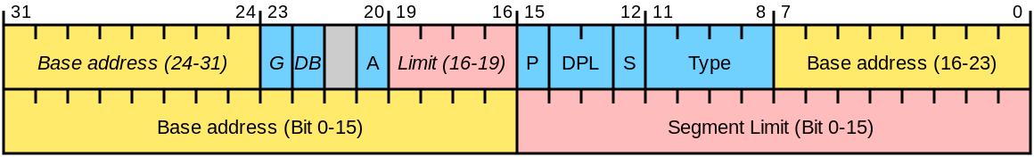
Segmentation
22
Extend idea from Base & Bound (B&B)
Divide address space into logical regions
Code segment (CS), Data segment (DS), Stack segment (SS), Extra segment (ES), for general use
FS, GS: canary-based stack protector, thread-local storage
For Intel specific implementation,
Segment descriptor: base & bound of a segment is stored in memory
All segments descriptors are in the ‘descriptor table’
Now, you have to know, which segment is used

Slide 23
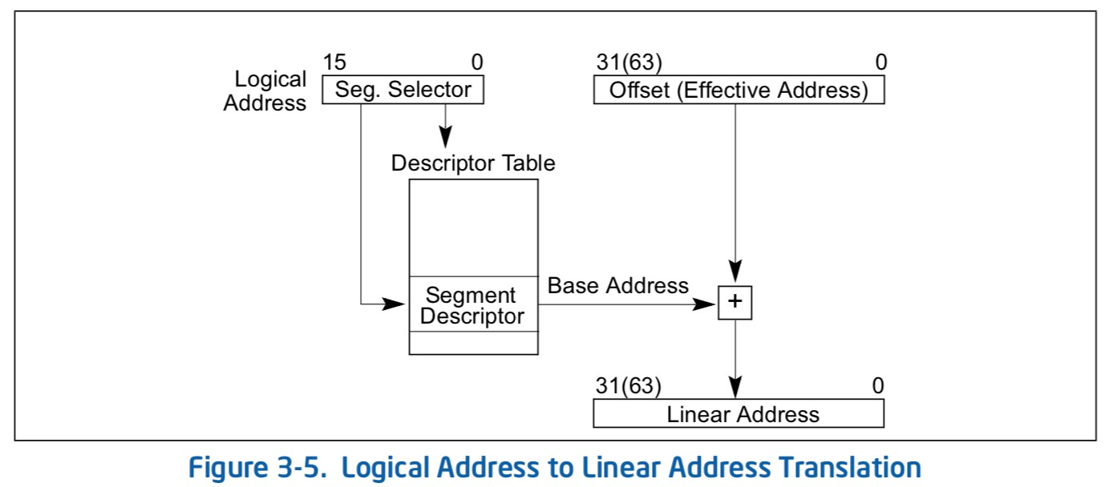
VA-to-PA mapping with segmentation
23
Prepare segment descriptors
Enable segmentation by programming segment register (segment selector)
CS = index of code segment descriptor (CS is a segment selector)
DS = index of data segment descriptor
Memory access
All code access
→ VA = (CS_{i}:base + addr)
→ Linear address
All data access
→ VA = (DS_{i}:base + addr)
→ Linear address

Slide 24
Paging and
Address translation architecture
24

Slide 25
Paging
25
Small, equal sized mapping between physical memory region into address space
Usually, 4KB sized mapping
Page
Fragment of address space, each of which has the small, equal sized region
Page number: index to all pages
VA: (page #) << 12 | (VA & 0xFFF)
Page frame
Fragment of physical memory
Each of which has the small, equal sized region
Pfn (page frame number): index to all page frames
PA: (pfn << 12) | (PA & 0xFFF)

Slide 26
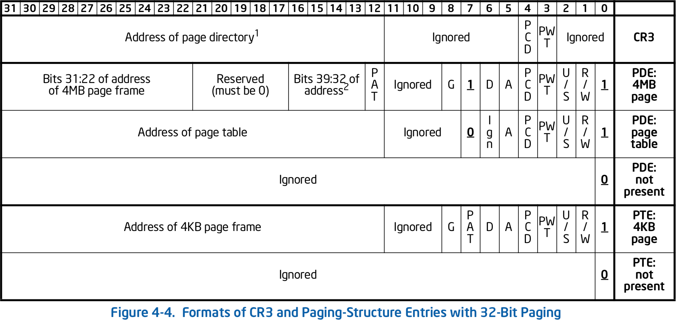
Mapping from VA-to-PA using paging
26
Page table has a mapping between (page number) and (page frame
number)
VA = (page number) : (page offset)
PA → Page table(page number) : (page offset)
Page | pfn
0 | 0x1234
1 | 0x1235
2 | 0x1236
…
0x100 | 0x1237
0xFFF | 0xFFF
… | …
0x80000 | 0x0
… | …
0xFFFFF | 0x4000
→ (page frame number) : (page offset)
Page table entry

Slide 27
Mapping from VA-to-PA using paging
27
Page table has a mapping between (page number) and (page
frame number)
VA = (page number) : (page offset)
PA → Page table(page number) : (page offset)
Page | pfn
0 | 0x1234
1 | 0x1235
2 | 0x1236
…
0x100 | 0x1237
0xFFF | 0xFFF
… | …
0x80000 | 0x0
… | …
0xFFFFF | 0x4000
→ (page frame number) : (page offset)
Page number is used as index into the page table
We don’t need to store them!
Page table entry
4-byte size: high bits have pfn

Slide 28
Address Translation: how to
28
Needs a translation table (page table)
Remembers VA-to-PA mapping
Use some bits in VA as index
Translation table is in memory
Needs architectural support
MMU is introduced
TTBR (translation table base register) points to the page table
ISA changed (H/W, S/W change required)
Needs a free page list
OS keeps track of free pages in the entire memory

Slide 29
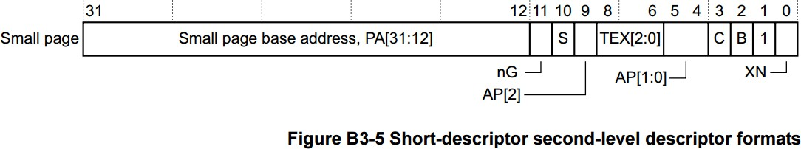
Page table looks like this
29
PA[31:12] + some more bits for the page
Translation table holds many entries of the following descriptors
ARM architecture reference manual ARMv7-A/R,
http://infocenter.arm.com/help/index.jsp?topic=/com.arm.doc.ddi0333h/I1029222.html

Slide 30
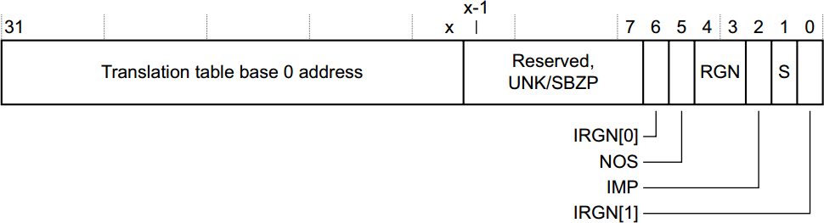
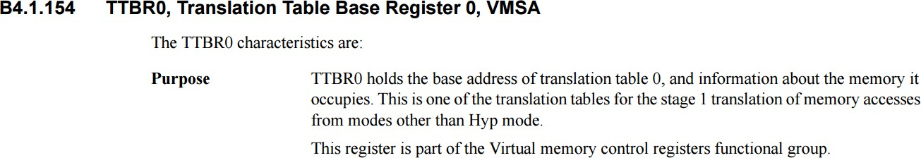
TTBR: translation table base register
30
OS sets up the page table, before it is used
OS writes TTBR register to change page table
When context switching occurs
TTBR: 변환 테이블 기본 레지스터

Slide 31
How large is page table?
31
Each entry is 4 bytes-sized (32 bit)
Each entry maps 4KB for small pages
How many entries for 32bit address space?
2³²/2¹² = 2²⁰ ~1M entries
1M entries x 4 bytes for each
4MB per process (1024 page frames are required)
Page table has to be contiguous
Too large!
Many of them are not used, but takes space!
Many entries are repeated for multiple processes!
Kernel region (1G/2G/3G) is the same for all of the processes
그것들 중 많은 것들이 사용되지 않지만, 공간을 차지합니다! 여러 프로세스에 대해 많은 항목이 반복됩니다! 커널 영역(1G/2G/3G)은 모든 프로세스에서 동일합니다.

Slide 32
About the page table size
32
페이지 테이블 크기 정보
Page table’s single entry size: 4 byte (32 bits)
How many mapping exists in a process?
Entire address space: 4GB for 32 bit machine (2³²)
Each mapping has 4KB (2¹²) address space, physical page frames
2³² / 2¹² = 2²⁰ = 1M
Page table size = (# of entries) * (entry size) = 1M * 4B = 4MB.
Too large for many-process systems
100 user processes = 400 MB of page tables
→ needs further reduction!
페이지 테이블 크기 = (항목 수) * (항목 크기) = 1M * 4B = 4MB입니다. 다중 프로세스 시스템에 비해 너무 큽니다. 100개의 사용자 프로세스 = 400MB의 페이지 테이블 → 더 줄일 필요가 있다
페이지 테이블의 단일 항목 크기: 4바이트(32비트)
한 프로세스에 몇 개의 매핑이 존재합니까? 전체 주소 공간: 32비트 시스템(232개)의 경우 4GB 각 매핑에는 4KB(212)의 주소 공간, 물리적 페이지 프레임이 있습니다. 2³² / 2¹² = 2²⁰ = 1M

Slide 33
Page table size reduction
33
페이지 테이블 크기 축소
Three observations
Observation one: Not all address space require mapping
There are numerous small programs, only utilizes several kilobytes of memory
Observation two: many programs share some memory (code / data)
Kernel, libc, shared library, JVM
Observation three: larger mapping reduces the mapping table size
What if 4MB (2²²) mapping is used?
Entry size: 4B
(# of entries in a page table): 2³² / 2²² = 2¹⁰
Page table size: 4KB!, same with the size of page frame!
일부 주소 공간에는 매핑이 필요하지 않습니다. 수많은 작은 프로그램들이 있고, 단지 몇 킬로바이트의 메모리만을 사용한다.
매핑 크기가 클수록 매핑 테이블 크기가 줄어듭니다. 4MB(222) 매핑을 사용하면 어떻게 됩니까? 엔트리 크기: 4B (페이지 테이블의 항목 수): 232 / 222 = 210 페이지 테이블 크기: 4KB!, 페이지 프레임 크기와 동일합니다!
많은 프로그램이 일부 메모리(코드/데이터)를 공유합니다. 커널, libc, 공유 라이브러리, JVM

Slide 34
Two-level paging
34
2단계 페이징
Make a coarse grained mapping for some regions
For empty (not utilized) mapping
For (large) shared mapping
How about the small mappings?
Add another level indirection
Coarse-grained mapping points to the next level page table
Page directory
Coarse-grained (4MB) mapping table, size?
# of entries: 4GB(=2³²) / 4MB (2²²) = 2¹⁰ = 1024 entries
Page table
4KB-size small mapping table, size?
# of entries: 4MB(=2²²) / 4KB (2¹²) = 2¹⁰ = 1024 entries
일부 지역에 대해 거친 매핑 만들기
빈(사용되지 않음) 매핑의 경우
(대형) 공유 매핑의 경우
작은 매핑은 어떻습니까?
다른 수준 간접 참조 추가
다음 레벨 페이지 테이블에 대한 조잡한 매핑 포인트
페이지 디렉토리
거친(4MB) 매핑 테이블, 크기?
항목 수: 4GB(=232) / 4MB(222) = 210 = 1024개 항목
페이지 테이블
4KB 크기의 작은 매핑 테이블, 크기는?
항목 수: 4MB(=222) / 4KB(212) = 210 = 1024개 항목

Slide 35
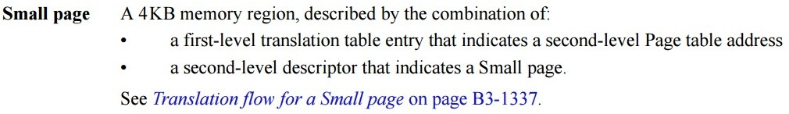
Two-level paging
35
Make levels
First level
Each entry represents coarse grained mapping
Second level
Each entry represents fine-grained mapping
첫 번째 수준
각 항목은 거친 매핑을 나타냅니다.
두 번째 수준
각 항목은 세분화된 매핑을 나타냅니다.

Slide 36
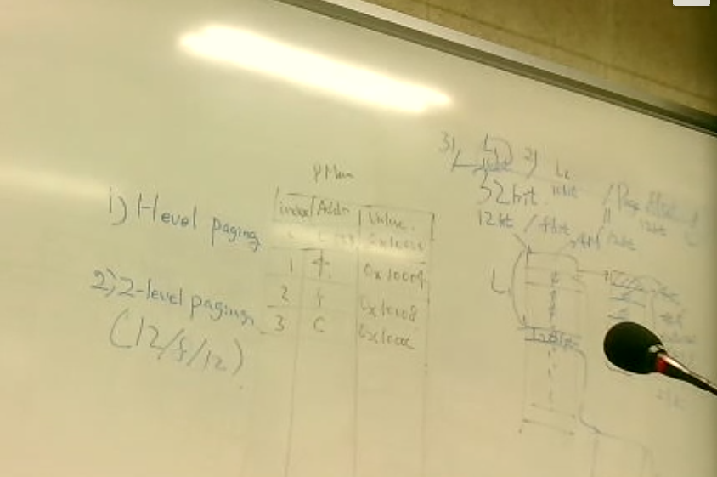
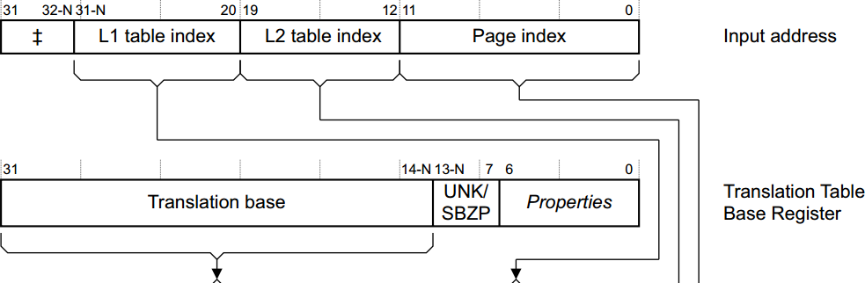
Two-level paging: step 1
36
Read TTBR (finds the page table)

Slide 37
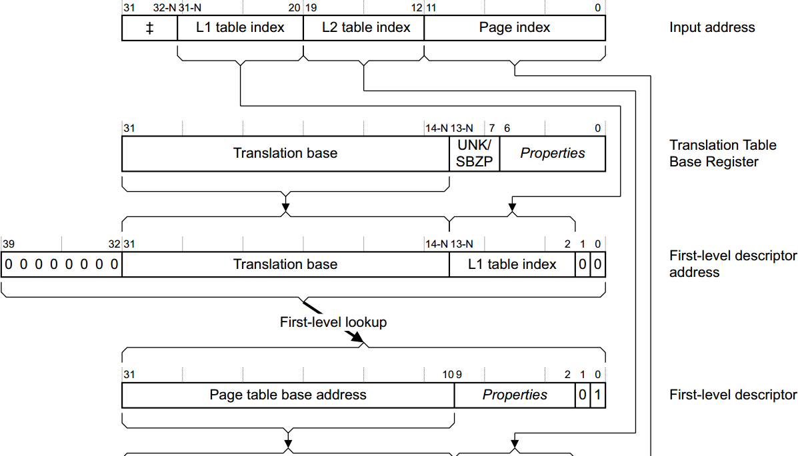
Two-level paging: step 2
37
First-level lookup
From TTBR addr,
Get L1 table index from VA
Look at Pagetable [L1_index(VA)]
Pagetable addr
+ L1_index(VA)*4
→ second-level table address + some bits

Slide 38
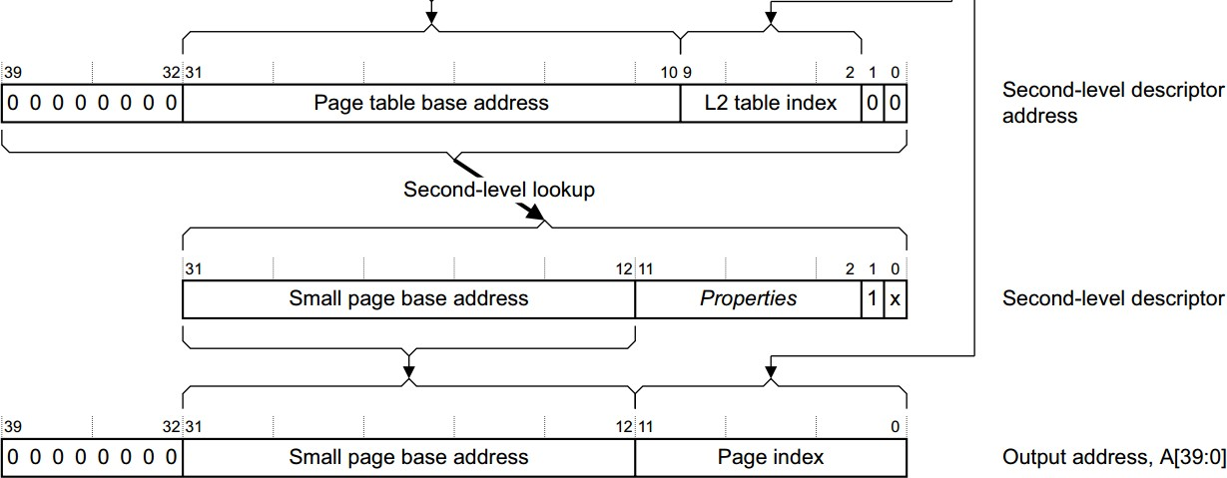
Two-level paging step 3
38
From second-level page table, L2_index(VA)
Look at L2_pagetable [L2_index(VA)]
addr
+ L2_index(VA)*4
→ page frame address
+ some bits

Slide 39
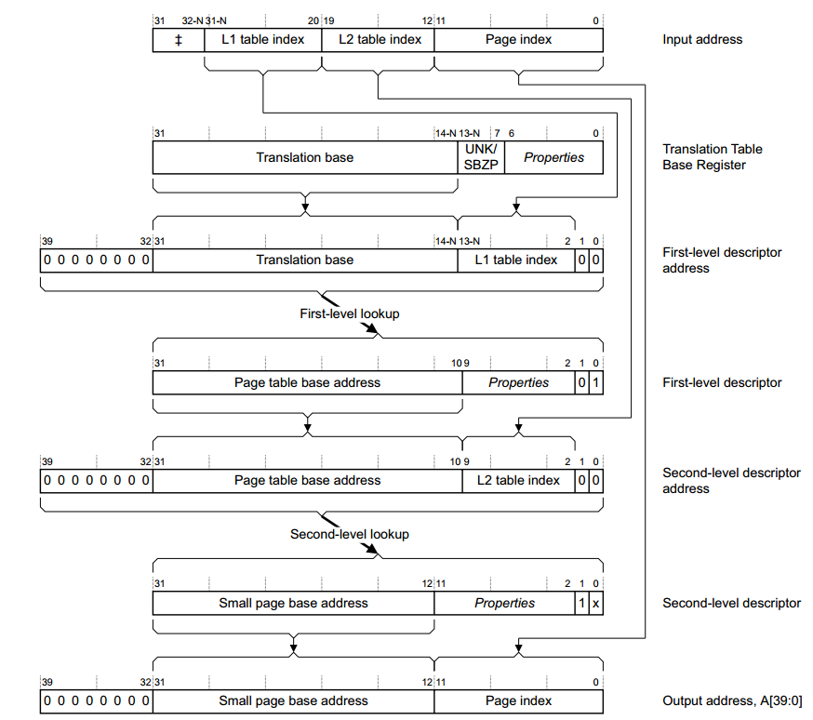
39

Slide 40
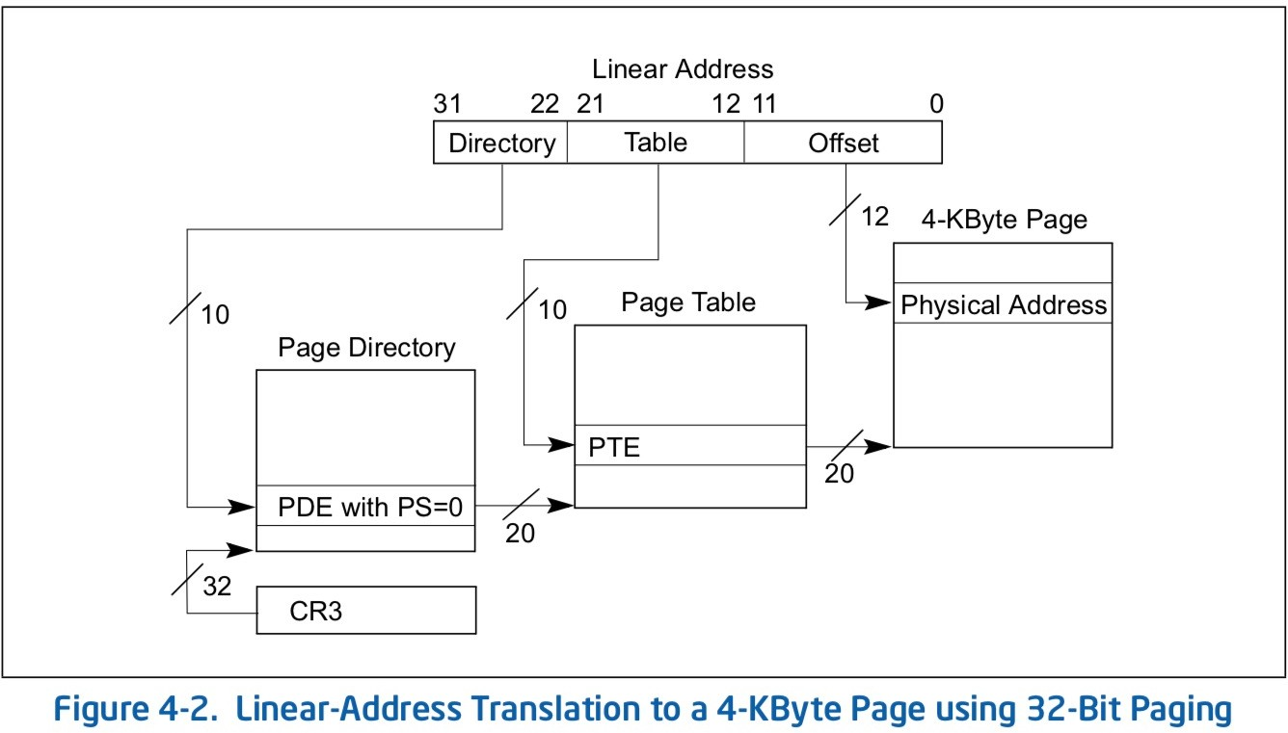
IA-32 paging structure
40
CR3 is a special register pointing to the page directory

Slide 41
Some more: demand paging
41
Page frames: at the beginning, not all the page frames are used
In fact, only a few page frames are required
Use only the frames that is actually touched
Allocate page frames on-demand
Initially, page table is empty
When first accessed, OS finds a free frame, maps it onto the requested virtual address
And you have to re-execute the instruction
Page fault
Occurs when the page table is invalid

Slide 42
Demand paging:
Filling in the page table, on-demand
42
Page table entry is empty/invalid → CPU cannot find proper physical page frame
Cannot make progress
Page fault is an exception, CPU execution enters OS
Pre-defined exception handler is invoked
Page fault handler
Page fault handler finds a new free page frame
Map the page onto the address space
Filling in the page table
Do the instruction again

Slide 43
Pros and Cons of two level paging
43
Pros
Small page tables
Better allocation
Reduce wasted (null) entries
Easy sharing
Cons
Slow translation
Additional memory access for single translation

Slide 44
Mitigate slow two-level translation
44
Introduce TLB (Translation Lookaside buffer)
Caches VA-PA mapping
Critical disadvantage of TLB?
Context switching
TLB lockdown
For kernel region
ASID
Tagged TLB

Slide 45
An example
45
Let’s assume that
PMem[Addr/4] = Addr+0x1:0000
Mem is 4 bytes array
TTBR value is 0
What’s the value of VA(0x1234:5678)?
피지컬메모리에 값이 이렇게 들어있다. 가상주소 0-9로 어떻게 할지
PMem[Addr/4] = addr + 0 x 1:0000
addr 에 0을 넣으면 값은 1:0000이 된다.
address 0
4번 주소에 들어있는 값은 address/4
배열의 index에 들어있는 값을 각각 구할 수 있다. :: PMem is 4 bytes array
4byte단위로 쭉 들어있는 PMEM인데 , TTBR은 0이 들어가있따. 0x1234:56778 을 가상조회하면 그 값은 무엇일까?

Slide 46
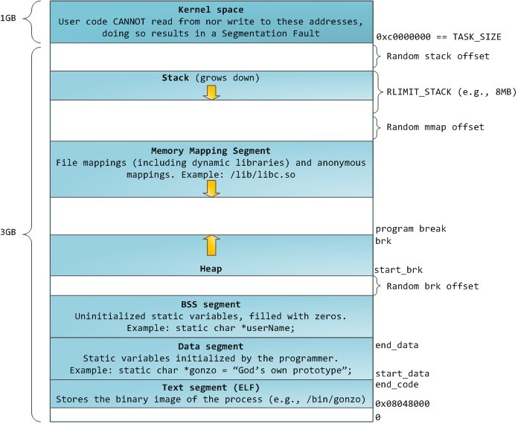
Shared mapping among processes
46
Kernel region (code, data)
Address space is reserved!
All user processes share the region
Shared library region (code, data)
Should be thread-safe
Can be re-entrant
We can make a shared page table
(shared 4MB mapping)

Slide 47
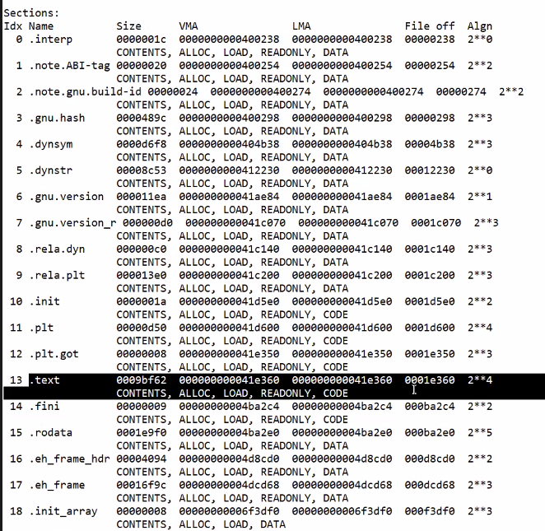
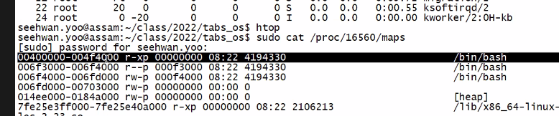
bin/bash : 메모리의 내용이 들어가있다.
Bash process 에 메모리의 랩핑이 어떻게 되어있는지알 수 있다.
Sudo cat / proc / 16560/maps
Proc 디렉토리는 사용자가 가지고 있는 디렉토리를 보여준다.
Proc/id/map
Stack 영역도 확인 할 수 있다.
실제로 남아있는 메모리가 얼마있는지
알 수 있다.

Slide 48
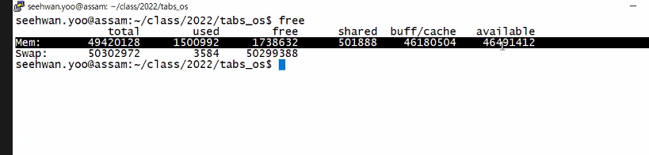

Slide 49
Disk Swapping
47

Slide 50

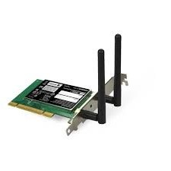
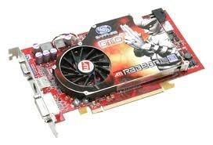
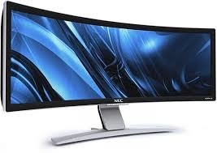

Recall: the most basic OS function
48
 | Threads
 |  |  |  |  |  | Windows
 |  | Address Spaces
Processes |  |  |  | Files |  |  |  | Sockets
Software
OS Hardware Virtualization
Hardware
ISA
Memory
Processor
Protection Boundary
OS
Ctrlr
Networks
storage
Dankook Universi Inputs
Displays
ty

Slide 51










Loading an executable into memory
49
실행 파일을 메모리에 로드
.exe
lives on disk in the file system
contains contents of code & data segments, relocation entries and symbols
OS loads it into memory, initializes registers (and initial stack pointer)
program sets up stack and heap upon initialization: CRT0
파일 시스템의 디스크에 저장 코드 및 데이터 세그먼트, 재배치 항목 및 기호의 내용 포함 OS가 메모리에 로드하고 레지스터를 초기화합니다(및 초기 스택 포인터). 프로그램 초기화 시 스택 및 힙 설정: CRT0
disk (huge)
memory
exe
info
data
code

Slide 52




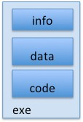


Create Virtual Address Space of the Process
50
프로세스의 가상 주소 공간 생성
Utilized pages in the VAS are backed by a page block on disk
called the backing store
typically in an optimized block store, but can think of it like a file
VAS에서 사용된 페이지는 디스크의 페이지 블록에 의해 백업됩니다. 백 스토어라고 불렸습니다. 일반적으로 최적화된 블록 저장소에 있지만 파일처럼 생각할 수 있습니다.
disk (huge) process VAS
memory
kernel
user page frames
stack
sbrk
user pagetable
heap
data
kernel code & data
code

Slide 53




Create Virtual Address Space of the Process
51
User Page table maps entire VAS
All the utilized regions are backed on disk
swapped into and out of memory as needed
사용자 페이지 테이블은 전체 VAS를 매핑 사용된 모든 영역이 Disk에 백업됨 필요에 따라 메모리 안팎으로 스왑
For every process
disk (huge, TB)
process VAS (GBs)
memory
kernel
stack
user page frames
stack
heap
data
heap
user pagetable
kernel code & data
data
code
code

Slide 54





Create Virtual Address Space of the Process
52
User Page table maps entire VAS
resident pages to the frame in memory they occupy
the portion of it that the HW needs to access must be resident in memory
사용자 페이지 테이블은 전체 VAS를 매핑 그들이 점유하고 있는 기억의 틀에 대한 상주 페이지들 HW가 액세스해야 하는 부분은 메모리에 상주해야 합니다.
disk (huge, TB)
PT
VAS – per process memory
kernel
stack
user page frames
stack
heap
data
heap
user pagetable
kernel code & data
data
code
code

Slide 55













Provide Backing Store for VAS
53
사용자 페이지 테이블은 전체 VAS를 매핑 메모리 프레임에 매핑된 상주 페이지 다른 모든 페이지의 경우 OS는 디스크에서 페이지를 찾을 수 있는 위치를 기록해야 합니다.
User Page table maps entire VAS
Resident pages mapped to memory frames
For all other pages, OS must record where to find them on disk
disk (huge, TB)
VAS – per process memory
kernel
stack
user page frames
stack
heap
heap
data code
user pagetable
kernel code & data
data
code

Slide 56
What data structure is required
to map non-resident pages to disk?
54
FindBlock(PID, page#) => disk_block
Like the PT, but purely software
Where to store it?
Usually want backing store for resident pages too.
Could use hash table (like Inverted PT)
블록 찾기(PID, 페이지 번호) => disk_block PT처럼, 하지만 순전히 소프트웨어입니다. 어디에 보관하죠? 일반적으로 상주 페이지에 대한 백업 저장소도 원합니다. 해시 테이블(Inverted PT 등)을 사용할 수 있습니다.
프로세스마다 자기의 페이징을
가지고 있고 그 정보를 현재 메모리 데이터에
가지고 있다면 메모리에서 처리하지만
가지고 있지 않다면 페이지 에 표시한다.
디스크 페이지에 표시를 하여 메모리 유무를
Cpu가 읽고 cpu가 없다는걸 알면 디스크에
가져오기 이해 페이지 처리를 한다

Slide 57



















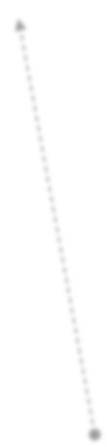





Provide Backing Store for VAS
55
disk (huge, TB)
VAS 1
PT 1
memory
kernel
stack
stack
stack
heap
user page frames
heap
heap
data code
data
code
VAS 2
PT 2
data
user pagetable
kernel code & data
kernel
stack
heap
data code

Slide 58







On page Fault …
56
disk (huge, TB)
VAS 1
PT 1
memory
kernel
stack
stack
stack
heap
user page frames
heap
heap
data code
data
code
VAS 2
PT 2
data
user pagetable
kernel code & data
kernel
stack
heap
active process & PT
data
code

Slide 59








On page Fault … find & start load
57
disk (huge, TB)
VAS 1
PT 1
memory
kernel
stack
stack
stack
heap
user page frames
heap
heap
data code
data
VAS 2
PT 2
data
code
user pagetable
kernel code & data
kernel
stack
heap
active process & PT
data
code

Slide 60



















On page Fault … schedule other P or T
58
disk (huge, TB)
VAS 1
PT 1
memory
kernel
stack
stack
stack
heap
user page frames
heap
heap
data code
data
VAS 2
PT 2
data
code
user pagetable
kernel code & data
kernel
stack
heap
active process & PT
data
code

Slide 61





On page Fault … update PTE
59
disk (huge, TB)
VAS 1
PT 1
memory
kernel
stack
stack
stack
heap
user page frames
heap
heap
data code
data
VAS 2
PT 2
data
code
user pagetable
kernel code & data
kernel
stack
heap
active process & PT
data
code

Slide 62
Eventually reschedule faulting thread
60
disk (huge, TB)
VAS 1
PT 1
memory
kernel
stack
stack
stack
heap
user page frames
heap
heap
data code
data
VAS 2
PT 2
data
code
user pagetable
kernel code & data
kernel
stack
heap
active process & PT
data
code

Slide 63
Where does the OS get the frame?
61
Keeps a free list
Unix runs a “reaper” if memory gets too full
As a last resort, evict a dirty page first

Slide 64
When OS begins,
62
Initialize physical memory
Free-page frames list
When a process begins, address space is given
Along with the page table
Initially empty mapping
When a process accesses memory,
Page fault occurs when invalid mapping is accessed
OS makes new mapping
Finds a new page frame
Fills in the page table with the new page frame
Re-access the memory by re-executing the fault instruction

Slide 65
When we run out of physical memory,
63
No more free memory list!
Yet, we need more free pages!
Swap a in-memory page with backing store’s page
Q1) Whom to evict? - Similar policy with CPU cache
Q2) Where to store? ­ needs a mapping table

Slide 66
Whom to evict from memory to backing store? ⁶⁴
Least recent used one (LRU)
Complex algorithm
Approximation to this, second-chance algorithm
Fully implemented in software
Still, it is too complex
Better idea ­ working set
Memory set that are used together
Evict all, swap-in all
How to know the working set?
Dirty bit in page table
Clean pages do not need write-back (always can fetch from the file system)

Slide 67
Side note: Thrashing
65
Consider a case that a process P1
request to memory M1 evicts M2 (was in physical memory)
M1 will come into memory (for execution)
Another (next) request to memory M2 evicts M1
Sometimes, it is too late!
P1 swap-out M1, M2, M1, M2, ….
Not much progress
Would affect the entire processes
Thrashing
CPU utilization is low, consume most of the time for swapping
When free memory < working set
Before it is too late, swap early
Monitoring the memory usage, do swapping actively (swapper)
Working set can be swapped-out altogether

Slide 68
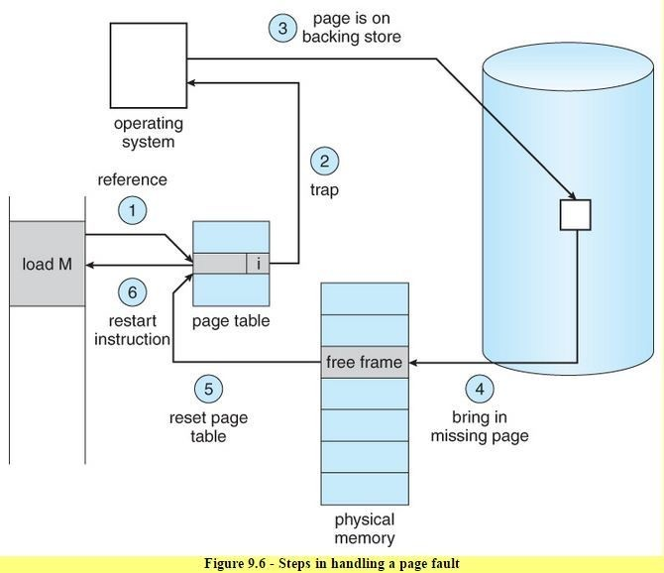
Page fault handling
66
PID, page # → block mapping info is essential data for recovery
To swap-in, you have to know the where you stored your data
Page fault handling
Check pg#, identify entry in the page table
If invalid, identify data location in the backing store
Find a free page frame,
copy data from backing store into new page frame
Maps the page into the address space by filling in page table
Restart instruction
Pic. from OS Concepts

Slide 69
For the case of swap-out (replacement)
67
Identify the page to swap out
Pick a block in the backing store
You will have to remember it
Copy data back to the backing store from the memory
Keep the information
So that you can find in the case of future reference
교환할 페이지 식별 백업 저장소에서 블록 선택 당신은 그것을 기억해야 할 것이다. 데이터를 메모리에서 백업 저장소로 다시 복사 정보를 보관하십시오. 나중에 참조할 경우 찾을 수 있도록

Slide 70
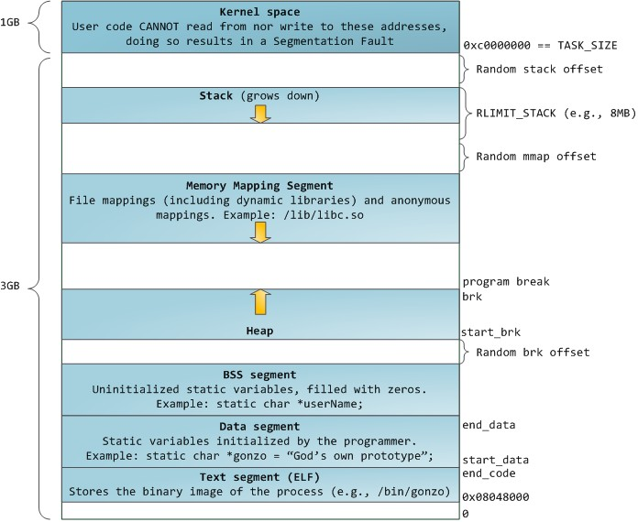
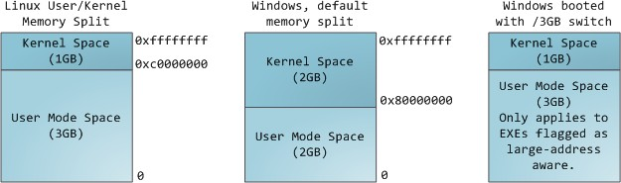
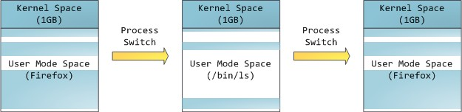
Virtual memory address space layouts
68
가상 메모리 주소 공간 레이아웃
내부적으로는, 주소 공간에 사전 정의된 레이아웃이 있으므로 사용자 전용 4G 공간을 사용할 수 없습니다.
Internally,
Address space has pre-defined layout; cannot use 4G space for user only

Slide 71
Memory allocation at different levels
69
User memory, put the flag (begin, end)
If you allocate more, end = end + size
malloc() simply returns the address that you can use
Kernel takes care of the physical memory, address space layout, page fault, etc.
Kernel memory
Types of physical memory region
Kernel code, data, User code, data, rest of it
DMA / device region, etc. (buffer cache, page cache)
Logical separation of kernel virtual memory region (page allocation)
Kernel also have memory layout, heap, stack, etc.
Zone allocator
Page level allocation
Buddy algorithm
Fine-grained kernel memory allocation
Power-of-2 allocator (needs some data structure)
사용자 메모리, 플래그(시작, 종료)를 넣습니다.
더 할당하면 끝 = 끝 + 크기
malloc()은 단순히 사용할 수 있는 주소를 반환합니다.
커널은 물리적 메모리, 주소 공간 레이아웃, 페이지 폴트 등을 처리합니다.
커널 메모리
물리적 메모리 영역의 유형
커널 코드, 데이터, 사용자 코드, 데이터, 나머지
DMA / 디바이스 영역 등 (버퍼캐시, 페이지캐시)
커널 가상 메모리 영역의 논리적 분리(페이지 할당)
커널에는 메모리 레이아웃, 힙, 스택 등이 있습니다.
영역 할당자
페이지 수준 할당
버디 알고리즘
세분화된 커널 메모리 할당
2의 거듭제곱 할당자(일부 데이터 구조 필요)

Slide 72
VM and its friends
70

Slide 73
VM with sharing
71
Inter-process communication
VM mapping between VA-PA
What if VA1 → PA, and VA2→PA?
Different VA, points to the same PA
Same copy for different address
Mapping across process boundary
What if P1.VA1 → PA, and P2.VA2→PA ?
Mapping across processes!
As a means of IPC
Mapping for OS kernel memory
Shared among all the processes

Slide 74
IPC facilities without shared memory
72
Signal (signal setup/use)
Message queue
pipe
Process P1
Process2
1. Systemcall (sigaction)
3. Systemcall kill(SIGALRM, P1)
2. Setup sighandler for P1 PCB.sigaction[SIGALRM] =
timer_handler
OS kernel
4. When P1 is scheduled,
Lookup sighandler for SIGALRM,
If there is, invoke handler (timer_handler)

Slide 75
IPC facilities without shared memory
73
Signal
Message queue (initialization)
pipe
Process P1
Process2
1. Systemcall (msgget)
2. Setup message queue Message queue id
OS kernel

Slide 76
IPC facilities without shared memory
74
Signal
Message queue (snd / rcv)
pipe
Process P1
Process2
1. Systemcall Msgsnd(qid, &data)
3. Systemcall msgrcv(qid, &data)
OS kernel
4. Copy data back
from message queue to user
2. Copy data from user Into message queue

Slide 77
Implication of data copy (esp. when data size is large)
75
Consume CPU cycles
Size could be large
Consume energy
Byte-sized
Word size, Cacheline alignment mismatch
Per-byte size check
Pollute cache
Useful data can be evicted from cache
Only efficient for a single (designated) process
Large cache misses
Slow execution

Slide 78
Some mitigations from cache pollution, and misses
76
Copy multiple bytes per operation
Word size consideration
Cacheline alignment
Avoid per-byte size check
Enhance copy algorithm
Page table entry has Cache-able property
When cleared, the address regions are not cached
No cache pollution
OMG. This makes copy operation much slow!

Slide 79
A better way, re-map the page
77
Shared memory
No copy
Process P1
Process2
1. Systemcall shmget(qid, &data)
3. Systemcall shmget(qid, &data)
OS kernel
4. Remap the same PA to another process
2. Create shared mapping

Slide 80
A consideration
78
Both processes can read/write data
Synchronization
That’s your responsibility
Semaphore (semget, semop)
Can be cached!
Cache with VA?
Cache with PA?
Virtual cache vs. physical cache?

Slide 81
Fork() and virtual memory
79
Fork syscall creates a new process
Actually, copies from existing one (parent)
Threads of control
Address space (VA, same with the parent)
Guess the page table at the time of fork?
Note that address space is given per-process
There are per-process page tables
One process has one page table

Slide 82
Fork() and virtual memory
80
Fork syscall creates a new process
Actually, copies from existing one (parent)
Threads of control
Address space (VA, same with the parent)
Guess the page table at the time of fork?
They (parent, child) are the same
Same mapping (PA-VA), regardless of the process boundary
Otherwise? To have the same data for the entire address space?
When they are detached?
When they are becoming different
When somebody write (sth) to memory

Slide 83
Copy-on-Write (CoW)
81
Copy occurs when write is performed
Before? it maintains the same mapping
VA of Proc1
VA of Proc2
Pgtbl Proc1
Pgtbl Proc2
PA of Proc1

Slide 84
When they are detatched?
82
Guess the page table at the time of fork?
They (parent, child) are the same
Same mapping (PA-VA), regardless of the process boundary
When they are detached?
When they are becoming different
When somebody write (sth) to memory
When somebody writes to memory → memory value becomes different
Two different processes should be detatched!
→ they cannot have the same mapping anymore!
They should have different mappings
The rest of the region (except for the modified bytes)?
→ should be copied
Copied when a process writes to memory!
Copy-on-write (CoW)

Slide 85
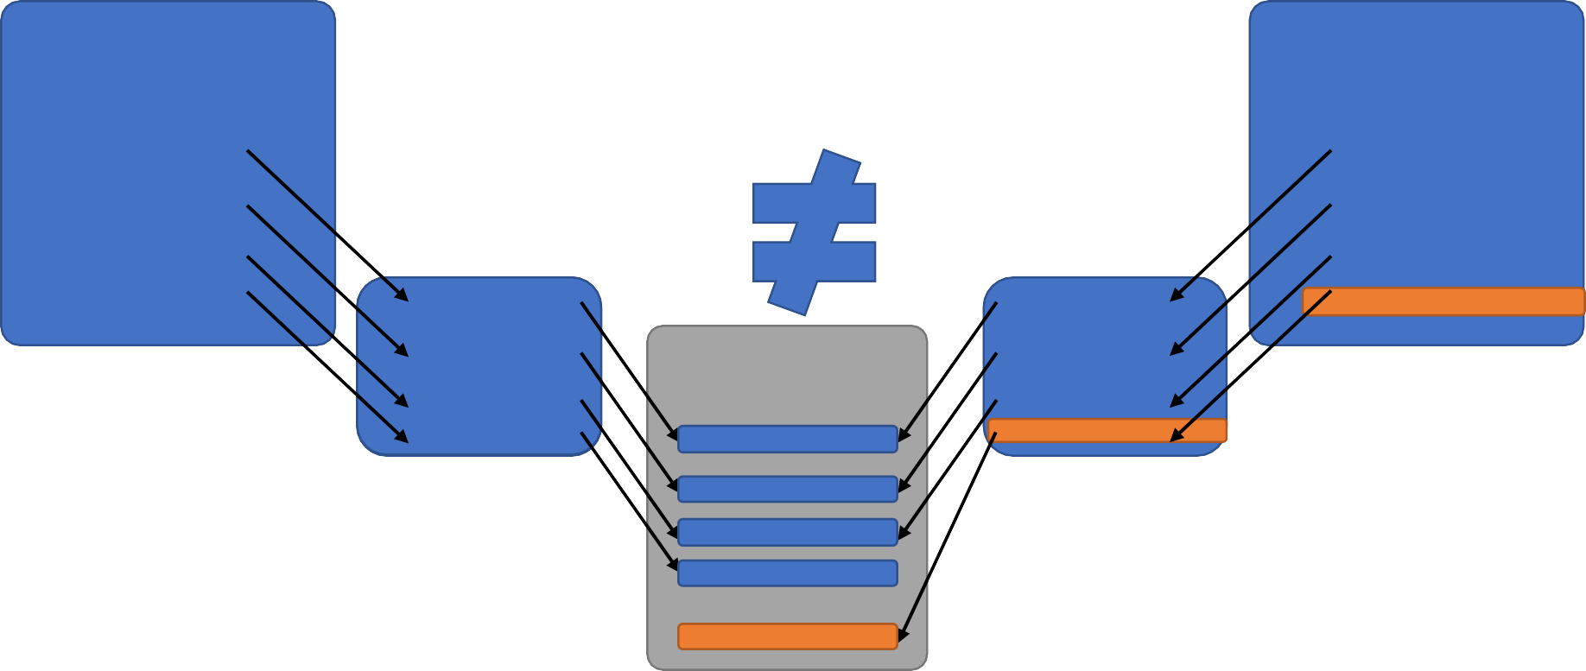
Detatched address space
83
Mapping is 4K (small size mapping)
Write 4 byte-sized integer value,
then (4096-4) bytes have to be copied from original page frame
VA of Proc1
VA of Proc2
Write to VA (ABCD)
Pgtbl Proc1
Pgtbl Proc2
PA

Slide 86
How can we know that a process writes to memory?⁸⁴
Make the address space read-only
Setting up the page table
Normally, user data
If a process begins to write, protection fault will occur
OS will catch the fault
Looks at the situation check whether the process in user mode, write data to read-only region (for available address)
Make a new mapping (find a page, fills in page table)
Copy the data from original page frame to new page frame
(further think about how)
Re-execute the instruction (write to new page frame)
Make the page read-write

Slide 87
Advantage of CoW
85
Copy before? Copy on write?
Opportunistic approach
Use when it is actually needed
Human factor
Better to begin early
Give response to the user as early as possible
vfork() syscall
Child borrows parent’s resources before execve/exit is called
During the time, parent is suspended
Let child run as early as possible
Assuming that the child will call exec() or exit

Slide 88
MMIO vs. IO-mapped-IO
86
Memory mapped I/O
I/O devices have memory map → I/O devices have internal VA-PA mapping
However, I/O devices registers are mapped to memory
Do the I/O by accessing register → MM-I/O
Open/read/write/close
Read/write to memory → read/write to device register
Device address space
Some address region (PA) is reserved for I/O devices
Virtual Memory allows OS to map I/O device region into process address space

Slide 89
MMap
87
Memory mapped file
File blocks can be mapped into memory
Read from a file easily
Write to the file easily
Files can be device!
Read from device easily
Write to device easily
At the user side!
But, needs permission from OS

Slide 90
Shared library and DLLs
88
Library shared across process boundary
Use VM page sharing
To use with multiple processes, some are statically allocated
Use the same address region for all processes
Where is printf ()? / homework: find out the location of printf() function
Dynamic linking/loading library (DLL)
Load library dynamically
Changes the address of some symbols
Needs re-location
Why?

Slide 91
Your code is based upon static memory layout
89
Assume a.out came from file_a.o, file_b.o, file_c.o
File_a has main(), calls foo()
File_b has foo(), calls bar()
File_c has bar()
Location of foo()?
Location of bar()?
You can make your own library lib_a.o that has foo() and bar()
At link time, the location is fixed for foo() and bar()
lib_a.o can work with file_a.o
lib_a.o can work with another program file_z.o, where file_z.o has another main(), calls foo()

Slide 92
Position independent code (PIC)
90
How about shared library?
Easy if it is static
All address is fixed
Making a library position independent
Include symbol table for the library
So that it can be re-located at different address (memory location)
DLL (dynamic linking library)
Library, that changes location at runtime
Different location for different process
ASLR (Address space layout randomization) effectively blocks attacks from some malicious shared library, that has pre-known vulnerable memory location

Slide 93
Mini-lab.
91

