Slide 1
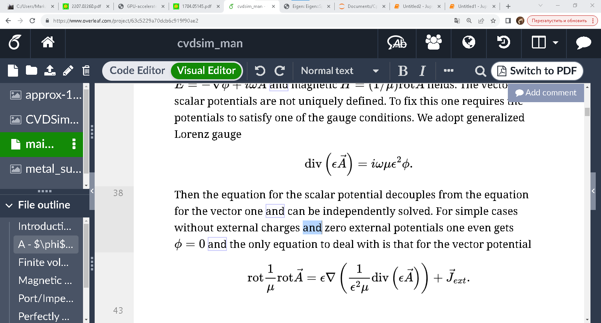
Equation modification:
Use generalized Lorenz gauge
To obtain magnetostatic equation in the form
This term should not be dropped off. Iterative solver is not stable without it!

Slide 2
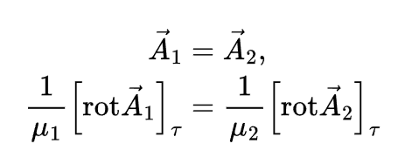
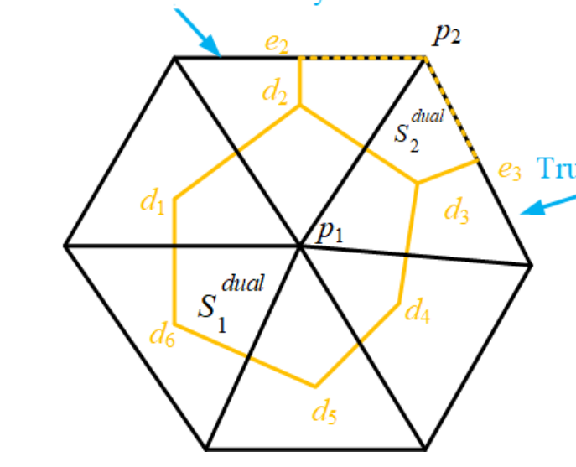
Boundary conditions for magnetostatics
rot A_11 + rot A_12 approximately tangential, the same is true for rot A_21 + rot A_22
Condition for matrix assembly:
(rot A_11 + rot A_12)/mu_1 – (rot A_21 + rot A_22)/mu_2 = 0
Vector potential A on p1-edge on one side is equal to that on the other side
Simple, but not accurate!
rot A_11
mu_1
rot A_12
mu_2
rot A_22
rot A_21

Slide 3
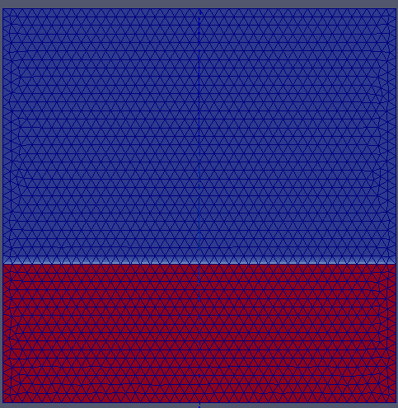
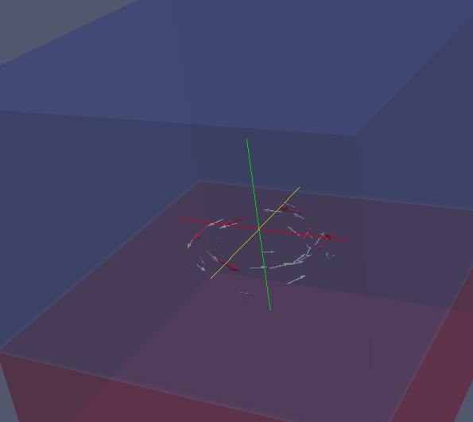
Solver draft: current ring over ferrite surface. Solution takes 800 iterations to converge to 2e-12. Mesh was not intended to be orthogonal
Model mesh
Geometry and current source
Mu = 1000
Ring current source

Slide 4
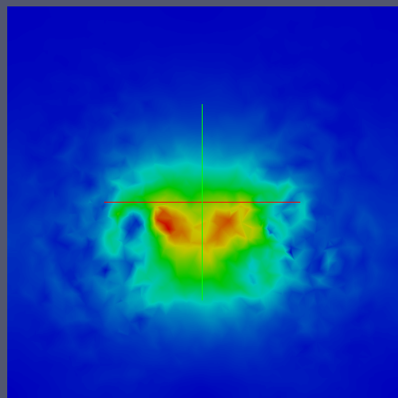
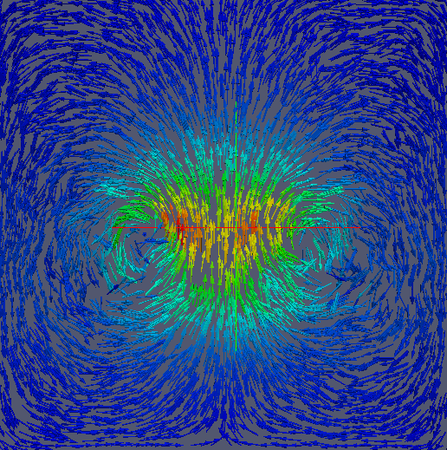
Solver draft: current ring over ferrite surface. B-field magnitude and vector
Not accurate interpolation from edges to nodes and bad use of Paraview

Slide 5
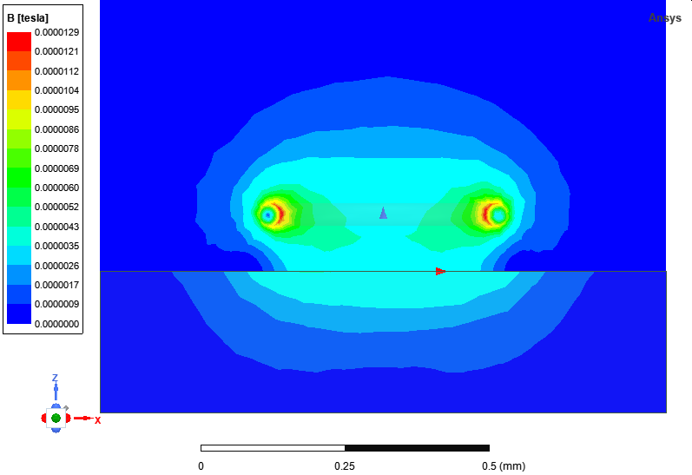
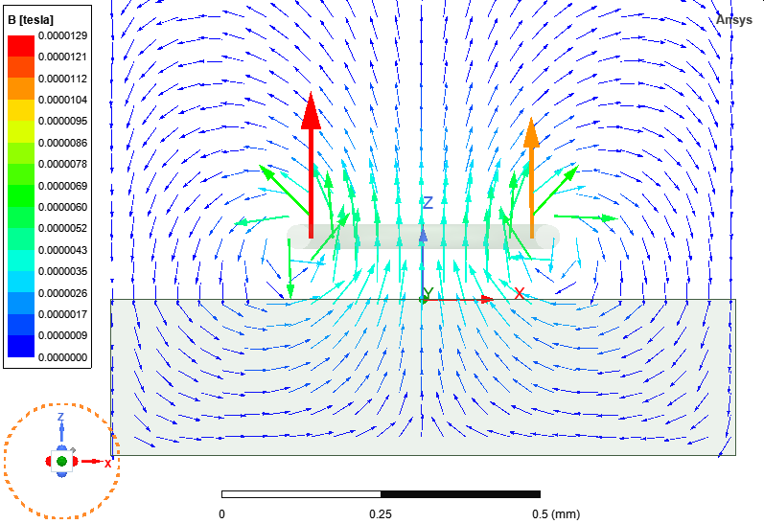
Ansys Maxwell 3D: Ring wire over ferrite surface
Mu = 1000

