Slide 1

Presentation on DS Project
Presentation by:
Shartaz yeasar feeham [191002130]

Slide 2
Friday is a pseudo intelligent chat bot that is made for entertainment purpose. This is a Data structures based project. It acts like Artificial intelligent but it is not. So it’s only goal is entertainment.
There are 13 user defined functions divided in three sections
Major user defined functions
Minor user defined functions &
Extra user defined functions

Slide 3
The code begins from main function. Which decorates the screen and runs a loop which calls the very user major defined functions as follows.
Learn
Listen
Decide
Reply

Slide 4
learn();
while (chatloop!=0)
{
listen();
decide();
reply();
cleartmem();
}
}
//Main Function
int main()
{
intro();
system("cls");
system("color 0F");
char a=177;
for(int j=1; j<=4; j++)
for(int i=4; i<=8; i++)
{
chcolor(i*15,a);
}
scolor(15," [ Chat bot status: ");
scolor(2,"ACTIVE ] ");
for(int j=1; j<=4; j++)
for(int i=8; i>=4; i--)
{
chcolor(i*15,a);
}
cout<<endl<<endl;

Slide 5
LEARN()
void learn()
{
strcpy(msg,"Hey, hey; Good morning, how you doing?");
readit();
memorise();
cleartmem();
strcpy(msg,"! ; Yes! No doubt!");
readit();
memorise();
cleartmem();
strcpy(msg,"system, close, terminate, exit, chat; Thank you, Friday");
readit();
memorise();
cleartmem();
strcpy(msg,"your, name ; I am Friday.");
readit();
memorise();
cleartmem();
strcpy(msg,"your, name ; My name is Friday.");
readit();
memorise();
cleartmem();

Slide 6
Readit() & Memoriesit()
void readit()
{
int ii, cc, ll;
ll=strlen(msg);
//Taking tags inside msga!
for(ii=0; ii<=ll; ii++)
{
if(msg[ii]==';')
{
cc=ii+1;
ii=ll+1;
}
else
msga[ii]=msg[ii];
}
//Taking reply inside msgb!
for(ii=cc; ii<=ll; ii++)
{
msgb[ii-cc]=msg[ii];
}
}

Slide 7
void memorise()
{
int ii=scount, jj, kk, cc;
//Storing value in last array!
cc=strlen(msgb);
for(kk=0; kk<=cc; kk++)
{
Base[scount][25][kk]=msgb[kk];
}
//Storing value in first arrays!
cc=strlen(msga);
int xx=0, ss=0;
for(jj=0; jj<=23; jj++)
{
for(kk=xx; kk<=cc; kk++)
{
if(kk==cc)
{
goto jend;
}
if(msga[kk]==',')
{
Base[scount][jj][kk]='\0';
xx=kk+1;
kk=cc+1;
}
else if (((msga[kk]>='A')&&(msga[kk]<='Z'))||((msga[kk]>='a')&&(msga[kk]<='z'))||((msga[kk]>='0')&&(msga[kk]<='9')))
{ if((msga[kk]>='A')&&(msga[kk]<='Z'))
Base[scount][jj][ss]=msga[kk]+32;
else
Base[scount][jj][ss]=msga[kk];
ss++;
}
}
ss=0;
}
jend:
{
jcount[scount]=jj+1;
}
scount++;
}

Slide 8
DECIDE()
dxx=0; dyy=0; dii=0; djj=0;
//Sorting
for(dii=0; dii<=1000; dii++)
{int a=dcc[dii][0], b=dcc[dii][1], c=dcc[dii][2];
for(djj=dii; djj<=1000; djj++)
{if(dcc[djj][1]>b)
{ a=dcc[djj][0]; b=dcc[djj][1]; c=dcc[djj][2]; dyy=djj; }}
int tempa=dcc[dii][0], tempb=dcc[dii][1], tempc=dcc[dii][2];
dcc[dii][0]=a; dcc[dii][1]=b; dcc[dii][2]=c;
dcc[dyy][0]=tempa; dcc[dyy][1]=tempb; dcc[dyy][2]=tempc;
}
int decide()
{
//Finding valid bases
for (dxx=0; dxx<=scount-1; dxx++)
{
ooo=0;
for (dyy=0; dyy<=23; dyy++)
{
for(dii=0; dii<=djj; dii++)
if (strcmp(Base[dxx][dyy],combase[cbcount][dii]) == 0)
{ ooo++; }
}
dcc[dxx][0]=dxx;
dcc[dxx][1]=ooo;
dcc[dxx][2]=ooo-jcount[dxx]+10;
}

Slide 9
if(dcc[0][1]==0) emptymsg();
else if(dcc[0][1]==1) past();
else
{
for(dii=0; dii<=100; dii++)
{
if(dcc[dii][1]>dcc[dii+1][1])
{
repcount=dii;
dii=101;
}
}
dxx=55;
for(dii=0; dii<repcount; dii++)
{if(dcc[dii][2]>dcc[dii+1][2])
{
dxx=dii;
repcount=dxx-100;
}}
gotit();
}
}

Slide 10
Emptymsg()
GOTIT()
void gotit()
{
for(int H=0; H<=25; H++)
{
strcpy(pastmem[pmloc][H],combase[cbcount][H]);
}
if(repcount<0)
repnum=repcount+100;
else
{
srand(time(0));
repnum=(rand()%(repcount+1));
}}
void emptymsg()
{
pmloc++;
// IF A MESSAGE IS EMPTY OR ITS CONTENT DOESN'T MATCH IN ENTIRE BASE THEN THIS FUNCTION IS CALLED WHICH IS ACTUALLY AN "REACT FOR EMPTY MESSAGE" FUNCTION!
int xx,yy=0,zz=0,ll;
//Set where to save command
//Then clears temporary command collector
djj=0;
cbcount++;
cleartmem();
strcpy(com,"I left a message empty");
ll=strlen(com);
for (xx=0; xx<=ll; xx++)
{
if(((com[xx]>='A')&&(com[xx]<='Z'))||((com[xx]>='a')&&(com[xx]<='z'))||((com[xx]>='0')&&(com[xx]<='9')))
{
if((com[xx]>='A')&&(com[xx]<='Z')) combase[cbcount][yy][zz]=com[xx]+32;
else
combase[cbcount][yy][zz]=com[xx];
zz++;
}
else if(com[xx]==' ')
{
zz=0;
yy++;
djj++;
}} decide();
}

Slide 11
PAST()
void past()
{
pmloc++;
for(int HH=0; HH<=25; HH++)
{
strcat(com," ");
strcat(com,pastmem[0][HH]);
}
trimTrailing(com);
int xx,yy=0,zz=0,ll;
djj=0;
cbcount++;
ll=strlen(com);
for (xx=0; xx<=ll; xx++)
{
if(((com[xx]>='A')&&(com[xx]<='Z'))||((com[xx]>='a')&&(com[xx]<='z'))||((com[xx]>='0')&&(com[xx]<='9')))
{
if((com[xx]>='A')&&(com[xx]<='Z'))
combase[cbcount][yy][zz]=com[xx]+32;
else
combase[cbcount][yy][zz]=com[xx];
zz++;
}
else if(com[xx]==' ')
{
zz=0;
yy++;
djj++;
}
}
decide();
}

Slide 12
REPLY()
void reply()
{
if(dcc[repnum][0]==1)
chatloop=0;
pmloc=0;
char a=177;
for(int i=4; i<=8; i++)
{chcolor(i,a);}
chcolor(15,'>');
chcolor(15,'>');
cout<<"";
………….
for(int i=4; i<=8; i++)
{chcolor(i*30,a);}
chcolor(15,'>');
chcolor(15,'>');
cout<<""; printf("%s\n",Base[dcc[repnum][0]][25]);
}
There are also some extra functions,
void cleartmem();
void delay(float seconds); void trimTrailing(char * str); void replydecider();
void chcolor(int x, char s); void scolor(int x, string s); void intro(); void typing();
These helps the chat bot to be more decorated and user friendly.

Slide 13
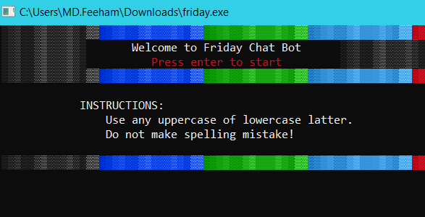
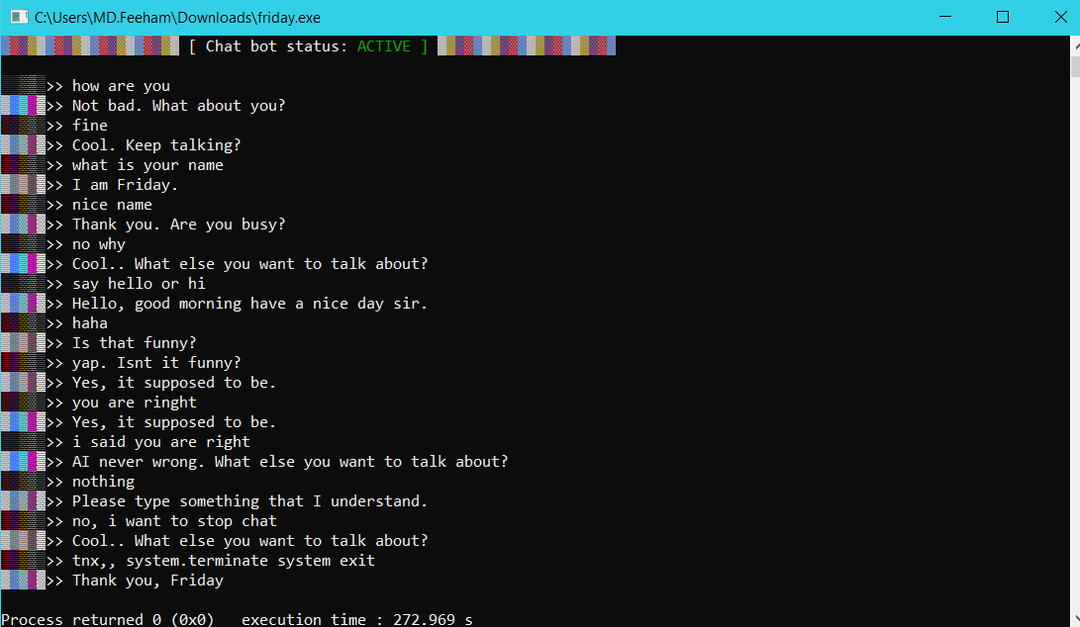

Slide 14
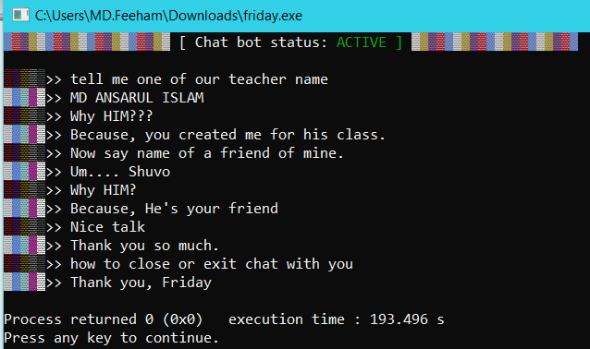
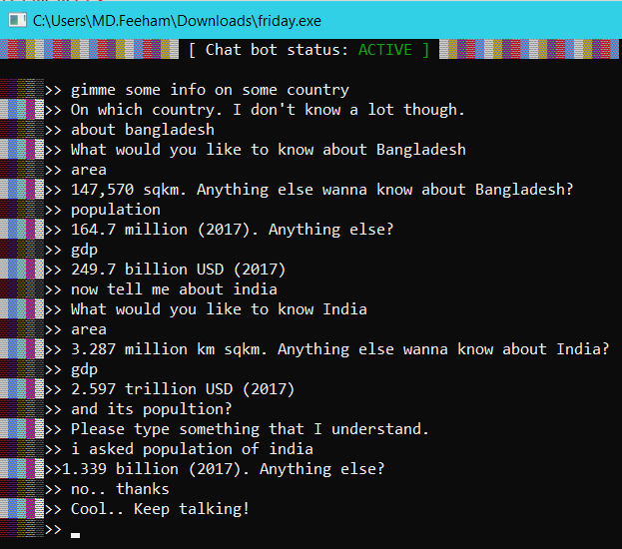

Slide 15
THANK YOU ANY QUESTION?

