Slide 1
Machine learning in biology
Jun. -Prof. Dr. rer. nat. Björn Voß MSc. Fikrat Talibli

Slide 2
Outline
Python programming language
Jupyter Notebook
Data Types
Variables
Control Flow
Libraries for ML
LIVE DEMO

Slide 3
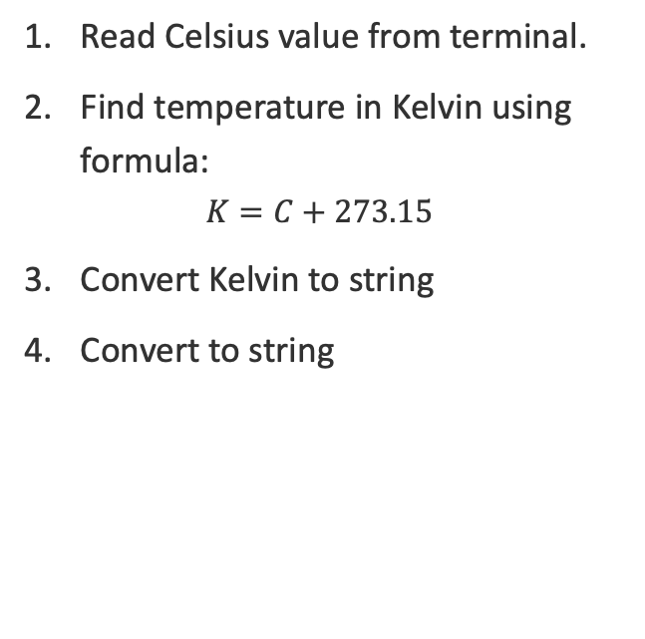
Task 1
Read Celsius value from terminal.
Find temperature in Kelvin using formula:
$$K=C+273.15$$
Convert Kelvin to string
Convert to string

Slide 4
Tools
python3 - programming language
pip3 – package installer with python3
Jupyter Notebook – interactive journal
LIVE DEMO

Slide 5
Data extraction library
Main data extraction and processing libraries are:
matplotlib – plot certain dataset or function
numpy - plot certain dataset or function
pandas – data analysis tools

Slide 11

Acknowledgement
Thank you for your attention!
Thanks to
The group at the IBVT Stuttgart

Slide 12
Back-up slides
BSD

