Slide 1
Machine learning in biology
Jun. -Prof. Dr. rer. nat. Björn Voß MSc. Fikrat Talibli

Slide 2
Outline
Python programming language
Jupyter Notebook
Data Types
Variables
Control Flow
Libraries for ML
LIVE DEMO

Slide 3
Little programs

Slide 4
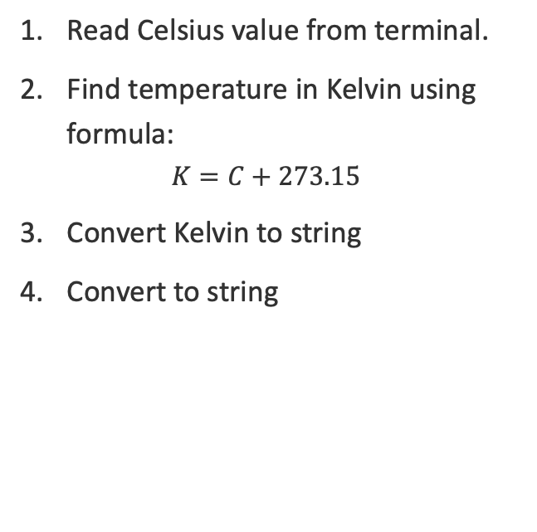
Task 1. Celsius -> Kelvin
Read Celsius value from terminal.
Find temperature in Kelvin using formula:
$$K=C+273.15$$
Convert Kelvin to string
Convert to string

Slide 5

Task 2. Driver license
Input name and age.
if:
age>19 => $“Good news”$
age<19 => $“Sorry”$
start
name(str)
age(int)
age>19
False
True
“Good news”
“Sorry”
end

Slide 6

Acknowledgement
Thank you for your attention!
Thanks to
The group at the IBVT Stuttgart

Slide 7
Back-up slides
BSD

