Slide 1
Predicting Breast Cancer Presence in Cell Nuclei
Tanti Ouattara, Jack Grimm, Mike Shoemake

Slide 2
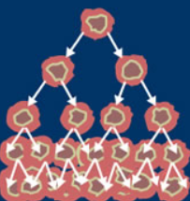
Summary of Intent
To identify key indicators that can consistently predict the presence of breast cancer in cell nuclei
To test the University of Wisconsin, Clinical Sciences Center data set for its machine learning accuracy potential
Build a machine learning model that help predict if a cell is cancerous based on the cell dimensions

Slide 3
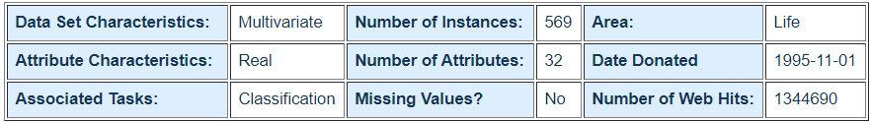
Understanding the Data
Breast Cancer Wisconsin (Diagnostic) Data Set
Features are computed from a digitized image of a fine needle aspirate (FNA) of a breast mass. They describe characteristics of the cell nuclei present in the image.
Data includes 10 real value features computed from each cell’s nucleus. These include:
Radius, texture, perimeter, area, smoothness, compactness, concavity, concave points, symmetry & fractal dimensions
Each feature has three data sets: mean, standard error & worst/largest (mean of the three largest values). These features were computed for each image, resulting in 30 features

Slide 4
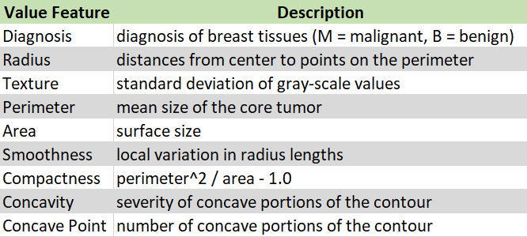
Key Indicators
Our analysis visualized seemingly related features such as:
Area & Symmetry
Radius & Perimeter
Perimeter & Compactness
Concavity & Concave Points

Slide 5
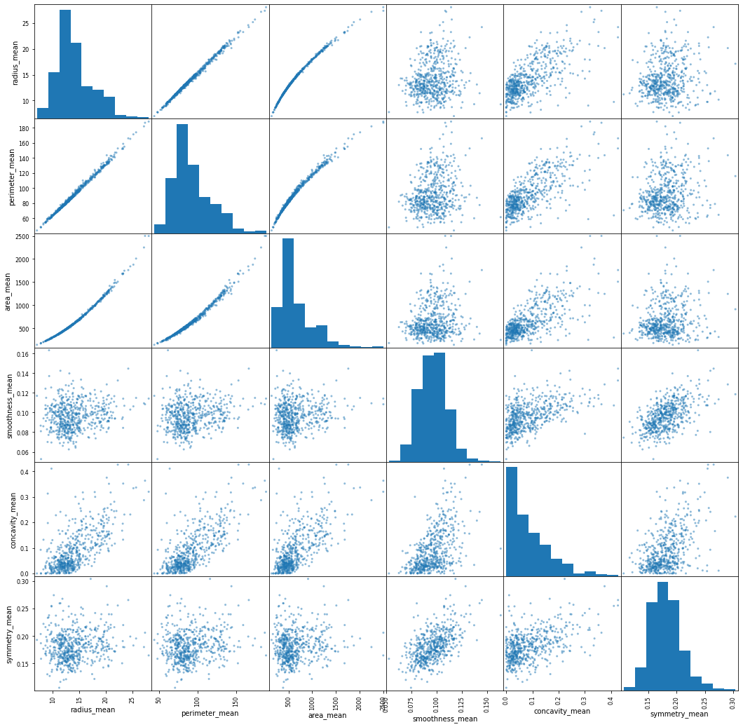
Pair_Scatterplot of some features
Running a pair_scatterplot of some of the

Slide 6
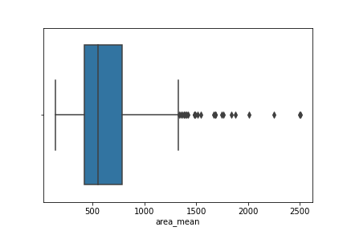
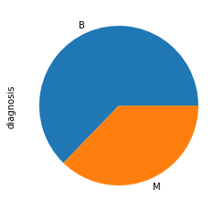
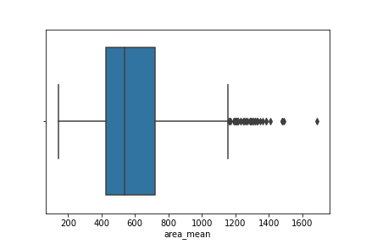
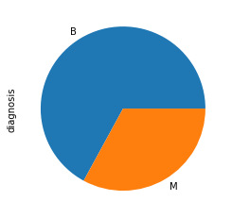
Applying the 3-sigma rule
Before
Before
After
3-sigma limits is a statistical calculation that refers to data within three standard deviations from a mean

Slide 7
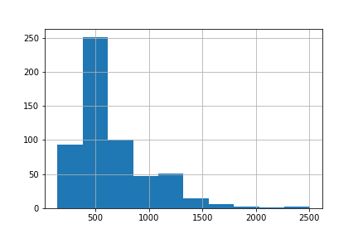
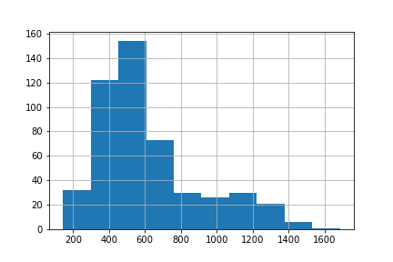
Applying the 3-sigma Rule
Before applying the 3-sigma filter, the histogram was very left skewed, but the filter is not to obtain a normal distribution but we do not think that we should go down to 2 or 1 sigma
Can we use other filters without altering our learning results

Slide 8
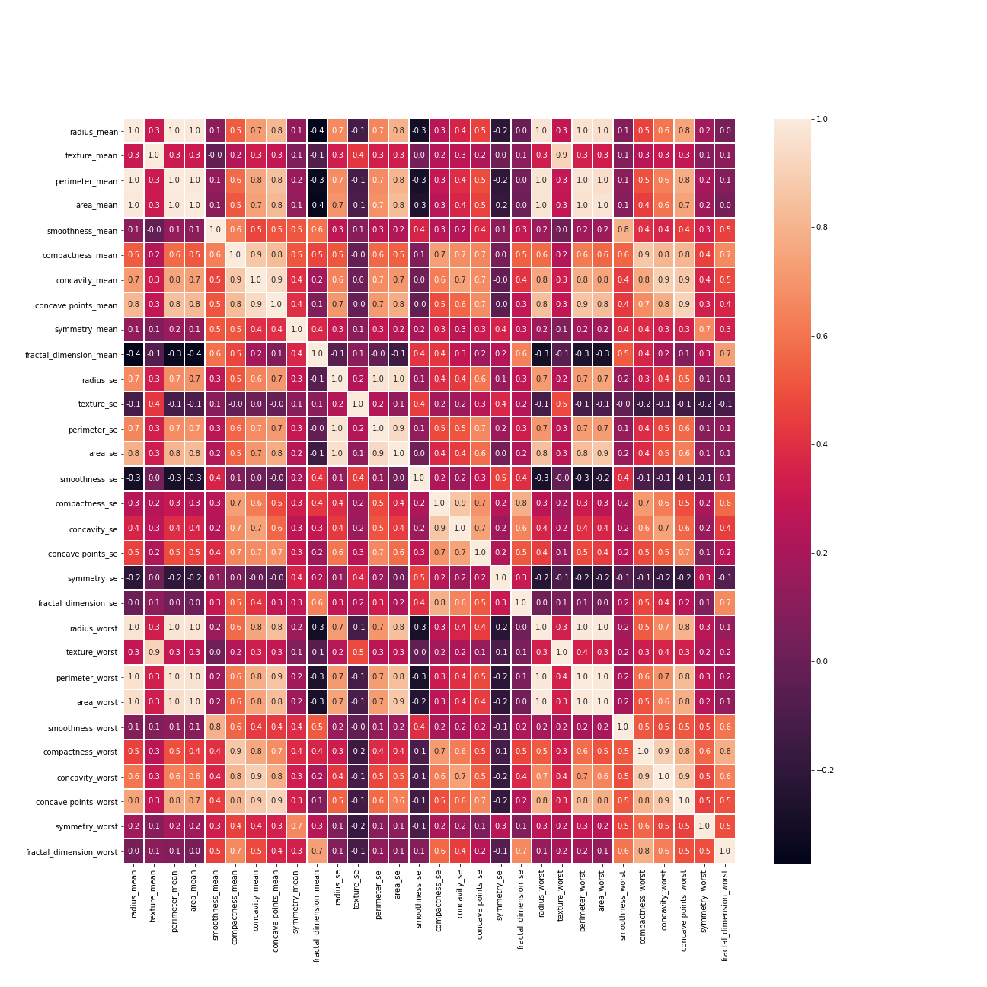
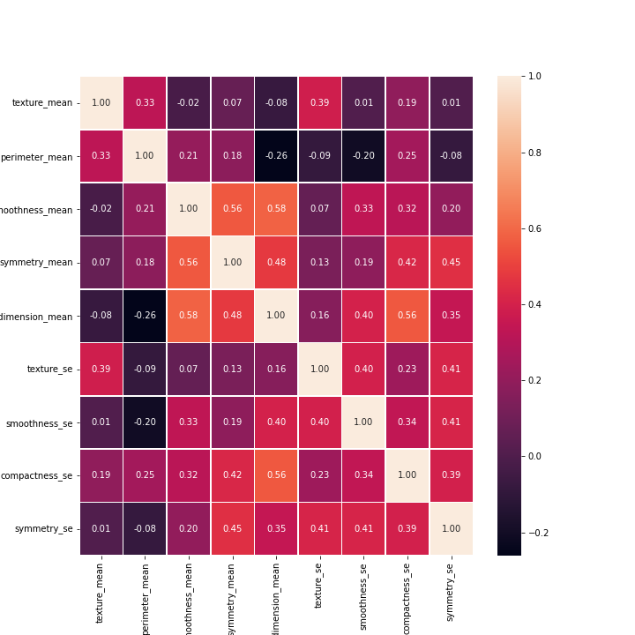
Correlation Matrix
If 2 features or more have a correlation of 0.8 or higher, only one of the features will be retained while dropping the other features

Slide 9
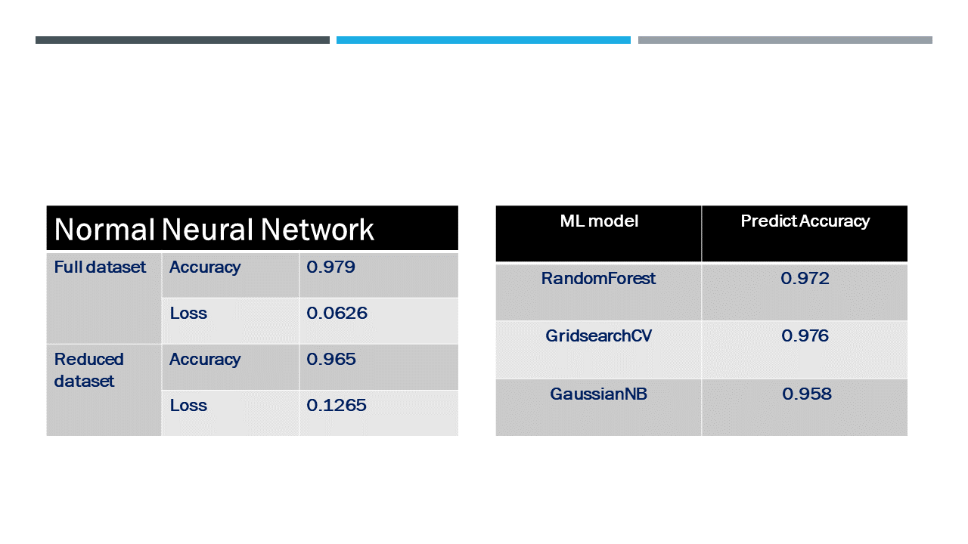
Machine Learning Results

Slide 10

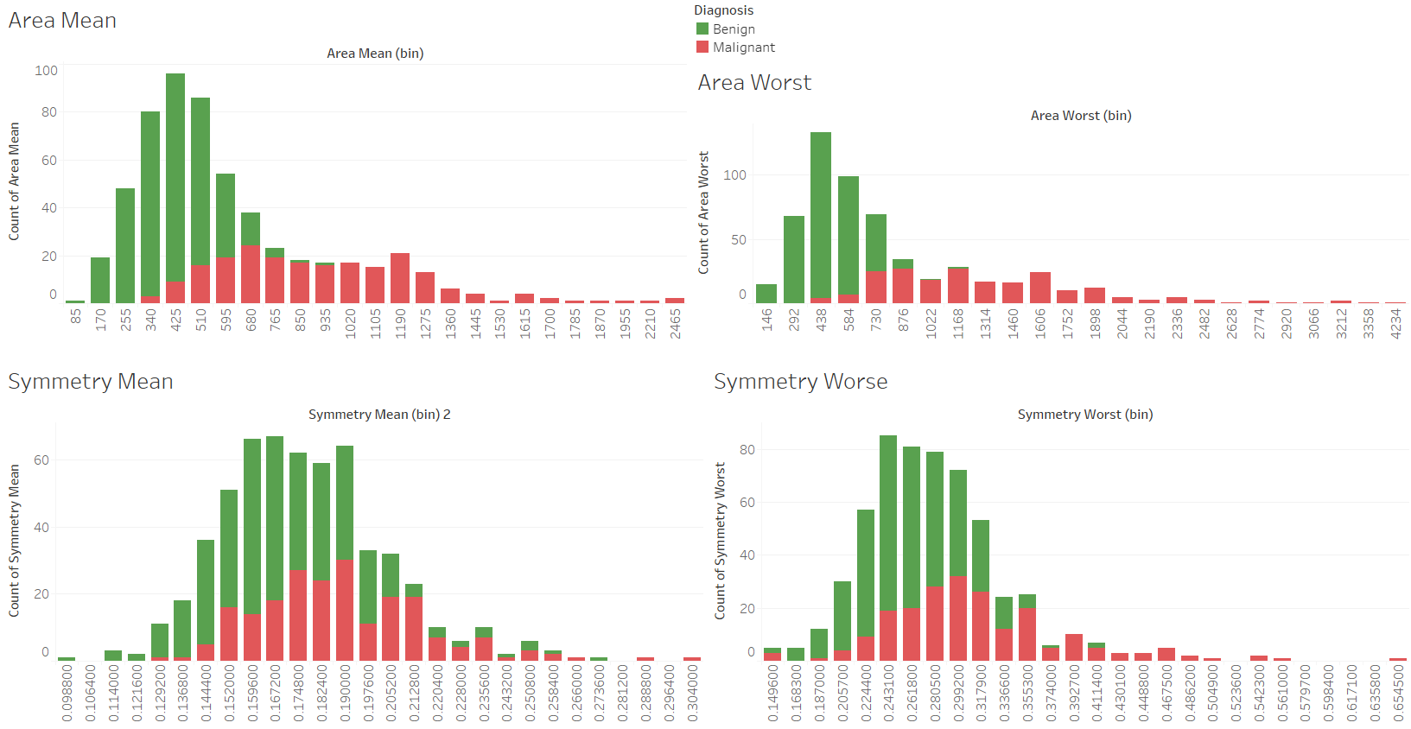
Area & Symmetry
Area Mean highlights a 52% increase in cancerous cells
Area Worst highlights a 60% increase in cancerous cells
Symmetry Mean highlights a 10% increase in cancerous cells
Symmetry Worst highlights a 16% increase in cancerous cells

Slide 11
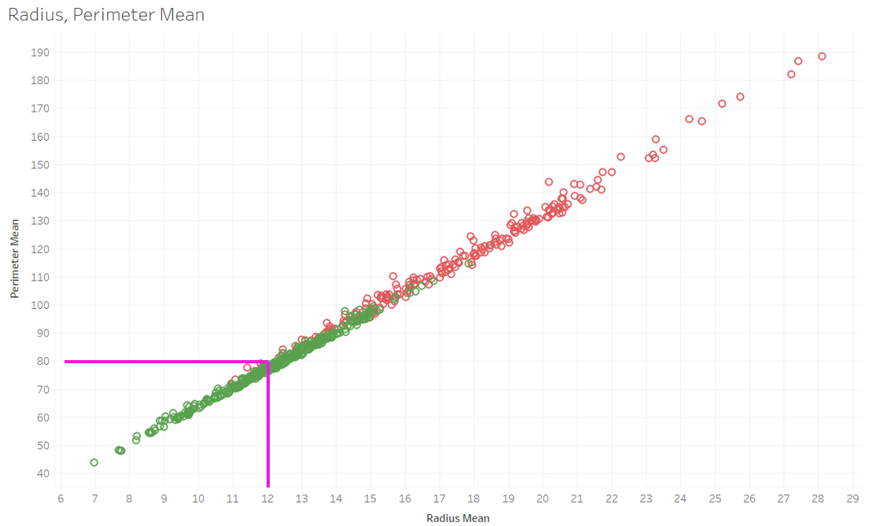
Radius & Perimeter
Sectioning out Perimeter below 80 & Radius below 12, the number of malignant cells drops to only 6 from 36, an 83% drop in malignant cases

Slide 12
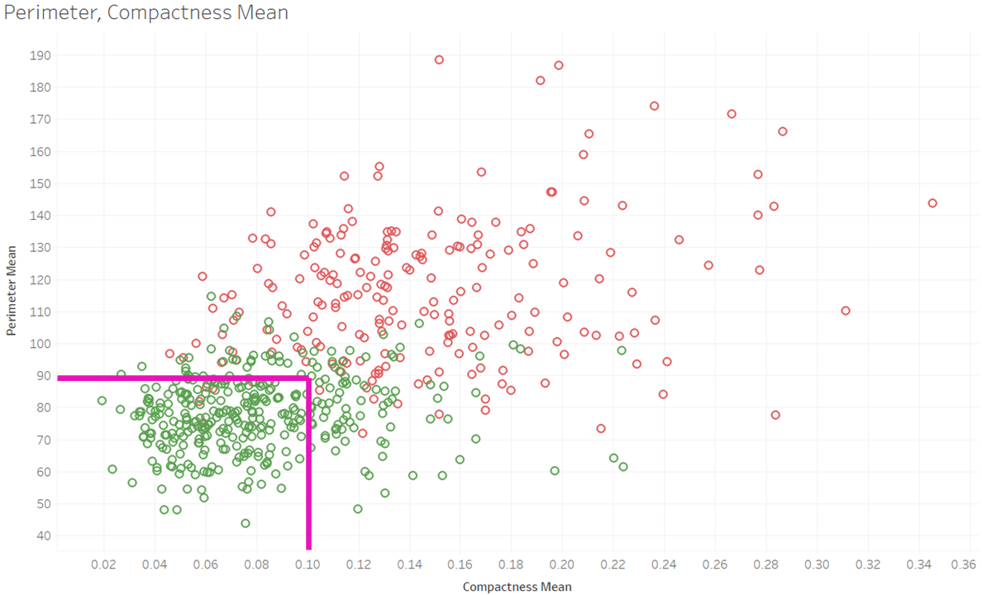
Perimeter & Compactness
Sectioning out Perimeter below 90 & Compactness below 0.10, the number of malignant cells drops to only 6 from 36, an 83% drop in malignant cases

Slide 13
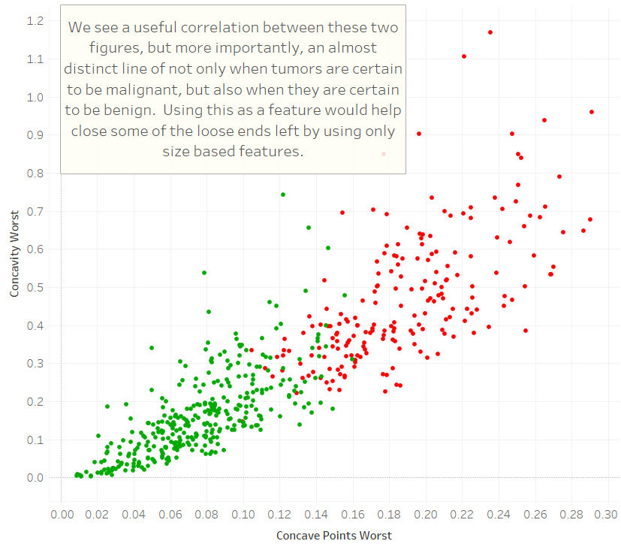
Concavity & Concave Points
Notes:
This forces us to look into qualities of the tumor that disregard the raw size of the tumor. Taking a look first at concavity. Concave points measures the amount of inward slopes on the contour / 100. Concavity measure of course how much of a concave (inward) slope there is (in this particular case, since a singal tumor will likely have more than 1 concave point, a mean is calculated for the concavity of every point. Concavity is the mean of the 3 worst points, and if a tumor doesnt have more than 3 then it is a mean of every point.

Slide 14
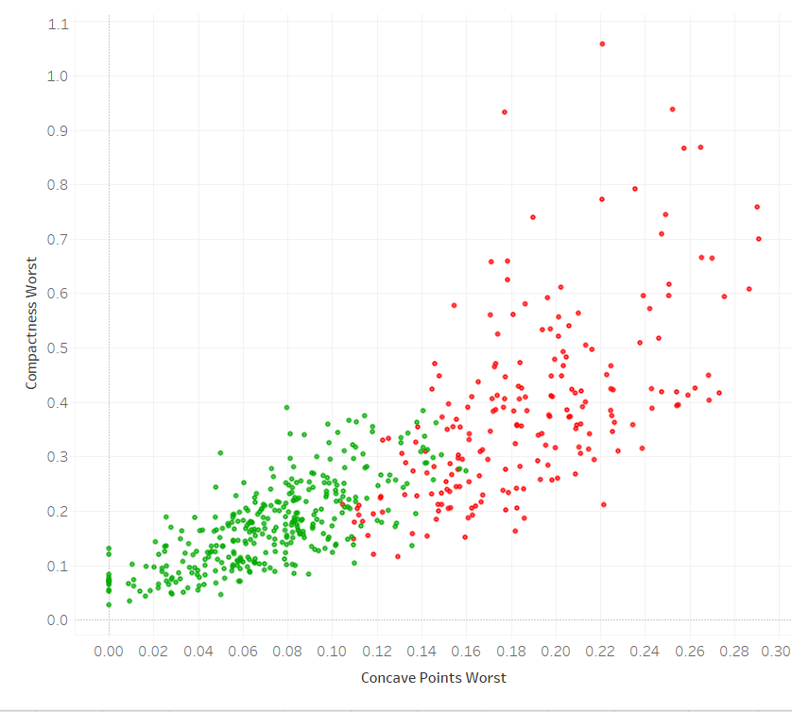
Concave Points v. Compactness
See the full story on non-size based features here:
https://public.tableau.com/profile/jack.grimm#!/vizhome/FinalProject_16029987565340/Story1?publish=yes
Notes:
The final feature which I theorize would complete the neural network for detecting cancerous tumors is compactness, another non-size based attribute. Looking here we see yet another raw cutoff point in which tumors can no longer be benign. This would really fill in any lose ends that is causing a neural network to trip up.

Slide 15
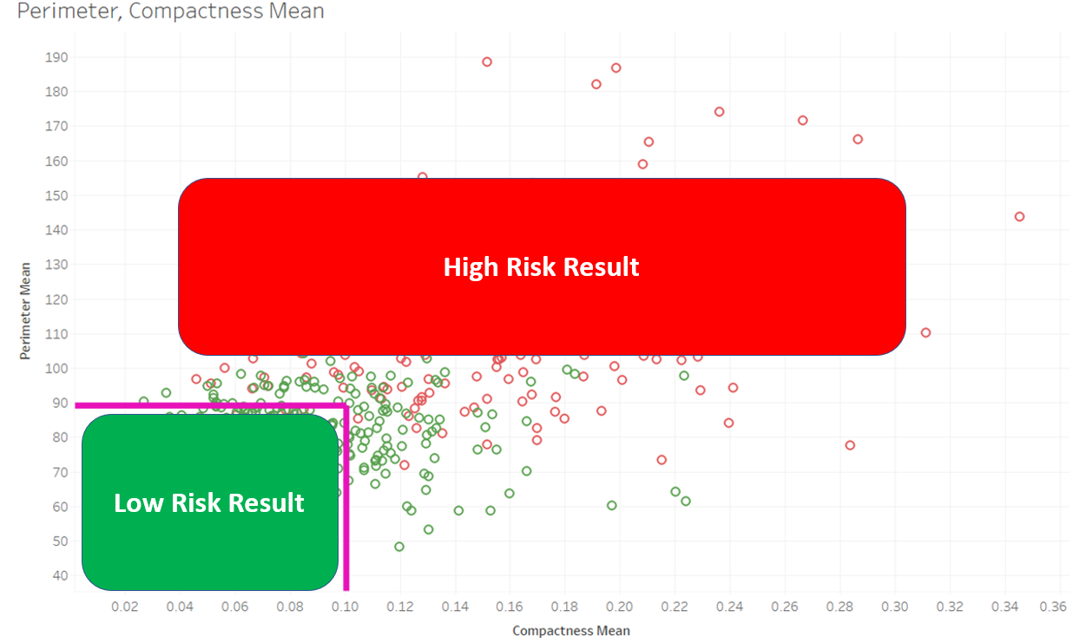
Conclusion
With a machine learning model predictability at 96.5% we see an opportunity to use these key features recorded in future testing as a way to predict breast cancer early so the proper treatments can begin to eliminate the spread.
Additionally, we could develop boundaries as shown when we compared radius & perimeter or compactness & perimeter much like we see today with blood testing, think of cholesterol levels. These boundaries can quickly identify those patients at a higher risk.

