Slide 1
CSS
Usefull to know

Slide 2
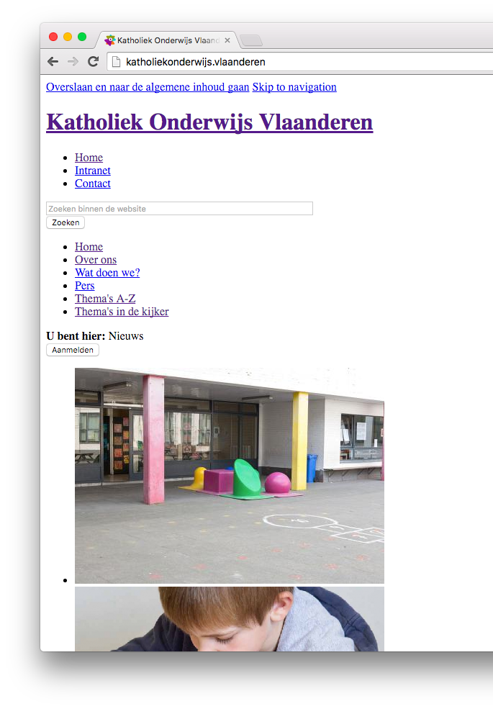
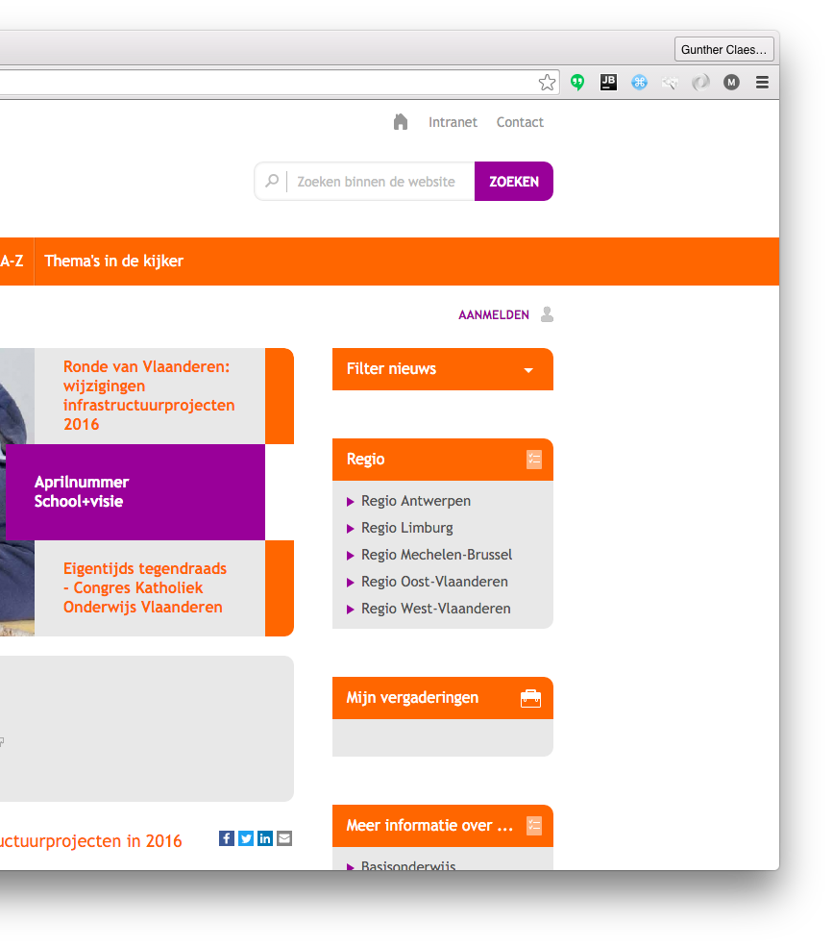
Why?

Slide 3
usage

Slide 4
Inclusions
<link rel="stylesheet" href=”style">
<style>
#container{
color: #FFFFFFF
}
</style>
<div id=“container” style=“color:#FFFFFF”>
Here is some content
</div>

Slide 5
selections
<div id=“container”>
<div class=“item active”>content</div>
<div class=“item”>content</div>
<div class=“item”>content</div>
</div>
#container{
background-color: #F4D82A;
}
.item{
background-color: #FFFFFF;
color: #000000;
}

Slide 6
selections
<div id=“container”>
<div class=“item active”>content</div>
<div class=“item”>content</div>
<div class=“item”>content</div>
</div>
#container .item{
background-color: #FFFFFF;
color: #000000;
}

Slide 7
selections
<div id=“container”>
<div class=“item active”>content</div>
<div class=“item”>content</div>
<div class=“item”>content</div>
</div>
#container .item{
background-color: #FFFFFF;
color: #000000;
}

Slide 8
selections
<div id=“container”>
<div class=“item active”>content</div>
<div class=“item”>content</div>
<div class=“item”>content</div>
</div>
.item{
background-color: #FFFFFF;
color: #000000;
}
.item.active{
color: #F4D82A;
}

Slide 9
selections
a {
color:#000000;
}

Slide 10
Margin vs padding

Slide 11
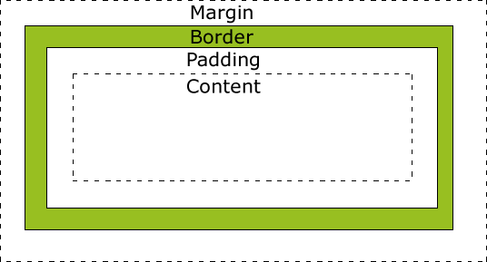
height
width

Slide 12
Fill

Slide 13

Notation
padding: 80px 30px 35px 10px;
padding-top: 80px;
padding-right:30px;
padding-bottom:35px;
Padding-left: 10px;

Slide 14
Border
border: 2px solid #bd238b;
border-bottom: 2px solid #bd238b;

Slide 15
Responsive
“this is so difficult”

Slide 16
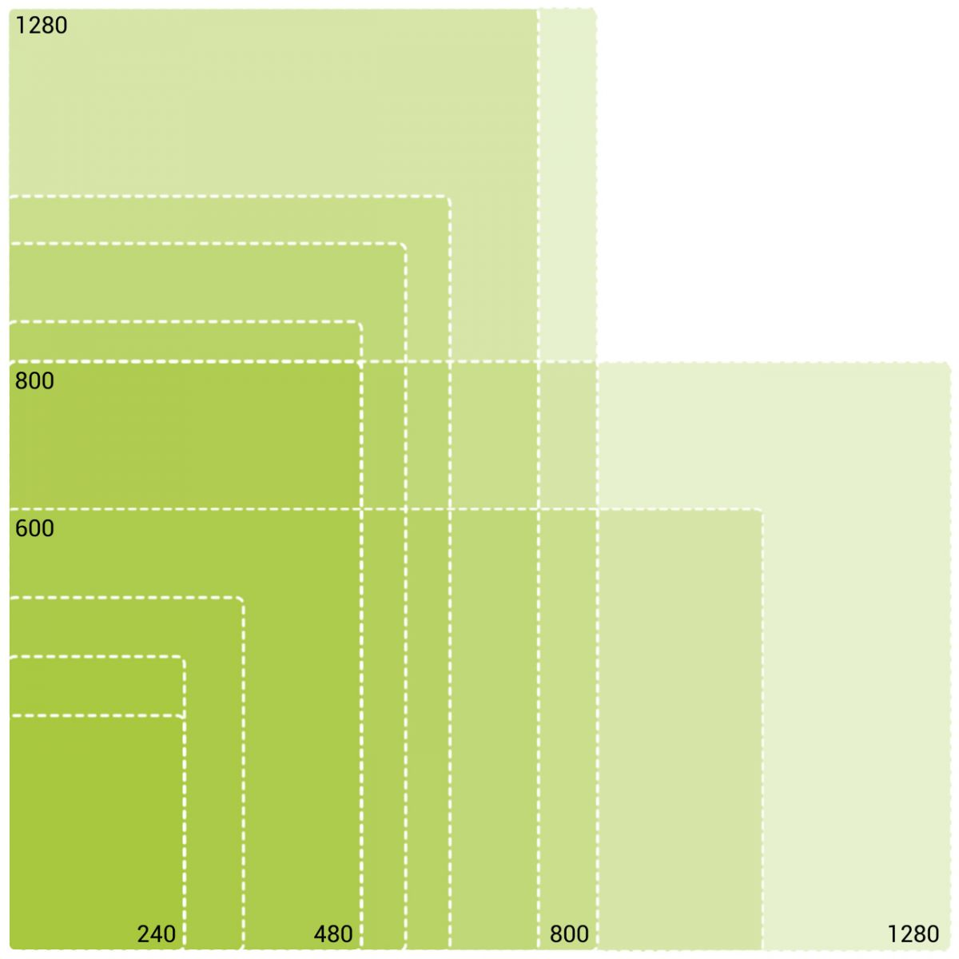

Slide 17
Px vs em
An em unit is a relative unit of measurement based on the parent element.
1em = fontsize
2em = 2 x fontzize

Slide 18
Px vs em
body{
font: 100%/1.5 serif; /* 16px */
} h1{
font-size: 2em; /* 32px */
} @media (min-width: 600px) { body {
font: 112.5%; /* 18px */
} h1 {
/* Do nothing! I'll automatically be 36px */
} }

Slide 19
Media-queries
.item{
background-color: #FFFFFF;
color: #000000;
}
@media (min-width: 768px) {
.item{
background-color: #3FDFDF;
}
}

Slide 20
Animations

Slide 21
transitions
.item{
background-color: #FFFFFF;
color: #000000;
}
.item.active{
color: #F4D82A;
}

Slide 22
transitions
.item{
background-color: #FFFFFF;
color: #000000;
transition: color 0.7s; }
.item.active{
color: #F4D82A;
}

Slide 23
transitions
.item{
background-color: #FFFFFF;
color: #000000;
transition: all 0.7s; }
.item.active{
color: #F4D82A;
}

Slide 24
Animations
.cirkel-holder #doughnut1{ -webkit-animation: spin 12s infinite linear; } @-webkit-keyframes spin { 0% { -webkit-transform: rotate(0deg);} 100% { -webkit-transform: rotate(360deg);} }

Slide 25
Positioning

Slide 26
Postition
static
relative
fixed
absolute

Slide 27
Position: static

Slide 28
Position: static
left:30px;

Slide 29
Position: relative

Slide 30
Position: relative
left:30px;

Slide 31
Position: fixed

Slide 32
Position: absolute

Slide 33
Position: absolute
left:30px;

Slide 34
Position: absolute
is positioned relative to the nearest positioned ancestor

Slide 35
float

Slide 36
Float
float: left;

Slide 37
Float
float: right;

Slide 38
Overflow
overflow: visible;

Slide 39
Overflow
overflow: hidden;

Slide 40
Overflow
overflow: scroll;

Slide 41
Overflow
y
overflow-x: scroll;
overflow-y: hidden;
x

Slide 42
Selections
But more complex

Slide 43
SELECTIONS
div, p{
… }
Selects all <div> elements and all <p> elements

Slide 44
SELECTIONS
div p{
… }
Selects all <p> elements inside <div> elements

Slide 45
SELECTIONS
div > p{
… }
Selects all <p> elements where the parent is a <div> element

Slide 46
SELECTIONS
div + p{
… }
Selects all <p> elements that are placed immediately after <div> elements

Slide 47
hover
a:hover{
color: #F4E3AA }

Slide 48
atributes
[ng-click]{
text-decoration: underline; }
#menu .item[ng-click]{
text-decoration: underline; }
[attribute=”value”]{
text-decoration: underline; }

Slide 49
Pseudo-elements
.item:first-child{
border-top-left-radius: 4px;
border-top-right-radius: 4px;
}
.item:last-child{
border-bottom-left-radius: 4px;
border-bottom-right-radius: 4px;
}

Slide 50
Going complex
Making things easier

Slide 51
Engine prefix
-webkit-animation: spin 12s infinite linear; -moz-animation: spin 12s infinite linear; -o-animation: spin 12s infinite linear; -ms-animation: spin 12s infinite linear;
animation: spin 12s infinite linear;
These browser prefixes are needed as the browsers experiment and test out their implementations of the newer CSS3 properties. Sometimes all the prefixes are not always needed, but it usually does not hurt to include them, as long as you make sure to put the non-prefixed version last.

Slide 52
Sass & less & …
#container{
background-color: #F4D82A;
.item{
background-color: #FFFFFF;
color: #000000;
transition: all 0.7s;
}
}

Slide 53
Sass
$primary-color: # F4D82A;
#container{
background-color: $primary-color;
.item{
background-color: #FFFFFF;
color: #000000;
transition: all 0.7s;
}
}

Slide 54
Playtime

Slide 55

ZILL navbar
Stays on top, even on scroll
Menu disappears on small screen
“support” is hovered
“bib” is active
on hover gray fades in

Slide 56
GITHUB
github.com/feelitloveit/cssworkshop

Slide 57
QUESTIONS?
guntherclaes@lemonade.be
@guntherclaes on slack

