Slide 1
CSS
Usefull to know

Slide 2
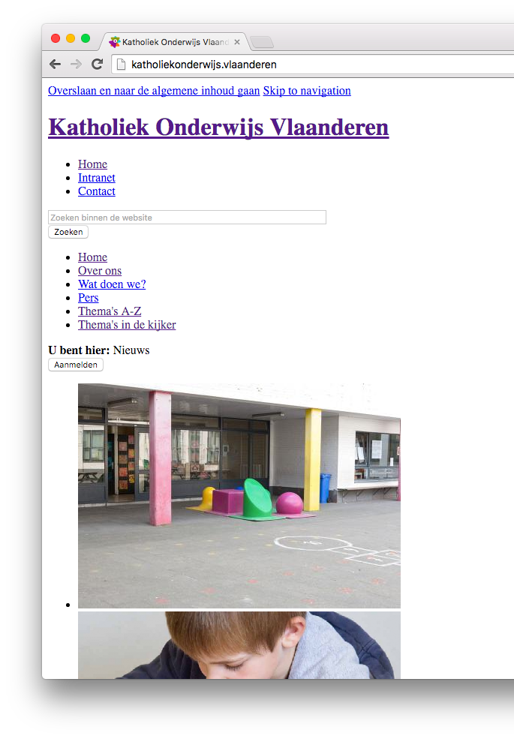
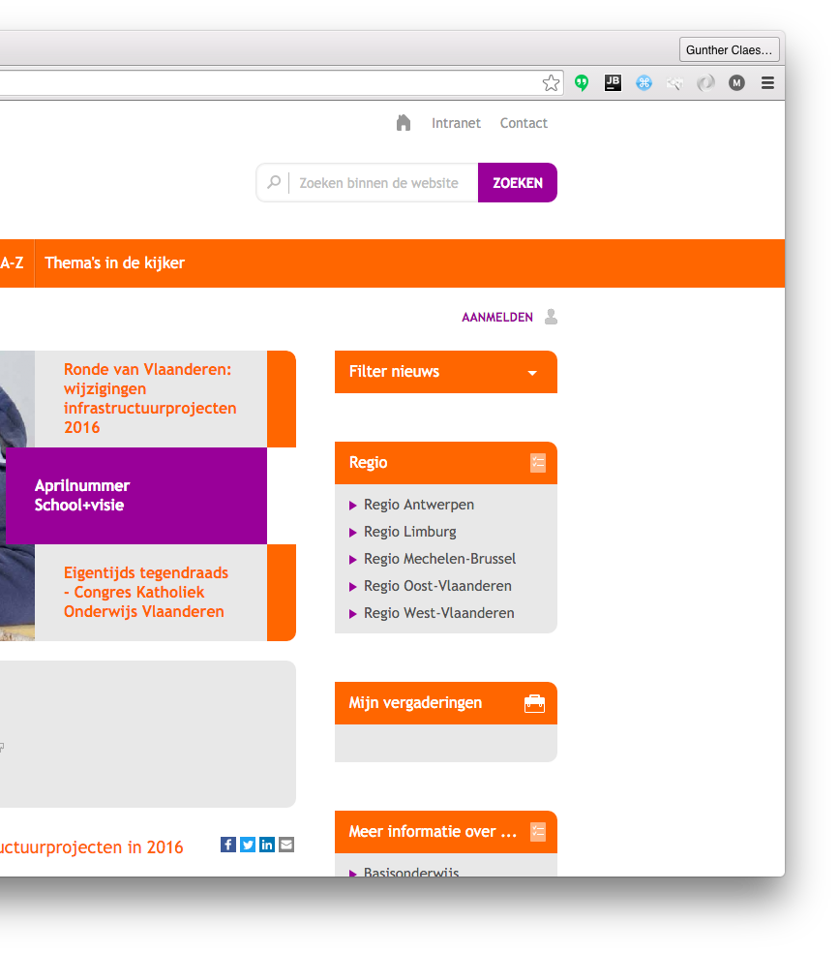
Why?

Slide 3
usage

Slide 4
Inclusions
<link rel="stylesheet" href=”style">
<style>
#container{
color: #FFFFFFF
}
</style>
<div id=“container” style=“color:#FFFFFF”>
Here is some content
</div>

Slide 5
selections
<div id=“container”>
<div class=“item active”>content</div>
<div class=“item”>content</div>
<div class=“item”>content</div>
</div>
#container{
background-color: #F4D82A;
}
.item{
background-color: #FFFFFF;
color: #000000;
}

Slide 6
selections
<div id=“container”>
<div class=“item active”>content</div>
<div class=“item”>content</div>
<div class=“item”>content</div>
</div>
#container .item{
background-color: #FFFFFF;
color: #000000;
}

Slide 7
selections
<div id=“container”>
<div class=“item active”>content</div>
<div class=“item”>content</div>
<div class=“item”>content</div>
</div>
#container .item{
background-color: #FFFFFF;
color: #000000;
}

Slide 8
selections
<div id=“container”>
<div class=“item active”>content</div>
<div class=“item”>content</div>
<div class=“item”>content</div>
</div>
.item{
background-color: #FFFFFF;
color: #000000;
}
.item.active{
color: #F4D82A;
}

Slide 9
selections
a {
color:#000000;
}

Slide 10
Margin vs padding

Slide 11
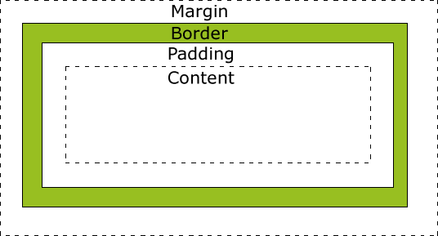
height
Fill
width

Slide 12

Notation
padding: 80px 30px 35px 10px;
padding-top: 80px;
padding-right:30px;
padding-bottom:35px;
Padding-left: 10px;

Slide 13
Border
border: 2px solid #bd238b;
border-bottom: 2px solid #bd238b;

Slide 14
Animations

Slide 15
Media-queries
.item{
background-color: #FFFFFF;
color: #000000;
}
@media (min-width: 768px) {
.item{
background-color: #3FDFDF;
}
}

Slide 16
transitions
.item{
background-color: #FFFFFF;
color: #000000;
}
.item.active{
color: #F4D82A;
}

Slide 17
transitions
.item{
background-color: #FFFFFF;
color: #000000;
transition: color 0.7s; }
.item.active{
color: #F4D82A;
}

Slide 18
transitions
.item{
background-color: #FFFFFF;
color: #000000;
transition: all 0.7s; }
.item.active{
color: #F4D82A;
}

Slide 19
Animations
.cirkel-holder #doughnut1{ -webkit-animation: spin 12s infinite linear; } @-webkit-keyframes spin { 0% { -webkit-transform: rotate(0deg);} 100% { -webkit-transform: rotate(360deg);} }

Slide 20
Positioning

Slide 21
Postition
static
relative
fixed
absolute

Slide 22
Position: static

Slide 23
Position: static
left:30px;

Slide 24
Position: relative

Slide 25
Position: relative
left:30px;

Slide 26
Position: fixed

Slide 27
Position: absolute

Slide 28
Position: absolute
left:30px;

Slide 29
Position: absolute
is positioned relative to the nearest positioned ancestor

Slide 30
float

Slide 31
Float
float: left;

Slide 32
Float
float: right;

Slide 33
Overflow
overflow: visible;

Slide 34
Overflow
overflow: hidden;

Slide 35
Overflow
overflow: scroll;

Slide 36
Overflow
y
overflow-x: scroll;
overflow-y: hidden;
x

Slide 37
Selections
But more complex

Slide 38
SELECTIONS
div, p{
… }
Selects all <div> elements and all <p> elements

Slide 39
SELECTIONS
div p{
… }
Selects all <p> elements inside <div> elements

Slide 40
SELECTIONS
div > p{
… }
Selects all <p> elements where the parent is a <div> element

Slide 41
SELECTIONS
div + p{
… }
Selects all <p> elements that are placed immediately after <div> elements

Slide 42
hover
a:hover{
color: #F4E3AA }

Slide 43
atributes
[ng-click]{
text-decoration: underline; }
#menu .item[ng-click]{
text-decoration: underline; }
[attribute=”value”]{
text-decoration: underline; }

Slide 44
Pseudo-elements
.item:first-child{
border-top-left-radius: 4px;
border-top-right-radius: 4px;
}
.item:last-child{
border-bottom-left-radius: 4px;
border-bottom-right-radius: 4px;
}

Slide 45
FUTURE
Already reality

Slide 46
Engine prefix
-webkit-animation: spin 12s infinite linear; -moz-animation: spin 12s infinite linear; -o-animation: spin 12s infinite linear; -ms-animation: spin 12s infinite linear;
animation: spin 12s infinite linear;
These browser prefixes are needed as the browsers experiment and test out their implementations of the newer CSS3 properties. Sometimes all the prefixes are not always needed, but it usually does not hurt to include them, as long as you make sure to put the non-prefixed version last.

Slide 47
Sass & less & …
#container{
background-color: #F4D82A;
.item{
background-color: #FFFFFF;
color: #000000;
transition: all 0.7s;
}
}

Slide 48
Sass
$primary-color: # F4D82A;
#container{
background-color: $primary-color;
.item{
background-color: #FFFFFF;
color: #000000;
transition: all 0.7s;
}
}

Slide 49
Playtime

Slide 50

ZILL navbar
Stays on top, even on scroll
Menu disapears on small screen
“support” is hovered
“bib” is active

Slide 51
GITHUB
github.com/feelitloveit/cssworkshop

Slide 52
QUESTIONS?
guntherclaes@lemonade.be
@guntherclaes on slack

