Slide 1
CSS
Usefull to know

Slide 2
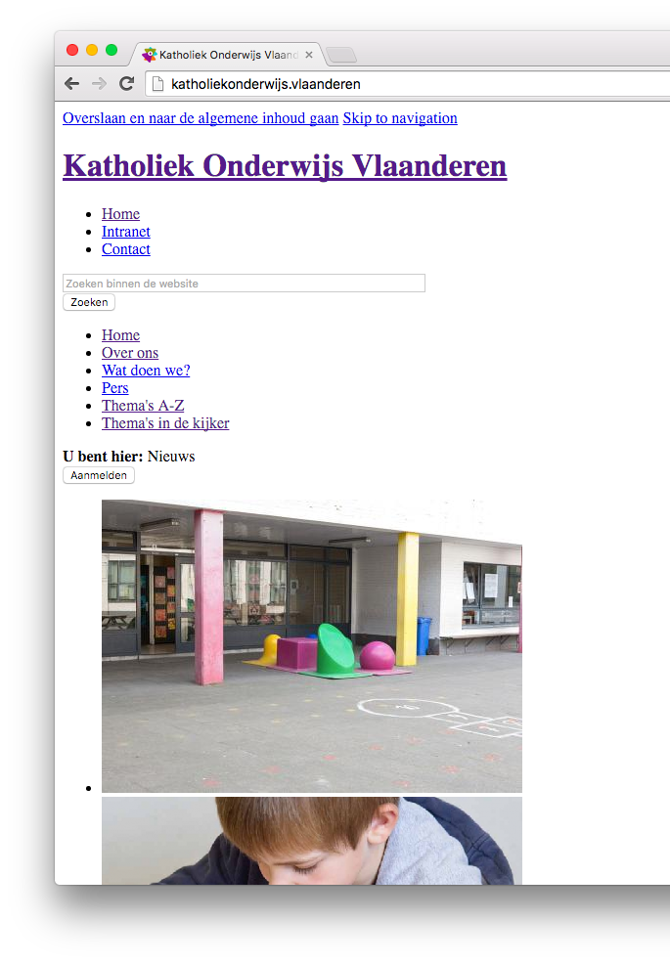
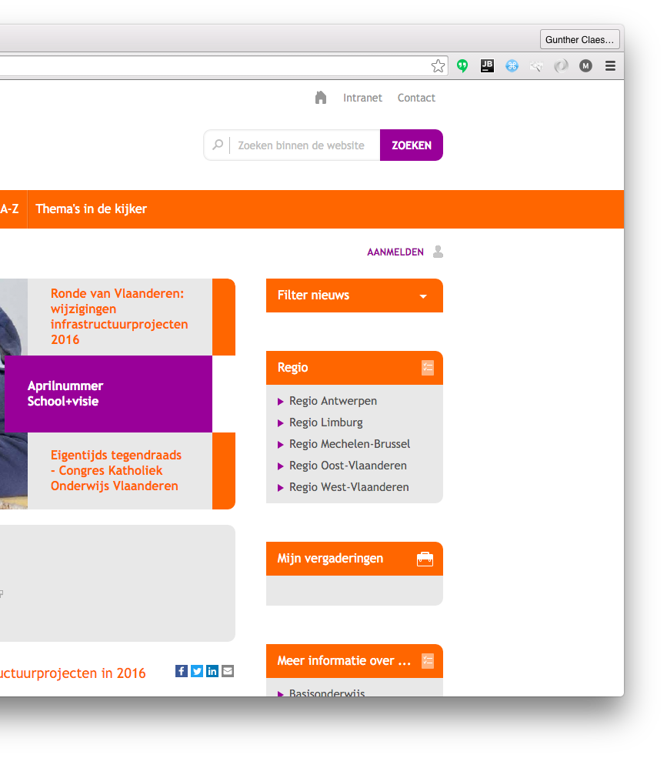
Why?

Slide 3
usage

Slide 4
Inclusions
<link rel="stylesheet" href=”style">
<style>
#container{
color: #FFFFFFF
}
</style>
<div id=“container” style=“color:#FFFFFF”>
Here is some content
</div>

Slide 5
selections
<div id=“container”>
<div class=“item active”>content</div>
<div class=“item”>content</div>
<div class=“item”>content</div>
</div>
#container{
background-color: #F4D82A;
}
.item{
background-color: #FFFFFF;
color: #000000;
}

Slide 6
selections
<div id=“container”>
<div class=“item active”>content</div>
<div class=“item”>content</div>
<div class=“item”>content</div>
</div>
#container .item{
background-color: #FFFFFF;
color: #000000;
}

Slide 7
selections
<div id=“container”>
<div class=“item active”>content</div>
<div class=“item”>content</div>
<div class=“item”>content</div>
</div>
#container .item{
background-color: #FFFFFF;
color: #000000;
}

Slide 8
selections
<div id=“container”>
<div class=“item active”>content</div>
<div class=“item”>content</div>
<div class=“item”>content</div>
</div>
.item{
background-color: #FFFFFF;
color: #000000;
}
.item.active{
color: #F4D82A;
}

Slide 9
selections
a {
color:#000000;
}

Slide 10
Margin vs padding

Slide 11
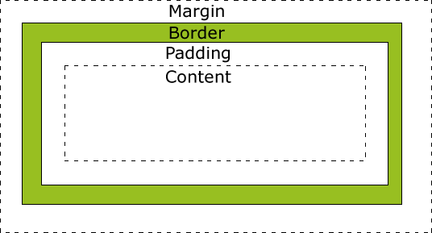
height
width

Slide 12
Fill

Slide 13

Notation
padding: 80px 30px 35px 10px;
padding-top: 80px;
padding-right:30px;
padding-bottom:35px;
Padding-left: 10px;

Slide 14
Border
border: 2px solid #bd238b;
border-bottom: 2px solid #bd238b;

Slide 15
Animations

Slide 16
Media-queries
.item{
background-color: #FFFFFF;
color: #000000;
}
@media (min-width: 768px) {
.item{
background-color: #3FDFDF;
}
}

Slide 17
transitions
.item{
background-color: #FFFFFF;
color: #000000;
}
.item.active{
color: #F4D82A;
}

Slide 18
transitions
.item{
background-color: #FFFFFF;
color: #000000;
transition: color 0.7s; }
.item.active{
color: #F4D82A;
}

Slide 19
transitions
.item{
background-color: #FFFFFF;
color: #000000;
transition: all 0.7s; }
.item.active{
color: #F4D82A;
}

Slide 20
Animations
.cirkel-holder #doughnut1{ -webkit-animation: spin 12s infinite linear; } @-webkit-keyframes spin { 0% { -webkit-transform: rotate(0deg);} 100% { -webkit-transform: rotate(360deg);} }

Slide 21
Positioning

Slide 22
Postition
static
relative
fixed
absolute

Slide 23
Position: static

Slide 24
Position: static
left:30px;

Slide 25
Position: relative

Slide 26
Position: relative
left:30px;

Slide 27
Position: fixed

Slide 28
Position: absolute

Slide 29
Position: absolute
left:30px;

Slide 30
Position: absolute
is positioned relative to the nearest positioned ancestor

Slide 31
float

Slide 32
Float
float: left;

Slide 33
Float
float: right;

Slide 34
Overflow
overflow: visible;

Slide 35
Overflow
overflow: hidden;

Slide 36
Overflow
overflow: scroll;

Slide 37
Overflow
y
overflow-x: scroll;
overflow-y: hidden;
x

Slide 38
Selections
But more complex

Slide 39
SELECTIONS
div, p{
… }
Selects all <div> elements and all <p> elements

Slide 40
SELECTIONS
div p{
… }
Selects all <p> elements inside <div> elements

Slide 41
SELECTIONS
div > p{
… }
Selects all <p> elements where the parent is a <div> element

Slide 42
SELECTIONS
div + p{
… }
Selects all <p> elements that are placed immediately after <div> elements

Slide 43
hover
a:hover{
color: #F4E3AA }

Slide 44
atributes
[ng-click]{
text-decoration: underline; }
#menu .item[ng-click]{
text-decoration: underline; }
[attribute=”value”]{
text-decoration: underline; }

Slide 45
Pseudo-elements
.item:first-child{
border-top-left-radius: 4px;
border-top-right-radius: 4px;
}
.item:last-child{
border-bottom-left-radius: 4px;
border-bottom-right-radius: 4px;
}

Slide 46
FUTURE
Already reality

Slide 47
Engine prefix
-webkit-animation: spin 12s infinite linear; -moz-animation: spin 12s infinite linear; -o-animation: spin 12s infinite linear; -ms-animation: spin 12s infinite linear;
animation: spin 12s infinite linear;
These browser prefixes are needed as the browsers experiment and test out their implementations of the newer CSS3 properties. Sometimes all the prefixes are not always needed, but it usually does not hurt to include them, as long as you make sure to put the non-prefixed version last.

Slide 48
Sass & less & …
#container{
background-color: #F4D82A;
.item{
background-color: #FFFFFF;
color: #000000;
transition: all 0.7s;
}
}

Slide 49
Sass
$primary-color: # F4D82A;
#container{
background-color: $primary-color;
.item{
background-color: #FFFFFF;
color: #000000;
transition: all 0.7s;
}
}

Slide 50
Playtime

Slide 51

ZILL navbar
Stays on top, even on scroll
Menu disappears on small screen
“support” is hovered
“bib” is active
on hover gray fades in

Slide 52
GITHUB
github.com/feelitloveit/cssworkshop

Slide 53
QUESTIONS?
guntherclaes@lemonade.be
@guntherclaes on slack

