Slide 1

PARALLEL PROGRAMMING...
Copyright 2023 Patrick Lemoine. All rights reserved.

Slide 2

Parallel Programming: Overview
SESSION 3/6
GOAL
Programming Interface for parallel computing
Hybrid = OpenMP (Open Multi-Processing) + MPI (Message Passing Interface)
병렬 컴퓨팅을 위한 프로그래밍
인터페이스

Slide 3

Hybrid MPI and OpenMP
Hybrid application programs using MPI + OpenMP are now common place on large HPC systems.
There are basically two main motivations:
1. Reduced memory footprint, both in the application and in the MPI library (eg communication buffers).
2. Improved performance, especially at high core counts where pure MPI scalability runs out.

Slide 4
Hybrid MPI and OpenMP
Parallel programming models
Parallel execution is based on threads or processes (or both) which run at the same time on different CPU cores
Processes
- Interaction is based on exchanging messages between processes
- MPI (Message passing interface)
Threads
- Interaction is based on shared memory, i.e. each thread can access directly other threads data
- OpenMP

Slide 5
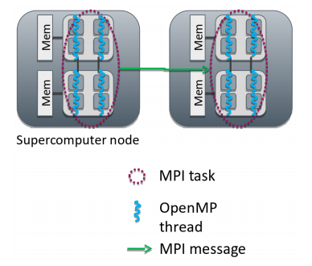
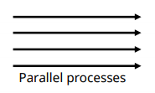
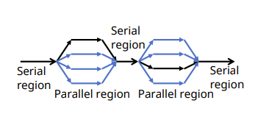
Hybrid MPI and OpenMP
1: MPI: Processes
- Independent execution units
- Have their own memory space
- MPI launches N processes at application startup
- Works over multiple nodes
2: OpenMP: Threads
- Threads share memory space
- Threads are created and destroyed (parallel regions)
- Limited to a single node
3: Hybrid programming: Launch threads (OpenMP) within processes (MPI)
- Shared memory programming inside a node, message passing between nodes
- Optimum MPI task per node ratio depends on the application and should always be experimented.

Slide 6
The Best From Both Worlds
MPI allows for inter-node communication.
MPI facilitates efficient inter-node reductions and sending of complex data structures.
Program state synchronization is explicit.
OpenMP allows for high performance intra-node threading.
OpenMP provides an interface for the concurrent utilization of each SMP's shared memory;
Program state synchronization is implicit.

Slide 7
Hybrid Programming
In hybrid programming each process can have multiple threads executing simultaneously
All threads within a process share all MPI objects Communicators, requests, etc.
MPI defines 4 levels of thread safety:
MPI_THREAD_SINGLE : One thread exists in program
MPI_THREAD_FUNNELED : Multithreaded but only the master thread can make MPI calls Master is one that calls MPI_Init_thread()
MPI_THREAD_SERIALIZED: Multithreaded, but only one thread can make MPI calls at a time
MPI_THREAD_MULTIPLE: Multithreaded and any thread can make MPI calls at any time. Use MPI_Init_thread instead of MPI_Init if more than single thread

Slide 8


Hybrid Programming
Potential advantages of the hybrid approach
Fewer MPI processes for a given amount of cores
- Improved load balance
- All-to-all communication bottlenecks alleviated
Decreased memory consumption if an implementation uses replicated data
Additional parallelization levels may be available
Possibility for dedicating threads for different tasks
- e.g. dedicated communication thread or parallel I/O
Dynamic parallelization patterns often easier to implement with OpenMP
Disadvantages of hybridization
Increased overhead from thread creation/destruction
More complicated programming
- Code readability and maintainability issues
Thread support in MPI and other libraries needs to be considered

Slide 9



Hybrid Examples

Slide 10


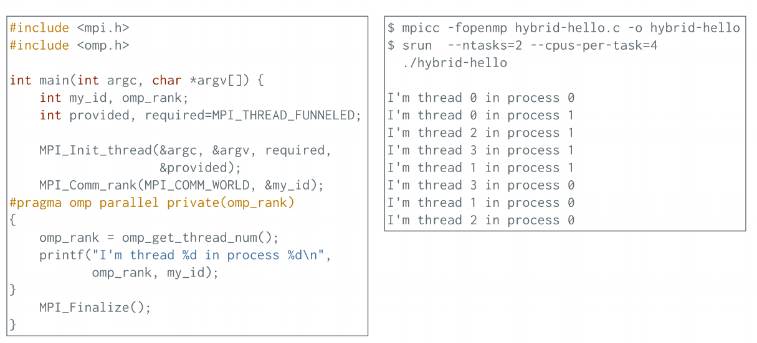
Hybrid Programming: Example

Slide 11
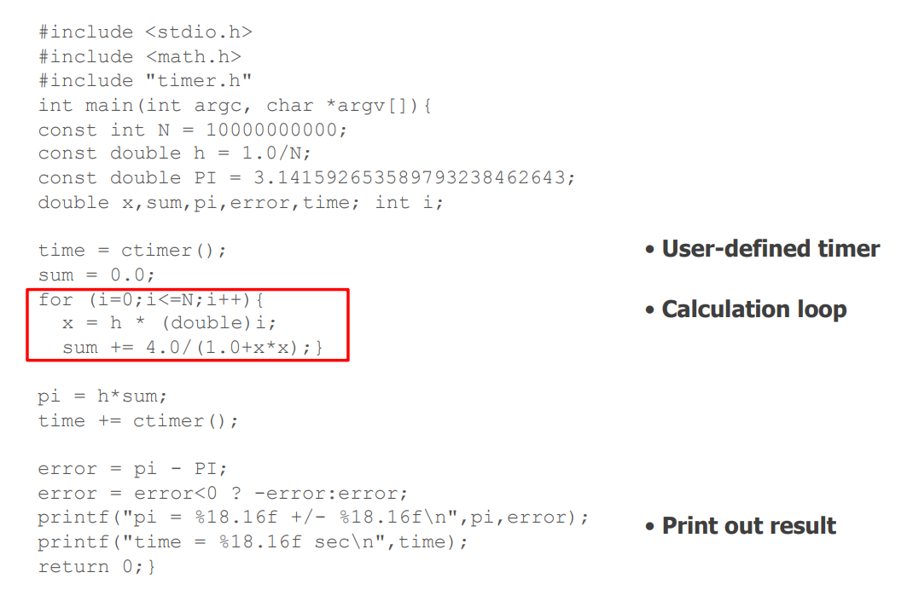
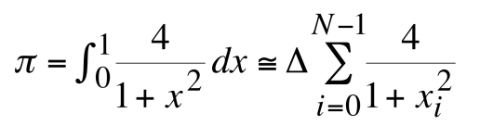
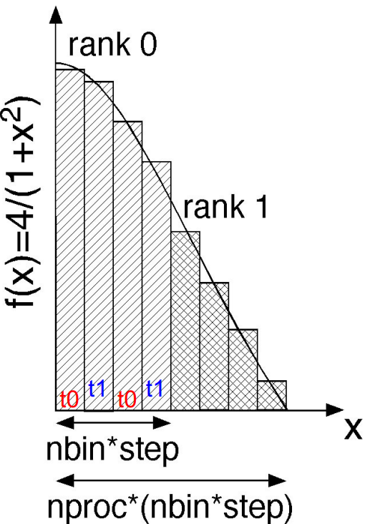
Hybrid: Comput PI With Serial Code
GOAL : The following code computes the π number by using a numerical evaluation of an integral by a rectangle method.

Slide 12
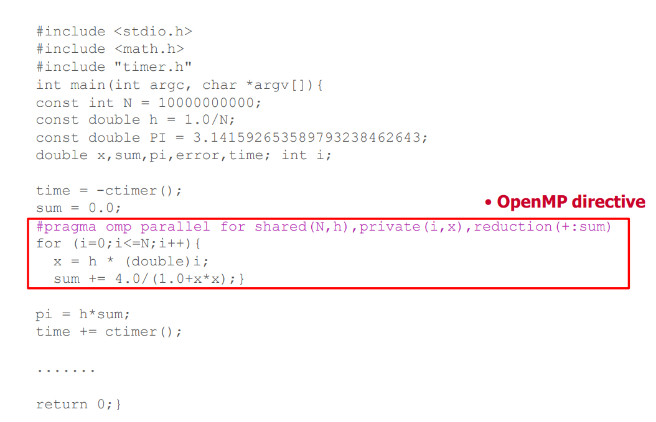
Hybrid: Comput PI With OpenMP Code
GOAL : The following code computes the π number by using a numerical evaluation of an integral by a rectangle method.

Slide 13
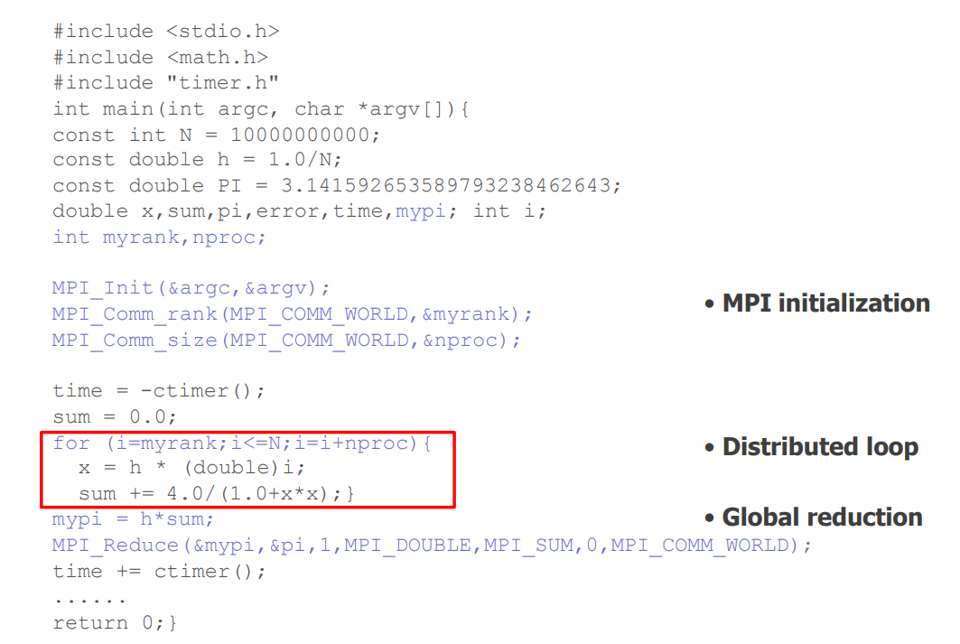
Hybrid: Comput PI With MPI Code
GOAL : The following code computes the π number by using a numerical evaluation of an integral by a rectangle method.

Slide 14
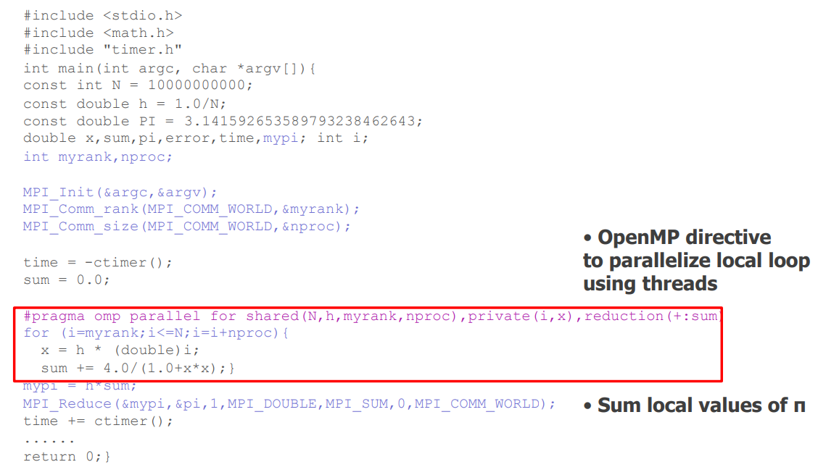
Hybrid: : Comput PI With MPI-OpenMP Code
GOAL : The following code computes the π number by using a numerical evaluation of an integral by a rectangle method.

Slide 15
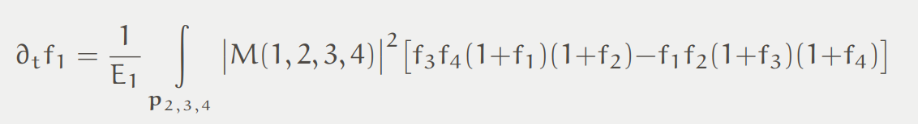
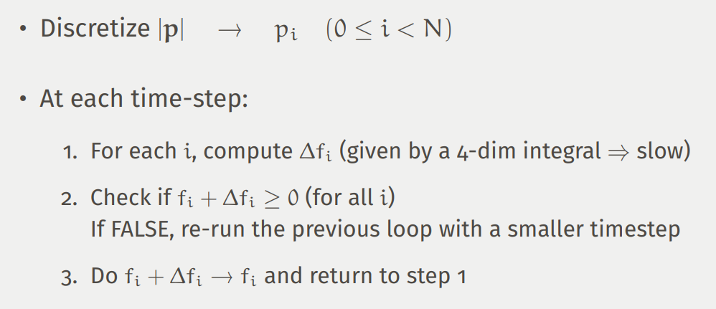
Hybrid: Deterministic Boltzmann Solver
Two-body elastic interactions
Spatially homogenous
Isotropic particle distribution
Scattering amplitude may be momentum dependent
Collision integral reduces to 4-dim integral thanks to momentum conservation and isotropy

Slide 16
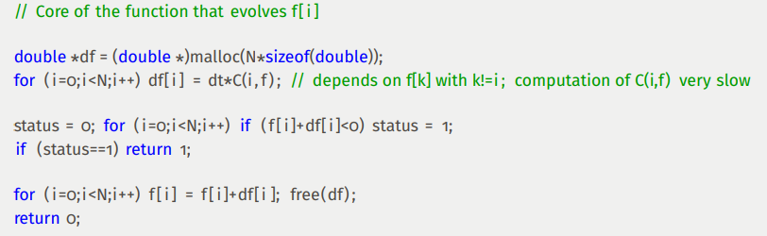
Hybrid: Deterministic Boltzmann Solver Sequential Version
Remarks
Large fraction of the time spent in the first loop
For a reasonable grid size: 30 minutes/timestep
Typical evolution: 2000 timesteps (1000 hours, or 42 days...)

Slide 17
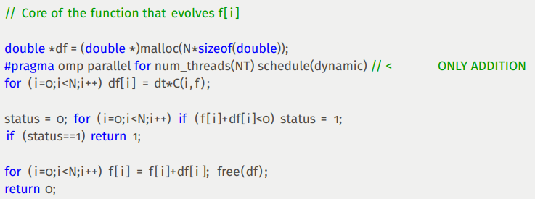
Hybrid: Deterministic Boltzmann Solver OpenMP Version
Remarks
Define NT (number of threads) in the scope of the function
Better use of threads if NT divides N

Slide 18
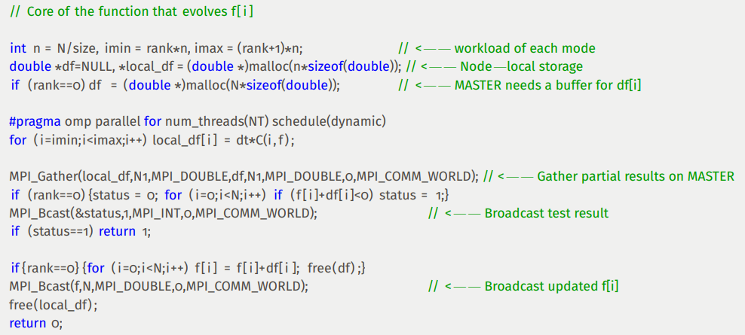
Hybrid: Deterministic Boltzmann Solver MPI OpenMP Version

Slide 19
Hybrid: Deterministic Boltzmann Solver Timing
Running time:
- Sequential: 1830 seconds/timestep
- OpenMP (16 cores): 154 seconds/timestep (×12 speedup, 75% efficiency)
- MPI+OpenMP (32 nodes × 16 cores): 6 seconds/timestep (×306 speedup, 60% efficiency)
Computation time reduced from 1000 hours to 3 hours 16 minutes
Coding time:
- Sequential: one week (about 600 lines of code)
- +OpenMP: +one minute (+1 line)
- +MPI: +one hour (+10 lines)

Slide 20


Thank you for your attention !

