Slide 1

PARALLEL PROGRAMMING...
Kokkos
By Patrick Lemoine 2025.

Slide 2


SESSION 1
Kokkos?
Basic Concepts
Views,
Memory spaces,
Memory access patterns,
Mirrors
Advanced Concepts
Asynchronicity, Streams and Task Parallelism
Multi-level hierarchical parallelism
Multidimensional Loops and Data Structures
Advanced Reductions
MPI (Message Passing Interface) and PGAS (Partitioned Global Address Spaces)
SIM (Single Instruction Multiple Data) Task Flow
GOAL

Slide 3


Introduction to Kokkos
Kokkos is a C++ library designed for parallel programming, allowing developers to write performance-portable code across various hardware architectures, including CPUs, GPUs, and multi-core processors.
Developed at Sandia National Laboratories (SNL) in the United States
An open source project with a growing community
The main goal of Kokkos is to facilitate the development of high-performance applications that can efficiently utilize the capabilities of various computing resources.
Kokkos-Core Github Repository:https://github.com/kokkos/kokkos

Slide 4
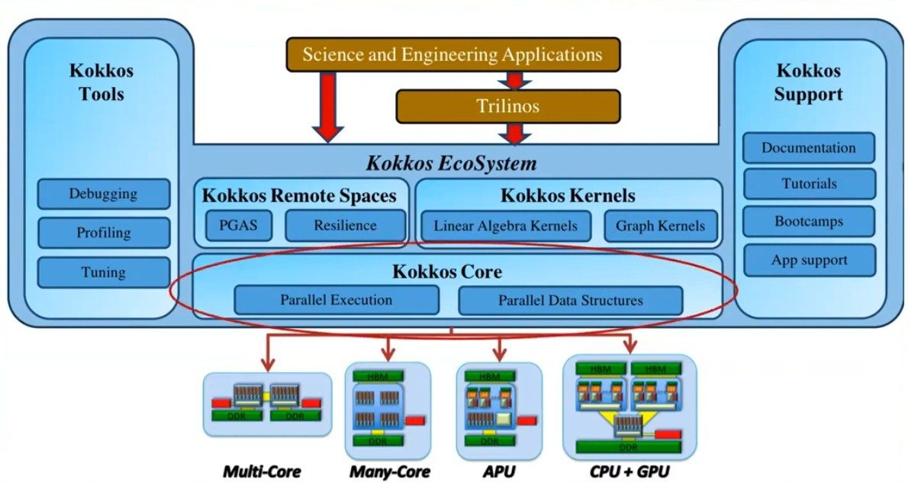
Kokkos Ecosystem
Kokkos Core:
Programming model for parallel execution.
Efficient data management across different architectures.
Kokkos Kernels:
Optimized math library.
Provides basic routines for increased performance.
Kokkos Tools:
Profiling tools to analyze application performance.
Debugging tools to facilitate development.
Portability:
Enables development of HPC applications on various architectures without rewriting code.
Performance :
Optimized to maximize efficiency on a variety of systems, from CPUs to GPUs.
This ecosystem is designed to simplify the development of scientific applications while ensuring high performance.

Slide 5
Why use Kokkos?
Benefits
Unified code base: write once, run on CPU, GPU or other accelerators without rewriting.
High performance: optimizes resource usage (e.g. multi-core CPU, GPU).
Scalability: Supports single-node and multi-node systems with complex memory hierarchies.
Adoption
- Used by hundreds of HPC developers worldwide
Examples of supported backends
CUDA (NVIDIA graphics processor)
HIP (AMD graphics processor)
OpenMP (multi-core processor)
SYCL (GPU and Intel accelerators)
Key components
Kokkos Core: Basic programming model
Kokkos Kernels: portable math library
Kokkos Tools: Debugging and performance analysis tools

Slide 6
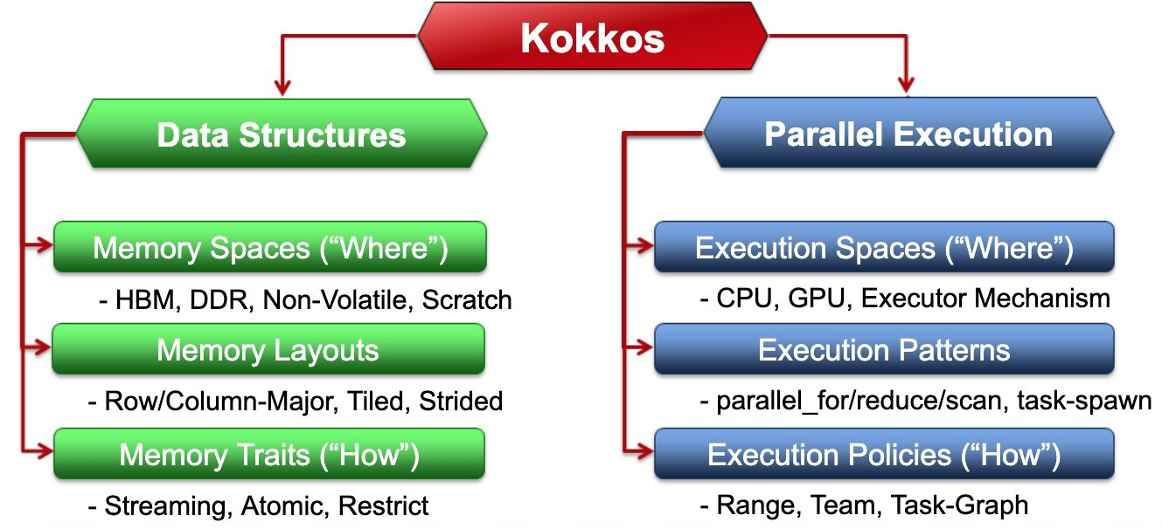
Abstractions of the Kokkos kernel
Kokkos provides a powerful abstraction for the development of parallel algorithms, enabling performance portability across diverse computing architectures through its execution and data management models.

Slide 7
Fundamental Concepts of Kokkos
Execution spaces:Define where parallel builds are executed
Memory spaces:Determine where and how data is allocated in memory
Main options:
Kokkos::CudaSpace (NVIDIA GPU memory)
Kokkos::HostSpace (CPU memory)
Kokkos::CudaUVMSpace (CPU-GPU unified memory)
Kokkos::CudaHostPinnedSpace (pinned CPU memory)
Kokkos::DefaultMemorySpace (default memory space)
Main options:
Kokkos::Cuda (NVIDIA GPU)
Kokkos::HIP (AMD graphics processor)
Kokkos::OpenMP (multi-core processor)
Kokkos::Threads (multithreaded processor)
Kokkos::Serial (single-threaded CPU)
Kokkos::DefaultExecutionSpace (default execution space))
Parallel models:Parallel models are high-level abstractions that simplify the implementation of parallel algorithms in Kokkos.
ParallelFor: a model that allows a loop to be executed in parallel. Distributes iterations across available threads.
ParallelReduThis: combines the results of multiple threads into a single output, useful for operations such as adding an array.
ParallelScan: computes prefix sums in parallel, allowing efficient data processing in algorithms that require cumulative results.
HostMemory:: standard memory accessible by the CPU. Used for data that does not require high-speed access.
DeviceMemory:memory allocated on GPUs. Provide faster access to calculations that take advantage of GPU capabilities.
PinnedMemory:a special type of host memory that allows faster data transfer between the host and device. Improved performance in data- intensive applications.

Slide 8
Kokkos “View” Concept
// Allocate x, y vectors and Matix A on device using vector = kokkos::view<double *>; using matrix = kokkos::view<double **>;
vector y(“y”,N);
vector x(“x”,M);
matrix A(“A”,N,M);
// Initialize y vector For (int i=0; i<N; ++i) {
y(i) = 1;//can potentially lead to illegal access if DefaultSpace is not accessible by the CPU!!!
}
Multidimensional array with management of compilation provisions and memory space.
Type of entries
Number of dimensions
Arrangement (LayoutLeft, LayoutRight)
Kokkos::View<double, Kokkos::LayoutRight> cpuView("cpuData", N, M); Kokkos::View<double, Kokkos::LayoutLeft> gpuView("gpuData", N, M);
Views:Work like pointers, but carry much more information:
DataType: type of data contained.
LayoutType: layout of data in memory.
MemorySpace: data storage location.
MemoryTraits: data access characteristics.
- Only the data type must be specified.
View<double***> data("label", N, M, K);//3 at runtime, 0 at compile time
View<double**[K]> data("label", N, M);//2 at runtime, 1 at compile time
View<double[N][M][K]> data("label");//3 at compilation

Slide 9
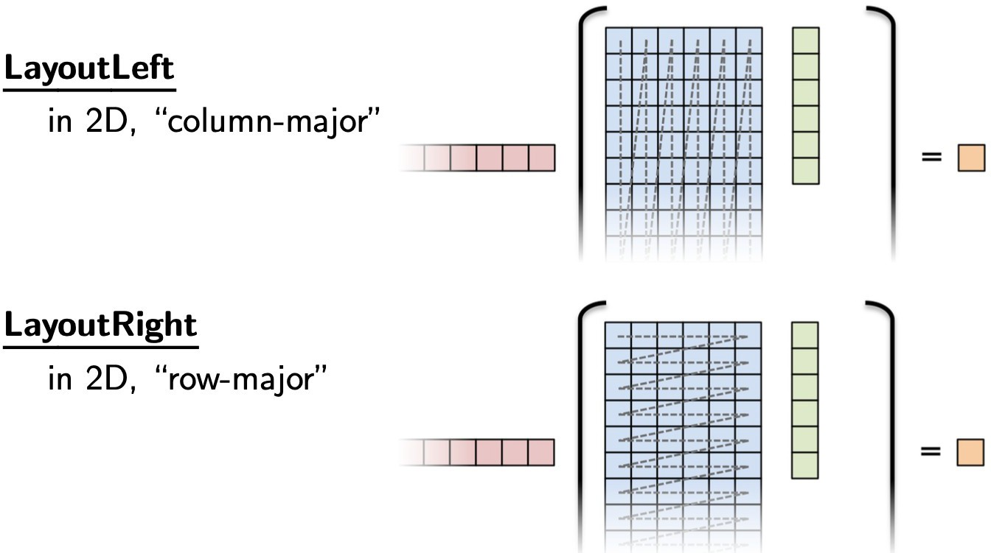
LayoutLeft, LayoutRight?
The adaptable memory layouts determine how data is organized in memory in Kokkos, thereby influencing memory access efficiency and overall application performance.
LayoutLeft: Ideal for GPU architectures where memory access coalescing is crucial, as this allows for faster data access.
LayoutRight: Preferred for traditional processors because it allows better cache utilization and increased performance when accessing data by rows.
The choice betweenLayoutLeftAndLayoutRight is essential to maximize access efficiency
memory and adapt the code to the different
hardware architectures used.

Slide 10
Kokkos Concept Mirrors
Mirror:These are views of equivalent tables that may reside in different memory spaces.
View Builder: It allows to create a view in a specific memory space.
Main functions:
create_mirror_view:Creates a mirror view in the host's memory space.
deep_copy:Copies data between compatible views.
create_mirror_view_and_copy:Creates a mirror view and copies the data at the same time.
Syntax:Kokkos::View<type, MemorySpace> data("label", dimensions);
// create host mirrors of device views vector::HostMirror h_y
= Kokkos::create_mirror_view(y); vector::HostMirror h_x = Kokkos::create_mirror_view(x); matrix::HostMirror h_A = Kokkos::create_mirror_view(A);
// initialize y vector on host
for (int i=0; i<N; ++i) { h_y(i) = 1;} // initialize x vector on host
for (int i=0; i<M; ++i) { h_x(i) = 1;}
// initialize A matrix on host
for (int j=0; j<N; ++j) {
for (int i=0; i<M; ++i) {
h_A(j, i) = 1;
}
}
// Deep copy views to device views
Kokkos::deep_copy(y, h_y); Kokkos::deep_copy(x, h_x); Kokkos::deep_copy(A, h_A);

Slide 11

Kokkos Memory Spaces
Representing the “where” and “how” of memory allocation and access in Kokkos, this concept is fundamental to ensuring performance portability.
Kokkos automatically adapts these models according to the target hardware.
Common memory spaces-Kokkos::HostSpace: Traditional CPU memory - Kokkos::CudaSpace: GPU memory for NVIDIA - Kokkos::CudaUVMSpace: Unified CPU-GPU memory...
Key Features
Portability:Optimization of memory accesses on CPU and GPU.
Flexibility:Adaptive memory layouts, such as LayoutLeft and LayoutRight.
Performances:Contiguous access on CPU and coalescing on GPU.
Implementation
CPU(eg: OpenMP): Use LayoutRight by default to optimize cache usage.
GPU(eg: CUDA): Use LayoutLeft by default to promote memory merging.
Layout polymorphism:Ability to change the schema without modifying the function code. This allows developers to easily adapt data structures to different hardware architectures (such as CPUs and GPUs) while maintaining a consistent interface.

Slide 12

Kokkos: Managing memory access patterns and impact on performance
Importance of memory access patterns
Essential for optimizing performance on CPU (cache) and GPU (coalescing).
Kokkos automatically adjusts these models according to the target architecture.
Memory arrangements in Kokkos
LayoutLeft: Main column order, ideal for GPU.
LayoutRight: Order of main lines, optimal for the processor.
Flexibility: Customizable layouts according to needs.
Optimization strategies
CPU:Optimized cache and memory usageSIMD. A technique that allows a single instruction to be executed on multiple data elements simultaneously. This contrasts with scalar operations which process one element at a time.
GPU:Ensure memory fusion for efficient access.
Impact on performance
Efficient memory access of up to 10 times more efficient.
Portability ensured thanks to a single code, allowing optimal performance on various architectures.

Slide 13


Kokkos Execution Spaces
Representing the “where” and “how” of parallel execution in Kokkos, this abstraction integrates available computing resources such as CPUs and GPUs.
Execution spaces
Execution models
Simple loops:Using parallel_for̀ .
Discounts:Using parallel_reduce`.
Scans:Using parallel_scan .̀
Execution Policy:are fundamental abstractions that define how parallel tasks are executed.
Range policies:Sets of indexes on which operations are performed.
Team policies:Grouping threads into teams, forming a subset of the execution space to enable hierarchical
parallelism.
Kokkos::parallel_for( Kokkos::RangePolicy<Kokkos::DefaultExecutionSpace>(0, 10), KOKKOS_LAMBDA(int n) { /* ... */ }
) ;
Kokkos::TeamPolicy<ExecutionSpace> team_policy(league_size, team_size);
Memory layout
Options: LayoutRight` vs L̀ayoutLeft , with automatic conversion between the two depending on runspaces.
Memory traits
Types of access:Atomic access, random access (shader memory), and streaming storage.

Slide 14


Thank you for your attention !

