Slide 1

pROJECT
Laminar, Isothermal Backward Facing Step Benchmark

Slide 2
I) Presentation of feel-pp:
Allows to solve multiphysical problems
Simulation of situations
Plenty of methods implemented

Slide 3
II) Contribute to the feel-pp documentation:
Method :
- Definition of the problem
- Solving the problem
- Exploit the results
Fluid
Solid

Slide 4
III) Presentation of the project:
Project
CFD
Simulation model
Aerodynamic flows - Heat transfer
Engine flows - Flows around buildings

Slide 5
Objectives
1) Test the coupling between oressure field and flow velocity
2) Compare the results of the velocity profile with numerical results
3) Prescribe input condition data from a file

Slide 6
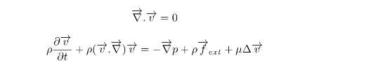
IV) The incompressible equations of navier stocks:
Definition

Slide 7


Reynolds number :

Slide 8

Expression :

Slide 9
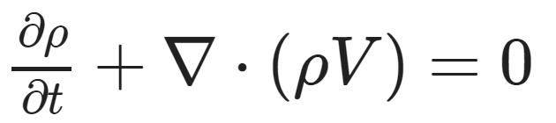
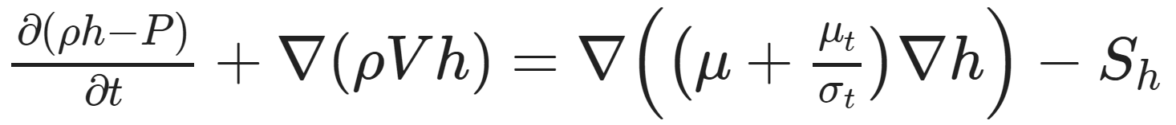
V) Boundary conditions:
Continuity equation
Momentum equation
Energy equation

Slide 10
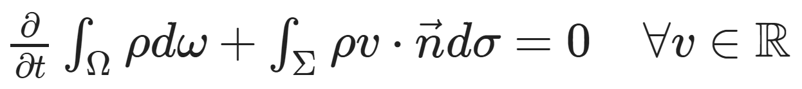

1) Continuity Equation:
Conservation of the mass
Theorem of Gauss

Slide 11
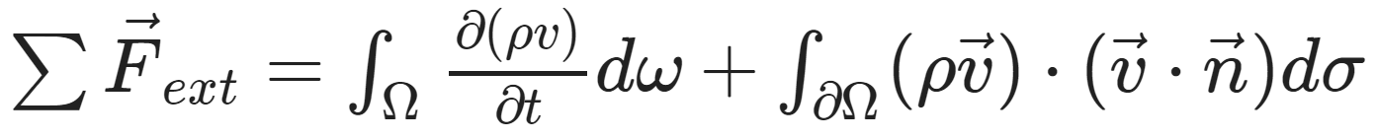
2) Momentum equation:
2nd Law of Newton
Theorem of Gauss

Slide 12
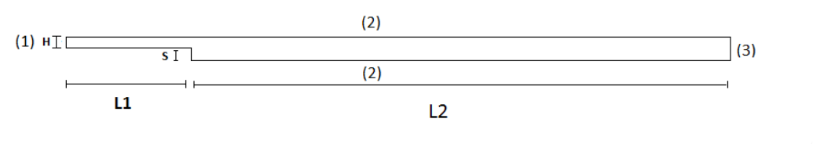
VI) The test cases :
1) Geometry :

Slide 13

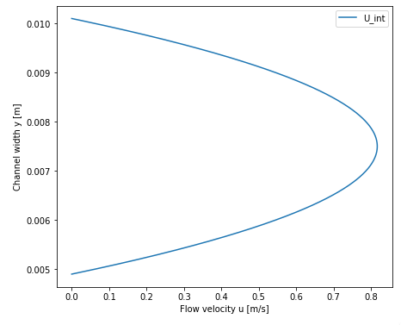
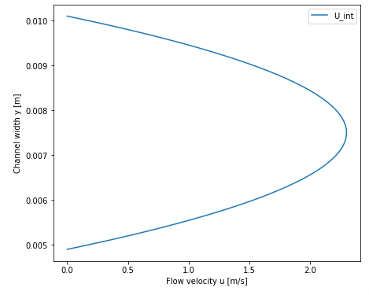
3) Boundary conditions:
Inlet Condition
The profile of Poiseuille at the entrance is represented by the graphs below

Slide 14

Wall Condition
Outlet condition

Slide 15
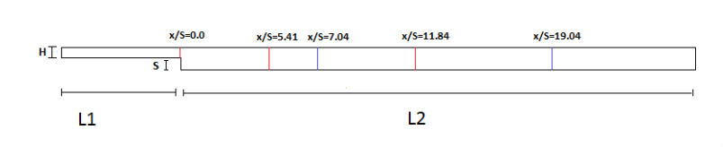
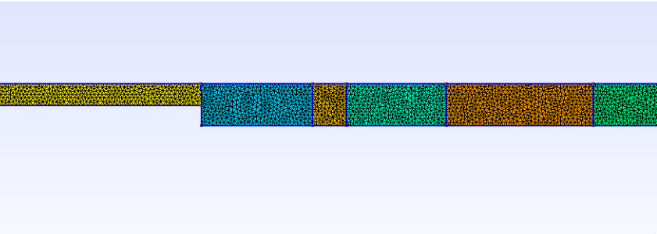
4) Block Division and mesh
Block division :
Mesh :

Slide 16
VII) Results:
Separation of the results between Re = 389 and Re = 1095

Slide 17
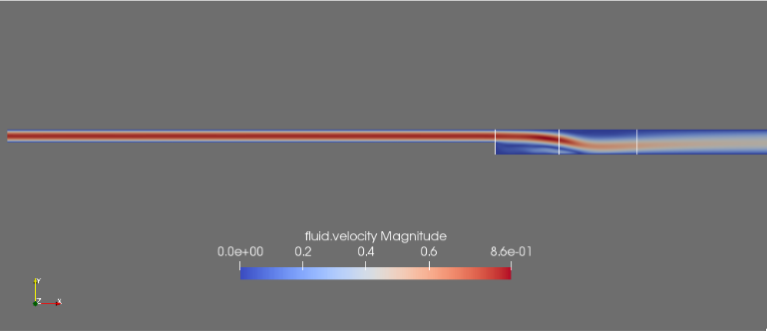
1) Re = 389:
The final stationnary solution obtained on paraview is :

Slide 18
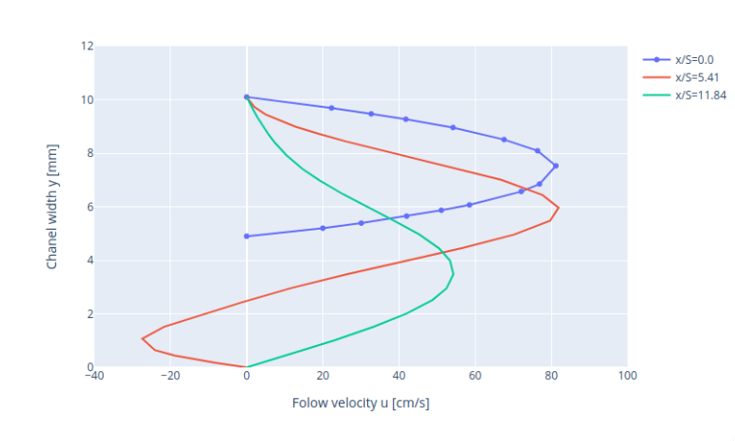
1) Re = 389:
Using plotly's bibliography, the graph presents the flow profile simulated at the different x/S locations:

Slide 19
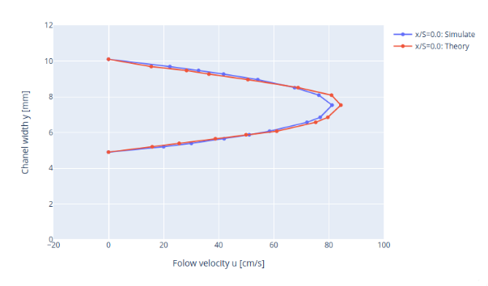
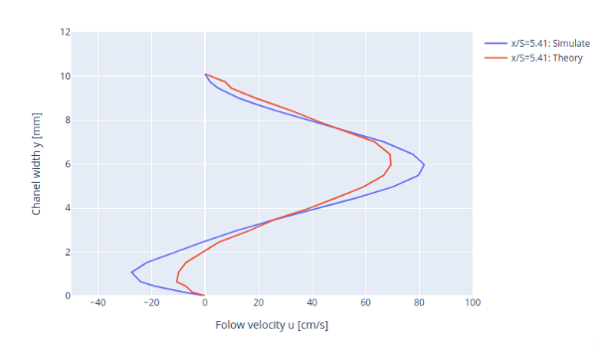
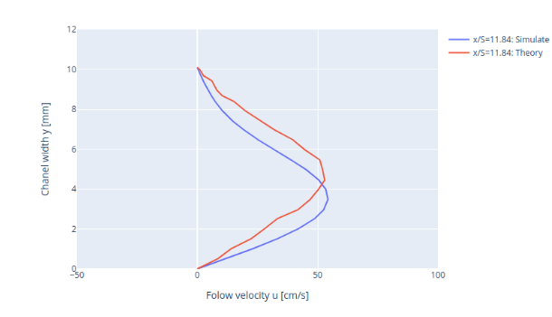
Comparison:
Let's move on to the comparison of the simulated results with the theory. using the root mean square error (or RMSE), as we cas see :

Slide 20
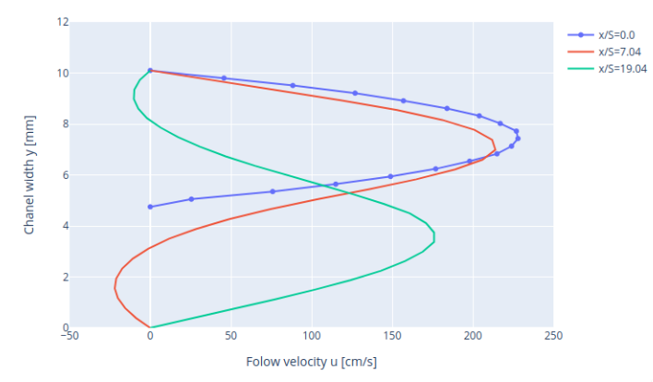
2) RE = 1095:
The flow profile simulated at the different x/S locations:

Slide 21
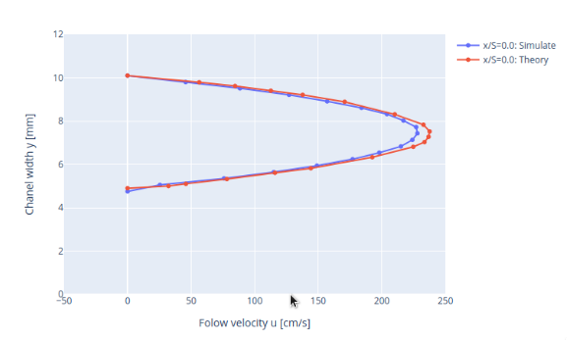
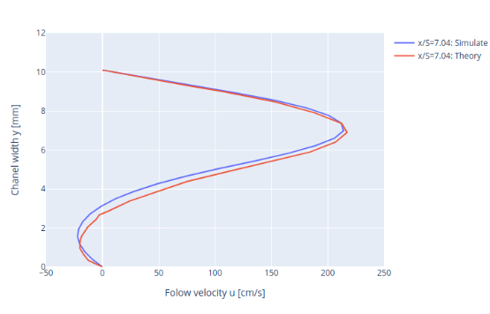
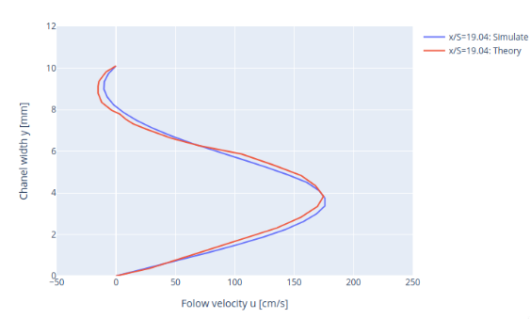
Comparison:
To make the comparison between the theorical and simulate results we use also the root mean square error RSME, the results generated are:

Slide 22
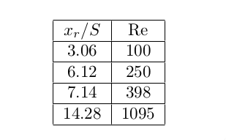
3) REATTACHEMENT LENGTH IN THE LAMINAR FLOW REGIM:
Reattachement length and Reynolds number

Slide 23
Conclusion:

