Slide 1

PARALLEL PROGRAMMING...
By Patrick Lemoine 2023.

Slide 2

Parallel Programming: Overview
SESSION 3/6
GOAL
Programming Interface for parallel computing
OpenMP (Open Multi-Processing)
병렬 컴퓨팅을 위한 프로그래밍
인터페이스

Slide 3



OpenMP (Open Multi-Processing)

Slide 4
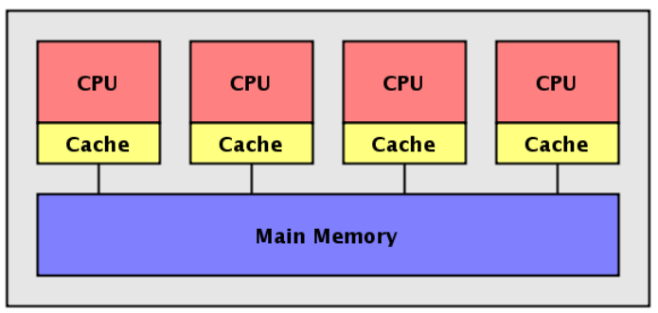

OpenMP (Open Multi-Processing)
Open Specifications for Multi Processing (OpenMP) is a programming interface
for parallel computing on shared memory architecture.
It allows you to manage:
the creation of light processes.
the sharing of work between these lightweight processes.
synchronizations (explicit or implicit) between all light processes.
the status of the variables (private or shared).

Slide 5
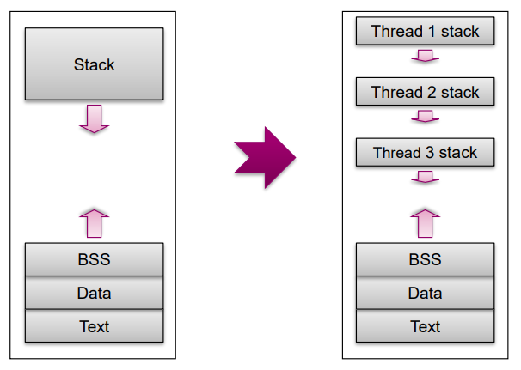
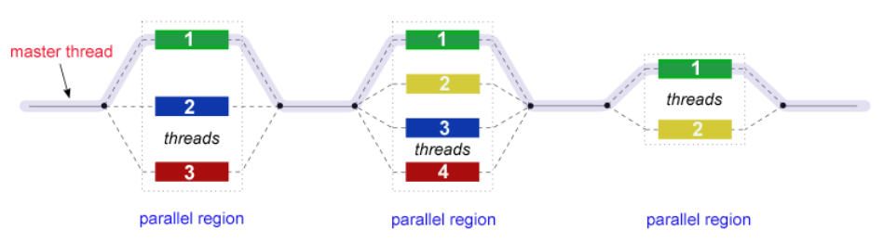
OpenMP (Open Multi-Processing)
OpenMP is based on Fork/Join model
When program starts, one Master thread is created
Master thread executes sequential portions of the program
At the beginning of parallel region, master thread forks new threads
All the threads together now forms a “team”
At the end of the parallel region, the forked threads die !

Slide 6


OpenMP (Open Multi-Processing)
The OpenMP API consists of:
compiler directives (for insertion into sequential Fortran/C/C++ code)
a few library routines
some environment variables
Advantages:
User-friendly
Incremental parallelization of a serial code
Possible to have a single source code for both serial and parallelized versions
Disadvantages:
Relatively limited user control
Most suitable for parallelizing loops (data parallelism)
Performance? ~

Slide 7
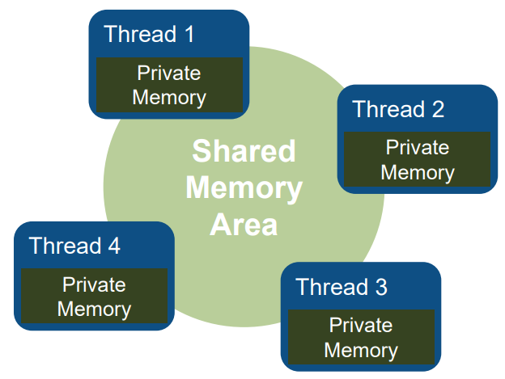
OpenMP (Open Multi-Processing)
What is a Shared-Memory Program?
One process that spawns multiple threads
Threads can communicate via shared memory
Read/Write to shared variables
Synchronization can be required!
OS decides how to schedule threads

Slide 8
OpenMP: Shared Memory
Shared memory model
Threads communicate by accessing shared variables.
The sharing is defined syntactically
Any variable that is seen by two or more threads is shared.
Any variable that is seen by one thread only is private.
Race conditions possible
Use synchronization to protect from conflicts.
Change how data is stored to minimize the synchronization.

Slide 9
OpenMP: Multithreading
Multithreading, natural programming model
All processors share the same memory.
Threads in a process see same address space.
Many shared-memory algorithms developed.
Multithreading is hard
Lots of expertise necessary.
Deadlocks and race conditions.
Non-deterministic behavior makes it hard to debug.

Slide 10
OpenMP: Process and thread
What is the difference ?
You need an existing process to create a thread.
Each process has at least one thread of execution.
A process has its own virtual memory space that cannot be accessed by other processes running on the same or on a different processor.
All threads created by a process share the virtual address space of that process.
They read and write to the same address space in memory.
They share the same process and user ids, file descriptors, and signal handlers.
They have their own program counter value and stack pointer, and can run independently on several processors.

Slide 11
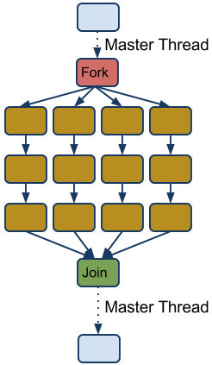
OpenMP: Terminology and behavior
OpenMP Team = Master + Worker
Parallel Region is a block of code executed by all threads simultaneously (has implicit barrier)
The master thread always has thread id 0 !
Parallel regions can be nested.
If clause can be used to guard the parallel region.

Slide 12


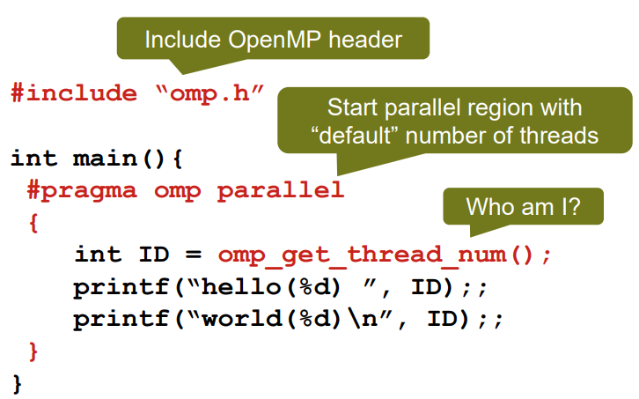
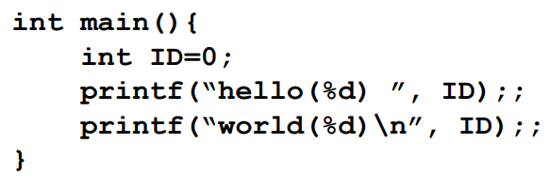


OpenMP: Example Code Structure
Make “Hello World” multi-threaded..

Slide 13
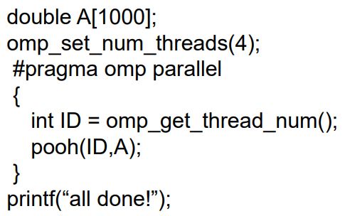
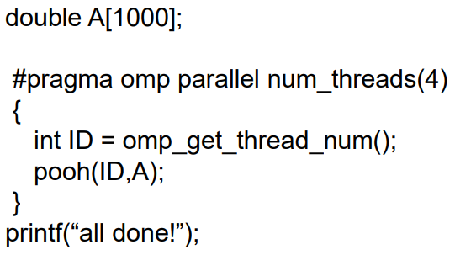
OpenMP: Parallel Region
A parallel region identifies a portion of code that can be executed by different threads
You can create a parallel region with the “parallel” directive
You can request a specific number of threads with omp_set_num_threads(N)
Each thread will call pooh(ID,A) function with a different value of ID

Slide 14
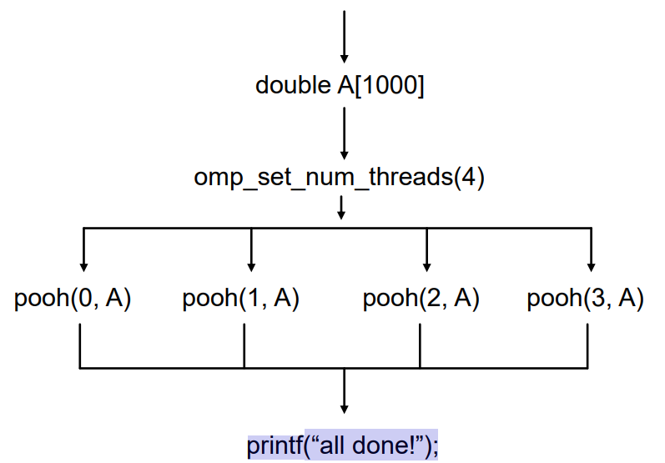
OpenMP: Parallel Region
All the threads execute the same code
The [A] array is shared
Implicit synchronization at the end of the parallel region

Slide 15
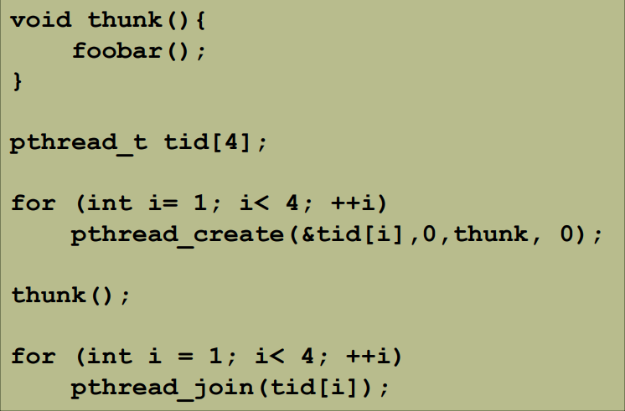
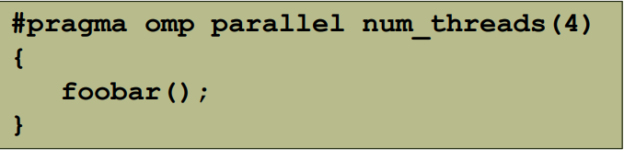
OpenMP: Behind the scenes...
The OpenMP compiler generates code logically analogous to that on the right.
All known OpenMP implementations use a thread pool so full cost of threads creation
and destruction is not incurred for each parallel region.
Only three threads are created because the last parallel section will be invoked from the parent thread.

Slide 16
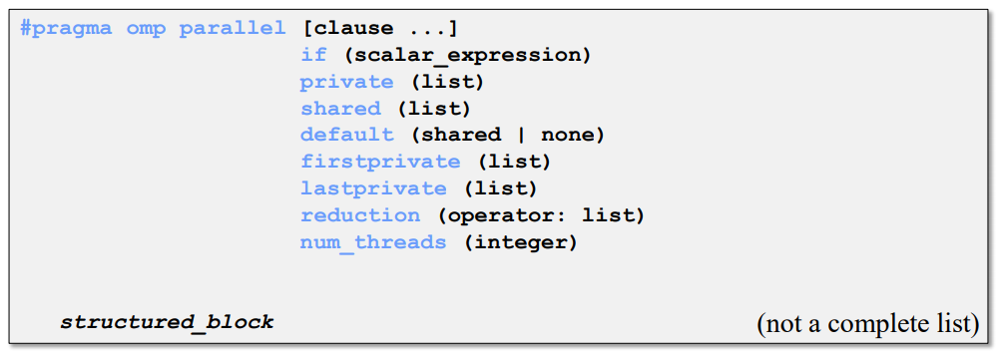
OpenMP: Constructs Parallel Region
Parallel region
Thread creates team, and becomes master (id 0).
All threads run code after.
Barrier at end of parallel section.
shared
private
firstprivate
default
threadprivate
lastprivate
reduction

Slide 17
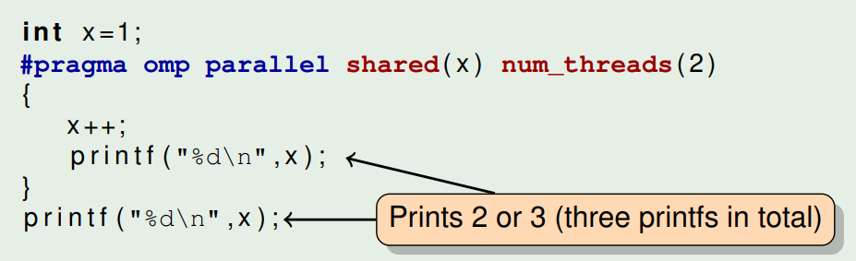
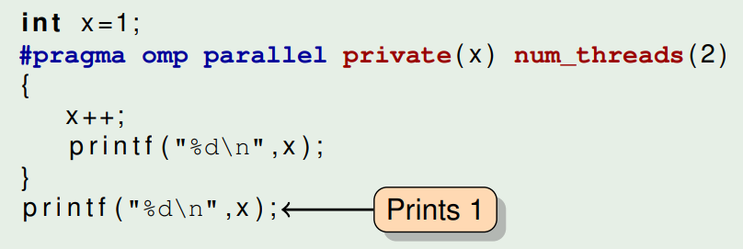
OpenMP: Data Sharing Attributes
Shared
The variable inside the construct is the same as the one outside the construct.
In a parallel construct this means all threads see the same variable but not necessarily the same value.
Usually need some kind of synchronization to update them correctly.
Private
The variable inside the construct is a new variable of the same type with an undefined value
In a parallel construct this means all threads have a different variable
Can be accessed without any kind of synchronization

Slide 18
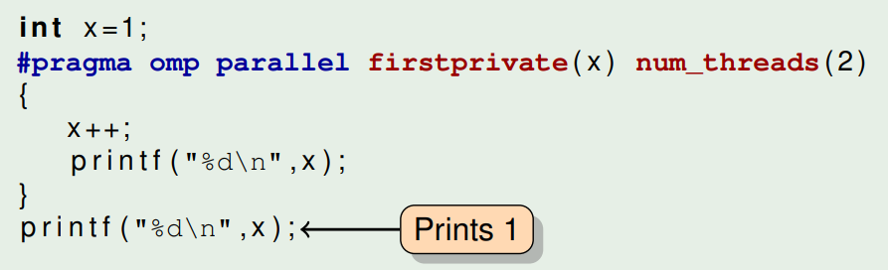
OpenMP: Data Sharing Attributes
Firstprivate
The variable inside the construct is a new variable of the same type but it is initialized to the original value of the variable
In a parallel construct this means all threads have a different variable with the same initial value
Can be accessed without any kind of synchronization
And default. What is the default?
If there is a default clause, what the clause says
none means that the compiler will issue an error if the attribute is not explicitly set by the programmer.
Otherwise, depends on the construct
For the parallel region the default is shared.

Slide 19
OpenMP: Synchronization
Directives to synchronize thread team or control thread access to code fragments
$OMP MASTER | Execute section only with master thread (no implied barrier).
$OMP CRITICAL | Restrict access to one thread at a time (otherwise block).
$OMP BARRIER | Synchronize all threads.
$OMP ATOMIC | Special case of CRITICAL, the statement following allows a specific memory location to be updated atomically (no multiple writes, can take advantage of specific hardware instructions for atomic writes).
$OMP FLUSH [(list) ] | Ensure threads have consistent view of shared variables (else just the named list).
$OMP ORDERED | Execute code in same order as under sequential execution.
$OMP SINGLE | Block executed by only one thread (implied BARRIER and FLUSH at the end)

Slide 20
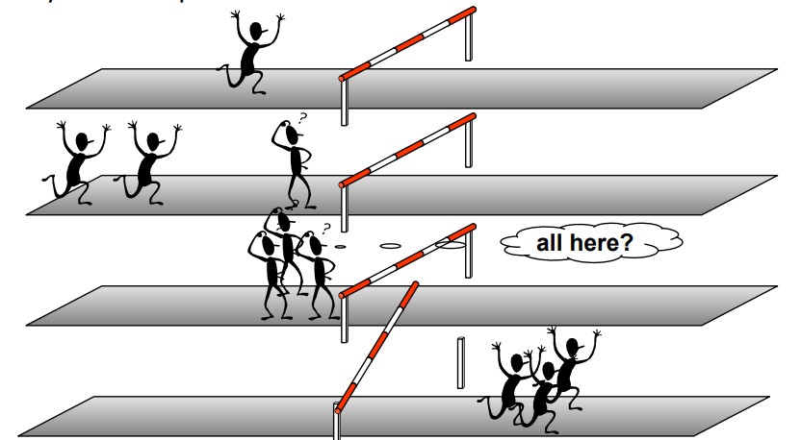
OpenMP: Barrier
When a thread reaches a barrier, it only continues after all the threads in the same thread team have reached it.
Each barrier must be encountered by all threads in a team, or none at all
The sequence of work-sharing regions and barrier regions encountered must be same for all threads in team
Implicit barrier at the end of: do, parallel, single, workshare

Slide 21
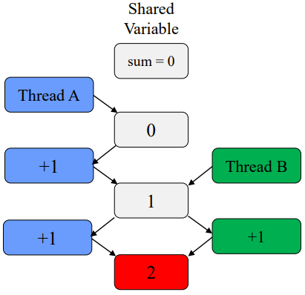
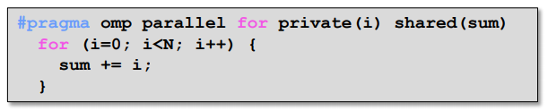
OpenMP: Caution Race Condition
When multiple threads simultaneously read/write
Multiple OMP solutions :
Reduction
Atomic
Critical
Should be 3!

Slide 22
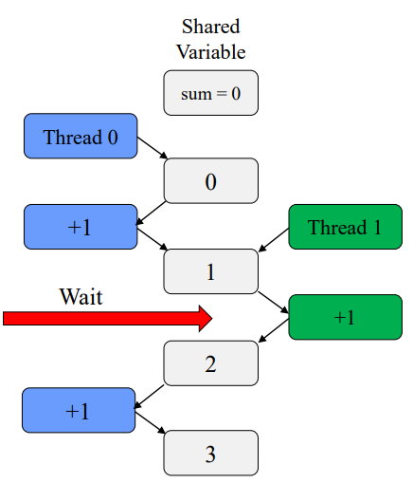
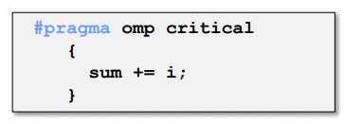
OpenMP: Critical Section
One solution: use critical
Only one tread at a time can execute a critical section
Downside ?
YES SLOOOOWWW
Overhead and serialization

Slide 23
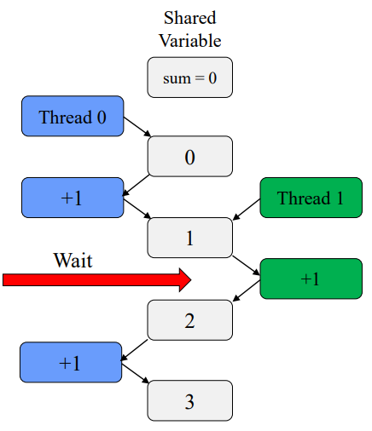
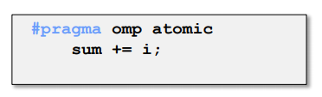
OpenMP: Atomic
Atomic provides mutual exclusion but only applies to the update of a memory location.
Atomics like "mini" critical
Only one line
Certain limitations
Hardware controlled
Less overhead the critical

Slide 24

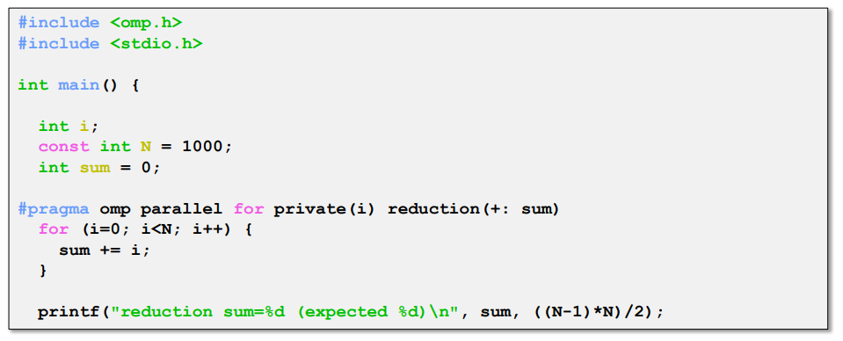
OpenMP: Reduction
Avoids race condition
Reduce variable must be shared
Makes variable private, then performs operator at end of loop
Operator cannot be overloaded (c++)
One of: +,*,-,/ (and &,^,|,&&,||)
OpenMP 3.1: added min and max for c/c++

Slide 25
OpenMP: Scheduling
Scheduling types:
Static
- Chunks of specified size assigned round-robin
Dynamic
- Chunks of specified size are assigned when thread finishes previous chunk
Guided
- Like dynamic, but chunks are exponentially decreasing
- Chunk will not be smaller than specified size
Runtime
- Type and chunk determined at runtime via environment variables

Slide 26
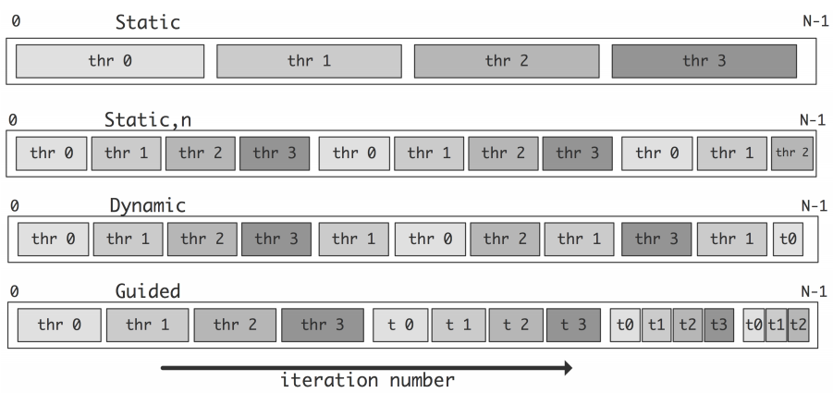
OpenMP: Scheduling
Illustration of the scheduling strategies of loop iterations.

Slide 27
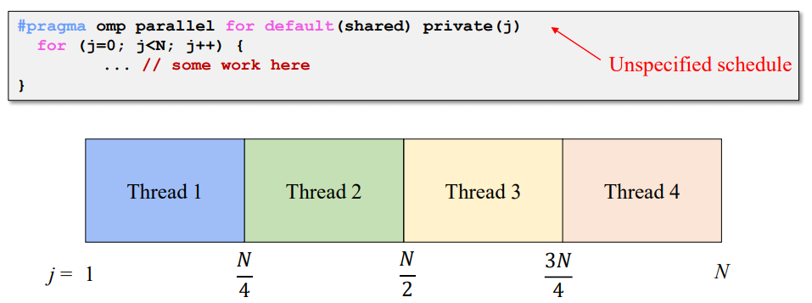
OpenMP: Scheduling
How does a loop get split up ? In MPI, we have to do it manually!!!
If you do not tell what to do, the compiler decides
Usually compiler chooses "static" - chunks of N/p

Slide 28
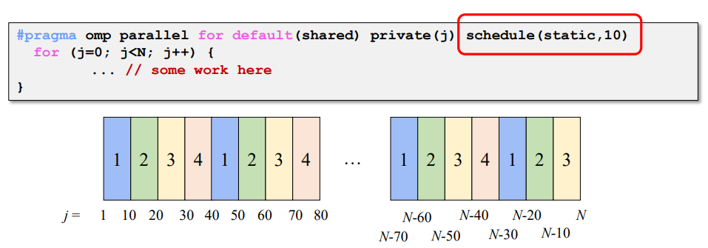
OpenMP: Static Scheduling
You can tell the compiler what size chunks to take ?
Keeps assigning chunks until done.
Chunk size that is not a multiple of the loop will results in thread with uneven numbers.

Slide 29
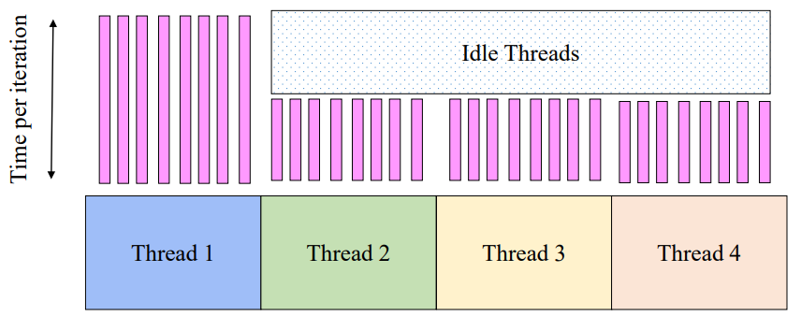
OpenMP: Problem with Static Scheduling
What happens if loop iterations do not take the same amount of time ?
Load imbalance

Slide 30
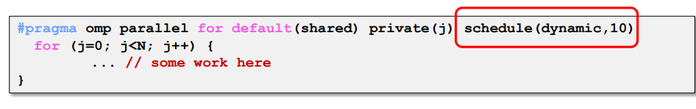
OpenMP: Dynamic Scheduling
Chunks are assigned on the fly, as threads become available.
When a thread finishes on chunk, it is assigned another
Caveat: higher overhead than static!

Slide 31


OpenMP Examples

Slide 32
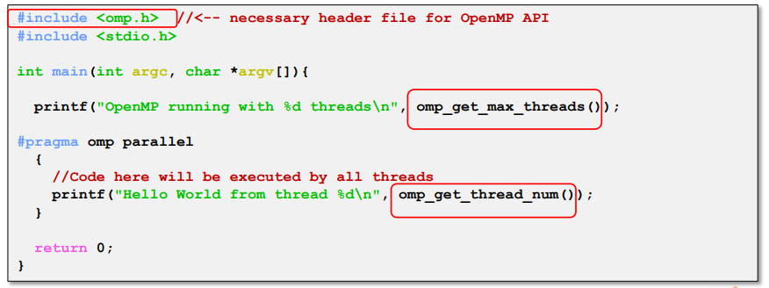
OpenMP: API
API for library calls that perform useful functions
Must include "omp.h"
Will not compile without OpenMP compiler support

Slide 33
COMPILING an OpenMP Program
Compiling a program for MPI is almost just like compiling a regular C or C++ program
For example, to compile MyProg.c you would use a command like
gcc -fopenmp -o MyProg MyProg.c
gcc -fopenmp -o MyProg MyProg.cpp
g++ -c MyProg. cpp -o MyProg.o -fopenmp
g++ MyProg.o -o MyProg -fopenmp -lpthread

Slide 34
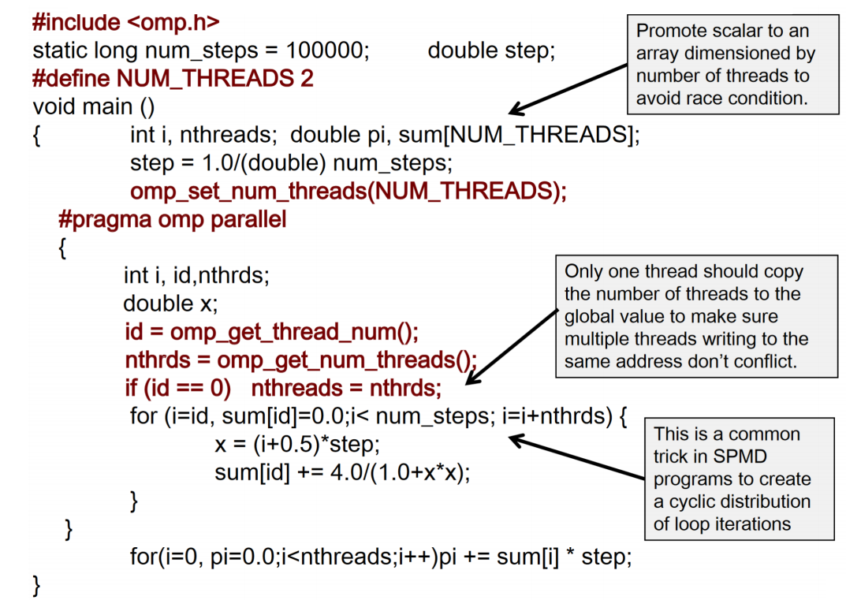
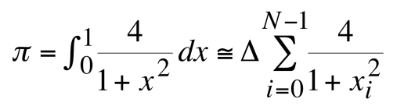
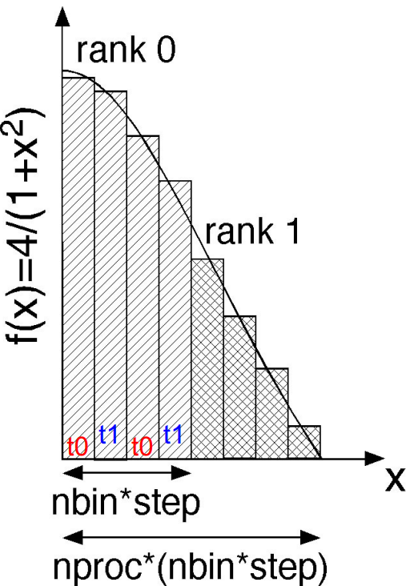
OpenMP: Compute PI
GOAL : The following code computes the π number by using a numerical evaluation of an integral by a rectangle method.

Slide 35
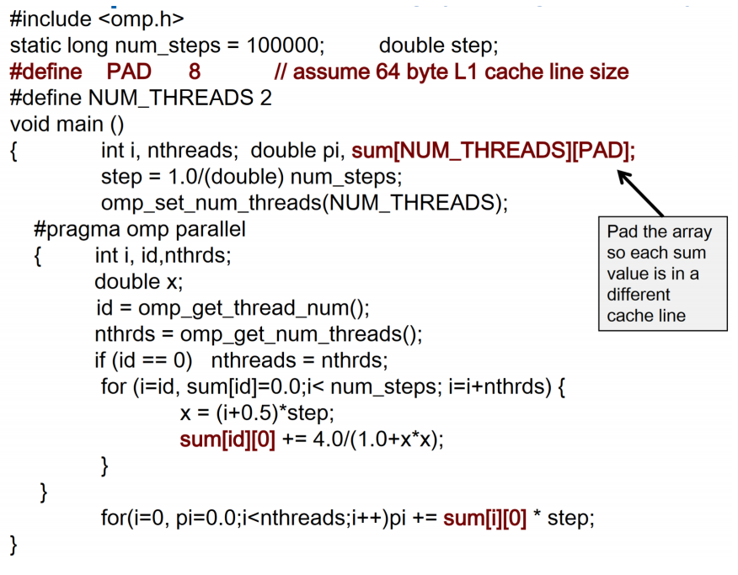
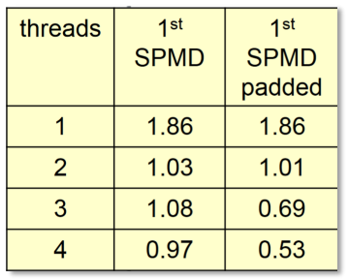
OpenMP: Compute PI with padding
Remark about false sharing : If independent data elements happen to sit on the same cache line, each update will cause the cache lines to “slosh back and forth” between threads.
HotFix with PAD, elements you use are on distinct cache lines.
Results
Padding arrays requires deep knowledge of the cache architecture, also be careful...

Slide 36
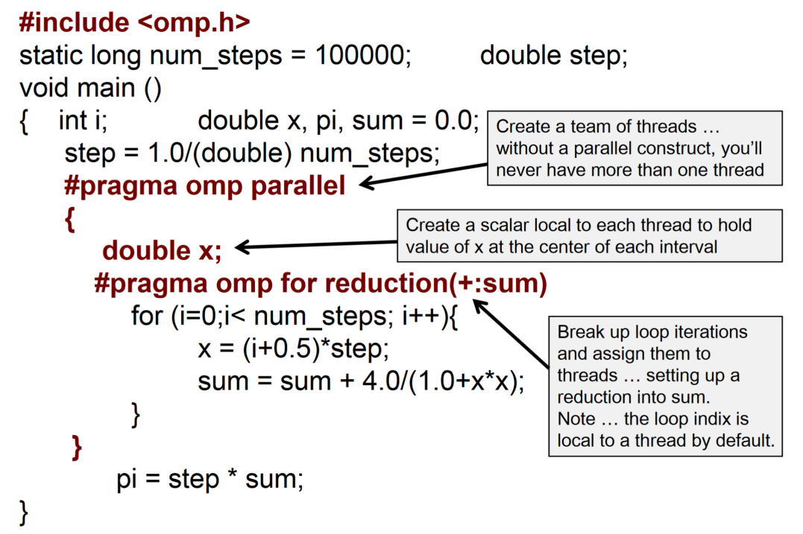
OpenMP: Compute PI with omp for reduction

Slide 37
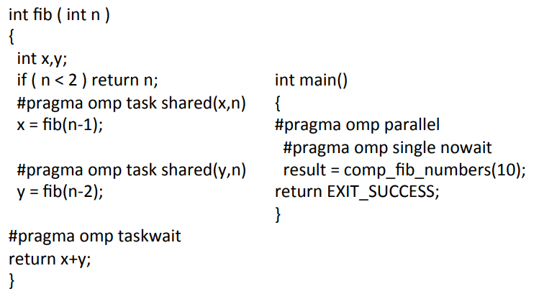
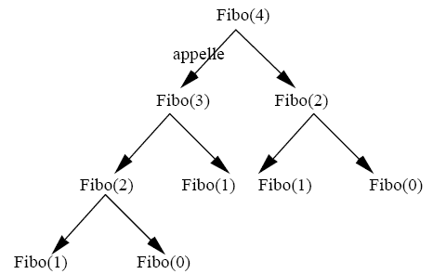
OpenMP: Fibonacci
fib(0) = 1
fib(1) = 1
fib(n) = fib(n-1) + fib(n-2)
avec n ∈ ℕ

Slide 38
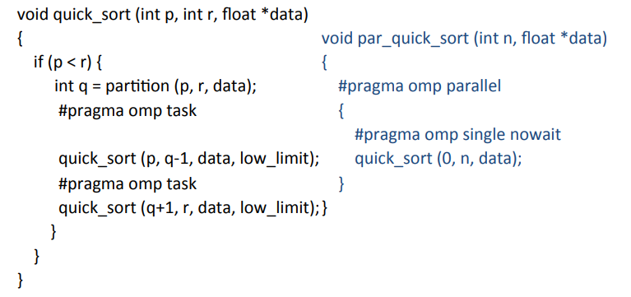
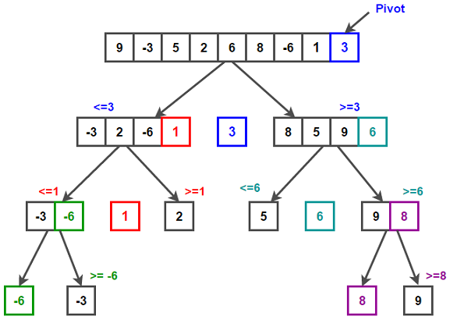
OpenMP: Quicksort

Slide 39
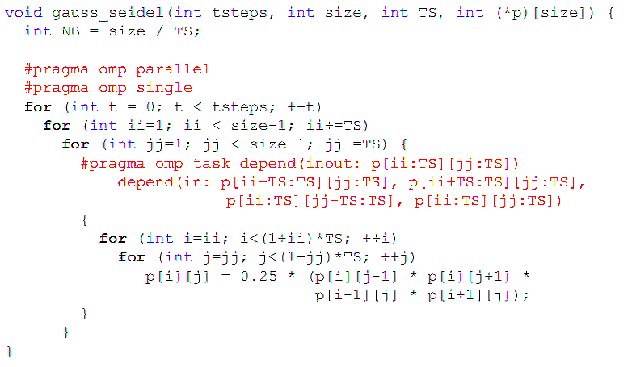
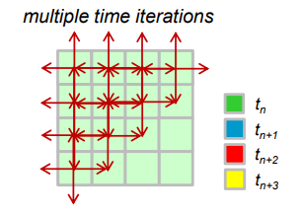
OpenMP: Gauss-Seidel
Gauss-Seidel Method is used to solve the linear system Equations. It is a method of iteration for solving n linear equation Ax=b with the unknown variables.

Slide 40
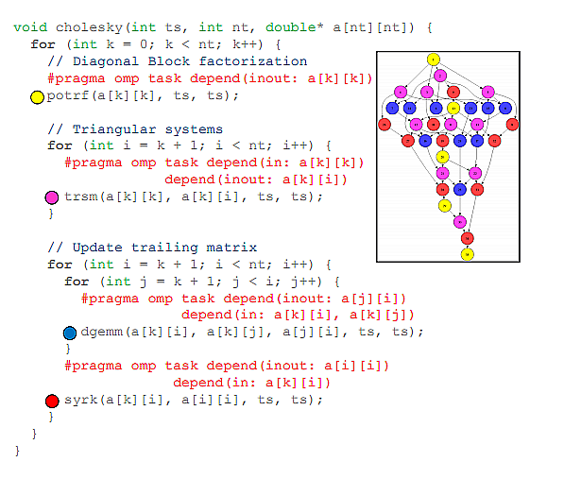
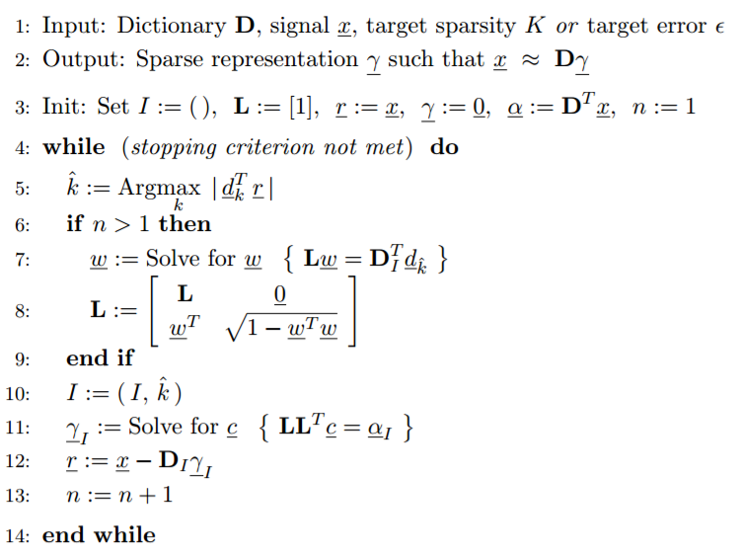
OpenMP: Cholesky Factorization
The Cholesky factorization, also known as Cholesky decomposition, is a process of breaking down of a Hermitian, positive-definite matrix into the product of a lower triangular matrix and its conjugate transpose, which is important for quick numerical solutions in linear algebra.

Slide 41

OpenMP: Performance Tips...
Avoid serialization !
Avoid using #pragma omp parallel for before loop.
Use reduction whenever possible.
Minimize I/O
Minimize critical
- Use atomic instead of critical where possible.

Slide 42


Thank you for your attention !

