Slide 1

PARALLEL PROGRAMMING...
By Patrick Lemoine 2023

Slide 2

Parallel Computing Using HIP
SESSION 5/6
Programming Interface for parallel computing With HIP
What is HIP ?
Synchronization and streams
Memory allocations, access and unified memory
Kernel optimization and profiling
Device Code, Shared Memory,and Thread Synchronization
Multi-GPU programming and HIP+MPI
API Examples
GOAL

Slide 3



What is HIP ?

Slide 4



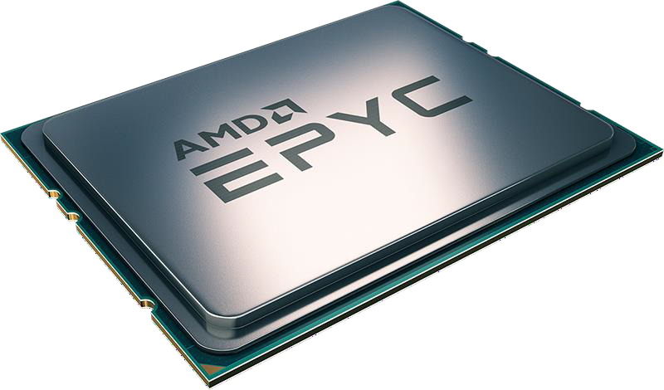
What is HIP ?
Heterogeneous-Compute Interface for Portability (HIP)
HIP, is a C++ runtime API and kernel language that allows developers to create portable applications that can run on AMD’s accelerators as well as CUDA devices Portable HIP C++
AMD effort to offer a common programming interface that works on both devices: CUDA and ROCm.

Slide 5
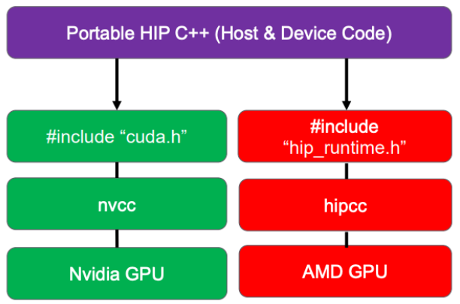
What is HIP ?
Heterogeneous-Compute Interface for Portability (HIP)
Is open-source.
Provides an API for an application to leverage GPU acceleration for both AMD and CUDA devices.
Syntactically similar to CUDA. Most CUDA API calls can be converted in place: cuda -> hip
Supports a strong subset of CUDA runtime functionality.
C++ runtime API and kernel language that allows developers to create portable applications.
ROCm: is an Advanced Micro Devices (AMD) software stack for graphics processing unit (GPU) programming and spans several domains: GPGPU, HPC ,heterogeneous computing

Slide 6

HIP comparison with CUDA
CUDA
cudaMalloc((void**)&nodes_dev, N*sizeof(float) );
HIP
hipMalloc((void**)&nodes_dev, N*sizeof(float) );
COMPILATION
With CUDA
==>$ nvcc source_code.cu
With HIP
==>$ hipcc source_code.cu
CUDA
dim3 threadsPerBlock(nthreads,nthreads,nthreads);
dim3 blocks(n_elements);
GPUKernel<<<blocks,threadsPerBlock>>>( input );
HIP
dim3 threadsPerBlock(nthreads,nthreads,nthreads);
dim3 blocks(n_elements);
hipLaunchKernelGGL(GPUKernel, dim3(blocks), dim3(threadsPerBlock), 0, 0, input);

Slide 7
Difference between HIP and CUDA
Some things to be aware of writing HIP, or porting from CUDA:
AMD GCN hardware ‘warp’ size = 64 (warps are referred to as ‘wavefronts’ in AMD documentation)
Device and host pointers allocated by HIP API use flat addressing
- Unified virtual addressing is enabled by default
- Unified memory is available, but does not perform optimally currently
Dynamic parallelism not currently supported
CUDA 9+ thread independent scheduling not supported (e.g., no __syncwarp)
Some CUDA library functions do not have AMD equivalents
Shared memory and registers per thread can differ between AMD and Nvidia hardware
Inline PTX or AMD GCN assembly is not portable

Slide 8
HIP API
Device Management:
⁃ hipSetDevice(), hipGetDevice(), hipGetDeviceProperties()
Memory Management
⁃ hipMalloc(), hipMemcpy(), hipMemcpyAsync(), hipFree()
Streams
⁃ hipStreamCreate(), hipSynchronize(), hipStreamSynchronize(), hipStreamFree()
Events
⁃ hipEventCreate(), hipEventRecord(), hipStreamWaitEvent(), hipEventElapsedTime()
Device Kernels
⁃ global , device , hipLaunchKernelGGL()
Device code
⁃ threadIdx, blockIdx, blockDim, shared
⁃ 200+ math functions covering entire CUDA math library.
Error handling
⁃ hipGetLastError(), hipGetErrorString()

Slide 9
Kernels, Memory
and Structure of Host Code

Slide 10

AMD GPU Terminology
- each wavefront has 64 threads
- number of wavefronts per workgroup is chosen at kernel launch
Workgroup (cf. CUDA thread block)
- group of wavefronts (threads) that are on the GPU at the same time and
- are part of the same compute unit (CU)
-can synchronise together and communicate through memory in the CU
Compute Unit
- one of the parallel vector processors in a GPU
Kernel
- function launched to the GPU that is executed by multiple parallel workers
Thread
- individual lane in a wavefront
Wavefront (cf. CUDA warp)
- collection of threads that execute in lockstep and execute the same instructions

Slide 11
HIP Kernel Language
HIP Kernel Language
Qualifiers: __device__, __global__, __shared__, ...
Built-in variables: threadIdx.x, blockIdx.y, ...
Vector types: int3, float2, dim3, ...
Math functions: sqrt, powf, sinh, ...
Intrinsic functions: synchronisation, memory-fences etc.
API
Device init and management
Memory management
Execution control
Synchronisation: device, stream, events
Error handling, context handling
Programming models
GPU accelerator is often called a device and CPU a host
Parallel code (kernel) is launched by the host and executed on a device by several threads
Code is written from the point of view of a single thread each thread has a unique ID

Slide 12
Device Kernels: The Grid
In HIP, kernels are executed on a 3D ”grid”
-You might feel comfortable thinking in terms of a mesh of points, but it’s not required
The “grid” is what you can map your problem to
-It’s not a physical thing, but it can be useful to think that way
AMD devices (GPUs) support 1D, 2D, and 3D grids, but most work maps well to 1D
Each dimension of the grid partitioned into equal sized “blocks”
Each block is made up of multiple “threads”
The grid and its associated blocks are just organizational constructs
- The threads are the things that do the work
If you’re familiar with CUDA already, the grid+block structure is very similar in HIP

Slide 13
Device Kernels: The Grid
Some Terminology
CUDA | HIP | OpenCL™
grid | grid | NDRange
block | block | work group
thread | work item / thread | work item
warp | wavefront | sub-group

Slide 14
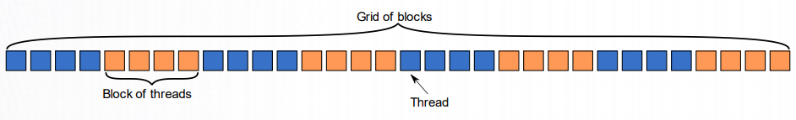
Device Kernels: The Grid blocks of threads in 1D
Threads in grid have access to:
- Their respective block: blockIdx.x
- Their respective thread ID in a block: threadIdx.x
- Their block’s dimension: blockDim.x
- The number of blocks in the grid: gridDim.x

Slide 15

Device Kernels: The Grid blocks of threads in 2D
Each color is a block of threads
Each small square is a thread
The concept is the same in 1D and 2D
In 2D each block and thread now has a two-dimensional index
Threads in grid have access to:
- Their respective block IDs: blockIdx.x, blockIdx.y
- Their respective thread IDs in a block: threadIdx.x, threadIdx.y

Slide 16
Device Kernels
Kernels
A simple embarrassingly parallel loop
A device function that will be launched from the host
program is called a kernel and is declared with the
global attribute
Kernels should be declared void
All pointers passed to kernels must point to memory on the device (more later)
All threads execute the kernel’s body “simultaneously”
Each thread uses its unique thread and block IDs to compute a global ID
There could be more than N threads in the grid (we’ll
see why in a minute)‹
for (int i=0;i<N;i++) { h_a[i] *= 2.0;
}
Can be translated into a GPU kernel:
global void myKernel(int N, double *d_a)
{
int i = threadIdx.x + blockIdx.x*blockDim.x;
if (i<N) { d_a[i] *= 2.0; }
}

Slide 17
Device Kernels
Kernels are launched from the host:
dim3 threads(256,1,1); //3D dimensions of a block of threads
dim3 blocks((N+256-1)/256,1,1); //3D dimensions the grid of blocks
hipLaunchKernelGGL(myKernel,
blocks,
threads,
0,
0,
N, a);
//Kernel name (__global__void function)
//Grid dimensions
//Block dimensions
//Bytes of dynamic LDS space (see extra slides)
//Stream (0=NULL stream)
//Kernel arguments
Analogous to CUDA kernel launch syntax:
myKernel<<<blocks, threads, 0, 0>>>(N,a);

Slide 18
SIMD Operations
Why blocks and threads?
Natural mapping of kernels to hardware:
Blocks are dynamically scheduled onto Cus
All threads in a block execute on the same CU
Threads in a block share LDS memory and L1 cache
Threads in a block are executed in 64-wide chunks called “wavefronts”
Wavefronts execute on SIMD units (Single Instruction Multiple Data)
If a wavefront stalls (e.g. data dependency) CUs can quickly context switch to another wavefront
A good practice is to make the block size a multiple of 64 and have several wavefronts (e.g. 256 threads)

Slide 19
Device Kernels
The host instructs the device to allocate memory in VRAM and records a pointer to device memory:
int main() {
…
int N = 1000;
size_t Nbytes = N*sizeof(double);
double *h_a = (double*) malloc(Nbytes); //Host memory
double *d_a = NULL;
hipMalloc(&d_a, Nbytes);
//Allocate Nbytes on device
free(h_a); hipFree(d_a);
//free host memory
//free device memory
}
…

Slide 20
Device Memory
The host queues memory transfers:
Can copy strided sections of arrays:
//copy data from host to device
hipMemcpy(d_a, h_a, Nbytes, hipMemcpyHostToDevice);
//copy data from device to host
hipMemcpy(h_a, d_a, Nbytes, hipMemcpyDeviceToHost);
//copy data from one device buffer to another hipMemcpy(d_b, d_a, Nbytes, hipMemcpyDeviceToDevice);
HipMemcpy2D (d_a, //pointer to destination
DLDAbytes, //pitch of destination array
h_a, //pointer to source
LDAbytes, //pitch of source array
Nbytes, //number of bytes in each row
Nrows, //number of rows to copy
hipMemcpyHostToDevice);

Slide 21
Error Checking
Most HIP API functions return error codes of type hipError_t hipError_t status1 = hipMalloc(…); hipError_t status2 = hipMemcpy(…);
If API function was error-free, returns hipSuccess, otherwise returns an error code.
Can also peek/get at last error returned with hipError_t status3 = hipGetLastError(); hipError_t status4 = hipPeekLastError();
Can get a corresponding error string using hipGetErrorString(status). Helpful for debugging, e.g.
#define HIP_CHECK(command) { \ hipError_t status = command; \ if (status!=hipSuccess) { \
std::cerr << “Error: HIP reports ” << hipGetErrorString(status) << std::endl; \ std::abort(); } }

Slide 22
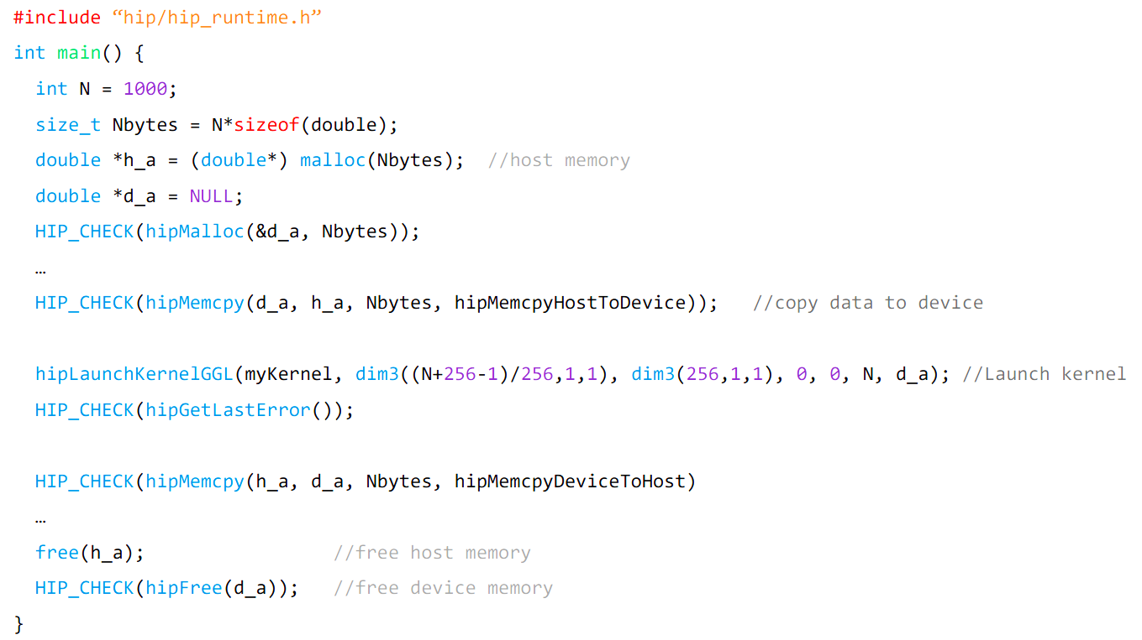
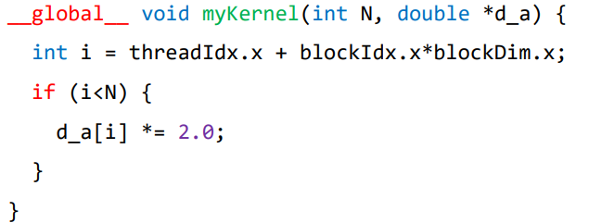
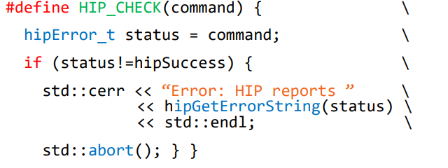
Putting all together

Slide 23

GPU Programming consideration
GPU model requires many small tasks executing a kernel
- e.g. can replace iterations of loop with a GPU kernel call
Need to adapt CPU code to run on the GPU
- rethink algorithm to fit better into the execution model
- keep reusing data on the GPU to reach high occupancy of the hardware
- if necessary, manage data transfers between CPU and GPU memories carefully
(can easily become a bottleneck!)

Slide 24

Grid: Thread Hierarchy
Kernels are executed on a 3D grid of threads
- threads are partitioned into equalized blocks
Code is executed by the threads,
the grid is just a way to organize the work
Dimension of the grid are set at
kernel launch
Built-in variables to be used within a kernel:
- threadIdx, blockIDx, blockDim, gridDim

Slide 25
HIP: Kernels
Kernel is a (device) function to be executed by the GPU
Function should be of void type and needs to be declared with the
__global__ or __device__ attribute
All pointers passed to the kernel need to point to memory accessible from the device
Unique thread and block IDs can be used to distribute work

Slide 26
HIP Synchronization
and streams

Slide 27
HIP: What is a stream ?
A sequence of operations that execute in issue-order on the GPU
HIP operations in different streams could run concurrently
The ROCm 4.5.0 brings the Direct Dispatch, the runtime directly queues a packet to the AQL queue in Dispatch and some of the synchronization.
The previous ROCm uses queue per stream

Slide 28
HIP: What is a stream ?
A stream in HIP is a queue of tasks (e.g. kernels, memcpys, events).
- Tasks enqueued in a stream complete in order on that stream.
- Tasks being executed in different streams are allowed to overlap and share device resources.
Streams are created via:
hipStream_t stream;
hipStreamCreate(&stream);
And destroyed via: hipStreamDestroy(stream);
Passing 0 or NULL as the hipStream_t argument to a function instructs the function to execute on a stream called the ‘NULL Stream’:
- No task on the NULL stream will begin until all previously enqueued tasks in all other streams have completed.
- Blocking calls like hipMemcpy run on the NULL stream.

Slide 29
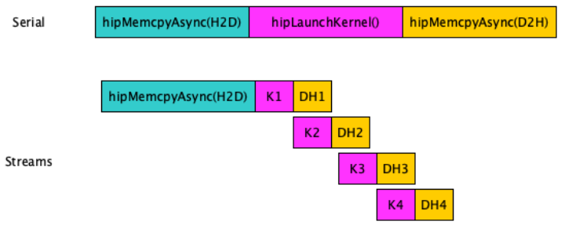
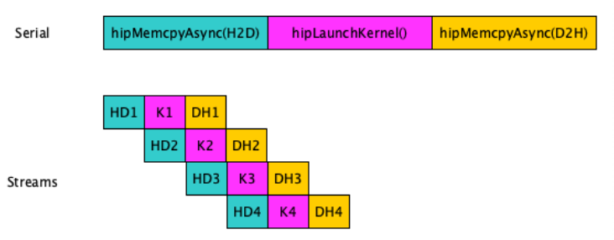
HIP: Stream
Concurreny
Amount of concurrency
Defaut
Only a single stream is used if not defined
Commands are synchronized except the Async calls and Kernels

Slide 30
HIP: Stream
Stream/Events API
hipStreamCreate: | Creates an asynchronous stream
hipStreamDestroy | Destroy an asynchronous stream
hipStreamCreateWithFlags | Creates an asynchronous stream with specified flags
hipEventCreate | Create an event
hipEventRecord | Record an event in a specified stream
hipEventSynchronize: | Wait for an event to complete
hipEventElapsedTime: | Return the elapsed time between two events
hipEventDestroy: | Destroy the specified event

Slide 31
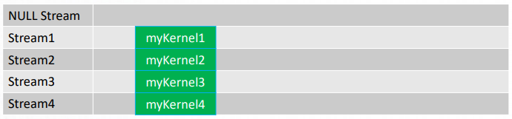
HIP: Stream
▪ Suppose we have 4 small kernels to execute:
hipLaunchKernelGGL(myKernel1, dim3(1), dim3(256), 0, 0, 256, d_a1);
hipLaunchKernelGGL(myKernel2, dim3(1), dim3(256), 0, 0, 256, d_a2);
hipLaunchKernelGGL(myKernel3, dim3(1), dim3(256), 0, 0, 256, d_a3);
hipLaunchKernelGGL(myKernel4, dim3(1), dim3(256), 0, 0, 256, d_a4);
▪ Even though these kernels use only one block each, they’ll execute in serial on the NULL stream:
▪ With streams we can effectively share the GPU’s compute resources:
hipLaunchKernelGGL(myKernel1, dim3(1), dim3(256), 0, stream1, 256, d_a1);
hipLaunchKernelGGL(myKernel2, dim3(1), dim3(256), 0, stream2, 256, d_a2);
hipLaunchKernelGGL(myKernel3, dim3(1), dim3(256), 0, stream3, 256, d_a3);
hipLaunchKernelGGL(myKernel4, dim3(1), dim3(256), 0, stream4, 256, d_a4);
Rem: Check that the kernels modify different parts of memory to avoid data races.
With large kernels, overlapping computations may not help performance.

Slide 32
HIP: Stream
There is another use for streams besides concurrent kernels:
-Overlapping kernels with data movement.
AMD GPUs have separate engines for:
- Host->Device memcpys
- Device->Host memcpys
- Compute kernels.
These three different operations can overlap without dividing the GPU’s resources.
- The overlapping operations should be in separate, non-NULL, streams.
- The host memory should be pinned.

Slide 33
HIP: Pinned Memory
Host data allocations are pageable by default. The GPU can directly access Host data if it is pinned instead.
Allocating pinned host memory:
double *h_a = NULL;
hipHostMalloc(&h_a, Nbytes);
Free pinned host memory:
hipHostFree(h_a);
Host<->Device memcpy bandwidth increases significantly when host memory is pinned.
- It is good practice to allocate host memory that is frequently transferred to/from the device as pinned memory.

Slide 34
HIP: Stream
Suppose we have 3 kernels which require moving data to and from the device:
hipMemcpy(d_a1, h_a1, Nbytes, hipMemcpyHostToDevice));
hipMemcpy(d_a2, h_a2, Nbytes, hipMemcpyHostToDevice));
hipMemcpy(d_a3, h_a3, Nbytes, hipMemcpyHostToDevice));
hipLaunchKernelGGL(myKernel1, blocks, threads, 0, 0, N, d_a1);
hipLaunchKernelGGL(myKernel2, blocks, threads, 0, 0, N, d_a2);
hipLaunchKernelGGL(myKernel3, blocks, threads, 0, 0, N, d_a3);
hipMemcpy(h_a1, d_a1, Nbytes, hipMemcpyDeviceToHost);
hipMemcpy(h_a2, d_a2, Nbytes, hipMemcpyDeviceToHost);
hipMemcpy(h_a3, d_a3, Nbytes, hipMemcpyDeviceToHost);

Slide 35
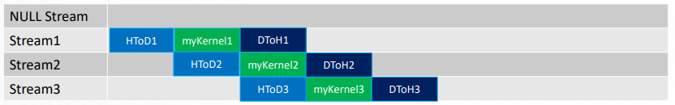
HIP: Stream
Changing to asynchronous memcpys and using streams:
hipMemcpyAsync(d_a1, h_a1, Nbytes, hipMemcpyHostToDevice, stream1);
hipMemcpyAsync(d_a2, h_a2, Nbytes, hipMemcpyHostToDevice, stream2);
hipMemcpyAsync(d_a3, h_a3, Nbytes, hipMemcpyHostToDevice, stream3);
hipLaunchKernelGGL(myKernel1, blocks, threads, 0, stream1, N, d_a1);
hipLaunchKernelGGL(myKernel2, blocks, threads, 0, stream2, N, d_a2);
hipLaunchKernelGGL(myKernel3, blocks, threads, 0, stream3, N, d_a3);
hipMemcpyAsync(h_a1, d_a1, Nbytes, hipMemcpyDeviceToHost, stream1);
hipMemcpyAsync(h_a2, d_a2, Nbytes, hipMemcpyDeviceToHost, stream2);
hipMemcpyAsync(h_a3, d_a3, Nbytes, hipMemcpyDeviceToHost, stream3);

Slide 36
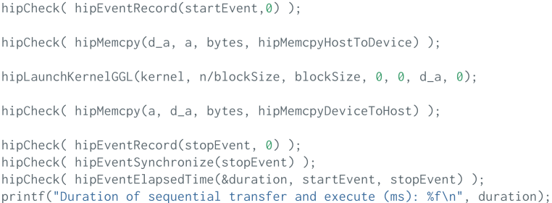
HIP: Example data transfer and compute
Serial

Slide 37
HIP: How on improve the performance ?
Use streams to overlap computation with communication
hipStream_t stream[nStreams];
for (int i = 0; i < nStreams; ++i) hipStreamCreate(&stream[i])
Use Asynchronous data transfer
Execute kernels on different streams
hipLaunchKernelGGL(some_kernel, gridsize, blocksize, shared_mem_size, stream,arg0, arg1, ...);

Slide 38
HIP: Synchronization
Synchronize everything, could be used after each kernel launch except if you know what you are doing
hipDeviceSynchronize()
Heavy-duty sync point.
Blocks host until all work in all device streams has reported complete.
Synchronize a specific stream Blocks host until all HIP calls are completed on this stream
hipStreamSynchronize(stream)
Synchronize using Events
Create event
hipEvent_t stopEvent
hipEventCreate(&stopEvent)
Record an event in a specific stream and wait until is recorded
hipEventRecord(stopEvent,0)
hipEventSynchronize(stopEvent)
Make a stream wait for a specific event
hipStreamWaitEvent(stream[i], stopEvent, unsigned int flags)

Slide 39
HIP: Events
What can we do with queued events?
hipEventSynchronize(event);
- Block host until event reports complete.
- Only a synchronization point with respect to the stream where event was enqueued.
hipEventElapsedTime(&time, startEvent, endEvent);
- Returns the time in ms between when two events, startEvent and endEvent, completed
- Can be very useful for timing kernels/memcpys
hipStreamWaitEvent(stream, event);
- Non-blocking for host.
- Instructs all future work submitted to stream to wait until event reports complete.
- Primary way we enforce an ‘ordering’ between tasks in separate streams

Slide 40
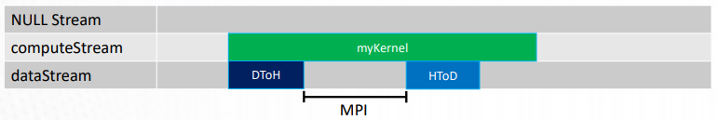
HIP: Stream
A common use-case for streams is MPI traffic:
//Queue local compute kernel
hipLaunchKernelGGL(myKernel, blocks, threads, 0, computeStream, N, d_a);
//Copy halo data to host
hipMemcpyAsync(h_commBuffer, d_commBuffer, Nbytes, hipMemcpyDeviceToHost, dataStream);
hipStreamSynchronize(dataStream); //Wait for data to arrive
//Exchange data with MPI
MPI_Data_Exchange(h_commBuffer);
//Send new data back to device
hipMemcpyAsync(d_commBuffer, h_commBuffer, Nbytes, hipMemcpyHostToDevice, dataStream);

Slide 41
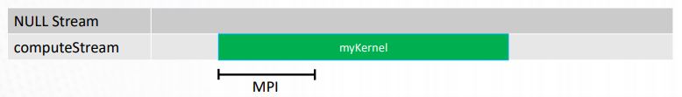
HIP: Stream
With a GPU-aware MPI stack, the Host<->Device traffic can be omitted:
//Some synchronization so that data on GPU and local compute are ready
hipDeviceSynchronize();
//Exchange data with MPI (with device pointer)
MPI_Data_Exchange(d_commBuffer, &request);
//Queue local compute kernel
hipLaunchKernelGGL(myKernel, blocks, threads, 0, computeStream, N, d_a);
//Wait for MPI request to complete
MPI_Wait(&request, &status);

Slide 42
HIP: Synchronization in kernel
Code
__global__ void reverse(double *d_a)
{
__shared__ double s_a[256]; //array of doubles, shared in this block
int tid = threadIdx.x;
s_a[tid] = d_a[tid]; //each thread fills one entry
//all wavefronts must reach this point before any wavefront is allowed to continue.
__syncthreads();
d_a[tid] = s_a[255-tid]; //write out array in reverse order
}

Slide 43
HIP Memory allocations,
access and unified memory

Slide 44
HIP: Memory
Memory model
Host and device have separate physical memories
It is generally not possible to call malloc() to allocate memory and access the data from the GPU
Memory management can be
- Explicit (user manages the movement of the data and makes sure CPU and GPU pointers are not mixed)
- Automatic, using Unified Memory (data movement is managed in thebackground by the Unified Memory driver)
Avoid moving data between CPU and GPU
Data copies between host and device are relatively slow
To achieve best performance, the host-device data traffic should be minimized regardless of the chosen memory management strategy
Initializing arrays on the GPU
Rather than just solving a linear equation on a GPU, also setting it up on the device
Not copying data back and forth between CPU and GPU every step or iteration can have a large performance impact!

Slide 45
HIP: Memory
Device memory hierarchy
Registers (per-thread-access)
- Used automatically
- Size on the order of kilobytes
- Very fast access
Local memory (per-thread-access)
- Used automatically if all registers are reserved
- Local memory resides in global memory
-Very slow access
Shared memory (per-blockaccess)
- Usage must be explicitly programmed
- Size on the order of kilobytes
- Fast access
Global memory (per-deviceaccess)
- Managed by the host through HIP API
- Size on the order of gigabytes
- Very slow access
There are more details in the memory hierarchy, some of which are architecture-dependent, eg,
- Texture memory
- Constant memory
Complicates implementation
Should be considered only when a very high level of optimization is desirable

Slide 46

HIP: Memory
Important memory operations
Allocate pinned device memory
hipError_t hipMalloc(void **devPtr, size_t size)
Allocate Unified Memory; The data is moved automatically between host/device
hipError_t hipMallocManaged(void **devPtr, size_t size)
Deallocate pinned device memory and Unified Memory
hipError_t hipFree(void *devPtr)
Copy data (host-host, host-device, device-host, device-device)
hipError_t hipMemcpy(void *dst, const void *src, size_t count, enum hipMemcpyKind kind)

Slide 47
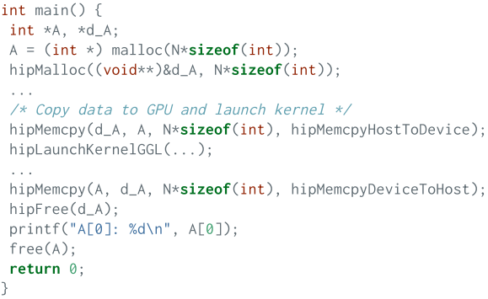
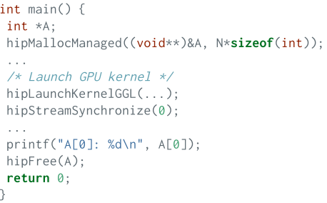
HIP: Memory
Example of explicit memory management
Example of Unified Memory

Slide 48
HIP: Memory
Unified Memory pros
Allows incremental development
Can increase developer productivity significantly
Especially large codebases with complex data structures
Supported by the latest NVIDIA + AMD architectures
Allows oversubscribing GPU memory on some architectures
Unified Memory cons
Data transfers between host and device are initially slower, but can be optimized once the code works
Through prefetches
Through hints
Must still obey concurrency & coherency rules, not foolproof
The performance on the AMD cards is an open question

Slide 49
HIP: Memory
Unified Memory workflow for GPU offloading
Allocate memory for the arrays accessed by the GPU with hipMallocManaged() instead of malloc()
It is a good idea to have a wrapper function or use function overloading for memory allocations
Offload compute kernels to GPUs
Check profiler backtrace for GPU->CPU Unified Memory page-faults
(NVIDIA Visual Profiler, Nsight Systems, AMD profiler?)
This indicates where the data residing on the GPU is accessed by the CPU very useful for large codebases, especially if the developer is new to the code)

Slide 50
HIP: Memory
Unified Memory workflow for GPU offloading
Move operations from CPU to GPU if possible, or use hints / prefetching (hipMemAdvice() / hipMemPrefetchAsync())
It is not necessary to eliminate all page faults, but eliminating the most frequently occurring ones can provide significant performance improvements
Allocating GPU memory can have a much higher overhead than allocating standard host memory
If GPU memory is allocated and deallocated in a loop, consider using a GPU memory pool allocator for better performance

Slide 51
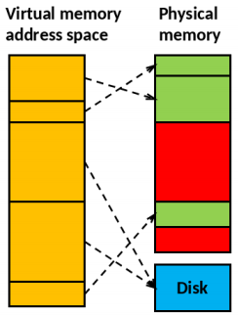
HIP: Memory
Virtual Memory addressing
Modern operating systems utilize virtual memory
- Memory is organized to memory pages
- Memory pages can reside on swap area on
the disk (or on the GPU with Unified Memory)

Slide 52
HIP: Memory
Page-locked (or pinned) memory
Normal malloc() allows swapping and page faults
User can page-lock an allocated memory block to a particular physical memory location
Enables Direct Memory Access (DMA)
Higher transfer speeds between host and device
Copying can be interleaved with kernel execution
Page-locking too much memory can degrade system performance due to paging problems

Slide 53
HIP: Memory
Allocating page-locked memory on host
Allocated with hipHostMalloc() function instead of malloc()
The allocation can be mapped to the device address space for device access (slow)
- On some architectures, the host pointer to device-mapped allocation can be directly used in device code (ie. it works similarly to Unified Memory pointer, but the access from the device is slow)
Deallocated using hipHostFree()

Slide 54
HIP: Memory
Asynchronous memcopies
Normal hipMemcpy() calls are blocking (i.e. synchronizing)
The execution of host code is blocked until copying is finished
To overlap copying and program execution, asynchronous functions are required
- Such functions have Async suffix, eg. hipMemcpyAsync()
User has to synchronize the program execution
Requires page-locked memory

Slide 55
HIP: Memory
Global memory access in device code
Global memory access from the device is slow
Threads are executed in warps, memory operations are grouped in a similar fashion
Memory access is optimized for coalesced access where threads read from and write to successive memory locations
Exact alignment rules and performance issues depend on the architecture

Slide 56
HIP: Memory
Coalesced memory access
The global memory loads and stores consist of transactions of a certain size (eg. 32 bytes)
If the threads within a warp access data within such a block 32 bytes, only one global memory transaction is needed
Now, 32 threads within a warp can each read a different 4-byte integer value with just 4 transactions
When the stride between each 4- byte integer is increased, more transactions are required (up to 32 for the worst case)!

Slide 57

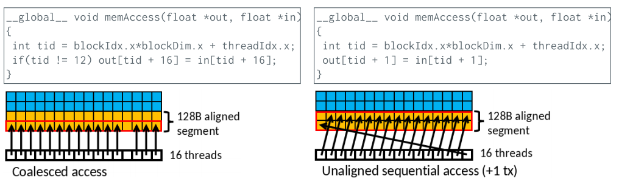
HIP: Memory
Coalesced memory access example

Slide 58
HIP Kernel optimization
and profiling

Slide 59
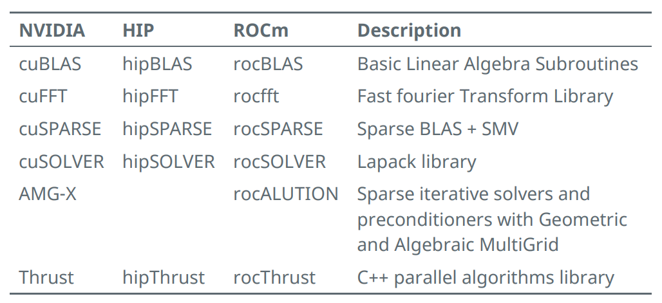
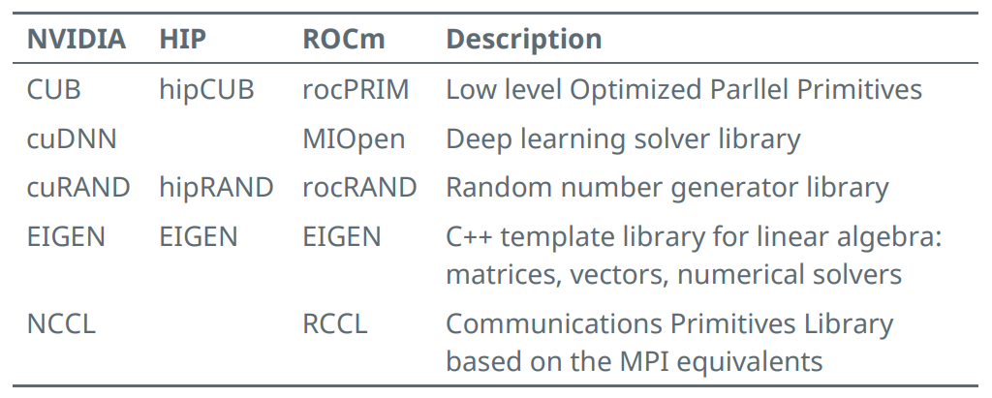
HIP: Libraries

Slide 60
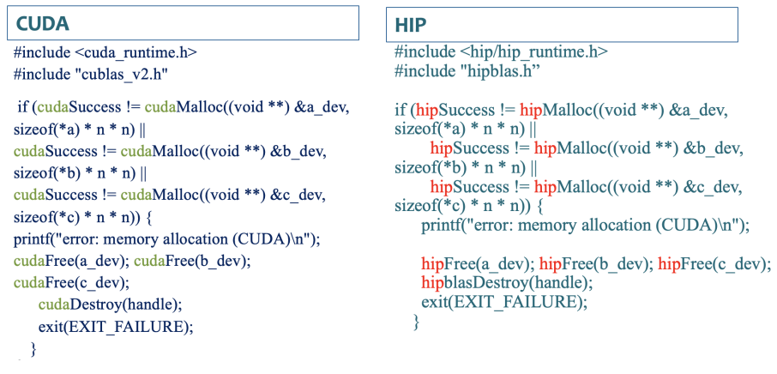
HIP: hipBLAS

Slide 61
HIP: Kernels
You can call a kernel with the command:
hipLaunchKernelGGL(kernel_name, dim3(Blocks), dim3(Threads), 0, 0, arg1, arg2, ...);
or
kernel_name<<<dim3(Blocks), dim3(Threads),0,0>>>(arg1,arg2,...);
where blocks are for the 3D dimensions of the grid of blocks dimensions
threads for the 3D dimentions of a block of threads
0 for bytes of dynamic LDS space
0 for stream
kernel arguments

Slide 62
HIP: Metrics
Various useful metrics
GPUBusy: The percentage of time GPU was busy
Wavefronts: Total wavefronts
VALUInsts: The average number of vector ALU instructions executed per work-item (affected by flow control).
VALUUtilization: The percentage of active vector ALU threads in a wave. A lower number can mean either more thread divergence in a wave or that the work-group size is not a multiple of 64. Value range: 0% (bad), 100%
(ideal - no thread divergence)
VALUBusy: The percentage of GPUTime vector ALU instructions are processed. Value range: 0% (bad) to 100% (optimal).
L2CacheHit: The percentage of fetch, write, atomic, and other instructions that hit the data in L2 cache. Value range: 0% (no hit) to 100% (optimal).
LDSBankConflict: The percentage of GPUTime LDS is stalled by bank conflicts. Value range: 0% (optimal) to 100% (bad).

Slide 63
Device Code, Shared Memory,
and Thread Synchronization

Slide 64
HIP: Function Qualifiers
hipcc makes two compilation passes through source code. One to compile host code, and one to compile device code.
▪ __global__ functions:
- These are entry points to device code, called from the host
- Code in these regions will execute on SIMD units
▪ __device__ functions:
- Can be called from __global__ and other __device__ functions.
- Cannot be called from host code.
- Not compiled into host code – essentially ignored during host compilation pass
__host__ __device__ functions:
- Can be called from __global__, __device__, and host functions.
- Will execute on SIMD units when called from device code!

Slide 65
HIP: SIMD Execution
SIMD Execution
On SIMD units, be aware of divergence.
Branching logic (if – else) can be costly:
- Wavefront encounters an if statement
- Evaluates conditional
- If true, continues to statement body
- If false, also continues to statement body with all instructions replaced with NoOps.
- Known as ‘thread divergence’
Generally, wavefronts diverging from each other is okay.
Thread divergence within a wavefront can impact performance.

Slide 66
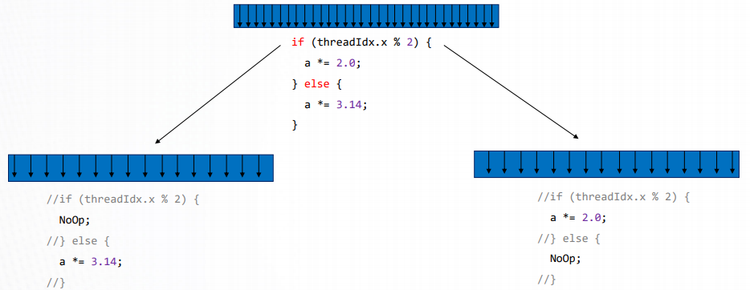
HIP: SIMD Execution
SIMD Execution

Slide 67
HIP: Memory
Memory declarations in Device Code
Malloc/free not supported in device code.
Variables/arrays can be declared on the stack.
Stack variables declared in device code are allocated in registers and are private to each thread.
Threads can all access common memory via device pointers, but otherwise do not share memory.
- Important exception: __shared__ memory
Stack variables declared as __shared__:
- Allocated once per block in LDS memory
- Shared and accessible by all threads in the same block
- Access is faster than device global memory (but slower than register)
- Must have size known at compile time

Slide 68
HIP: Shared Memory
Shared Memory
__global__ void reverse(double *d_a) {
__shared__ double s_a[256]; //array of doubles, shared in this block
int tid = threadIdx.x;
s_a[tid] = d_a[tid]; //each thread fills one entry
//all wavefronts must reach this point before any wavefront is allowed to continue.
__syncthreads();
d_a[tid] = s_a[255-tid]; //write out array in reverse order
}
int main() {
…
hipLaunchKernelGGL(reverse, dim3(1), dim3(256), 0, 0, d_a); //Launch kernel
…
}

Slide 69
HIP: Thread Syncrhonization
Thread Synchronization
__syncthreads():
- Blocks a wavefront from continuing execution until all wavefronts have reached __syncthreads()
- Memory transactions made by a thread before __syncthreads() are visible to all other threads in the block after
__syncthreads()
- Can have a noticeable overhead if called repeatedly
Best practice: Avoid deadlocks by checking that all threads in a block execute the same __syncthreads() instruction.
Rem 1: So long as at least one thread in the wavefront encounters __syncthreads(), the whole wavefront is considered to have encountered __syncthreads().
Rem 2: Wavefronts can synchronize at different __syncthreads() instructions, and if a wavefront exits a kernel
completely, other wavefronts waiting at a __syncthreads() may be allowed to continue.

Slide 70
HIP: API
Device Management:
- hipSetDevice(), hipGetDevice(), hipGetDeviceProperties()
Memory Management
- hipMalloc(), hipMemcpy(), hipMemcpyAsync(), hipFree()
Streams
- hipStreamCreate(), hipSynchronize(), hipStreamSynchronize(), hipStreamFree()
Events
- hipEventCreate(), hipEventRecord(), hipStreamWaitEvent(), hipEventElapsedTime()
Device Kernels
__global__, __device__, hipLaunchKernelGGL()
Device code
- threadIdx, blockIdx, blockDim, __shared__
- 200+ math functions covering entire CUDA math library.
Error handling
- hipGetLastError(), hipGetErrorString()

Slide 71
HIP Multi-GPU programming
and HIP+MPI

Slide 72
HIP: GPU Context
Context is established when the first HIP function requiring an active context is called hipMalloc()
Several processes can create contexts for a single device
Resources are allocated per context
By default, one context per device per process (since CUDA 4.0)
-Threads of the same process share the primary context (for each device)
Driver associates a number for each HIP-capable GPU starting from 0
The function hipSetDevice() is used for selecting the desired device

Slide 73

HIP: Device Management
Return the number of hip capable devices in *count
hipError_t hipGetDeviceCount(int *count)
Set device as the current device for the calling host thread
hipError_t hipSetDevice(int device)
Return the current device for the calling host thread in *device
hipError_t hipGetDevice(int *device)
Reset and explicitly destroy all resources associated with the current device
hipError_t hipDeviceReset(void)

Slide 74
HIP: Quering devices properties
One can query the properties of different devices in the system using hipGetDeviceProperties() function
- No context needed
- Provides e.g. name, amount of memory, warp size, support for unified virtual addressing, etc.
- Useful for code portability
Return the properties of a HIP capable device in *prop
hipError_t hipGetDeviceProperties(struct hipDeviceProp *prop, int device)

Slide 75
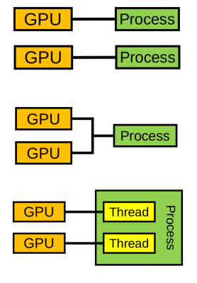
HIP: Multi-GPU prograsmming models
One GPU per process
- Syncing is handled through message passing (eg. MPI)
Many GPUs per process
- Process manages all context switching and syncing explicitly
One GPU per thread
- Syncing is handled through thread synchronization requirements

Slide 76
HIP: Multi-GPU, one GPU per process
Recommended for multi-process applications using a message passing library
Message passing library takes care of all GPU-GPU communication
Each process interacts with only one GPU which makes the implementation easier and less invasive (if MPI is used anyway)
- Apart from each process selecting a different device, the implementation looks
much like a single-GPU program
Multi-GPU implementation using MPI is discussed at the end!

Slide 77
HIP: Multi-GPU, many GPUs per process
Process switches the active GPU using hipSetDevice() function
After setting the device, HIP-calls such as the following are effective only on the selected GPU:
- Memory allocations and copies
- Streams and events
- Kernel calls
Asynchronous calls are required to overlap work across all devices

Slide 78
HIP: Multi-GPU, one GPU per process
One GPU per CPU thread
- I.e one OpenMP thread per GPU being used
HIP API is threadsafe
- Multiple threads can call the functions at the same time
Each thread can create its own context on a different GPU
- hipSetDevice() sets the device and creates a context per thread
- Easy device management with no changing of device
Communication between threads becomes a bit more tricky
#pragma omp parallel for
for(unsigned int i = 0; i < deviceCount; i++)
{
hipSetDevice(i);
kernel<<<blocks[i],threads[i]>>>(arg1[i], arg2[i]);
}

Slide 79
HIP: Peer access
Access peer GPU memory directly from another GPU
- Pass a pointer to data on GPU 1 to a kernel running on GPU 0
- Transfer data between GPUs without going through host memory
- Lower latency, higher bandwidth
Check peer accessibility
hipError_t hipDeviceCanAccessPeer(int* canAccessPeer, int device, int peerDevice)
Enable peer access
hipError_t hipDeviceEnablePeerAccess(int peerDevice, unsigned int flags)
Disable peer access
hipError_t hipDeviceDisablePeerAccess(int peerDevice)

Slide 80
HIP: Peer to peer communication
Devices have separate memories
With devices supporting unified virtual addressing, hipMemCpy() with kind=hipMemcpyDefault, works:
hipError_t hipMemcpy(void* dst, void* src, size_t count, hipMemcpyKind kind)
Other option which does not require unified virtual addressing
hipError_t hipMemcpyPeer(void* dst, int dstDev, void* src, int srcDev, size_t count)
If peer to peer access is not available, the functions result in a normal copy through host memory

Slide 81
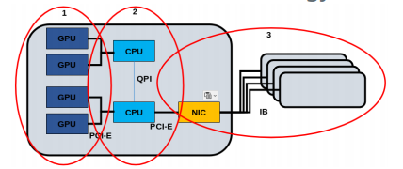
HIP: Three levels of parallelism
1. GPU - GPU threads on the multiprocessors
Parallelization strategy: HIP, SYCL, Kokkos, OpenMP
2. Node - Multiple GPUs and CPUs
Parallelization strategy: MPI, Threads, OpenMP
3. Supercomputer - Many nodes connected with interconnect
Parallelization strategy: MPI between nodes

Slide 82
HIP: Strategies
MPI+HIP strategies
1. One MPI process per node
2. One MPI process per GPU
3. Many MPI processes per GPU, only one uses it
4. Many MPI processes sharing a GPU
2 is recommended (also allows using 4 with services such as CUDA MPS)
- Typically results in most productive and least invasive implementation for an MPI program
- No need to implement GPU-GPU transfers explicitly (MPI handles all this)
- It is further possible to utilize remaining CPU cores with OpenMP (but this
is not always worth the effort/increased complexity)

Slide 83
HIP: Strategies
Selecting the correct GPU
Typically all processes on the node can access all GPUs of that node.
The following implementation allows utilizing all GPUs using one or more processes per GPU.
-Use CUDA MPS when launching more processes than GPUs
int deviceCount, nodeRank;
MPI_Comm commNode;
MPI_Comm_split_type(MPI_COMM_WORLD, MPI_COMM_TYPE_SHARED, 0, MPI_INFO_NULL, &commNode);
MPI_Comm_rank(commNode, &nodeRank);
hipGetDeviceCount(&deviceCount);
hipSetDevice(nodeRank % deviceCount);

Slide 84
HIP: Strategies
GPU-GPU communication through MPI
CUDA/ROCm aware MPI libraries support direct GPU-GPU transfers
- Can take a pointer to device buffer (avoids host/device data copies)
Unfortunately, currently no GPU support for custom MPI datatypes
(must use a datatype representing a contiguous block of memory)
- Data packing/unpacking must be implemented application-side on GPU
ROCm aware MPI libraries are under development and there may be
problems
- It is a good idea to have a fallback option to use pinned host staging buffers

Slide 85
HIP: Strategies
Many options to write a multi-GPU program:
Use hipSetDevice() to select the device, and the subsequent HIP calls operate on that device
If you have an MPI program, it is often best to use one GPU per process, and let MPI handle data transfers between GPUs
There is still little experience from ROCm aware MPIs, there may be issues
Note that a CUDA/ROCm aware MPI is only required when passing device pointers to the MPI, passing only host pointers does not require any CUDA/ROCm awareness

Slide 86
HIP Examples

Slide 87
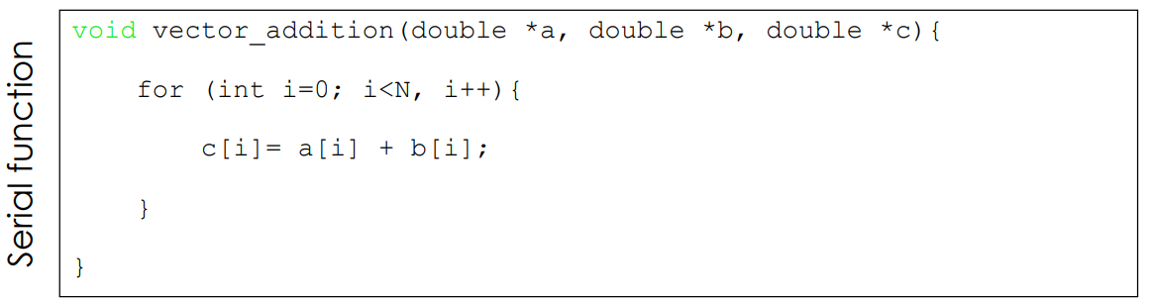
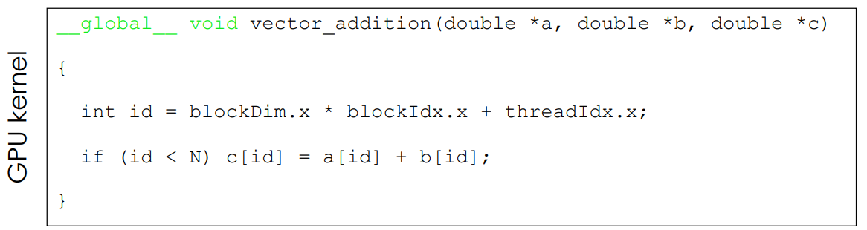
HIP: Vector Addition
Embarrassingly Parallel; each element-wise addition is completely independent from all others,
⇒ so all elements can be computed at the same time.
A single process
iterates through the loop and adds the vectors element by element (sequentially)
GPU kernel
All GPU threads run same kernel function,
but each thread is assigned a unique global ID to know which element(s) to calculate.
__global__ : Indicates the function is a HIP kernel function – called by the host (CPU) and executed on the device (GPU).

Slide 88
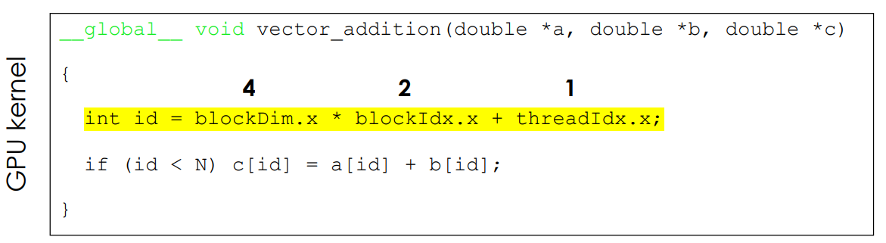
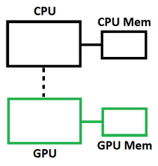
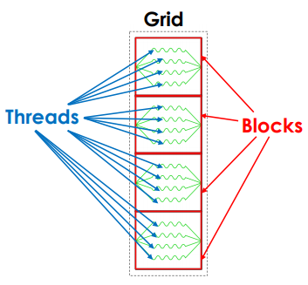
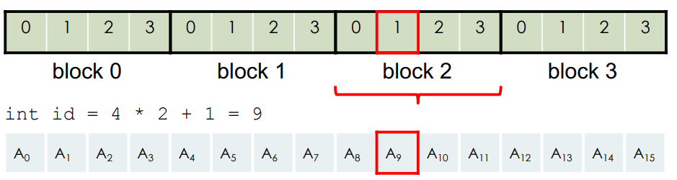
HIP: Vector Addition
For example, with blockIdx.x = 2 and threadIdx.x = 1…

Slide 90


Thank you for your attention !

