Slide 1

Bow-Tie Architecture in the
Drosophila melanogaster Connectome
A Two-Scale Structural Analysis
Candidate
Federico Di Franco — student ID 263678
Supervisor
Prof. Giorgio Terracina
Academic Year 2025/2026
Notes:
[read out by the chair: do not read it again]

Slide 2
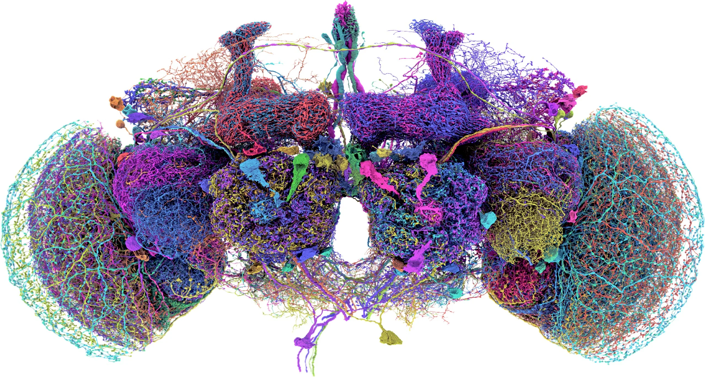
A connectome, and the question I ask of it
A connectome is the complete map of a brain: every neuron, and every connection between them, traced one synapse at a time.
For the adult fruit fly it was finished in 2024 — the first ever for an adult brain of this size.
134,181 neurons 2,700,513 connections
Everything here is computed on that map and nothing else: no experiments, only the wiring.
The question: does the brain funnel its traffic through a few central elements, the way an hourglass does?
rendering: the 50 largest neurons — FlyWire
1
Notes:
[40 s] This is a connectome: the complete map of every neuron in a brain and every connection between them, traced one synapse at a time. For the adult fruit fly it was finished in twenty twenty-four, and it is the first one ever completed for an adult brain of this size. Everything I will show is computed on that map and on nothing else: no recordings, no experiments, only the wiring. And the question I ask of it is whether the brain funnels its traffic through a few central elements, the way an hourglass does.

Slide 3
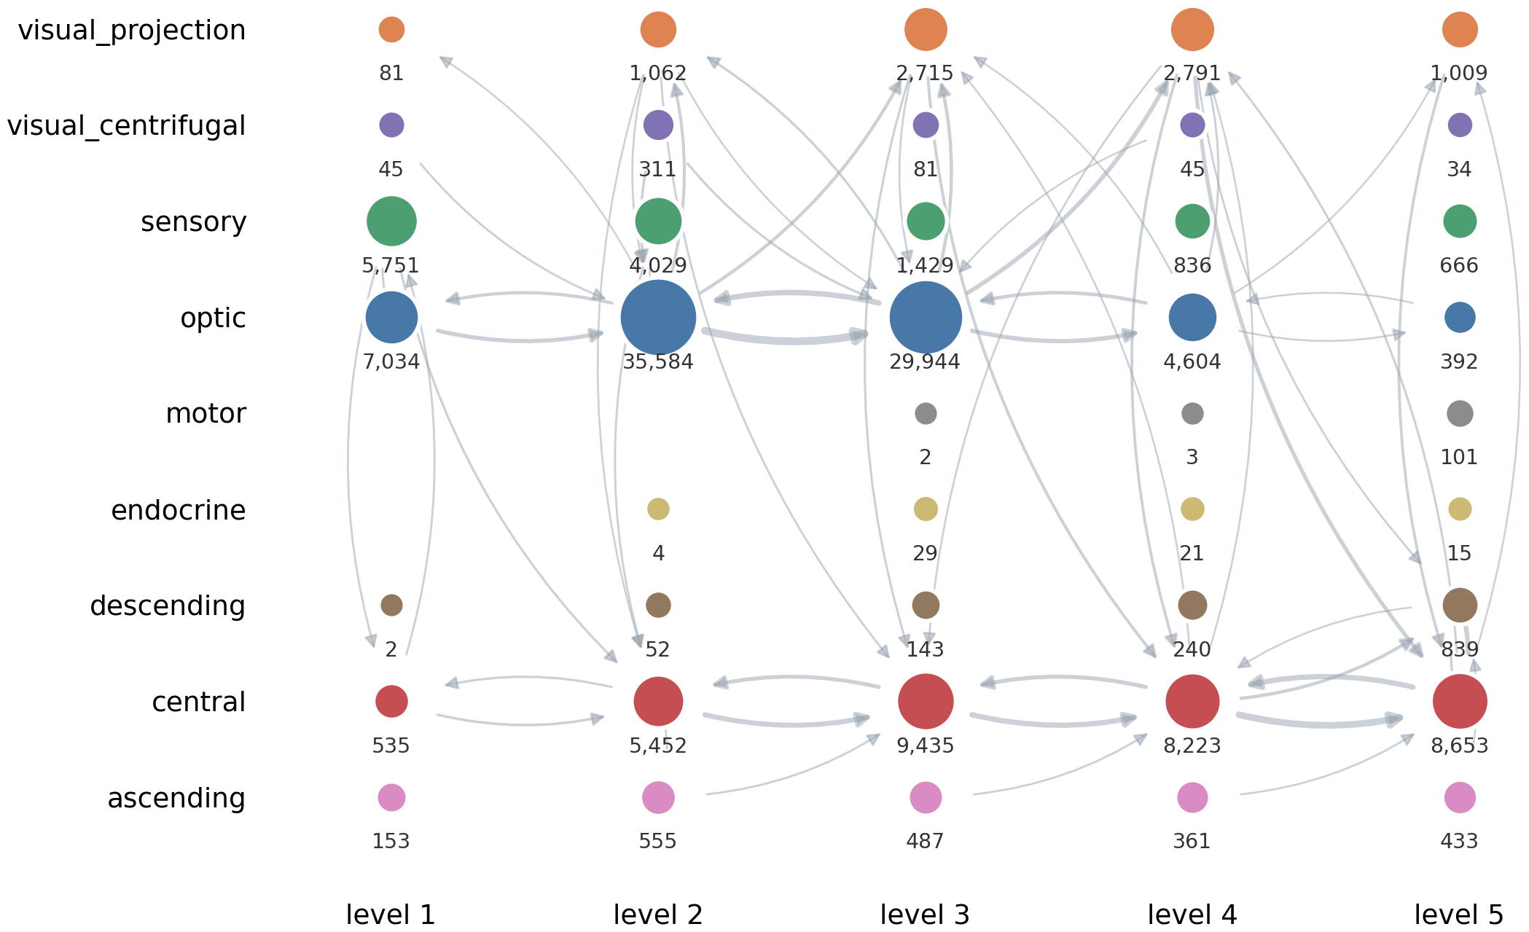
The map I work on
Every neuron carries a level, from 1 near the senses to 5 near the muscles.
One brain region at one level makes one node: 1,698 nodes instead of 134,181 neurons.
A motif is a small shape of connections that keeps recurring between those nodes.
Circle size is how many neurons; line thickness is how strong the connection.
2
Notes:
[35 s] Two things before the results. First, every neuron carries a level, from one near the senses to five near the muscles, so the brain has a front-to-back order. Second, a single neuron tells you nothing and a hundred and thirty-four thousand are too many, so I group them: one brain region at one level makes one node. Sixteen hundred nodes remain, and this is the map. Circle size is how many neurons; line thickness is how strong the connection. A motif is a small shape of connections that keeps recurring on this map.
[se chiedono perche' la tesi dice 879] Quello e' il conto sulla sola finestra 1-2-3, dove si contano i motif. Qui la mappa e' su tutti e cinque i livelli, e i metanodi sono 1.698.

Slide 4
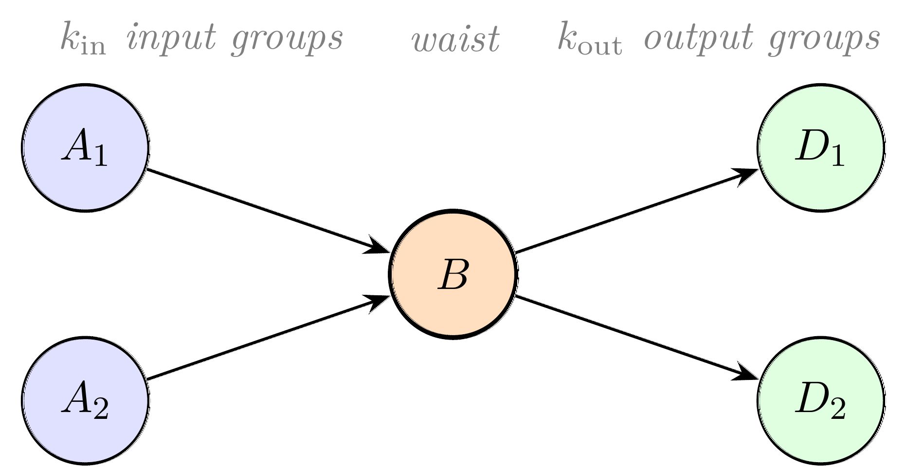
Two ways to measure the same shape
“Hourglass” is a claim about shape, and shape can be measured from two distances. Neither one answers the question alone.
Close up — one motif at a time
Far away — the whole network at once
How often do several regions converge on a single middle region, which then fans out again?
How few neurons does it take to cover every route from the senses to the muscles?
154 neurons
cover 90% of the routes — a score of H = 0.498, against 0.74–0.87 for the worm C. elegans
Tells me whether the brain has a bottleneck at all.
Tells me which structures are bottlenecks.
3
Notes:
[40 s] Now, an hourglass is a claim about shape, and shape can be measured in two different ways. Locally I take one motif at a time and ask how often several regions converge on a single middle one, which then fans out again: that tells me which structures are bottlenecks. Globally I ask the same of the whole network, and that tells me whether there is a bottleneck at all: a hundred and fifty-four neurons cover ninety per cent of the routes, which scores zero point five, against zero point seven-four to eight-seven for the worm C. elegans. Neither view answers the question alone.

Slide 5
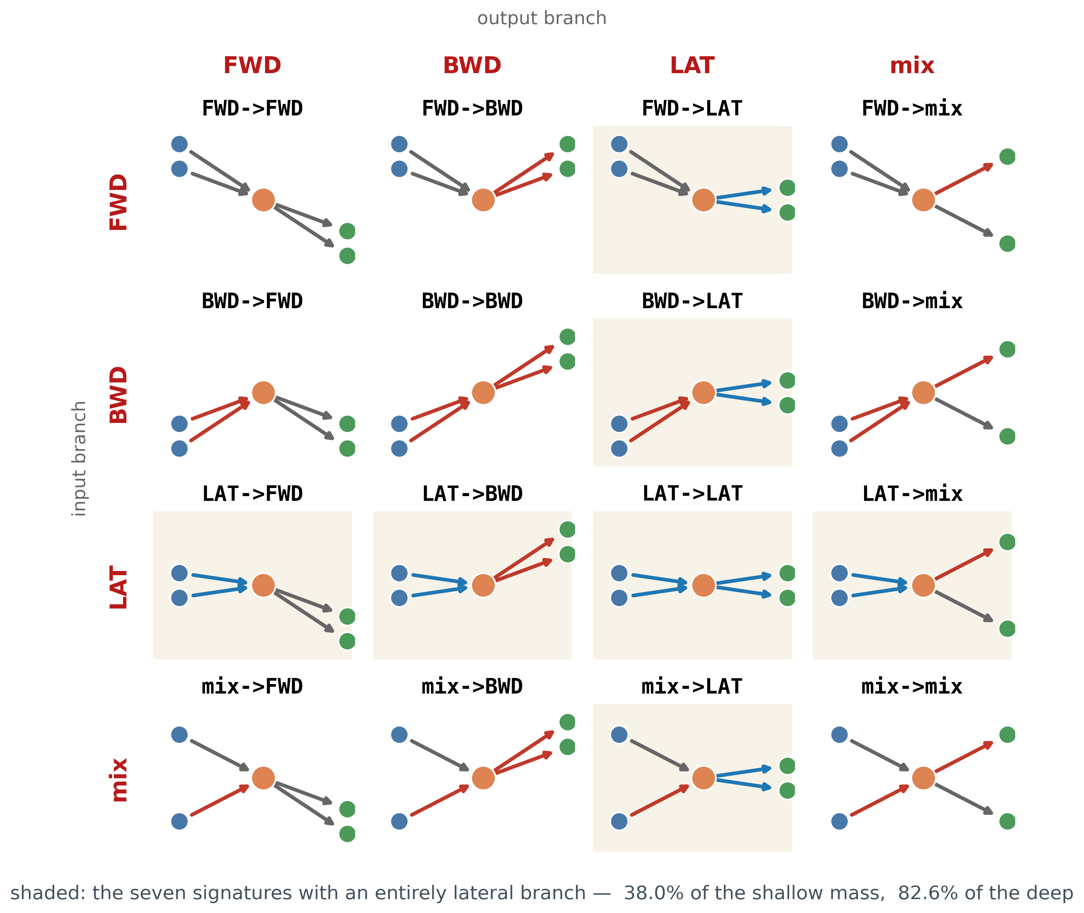
Sixteen directional signatures
Labelling all four connections at once is useless: it puts 94% of motifs into one bucket.
So each motif gets two labels, one per branch — the one going in, the one coming out.
Each branch runs deeper, runs back, stays level, or is mixed. Four by four: sixteen signatures.
Depth increases downwards, so the signature can be read from the slope of the arrows alone.
4
Notes:
[30 s] Back to the local view. Each motif has two branches, the one entering the middle and the one leaving it. Labelling all four connections at once is useless, because it puts ninety-four per cent of the motifs into a single bucket. So I label the two branches separately: each can run deeper, run back towards the senses, stay level, or be mixed. Four by four gives sixteen signatures.

Slide 6
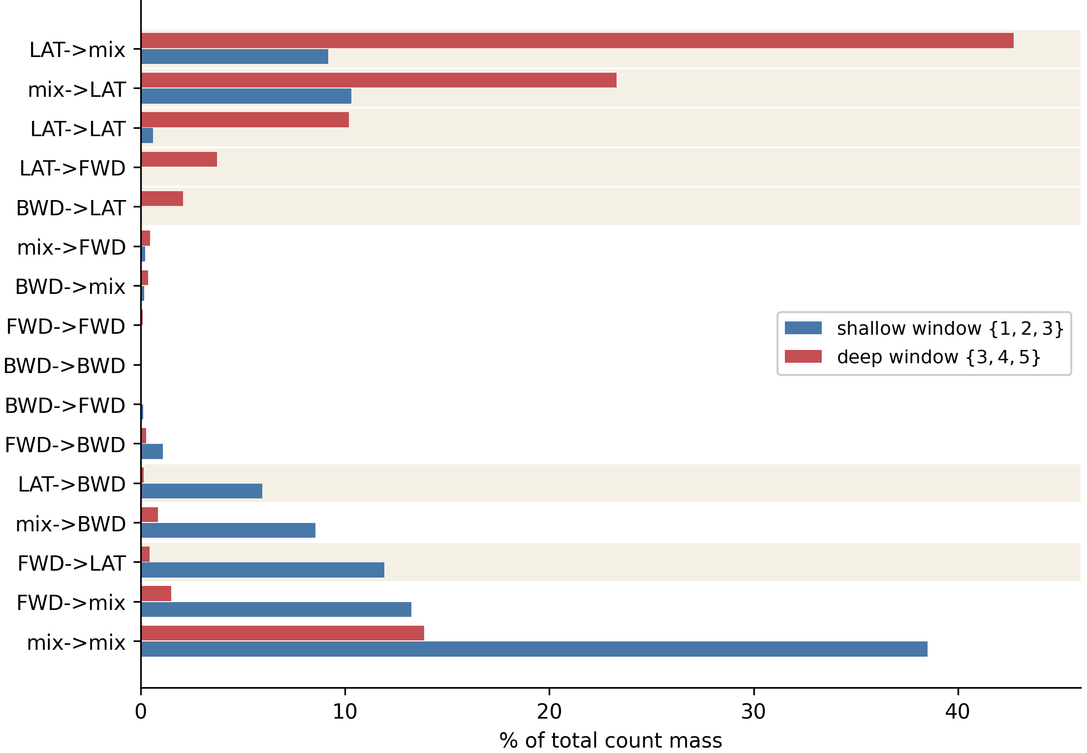
The deep brain stirs instead of advancing
Near the senses the flow runs forward. Deep down it turns sideways.
38.0% → 82.6%
of the motif traffic, in signatures with an entirely sideways branch
The deep brain does not push the signal onwards: it stirs it in place.
5
Notes:
[35 s] And this is the main local result. I compare the shallow part of the brain with the deep part. Near the senses the flow runs forward, as you would expect. Deep down it flips: signatures with a sideways branch go from thirty-eight per cent to eighty-three per cent of the traffic. The deep brain is not pushing the signal onwards. It is stirring it in place.

Slide 7
Do the two views agree?
Out of 660 regions, both views put the same four near the top — and all four sit on the olfactory pathway.
Brain region
rank, close up
rank, far away
antennal lobe → mushroom body
8
12
antennal lobe → lateral horn
10
2
antennal lobe
20
4
antennal lobe → posterior lateral
50
8
Across all regions the agreement is weak (ρ = +0.121), so the two measures are not interchangeable. But where they agree, they agree on the circuit that comes next.
6
Notes:
[25 s] Do the two views agree? Out of six hundred and sixty regions, both put the same four near the top, and all four sit on the olfactory pathway. Overall the agreement is weak, so I am not claiming the two measures are interchangeable. But where they do agree, they agree on something that matters.

Slide 8
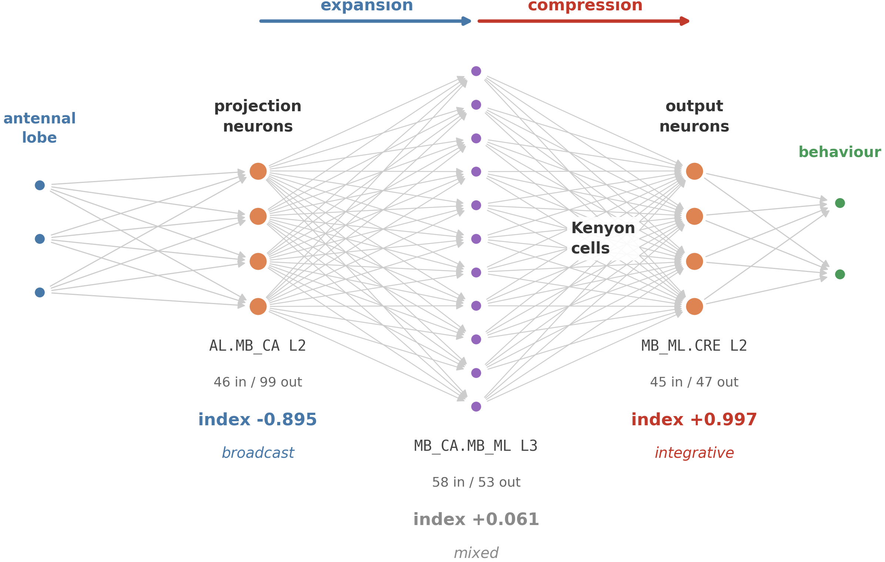
Wiring alone recovers the olfactory pathway
Why this circuit: it is the one whose answer was already known from physiology — so it is a test I could fail.
An index, negative when a circuit fans out and positive when it funnels in, computed from the wiring only.
The five rows were chosen by anatomy, before looking at any numbers.
–0.895 → +0.061 → +1.000
fans out, holds, funnels in — in that order
It is the same shape as a high-dimensional expansion followed by a readout — but the comparison with artificial neural networks is a reading, not a result of the thesis.
7
Notes:
[45 s] Which is the last result. So far every motif had the same number of branches in and out. Letting those vary gives an index that is negative when a circuit fans out and positive when it funnels in, computed from the wiring only. I applied it to the olfactory pathway because it is the one circuit whose answer was already known from physiology, so it is a test I could fail. I picked the five rows by anatomy, before looking at any numbers. The index comes out negative where the circuit expands and at the maximum where it compresses: the textbook description, recovered from the wiring alone.
[if asked about artificial neural networks] The shape is that of a high-dimensional expansion followed by a readout, but that is a reading: the thesis does not make the comparison.
[if asked how general it is] It is validated on one circuit only, the one where the answer was already known. The other seven hundred nodes carry index values too, but nothing here establishes that those are equally meaningful.

Slide 9
Conclusions and future work
What was found
• The hourglass is there, but how narrow it looks depends on how you trace the routes: 0.247 to 0.498.
• Deep in the brain the signal stops advancing and is stirred instead: 38.0% → 82.6%.
• An index built from wiring alone recovers a circuit already known from physiology.
• Whether a connection's direction predicts its chemistry was also tested: it does not hold up, and is reported as a negative result.
Future work
• Repeat the analyses on the deep part of the brain, not only the shallow one.
• Let the motif shape vary across the whole network, not only on the olfactory pathway.
• Apply the same counting to other connectomes: the method does not depend on the species.
8
Notes:
[30 s] To sum up. The hourglass is there, but how narrow it looks depends on how you trace the routes. Deep in the brain the signal stops advancing and is stirred instead. And an index built from wiring alone recovers a circuit already known from physiology. I also tested whether a connection's direction predicts its chemistry: it does not hold up, and I report it as a negative result. The method does not depend on the species. Thank you.

