Slide 1
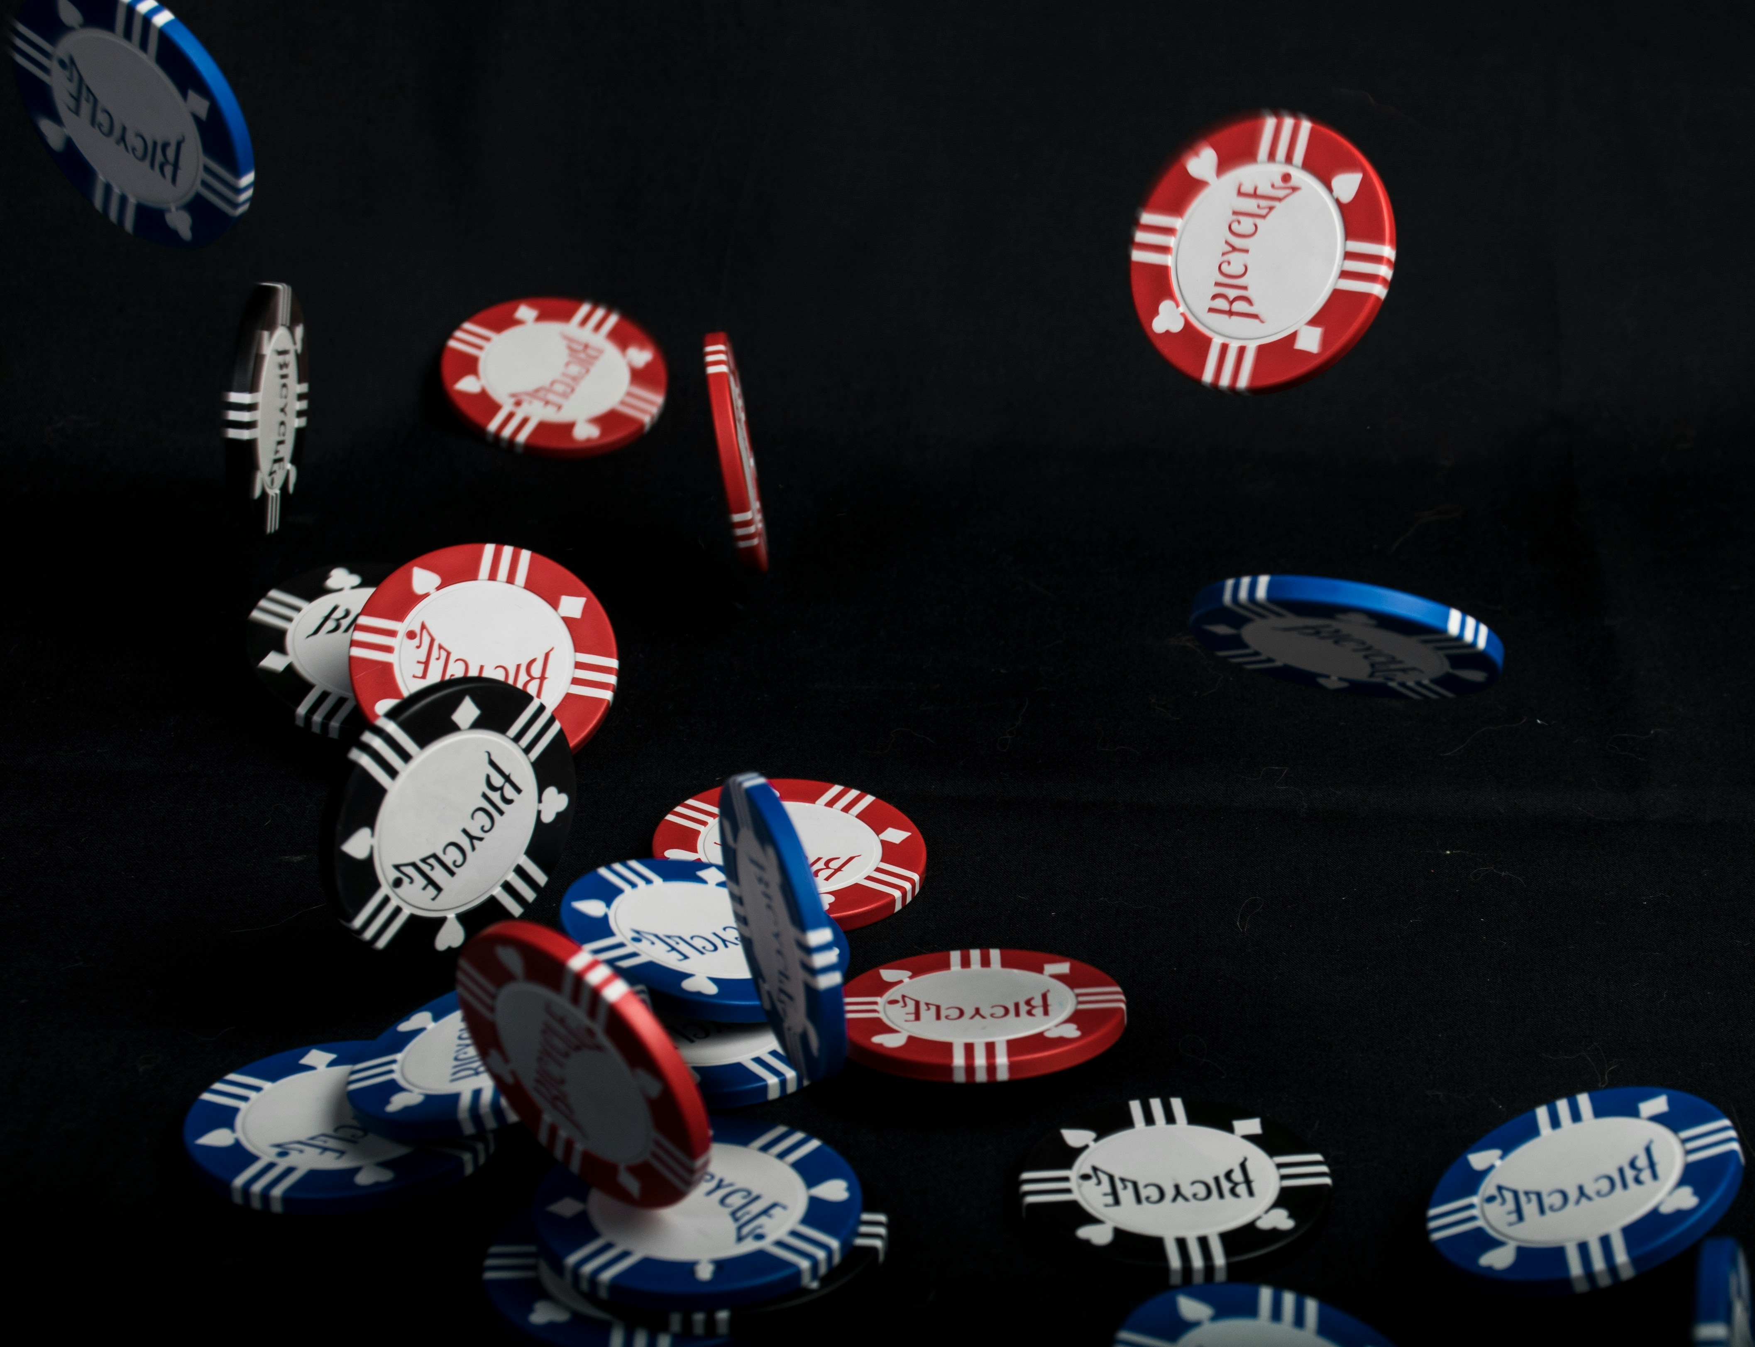

BlackJack Advisor
Automatic Blackjack Hand Recognition and Fundamental Strategy Application Using Computer Vision

Slide 2
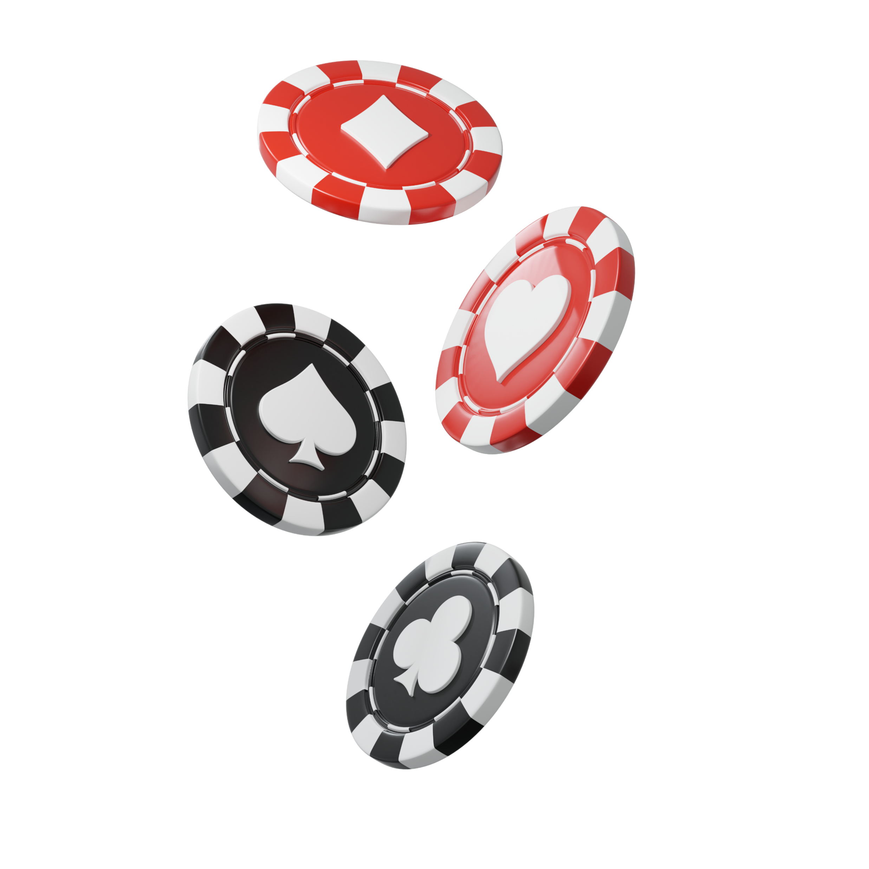
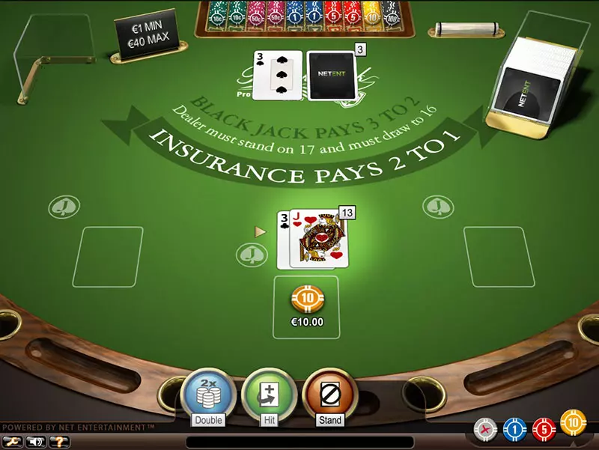
01 - Introduction
Blackjack is one of the most popular gambling games in the world due its semplicity and its probability of winning.
By applying a series of rules,
it is possible to reach a winning percentage of 49%.

Slide 3

02 – Project Goals
BlackJack Advisor aims to automatically apply rules based on probabilistic advantages, taking as input the image of a match.
The project is developed in four main phases:
Object Detection with YOLO
BJ Fundamental
Strategy
Graphic User Interface (GUI)
CNN
Classification

Slide 4

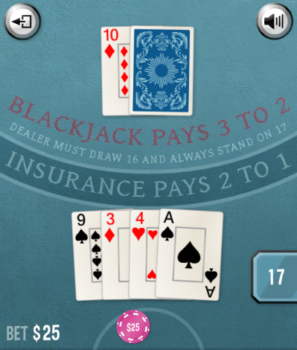
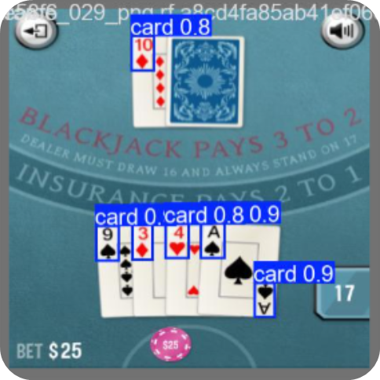
03 – Object Detection
For the first phase, YOLO (You Only Look Ones) was used
YOLO is an efficient deep learning algorithm based on CNN, which identifies and localizes objects within an image.

Slide 5
YOLO Results

Slide 6
04 - CNN Classification
Come abbiamo visto, la nostra CNN è della tipologia nominata a doppia testa, in quanto progettata per effettuare due classificazioni indipendenti a partire dalla stessa immagine di input.
Immagine Architettura

Slide 7
Train e results

Slide 8
05 – Fundamental Strategy

Slide 9
06 - GUI

Slide 10
ESEMPIO 1

Slide 11
ESEMPIO 2

Slide 12
FUTURE DEVELOPS

Slide 13
Link e partecipanti

Slide 14
Il gioco d’azzardo può causare dipendenza patologica!
GRAZIE PER L’ATTENZIONE

