Slide 1
Yes, I'm able to index audio files within Alfresco
2013
Fernando González
fernando.gonzalez@ricoh.es
@fegorama
Notes:
Hi everyone!
I’m Fernando González and this lightning talk is about indexing audio files within Alfresco.

Slide 2

Why?
A lot of audio/video files in many companies
The need to seek words in audio files
Transcription of important conversations
Efficiency in DAM
fernando.gonzalez@ricoh.es
@fegorama
Notes:
There are many answers about the possibilities of indexing audio files:
Many companies have a lot of audio and video files
It’s necessary to search audio files for text words
Many important talks have to be transcribed
Audio indexing promotes efficiency in DAM (Digital Asset Management)

Slide 3

What is it?
AAT (Alfresco Audio Transcriber)
Alfresco Action (Java) for audio transcription with Sphinx-4 from Carnegie Mellon University
fernando.gonzalez@ricoh.es
@fegorama
Notes:
AAT (Alfresco Audio Transcriber) is an Alfresco Module created in Java for audio transcription with Sphinx4 program developed by Carnegie Mellon University. This transcription is used to index text words in Alfresco.

Slide 4

What is Sphinx-4?
A group of speech recognition systems developed at Carnegie Mellon University. These include a series of speech recognizers (Sphinx 2 - 4) and an acoustic model trainer (SphinxTrain).
fernando.gonzalez@ricoh.es
@fegorama
Notes:
But, what is Sphinx-4?
Sphinx-4 describes a group of speech recognition systems developed at Carnegie Mellon University. These include a series of speech recognizers (Sphinx 2 - 4) and an acoustic model trainer (called SphinxTrain).

Slide 5
Elements of Sphinx-4
Language model:
Grammars
Dictionaries
Acoustic models:
Hidden Markov Model (HMM)
fernando.gonzalez@ricoh.es
@fegorama
Notes:
The main elements of Sphinx-4 are:
Two model types --a language model and an acoustic model. The language model includes grammars and dictionaries. Acoustic models are wave modulation algorithmics for human voice recognition --this software uses the Hidden Markov Model (HMM).

Slide 6
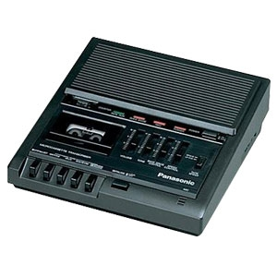
How does the action work?
The action…
Transcribes by direct execution
Transcribes using content rules
Transcribes using UI-Actions
Transcribes with Alfresco Scheduler
fernando.gonzalez@ricoh.es
@fegorama
Notes:
The Alfresco Java Action works as follows:
Audio transcription from direct execution of Java Action
Audio transcription using content rules
Audio transcription using UI-Actions in Alfresco Share
Audio transcription with Alfresco Scheduler by settinp up a scheduler-actions-context.xml file

Slide 7
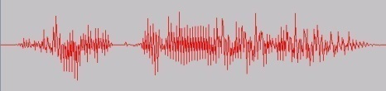
Features
Use of Sphinx-4 and JSAPI2 for recognition
Use of "policies" to transcribe uploaded content
Use of "scheduler" to transcribe spaces programmatically
Use of action “Audio Transcriber" in user interfaces (Alfresco Explorer and Share)
List of available Audio Files
Assignment of "aspects" to control transcriptions
fernando.gonzalez@ricoh.es
@fegorama
Notes:
With respect to the supported features…
Use of Sphinx-4 and JSAPI2 for human voice recognition
Use of Alfresco Events (policies) to transcribe uploaded content
Use of “scheduler” to transcribe spaces or folders programmatically
Use of the Alfresco Java Action “Audio Transcriber” in user interfaces --Alfresco Share and Alfresco Explorer
Maintenance of a list of available audio files
Assignment of “aspects” from “custom content model” to control transcriptions

Slide 8
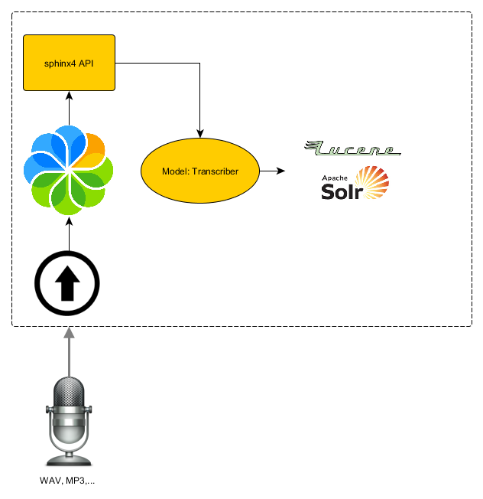
Architecture
  Alfresco API (Actions)
  Share API (UI-Actions)
  JSAPI2
  Sphinx-4 API
fernando.gonzalez@ricoh.es
@fegorama
Notes:
AAT uses four main elements:
Alfresco API for development of Java Actions extended from ActionExecuterAbstractBase and Scripts in JavaScript
Alfresco Share API for development of webscriots UI-Actions
JSAPI2 (Java Speech API 2.0) as middleware providing JSGF and JSML specifications, support for audio redirection, and more…
…and Sphinx-4 API as main element for audio recognition and transcription

Slide 9
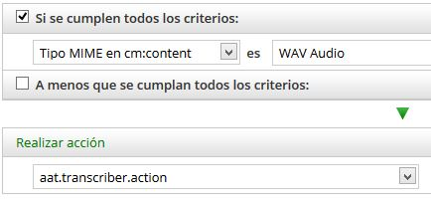
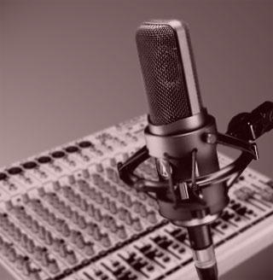
Transcriber Action
Upload the file (WAV,…)
Run the Action
  Call to transcriber and recognizer
  Capture words and other properties
  Indexing…
Notes:
Upon uploading an audio file, Java “Transcriber Action” is called and a voice recognition is made using a grammar and dictionaries model and an acoustic model. Afterwards, the words captured are included into properties …and indexed!

Slide 10
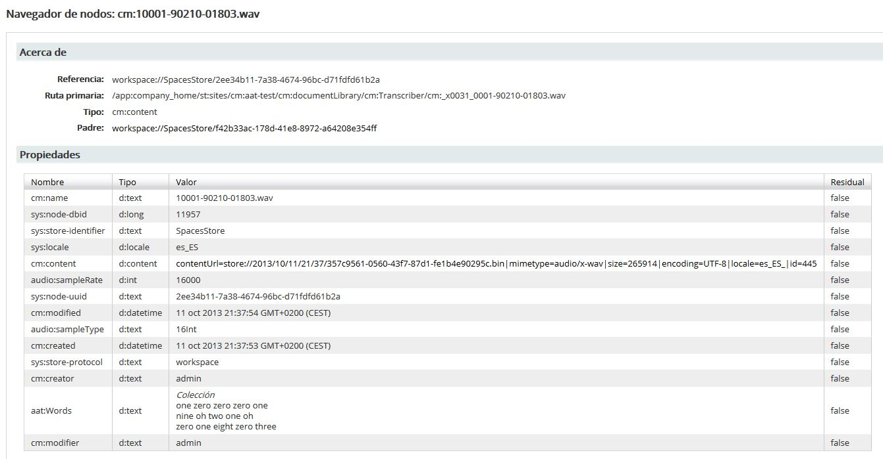
Model for audio-indexing
Aspect: Transcriber
Property: Words
Index: Atomic and Tokenized
Property: Frames
Index: No
Words and Frames are multiple
Notes:
The custom content model is very simple –it uses a Transcriber Aspect to assign properties. The properties contain multiple values and save text words and frames/time during detection. Text words are indexed in atomic form.

Slide 11
Ways to transcribe
Automatic transcription
  Upload/Create and Load documents
  Actions/Rules
Programming transcription
  Scheduled Actions
Interactive transcription
  Repository action running
  UI Action running
Notes:
Use of automation for transcription by using uploaded audio files as events and action rules
Use of transcription through scheduled actions
And interactive transcription with execution of Repository and UI-Actions within Alfresco Share and Alfresco Explorer

Slide 12

Fields of application
DAM (Digital Asset Management)
Trials recording
Movies and Songs
Radio and TV
Education
Notes:
There are many fields of application:
DAM (Digital Asset Management)
Trials recording in courts
Movies and songs in media companies
Radio and TV
Education and more

Slide 13
To Do…
New formats of audio files for transcriptions
Internationalization (Grammars and Acoustic models)
Specialized Dictionaries
Refactoring, refactoring and refactoring…
Notes:
The to-do list includes:
New formats of audio files for transcriptions
Internationalization of grammars, dictionaries and acoustic models
Specialized dictionaries and thesaurus
And more refactoring…

