Slide 1
Fighting viruses with Alfviral
2013
Fernando González
fernando.gonzalez@ricoh.es
@fegorama
Notes:
Hi everyone!
I’m Fernando González and this lightning talk is about fighting viruses from Alfresco using Alfviral module.

Slide 2

Why?
Virus today... inside of:
  Word and Writer documents
  PowerPoint and Impress documents
  PDF (Portable Document Format)
  …more
fernando.gonzalez@ricoh.es
@fegorama
Notes:
Why developing a module that detects viruses and malware in Alfresco, particularly in Document and Records Management systems?
The answer is very simple! – Viruses and malware are inside many types of documents (DOC, PPT, PDF, etc.)

Slide 3
What is it?
Alfviral is a module installable in Alfresco (Repository and Share) that uses an antivirus software (currently ClamAV and VirusTotal.com) to scan both new uploaded documents and those already present in the repository.
fernando.gonzalez@ricoh.es
@fegorama
Notes:
But, what is Alfresco Virus Alert Module (Alfviral)?
This is a module installable in Alfresco, in Repository and Share, that uses an antivirus software or some engines as ClamAV, Virustotal.com and others to scan both new uploaded documents and other documents already included in the repository.

Slide 4

How it works
Three different modes:
Running virus scan program with defined parameters
Sending document data flow to an antivirus port
Using JSON/HTTP protocol to send files to www.totalantivirus.com
fernando.gonzalez@ricoh.es
@fegorama
Notes:
This module currently works in three different ways:
Executing the virus scan program from command line with the defined parameters, for example, clamav.exe, kav.exe, etc.
Sending the document data flow to an antivirus port (for example, a port on ClamAV through streaming)
Using JSON/HTTP protocol to send document contents to www.totalantivirus.com over HTTP protocol with POST method.

Slide 5
Features
Detection through 3 modes
Use of "policies" to scan uploaded and/or read content
Use of "scheduler" to scan spaces programmatically
Use of action "Scan" in user interfaces (Alfresco and Share)
File exceptions
Assignment of "aspects" to classify infections
fernando.gonzalez@ricoh.es
@fegorama
Notes:
This module supports three detection modes:
Use of “policies” to scan uploaded and/or read content
Use of scheduler to scan spaces programmatically
Use of action “Scan” in user interfaces file or content verification from Alfresco or Share
List of exceptions to file extensions in MimeType
Assignment of custom aspects to classify infections and other relevant information

Slide 6
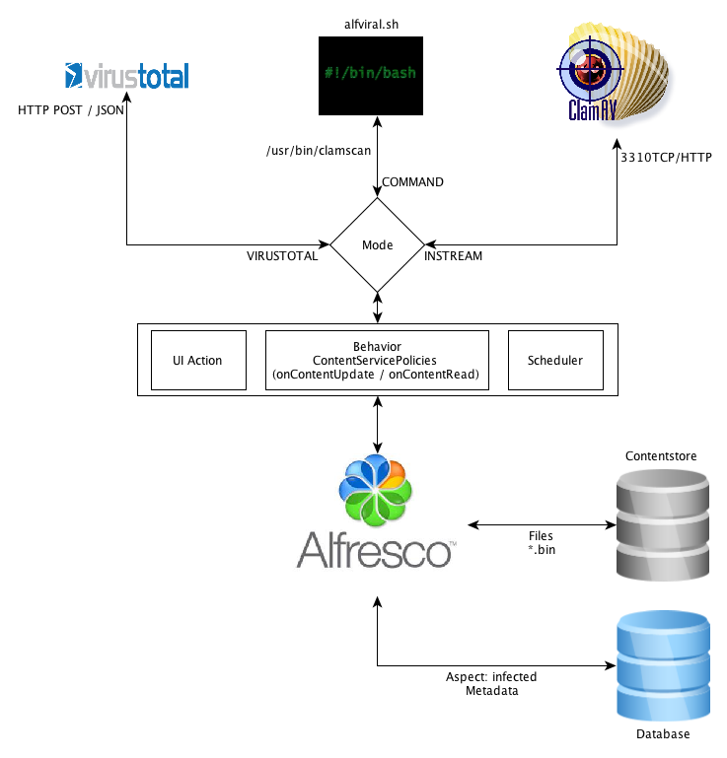
Architecture
Modes
Command
Instream
Virustotal
Image title
Notes:
This architecture is a classical Java Class with support for scripts and webscripts.
The Java class “VirusScan” inherits from ActionExecuterAbstractBase class and calls other Java Classes --CommandScan, InStream, VirusTotalScan…
For scripts and webscripts, the logic is calling to VirusScan Java Class
We can therefore consider two layers in the action, one layer for the action in Java and another layer for scripts and webscripts as UI-Actions, calls from “scheduler” and more.

Slide 7
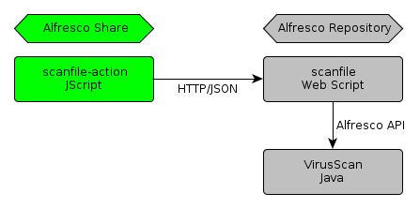

Action Share to Repository
Java Class
  VirusScan
Repository action (Javascript)
  Scanfile
Share ui-action (Web Script)
  Scanfile-action
Notes:
In this picture we can see the two layers --Alfresco Repository (or Explorer) and Alfresco Share. A JSON communication is established between "scanfile-action” from Alfresco Share and scanfile as webscript, and finally a call is made to VirusScan class.

Slide 8

Configuration
# Command to exec, i.e. clamscan, alfviral.sh, etc.
alfviral.command=C\:\\Users\\fegor\\Documents\\alfviral.bat
# Config for ClamAV in stream data
alfviral.timeout=30000
alfviral.host=127.0.0.1
alfviral.port=3310
#Config for VIRUSTOTAL
vt.key=246df658bca5e2968956c01b2eb3a00b0cb506bda774b7148802020302
vt.url=https://www.virustotal.com/vtapi/v2/file/scan
# Modes: COMMAND, INSTREAM, VIRUSTOTAL
alfviral.mode=VIRUSTOTAL
# Events
alfviral.on_update=TRUE
alfviral.on_read=FALSE
# Scheduled action
alfviral.scheduled.pathQuery=/app:company_home/st:sites
alfviral.scheduled.cronExpression=* * 3 * * ? 2099
# List of file exceptions
alfviral.file.exceptions=text/html|text/xml|application/pdf|image/jpeg|text/plain
Use of alfviral.properties file for configuration
  Modes
  Events
  Schedules
  Exceptions
Notes:
Alfviral can be easily configured with “alfviral.properties” file, where you can:
Set up modes (currently, COMMAND, INSTREAM and VIRUSTOTAL)
Set up events for Alfresco policies as updated and read content
Set up schedules to plan for scans
Set up exceptions lists for mime-types of files

Slide 9
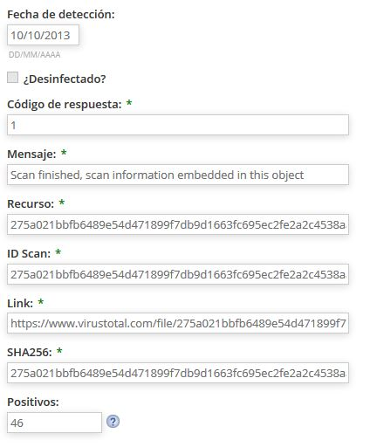

Aspects for detection control
Properties personalized based on type of infection, for example:
  Date of detection
  Code of response
  ID Scan
  SHA256
  Positives
  Etc.
Notes:
The use of custom data model is a great option to identify and classify infections. Alfviral contains one general aspect “ava:infected” and one aspect per scanning mode. This information includes:
Date of detection
Is this desinfected?
…and different properties for each detection mode

Slide 10
More ways to scan
Automation
  Upload/Create and Load documents
  Actions/Rules
Scanning Planification
  Scheduled Actions
Interactive Scanning
  Actions Run
  UI Actions
fernando.gonzalez@ricoh.es
@fegorama
Notes:
Alfviral is capable to scan files in three different ways:
With automation by using content events --modify or read, and content rules
With planification by using scheduled actions
With human interactive scanning by using actions and UI-Actions

Slide 11
To Do…
List of Mime-Types inclusions
Dashlets for monitorization
Reports of activity
Refactoring, refactoring and refactoring…
Notes:
There is still a lot to be done, for example:
One list of mime-types files to include
Controls and dashlets for infections monitorization
Reports of activity, number of infected documents and users, etc.
And above all… refactoring and verifying code

Slide 12
Advanced To Do… ☺
Connectors and interfaces for scanning and virus detection for:
  Symantec
  Trend Micro
  McAfee
  Avast!
  …and more!
Notes:
Ah!, and also create other connectors for Symantec Antivirus, Trend Micro Antivirus, … asterisk-Antivirus.

Slide 13
Where is the project?
http://code.google.com/p/alfviral
fernando.gonzalez@ricoh.es
@fegorama
Notes:
The project is available in Google Code and is open to new committers ☺

