Slide 1
DBM1 Project: Letterboxd
Erica Guardamagna & Fiona Eguare

Slide 2
Our Data Set
Kaggle - “Letterboxd Movie Ratings Data”
4,885 Letterboxd movie data entries
11,078,167 entries of ratings made by Letterboxd users

Slide 3
Pre-processing
Correct erroneous data formatting
Remove very incomplete entries
Normalize redundant data
Select interesting Data
Rename poorly named attributes

Slide 4
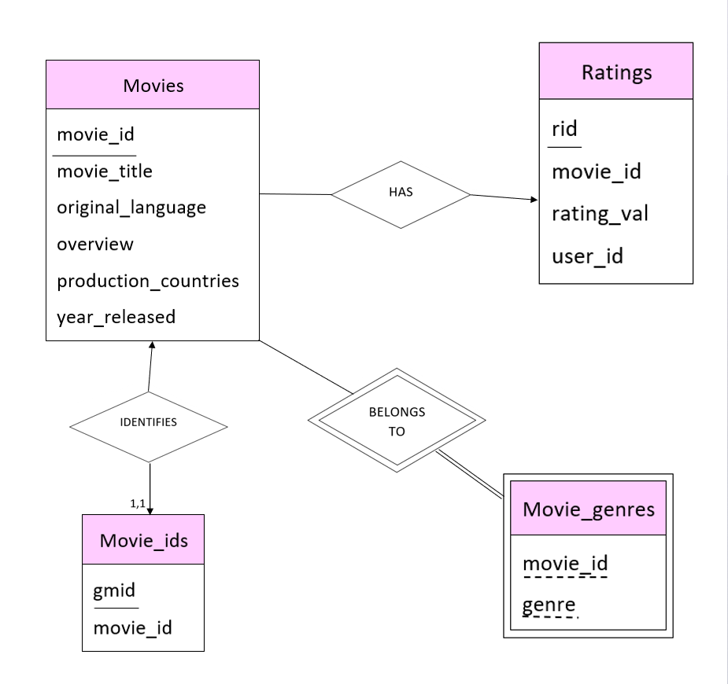
Er diagram

Slide 5
Our Queries
List all original languages and number of movies with each
List title and number of ratings for each movie rated, in descending order
Count ratings with each rating value
Give the title, original language and release year for each movie that received a rating of 10
List title of every movie rated by a given user, and the rating they gave
List ID, average rating, and number of ratings for movies with a given title
List number of ratings, and average rating given by each user
List all users who didn’t rate any of the movies in the movies table
List the titles of all horror movies released in 2020

Slide 6
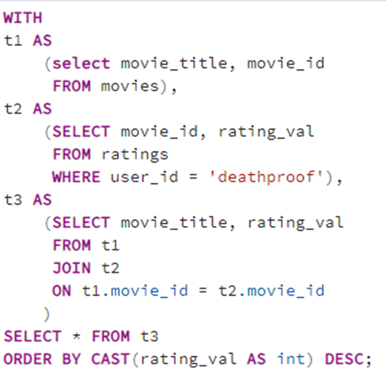
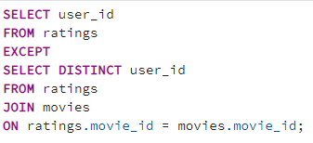
Our queries in sql
Query n°5
Query n°8

Slide 7

Our Queries in RELATIONAL ALGEBRA
$⨅_{movie_id, rating_val}(θ_{user_id=^{′}deathproof^{′}}(Movies⋈_{Movies.movie_id=Ratinigs.movie_id}Ratings)$
$$⨅_{user_id}(Ratings)−⨅_{user_id}(Ratings⋈_{ ratings.movie_id = movies.movie_id}Movies)$$
Query n°5
Query n°8

Slide 8
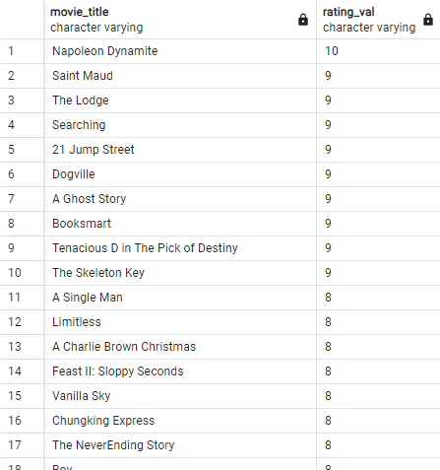
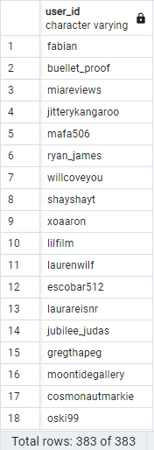
Our queries Outputs
Query n°5
Query n°8

Slide 9
THANK YOU
We are happy to take any questions!

