Slide 1
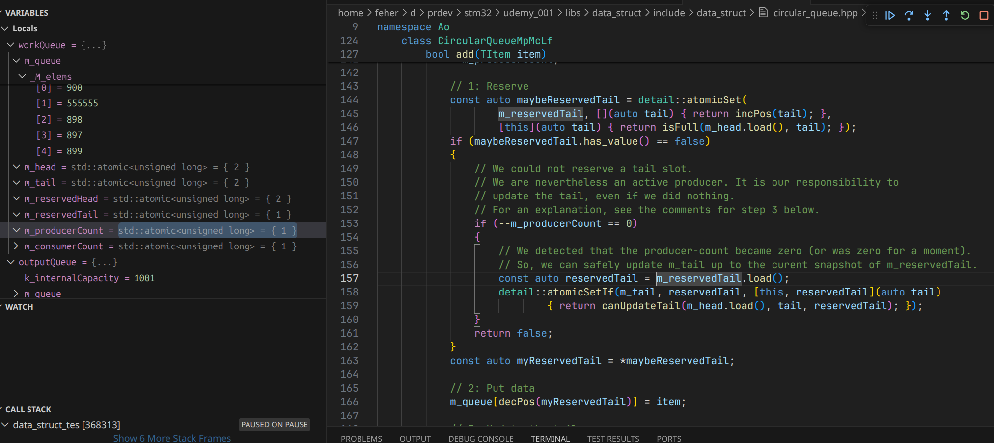

Slide 2
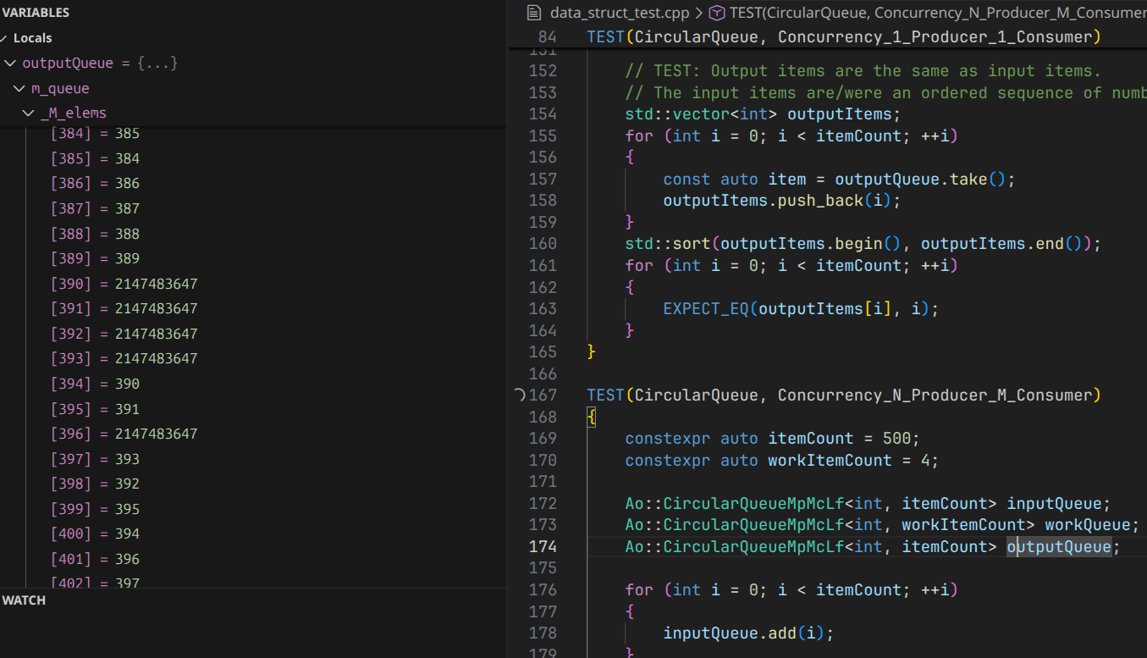

Slide 3
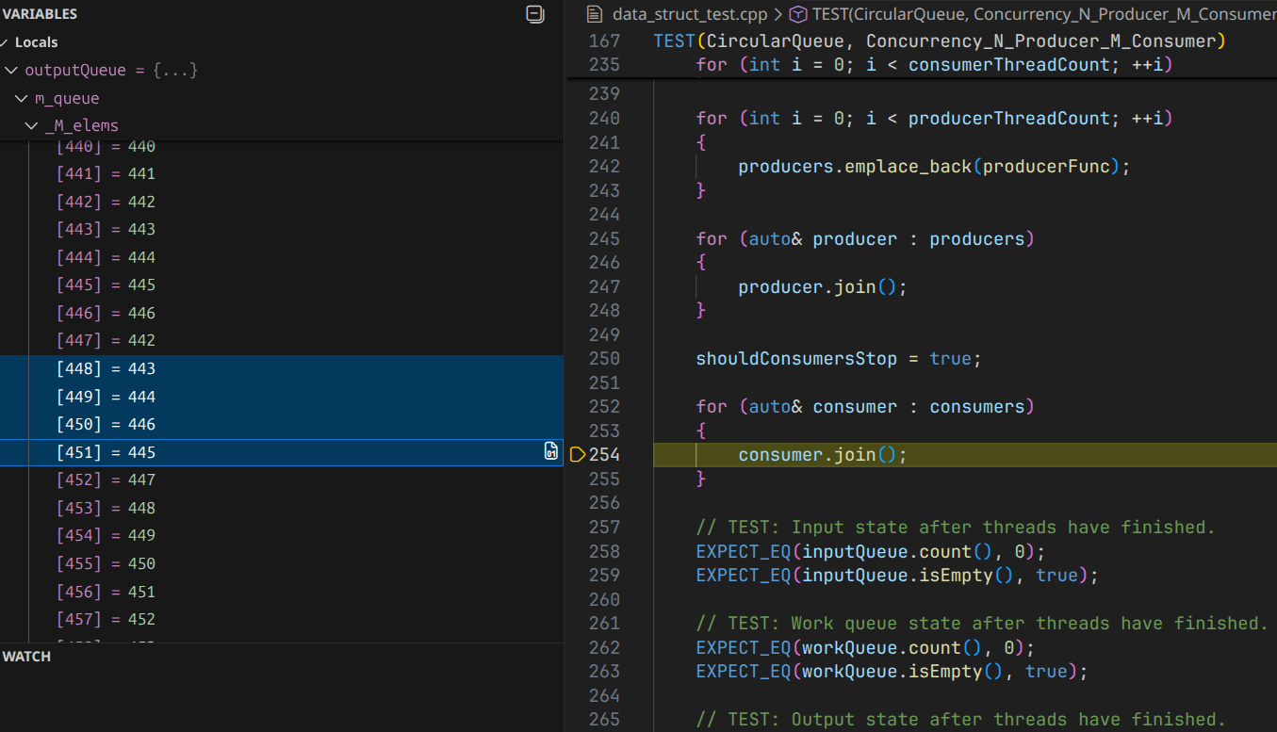
Duplicate items in output queue.
Multiple producers take the same item from the input queue?
Multiple consumers take the same item from the work queue?

Slide 4
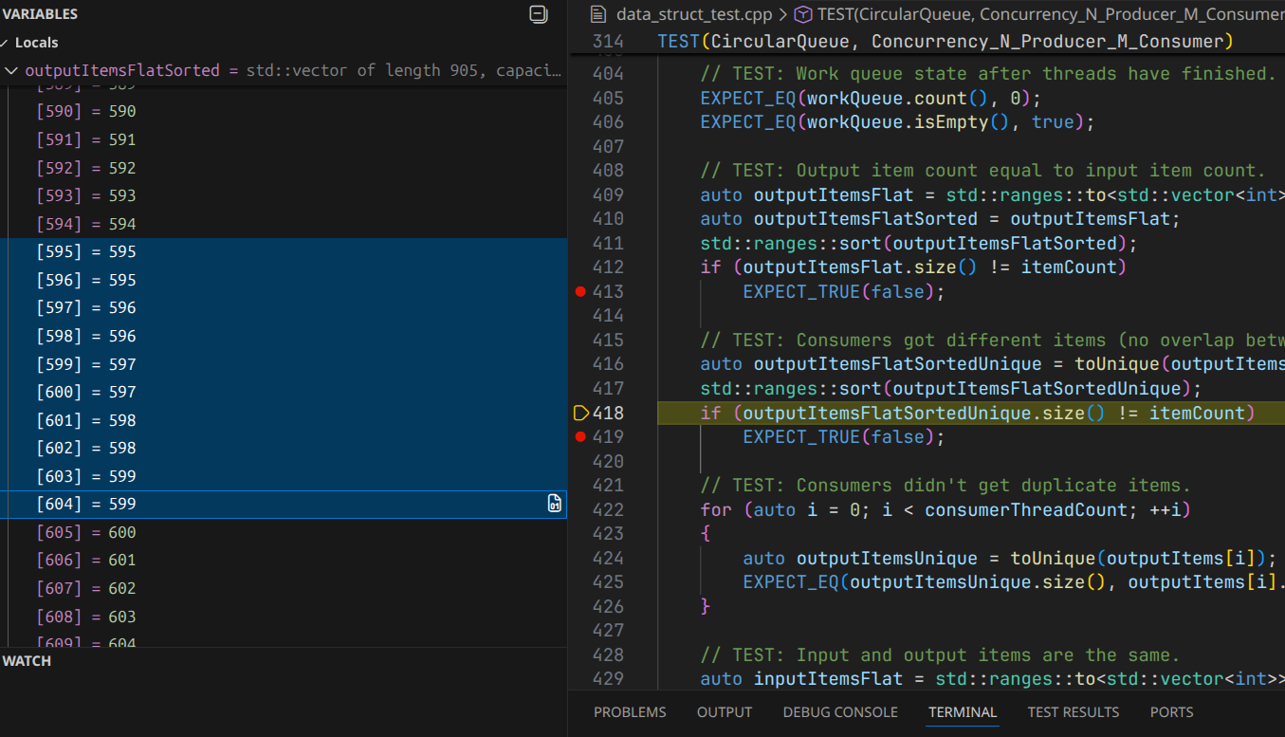

Slide 5
