Slide 1

Web-based Crowd Trajectory Visualization Framework Final Project - Group A
January 25, 2023
Master Praktikum: Modelling and Simulation of Crowds
Didem Öngü
Tigran Bunarjyan
Fehmi Sener
Notes:
Tigran

Slide 2
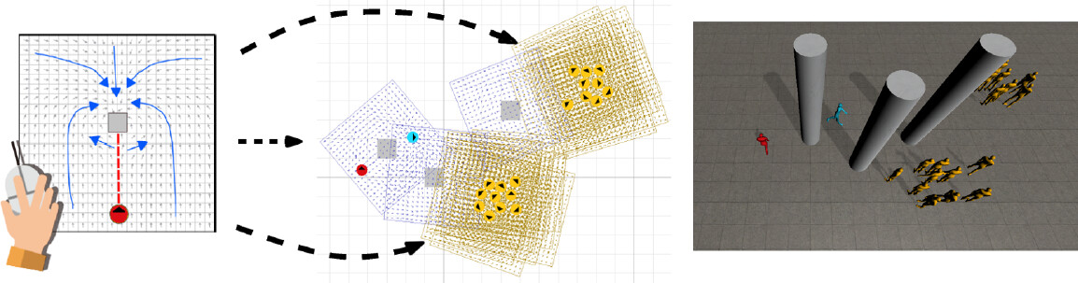
Objective
Notes:
Tigran

Slide 3
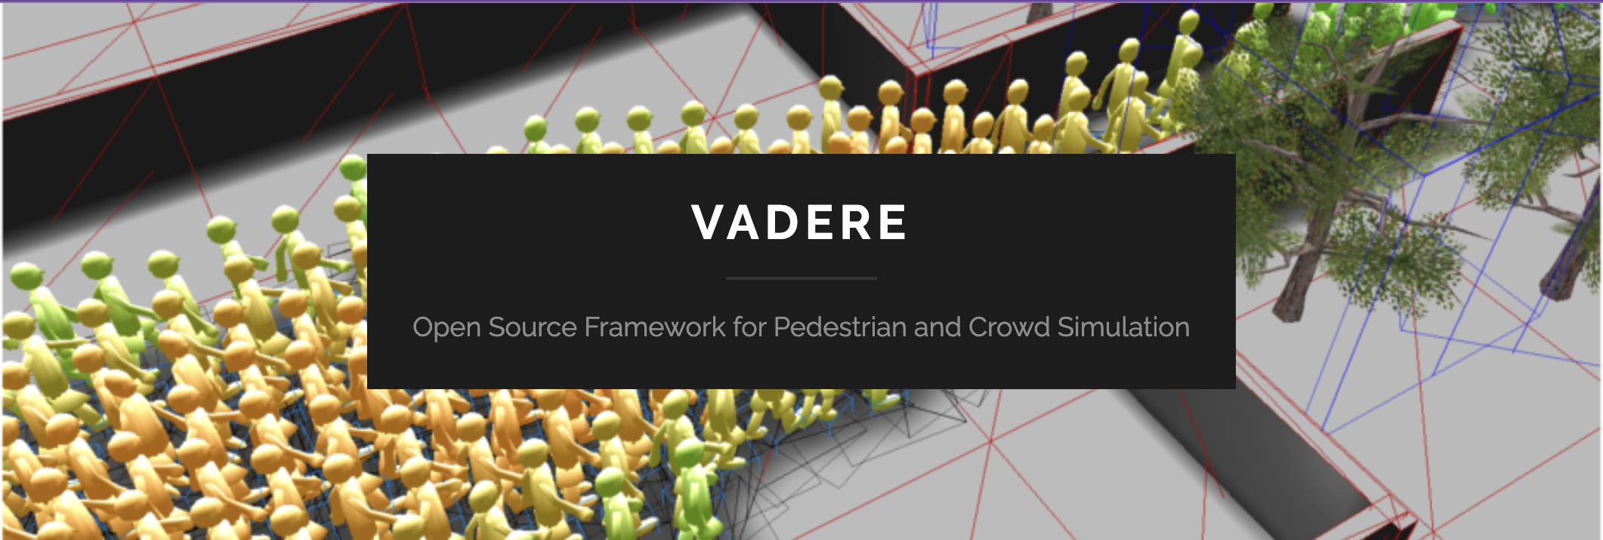
Background | Vadere
Notes:
Tigran

Slide 4
JavaScript & HTML
Python & Flask
Background | Tech Stack
Notes:
Didem

Slide 5
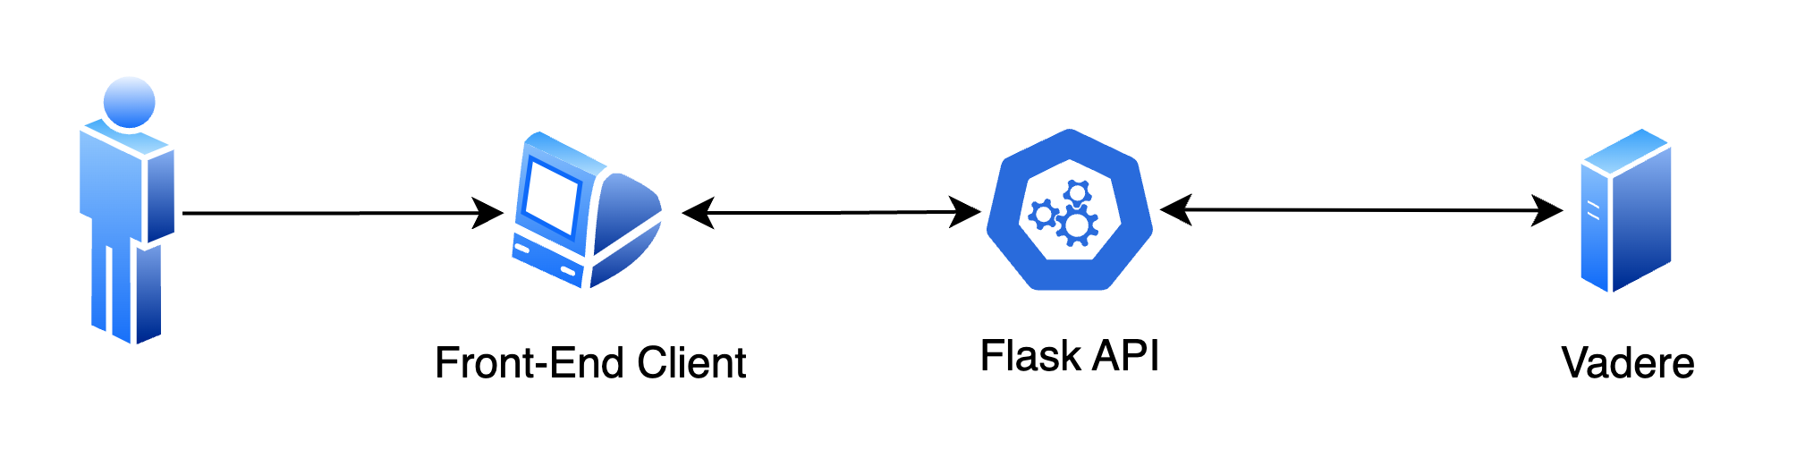
Architecture
Notes:
Didem

Slide 6
Simulation stops too early if it takes too long. Let the simulation run until it finishes on its own to get more accurate results.
TODOs
Make a better and more user friendly design
Notes:
Didem

Slide 7
Demo
Notes:
Fehmi

Slide 8
Q&A
THANK YOU!
Notes:
Fehmi

