Slide 1
Bridging the gap between Data Science & Software Engineering
Farzad Ehtemam

Slide 2
Building modern data products
Partnership between many teams
Data engineers, software engineers, data scientists, ML engineers, …
A common language
Highly efficient collaborations
Notes:
Thanks to the open source tools we have in the industry today, many developers from different backgrounds can work together on large-scale complex projects.

Slide 3
Modern development workflows
TDD and BDD
Code quality standards
Reproducibility
Modularity and orchestration
Agile frameworks
Notes:
Thanks to the open source tools we have in the industry today, many developers from different backgrounds can work together on large-scale complex projects.

Slide 4
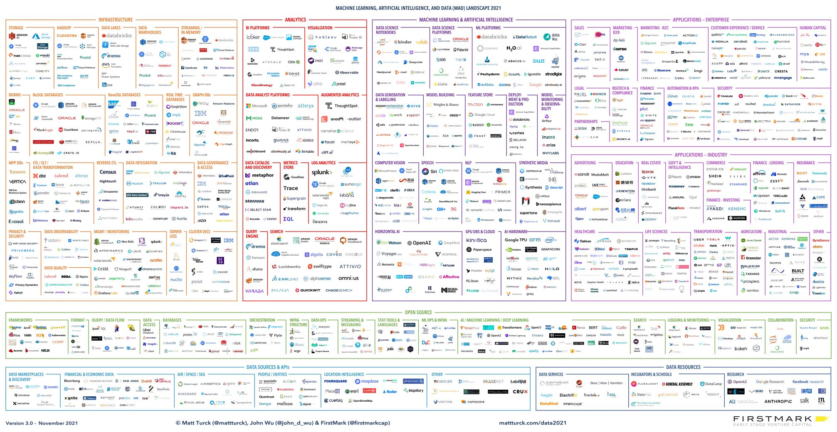
Data Landscape
https://mattturck.com/data2021/
Notes:
Today’s data landscape is vast. It’s actually more of an ocean rather than a landscape! I can’t show this in one or two slides so you can check it out at the link below. Matt Turck updates this every year and we have the 2021 version now. There are many regions here going from infrastructure (data warehouses, data lakes, data governance, …) to analytics (BI platforms, visualization, log analytics, ...) to machine learning and AI and then to building applications in the enterprise. While we expect everyone to work by that common language called code, these ecosystems enforce their own rules and encourage certain practices.

Slide 5
Building modern data products
Diverging paths
Sub-optimal workflows
Opportunities for outreach
Optimizing through knowledge transfer
Notes:
Thanks to the open source tools we have in the industry today, many developers from different backgrounds can work together on large-scale complex projects.

Slide 6
Thank You!
Notes:
Thanks to the open source tools we have in the industry today, many developers from different backgrounds can work together on large-scale complex projects.

