Slide 1
Bridging the gap between Data Science & Software Engineering
Farzad Ehtemam

Slide 2
Building modern data products
Partnership between many teams
Data engineers, software engineers, data scientists, ML engineers, …
A common language
Highly efficient collaborations
Notes:
Thanks to the open source tools we have in the industry today, many developers from different backgrounds can work together on large-scale complex projects.

Slide 3
Modern development workflows
TDD and BDD
Code quality standards
Reproducibility
Modularity and orchestration
Agile frameworks
Notes:
Thanks to the open source tools we have in the industry today, many developers from different backgrounds can work together on large-scale complex projects.

Slide 4
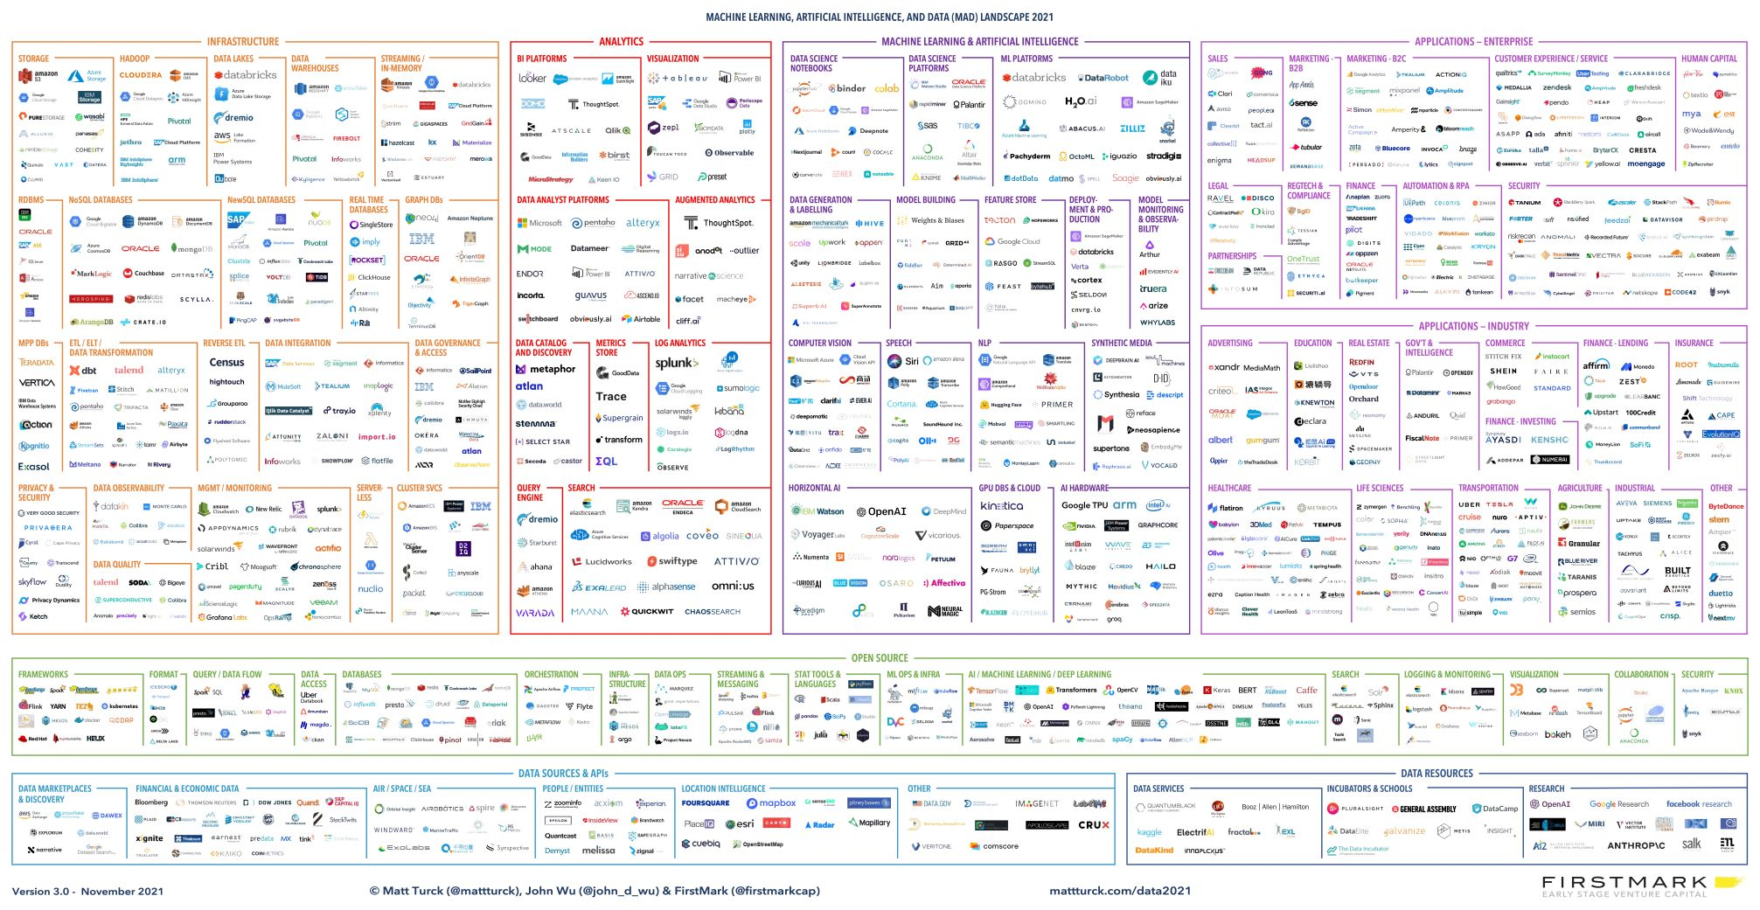
Data Landscape
https://mattturck.com/data2021/
Notes:
Thanks to the open source tools we have in the industry today, many developers from different backgrounds can work together on large-scale complex projects.

Slide 5
Building modern data products
Diverging paths
Sub-optimal workflows
Opportunities for outreach
Optimizing through knowledge transfer
Notes:
Thanks to the open source tools we have in the industry today, many developers from different backgrounds can work together on large-scale complex projects.

Slide 6
Thank You!
Notes:
Thanks to the open source tools we have in the industry today, many developers from different backgrounds can work together on large-scale complex projects.

