Slide 1

Research Data Management for the Life Sciences
Emily Kate and Michael Feichtinger
Cite as Feichtinger, Michael and Emily J. Kate. 2023. University of Vienna Research Data Management for PhD Candidates in the Life Sciences Course Workshop Slides. Version 01. CC-BY 4.0.

Slide 2
Workshop Schedule
Day 1
9:00-9:30 Welcome and Introduction
9:30-10:20 Research Data Life Cycle, FAIR data principles, Open Research
10:20-10:35 Break
10:35-11:10 Data Management Plans
11:10-11:45 Organizing your Data
11:45-12:00 Storing and Securing your Data (Part I)
Day 2
9:00-9:15 Recap and Open Questions of Day 1
9:15-9:30 Storing and Securing your Data
(Part II)
9:30-10:00 Documenting and Annotating your Data
10:00-10:10 Break
10:10-11:10 Publishing and Archiving your Data
11:10-11:15 Break
11:15-11:45 Revisit DMP and Course Evaluation
11:45-12:00 Research Ethics and Legal Issues

Slide 3
Learning Objectives Day 1
Explain the research data life cycle, FAIR principles and Open Research
Write a data management plan for your project
Develop a data orginization schema for a research project
Know how and where to securily store your data

Slide 4
Get to Know

Slide 6
What is Research Data Management?
Research Data Lifecycle, Fair Data Principles, and Open Research

Slide 7
What is Research Data?
“Research data comprise all materials that are created in the course of academic work, including records, source research, experiments, measurements, surveys and interviews, as well as software and code. Research data may take on various different forms: during the lifespan of a research activity, data may exist as gradations from raw data to processed data (and even include negative and inconclusive results).”
- RDM Policy of the University of Vienna

Slide 8
What is Metadata?
Data about your data
Different types of metadata
Administrative metadata
Structural metadata
Descriptive metadata

Slide 9
Activity: Research Data Life Cycle
Group work:
Arrange the research data life cycle cards in the order that makes most sense to you.
Add steps (blank cards) if you think something is missing.
Allocated time: 5-10 min

Slide 10
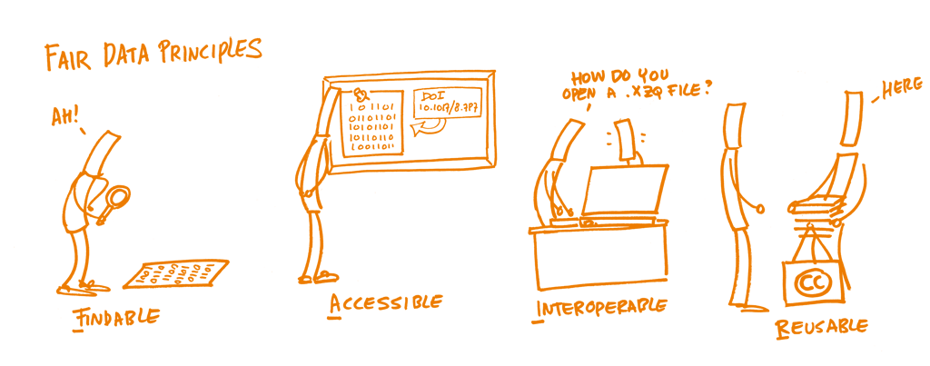
FAIR Data Principles

Slide 11
Open Research
Open research is the practice of making “the primary outputs of publicly funded research results – publications and the research data – publicly accessible in a digital format with no or minimal restriction.”
- Organisation for Economic Co-operation and Development (OECD)

Slide 12
Activity: FAIR and Open Research Cost Benefit Analysis
Group work:
Discuss the assigned question(s) regarding FAIR data and/or Open Research in your group.
Allocated time: 10-15 min

Slide 13
Data Management Plans

Slide 14
What is a DMP?
A DMP “describes how research data should be handled, and is therefore a tool for research data management. The plan explains which data are collected or generated during a research activity and specifies what needs to be done during the data lifecycle, i.e. the whole data process (storage, publication, citation, long-term availability, pseudonymisation, anonymisation, reuse, deletion, etc.)”.
- RDM Policy of the University of Vienna

Slide 15
Activity: DMP Journal Time
Try to add information or notes on your own research project to each section of the DMP.
Allocated time: 15 min

Slide 16
Organizing your Data

Slide 17
Data Organization
Manage your raw data
Use effective file names
Design a clear and consistent folder structure
Select proper file formats

Slide 18
Activity: Data Organization Schema for a Research Project
Group work:
Read your project scenario and develop a folder structure that represents the different data types in the project.
Come up with file naming conventions that contain the crucial information for the data types.
Don‘t worry if you are not familiar with the experimental procedures in the projects! Focus more on how to organize data from different sources and/or temporally or spatially distributed series of experiments.
Allocated time: 20 min

Slide 19
Storing and Securing your Data

Slide 20
Best-Practices and Resources
3-2-1 concept for back-ups
u:cloud or OneDrive
Institutional shares
Back-ups on LiSC
Sensitive Data

Slide 21
Questions? Concerns? Comments?

Slide 22
Research Data Management for the Life Sciences
Emily Kate and Michael Feichtinger

Slide 23
Workshop Schedule
Day 1
9:00-9:30 Welcome and Introduction
9:30-10:20 Research Data Life Cycle, FAIR data principles, Open Research
10:20-10:35 Break
10:35-11:10 Data Management Plans
11:10-11:45 Organizing your Data
11:45-12:00 Storing and Securing your Data (Part I)
Day 2
9:00-9:15 Recap and Open Questions of Day 1
9:15-9:30 Storing and Securing your Data
9:30-10:00 Documenting and Annotating your Data
10:00-10:10 Break
10:10-11:10 Publishing and Archiving your Data
11:10-11:15 Break
11:15-11:45 Revisit DMP and Course Evaluation
11:45-12:00 Research Ethics and Legal Issues

Slide 24
Learning Objectives Day 2
Know how and where to securily store your data
Write a readme for your project and data
Find a proper repository to publish and archive your data
Choose licenses for your published data and code
Be aware of ethical and legal issues that you have to considered in your data management

Slide 25
Any open questions from yesterday?

Slide 26
Storing and Securing your Data

Slide 27
Best-Practices and Resources
3-2-1 concept for back-ups
OneDrive or u:cloud
Institutional shares
Back-ups on LiSC
Sensitive Data

Slide 28
Activity: Storage and Security Decisions
Group work:
Sort the handed-out decisions regarding back-ups, data security and the handling of sensitive data from bad to good, better, and best.
Allocated time: 10 min

Slide 29
Documenting and Annotating your Data

Slide 30
How and Why Document your Data?
Someone who is familiar with your field can interpret your data.
Project- and data-level documentation
Metadata standards
README files

Slide 31
Activity: README Journaling
Try to add information or notes on your own research project or one of your data sets to each (relevant) section of the README template.
Add additional sections or information that may be relevant to understand your project or data set.
Allocated time: 10-15 min

Slide 32
Version Control
… is a system that keeps track of changes made to files, allowing users to easily revert to previous versions, collaborate on projects, and manage different versions of the same files.
Basic: Informatively named files
Automated: Built in Software Platforms
Advanced: Version Control System such as Git

Slide 33
Publishing and Archiving your Data

Slide 34
Why Publish and Preserve your Data?
Verification and reproducibility of your data for several years after the end of the project
Allow the reuse of your data
Funders, publishers, institutions and organizations requirements
Significant value for society

Slide 35
How to Publish and Preserve your Data?
Choose a repository
Get a persistent identifier
Assign a license

Slide 36
Example: Finding Repositories
Your research project aims to understand the mutualistic relationship between lucinid clams and sulfur-oxidizing bacteria in their gill cells. Therefore, you will employ a combination of microscopic observation, including spatial arrangement of the bacteria, and histopathological parameters, with molecular techniques, including qPCR, and metagenomic sequencing, to elucidate the mechanisms of this host-microbe association.

Slide 37
Activity: Finding a Repository for your Data
Group work:
Try to find suitable repositories for the data of each person in your group.
Allocated time: 15 min

Slide 38
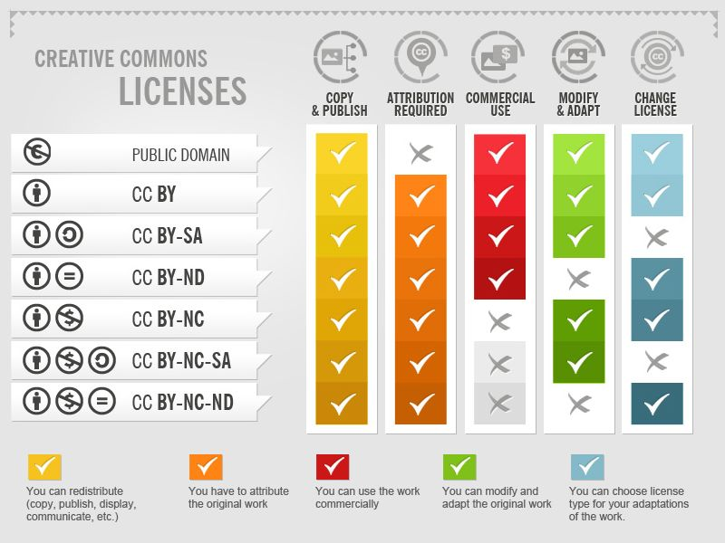
Licensing your Data

Slide 39
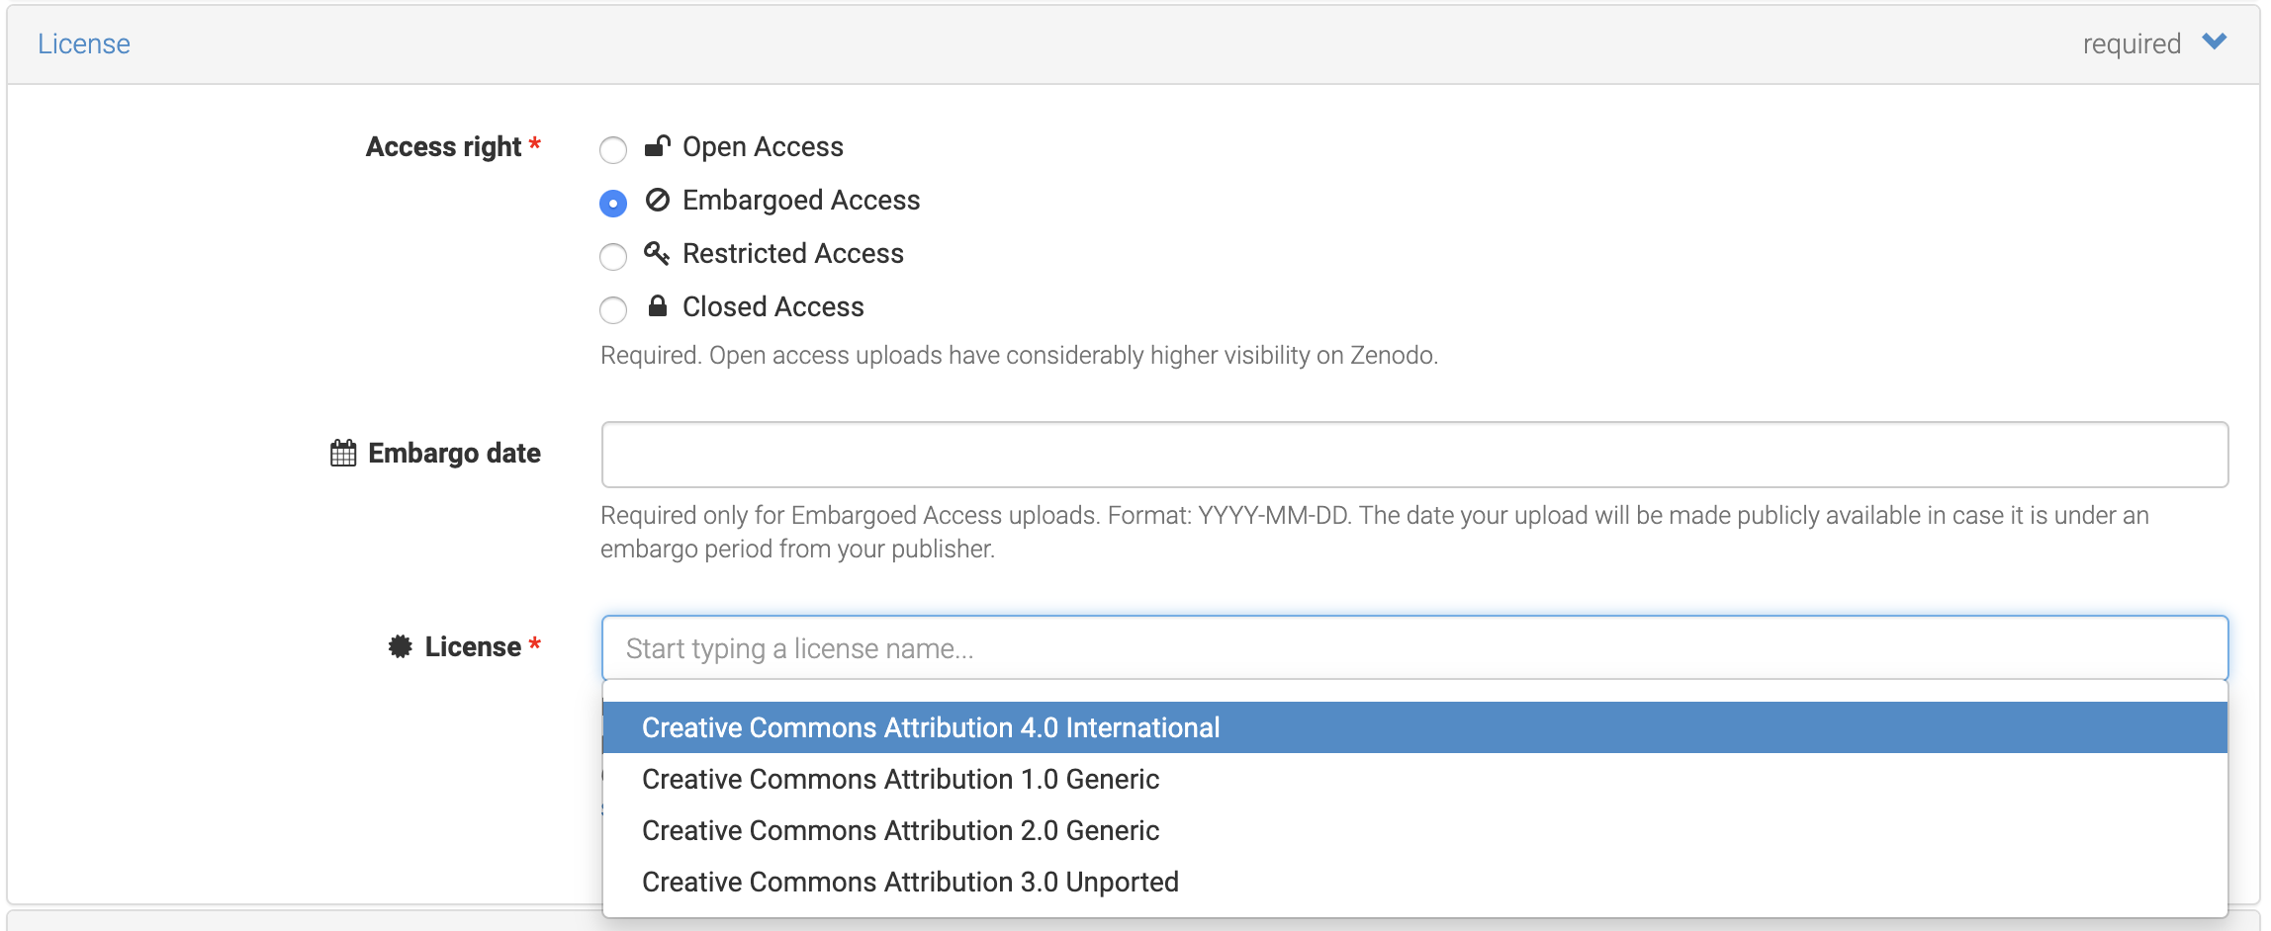
Licensing your Data

Slide 40
Activity: Licensing Scenarios
Group work:
Try find solutions to your assigned research scenarios that include details about licensing requirements, software, and data reuse.
Allocated time: 10 min

Slide 41
Course Evaluation
Complete the post-learning assesment and the course evaluation on Moodle.
Put your name and e-mail into the shared excel sheet on Moodle to receive a confirmation for your participation.
Allocated time: 15-20 min

Slide 42
Activity: Revisit your DMP
Revisit your DMP draft from yesterday and review or add further information based on the knowledge you obtained in the last two days.
Allocated time: 10 min
If you would like to receive feedback on your DMP, please either schedule a meeting with one of us or upload your completed DMP to Moodle (till October 31).

Slide 43
Ethical and Legal Aspects of RDM

Slide 44
Research Ethics and Research Integrity
Responsible Research and Innovation is defined as “an approach that anticipates and assesses potential implications and societal expectations with regard to research and innovation, with the aim to foster the design of inclusive and sustainable research and innovation.” (European Commission)
Research Integrity refers to an “active adherence to the ethical principles and professional standards essential for the responsible practice of research” (Korenmann 2006).

Slide 45
Legal Considerations
CARE principles
General data protection regulation (GDPR)
Working with animals
Nagoya protocol
International transport of samples
Research using private funds

Slide 46
Questions? Concerns? Comments?

Slide 47
Let‘s keep in touch!
emily.jean.kate@univie.ac.at
michael.feichtinger@univie.ac.at
rdm@univie.ac.at

Slide 48
RDM Games and Activities
https://community.data.4tu.nl/reprojuice/
https://rdm-games.gitlab.io/rdm-adventure/
https://vu.nl/en/about-vu/more-about/data-horror-stories
https://www.eur.nl/en/about-eur/policy-and-regulations/integrity/research-integrity/dilemma-game
https://dilemmagame.eur.nl/ui/

