Slide 1
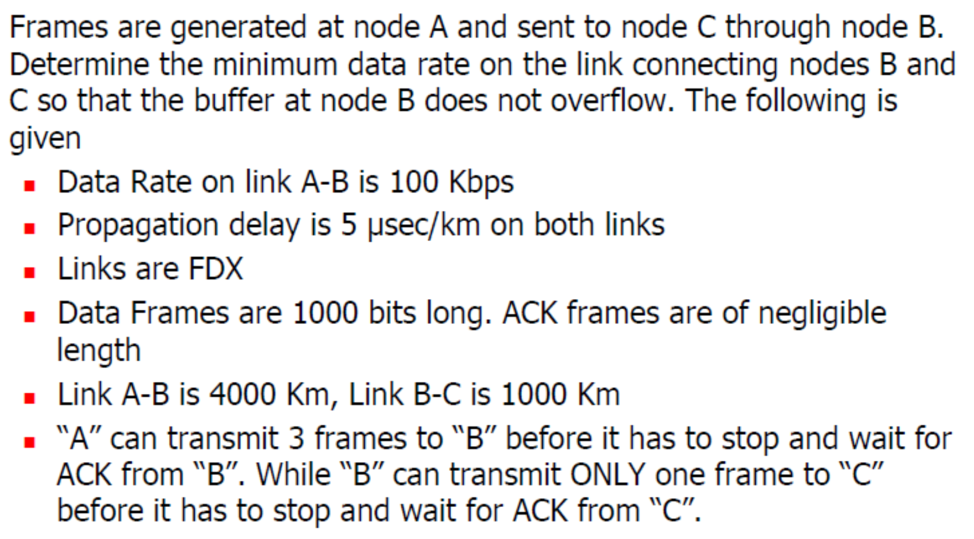
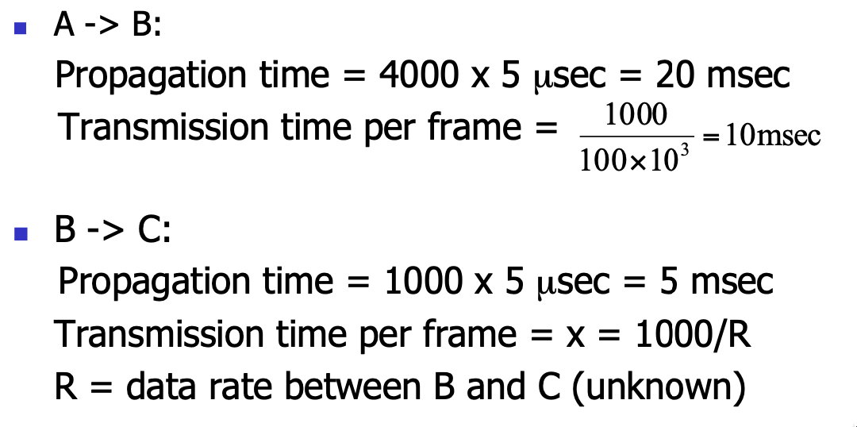

Slide 2
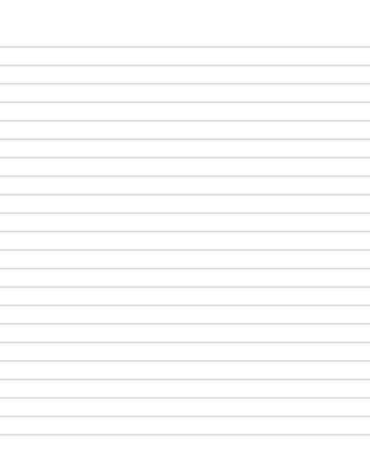
A
B
C
0
10
20
30
40
50
60
70
80
d_{p} (A-B) = 20 msec
d_{t} (A-B) = 10 msec
d_{p} (B-C) = 5 msec
d_{t} (B-C) = ?
F₀
F₁
F₂
F₀
ACK₁
F₀
ACK₁
ACK₂
ACK₁
F₁
F₃
ACK₃
ACK₂
F₄
F₂
T_{g}
ACK₃
T_{y}
F₅
F₃
ACK₄
T_{g} <= T_{y}
30 + 3 x (10 + d_{t}) <= 80
d_{t} = 1000 / R <= 20 / 3
R >= 3000 / 20 = 150 Kbps

Slide 3
A
B
C
0
10
20
30
40
50
60
d_{p} (A-B) = 20 msec
d_{t} (A-B) = 10 msec
d_{p} (B-C) = 5 msec
d_{t} (B-C) = ?
F₀
F₁
F₂
ACK₁
F₀
ACK₂
ACK₁
F₁
F₃
ACK₃
ACK₂
F₄
F₂
ACK₃
F₅
F₃
ACK₄
In terms of 3 frames,
Throughput A-B <= Throughput B-C
A can transmit three frames to B and then must wait for the acknowledgment of the first frame before transmitting additional frames.
B can transmit one frame to C at a time.
d_{t} (A-B) + 2 x d_{p} (A-B) >= 3 x [ d_{t} (A-B) + d_{p} (A-B) ]
R >= 3000 / 20 = 150 Kbps

Slide 4
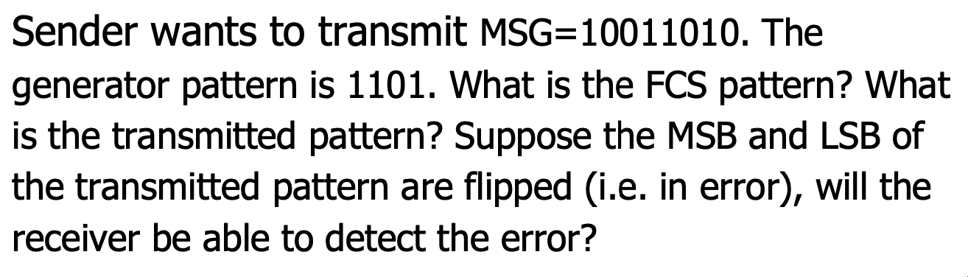
Data Link Control Protocols
Error Detection: Frame Check Sequence

Slide 5
XOR
1 1 1 1 1 1
1 1 0 1
1 0 0 1 1 0 1 0 0 0 0
1 1 0 1
1 0 0 1
1 1 0 1
1 0 0 0
1 1 0 1
1 0 1 1
1 1 0 1
1 1 0 0
1 1 0 1
1 0 0 0
1 1 0 1
1 0 1
Transmitted pattern:
1 0 0 1 1 0 1 0 1 0 1
which is exactly divisible by 1101

Slide 6
1 0 0 1 1 0 1 0 1 0 1 Flip MSB & LSB:
1
1 1 0 1
0 0 0 1 1 0 1 0 1 0 0
1 1 0 1
1 0 0
Error Detected!
(for 100% sure)
1 0 0 1 1 0 1 0 1 0 1 Flip 3 bits:
1
1 1 0 1
0 0 0 1 1 0 1 0 0 0 0
1 1 0 1
0 0 0
Error Not Detected!

Slide 7
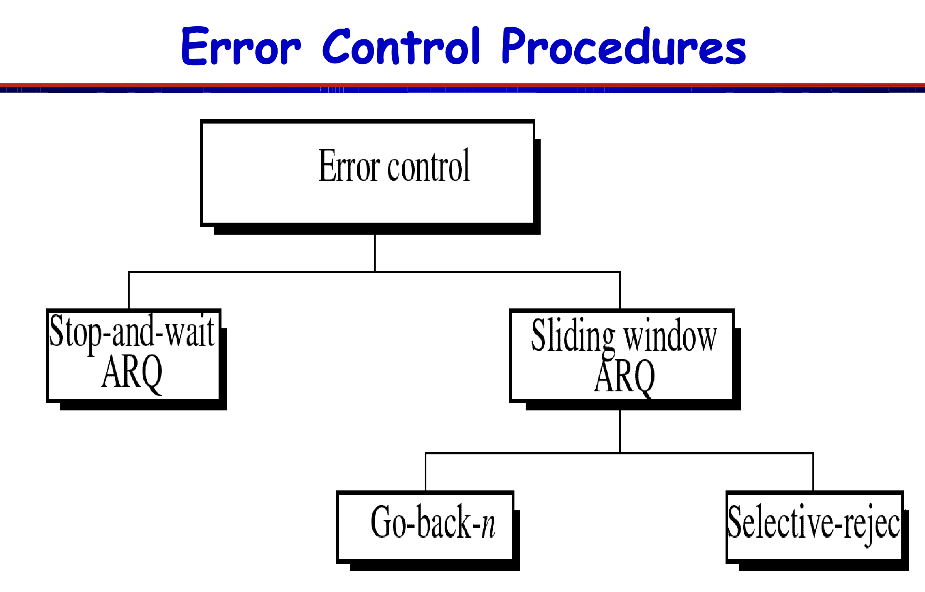
Automatic Repeat Query (ARQ)

Slide 8
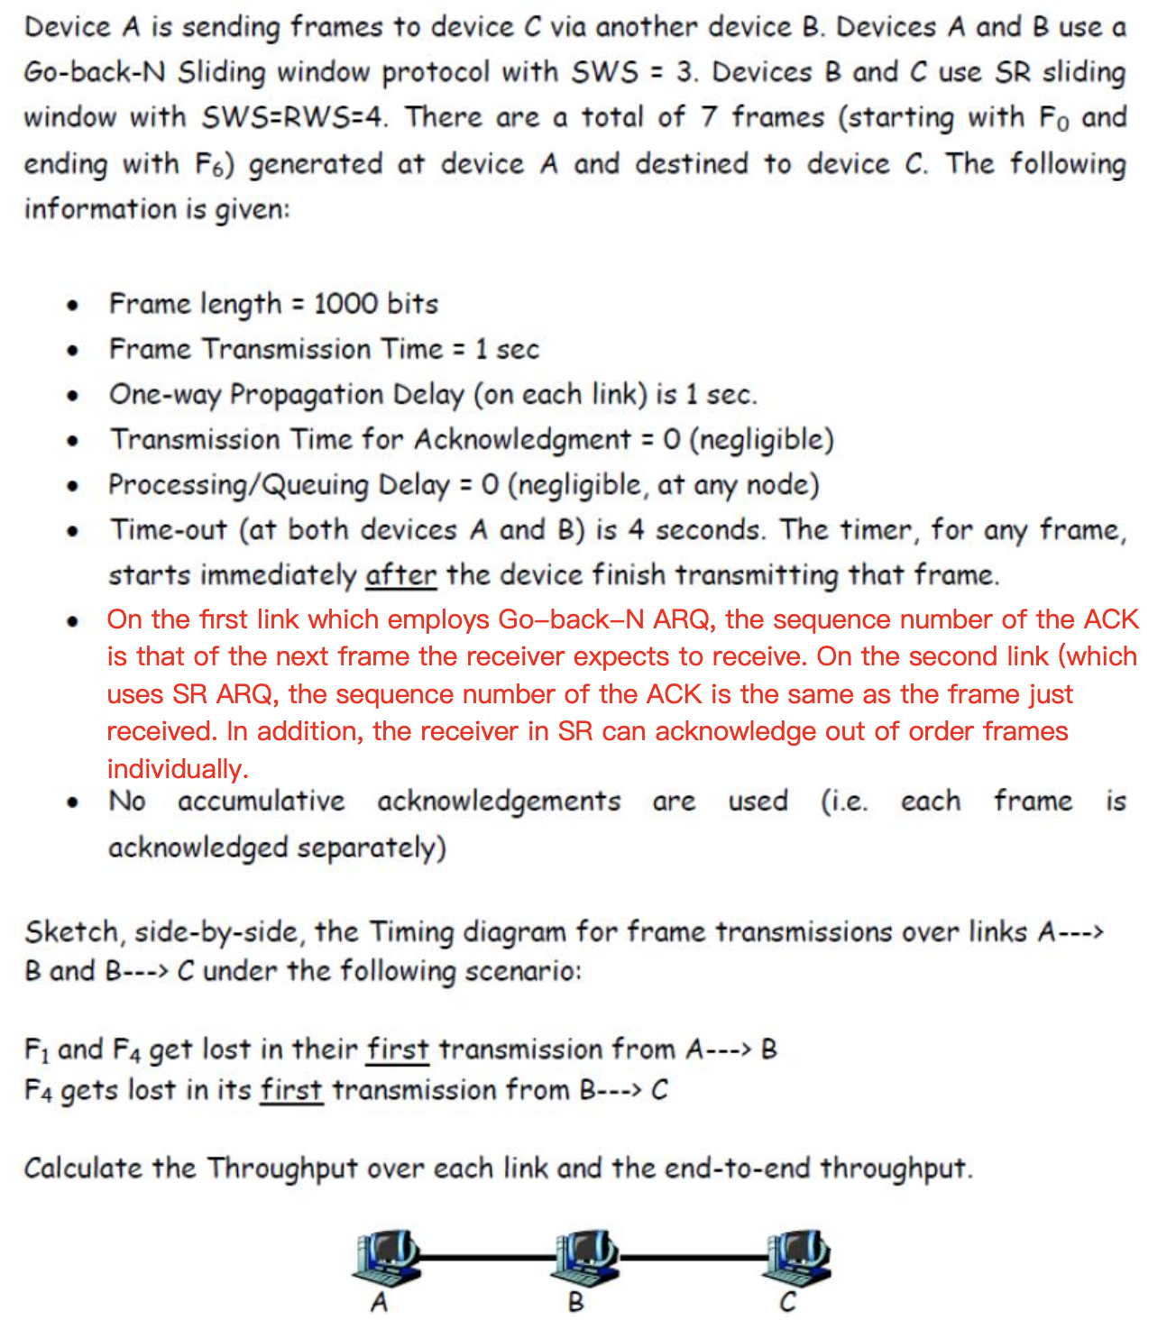

Slide 9

d_{p} = d_{t} = 1 sec
Go-Back-N
SWS=3, RWS=1
Selective Reject
SWS=RWS=4
A
B
C
0
1
2
3
4
5
F₀
F₁
F₁
F₂
F₀
ACK₁
F₂
F₃
F₃
ACK₁
ACK₀
6
7
8
9
10
F₁
ACK₁
F₂
F₃
F₁
F₄
ACK₂
F₂
F₅
ACK₃
F₃
F₄
ACK₄
ACK₁
F₅
11
12
13
14
15
F₆
ACK₂
F₆
ACK₄
ACK₃
F₄
ACK₄
F₅
16
17
18
19
20
21
22
23
24
25
26
F₆
F₄
ACK₅
F₅
ACK₆
F₆
F₄
ACK₇
ACK₅
ACK₆
F₄
ACK₄

Slide 10
A -> B Throughput = 7 x 1000 bits / 19 sec = 368.4 bps
B -> C Throughput = 7 x 1000 bits / 22 sec = 318.2 bps
A -> C Throughput = 7 x 1000 bits / 24 sec = 292 bps

