Slide 1
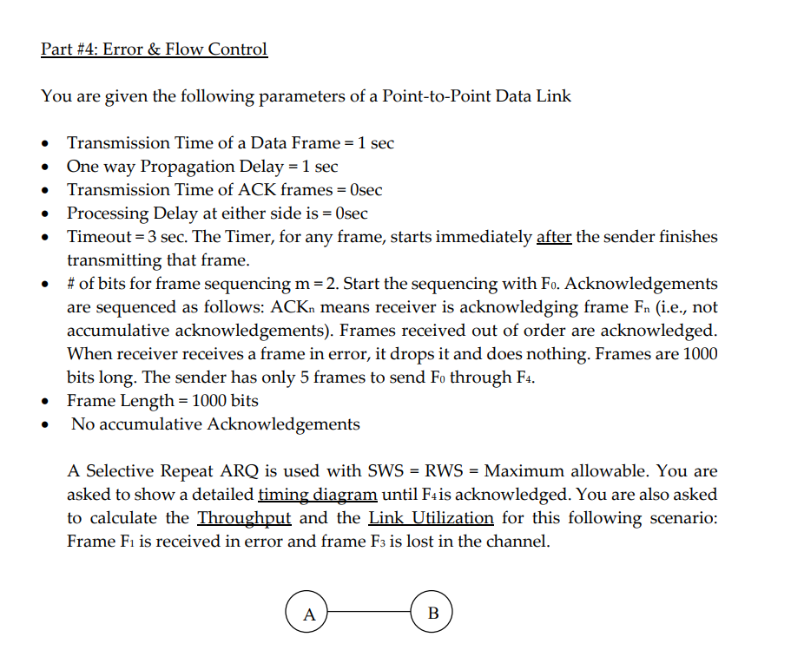

Slide 2
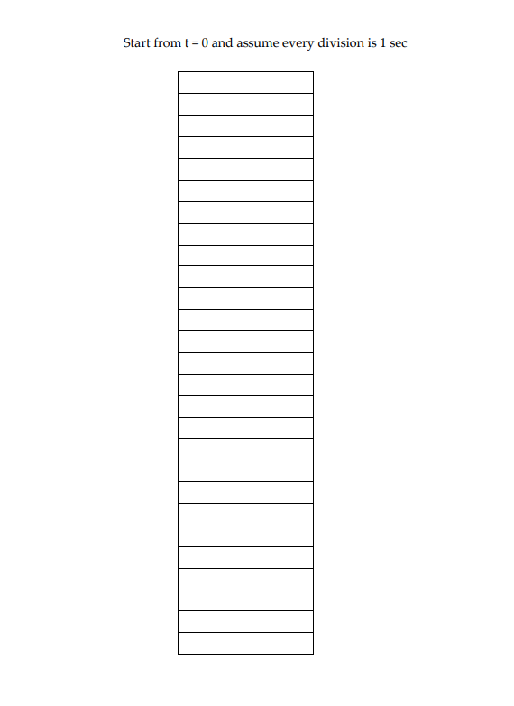

Slide 3
Data Frame End – to –End delay = Tf + Tp = 2 seconds
ACK Frame End – to –End delay = Tf + Tp = 1 second
Selective Repeat ARQ = SWS = RWS = 2^(m-1) = 2
Retransmission Strategy: After Timeout Expires (3 seconds
After the sender finishes transmission)
Drop Strategy: Do Nothing
ACK Strategy: ACK_{n} for F_{n}
F₁ dropped and F₃ is lost

Slide 4
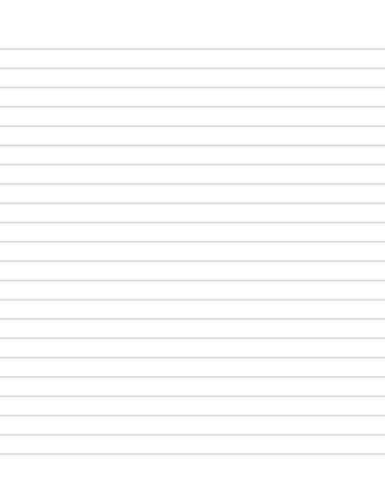

SR ARQ
SWS=2, RWS=2
A
B
0 1 2 3
0
1
2
3
4
5
F₀
0 1 2 3
F₁
F₁
0 1 2 3
0 1 2 3
F₂
ACK₀
0 1 2 3
0 1 2 3
F₁
0 1 2 3
6
7
8
9
10
ACK₂
0 1 2 3
0 1 2 3 0
F₃
ACK₁
F₃
0 1 2 3 0
F₄ (F₀)
11
12
13
14
15
ACK₄ (ACK₀ )
F₃
ACK₃

Slide 5
Throughput = 5 x 1000 bits / 15 sec = 333.3bps
Link Utilization = (5 * 1s / 15 secs) * 100 = 33.33 %

Slide 6
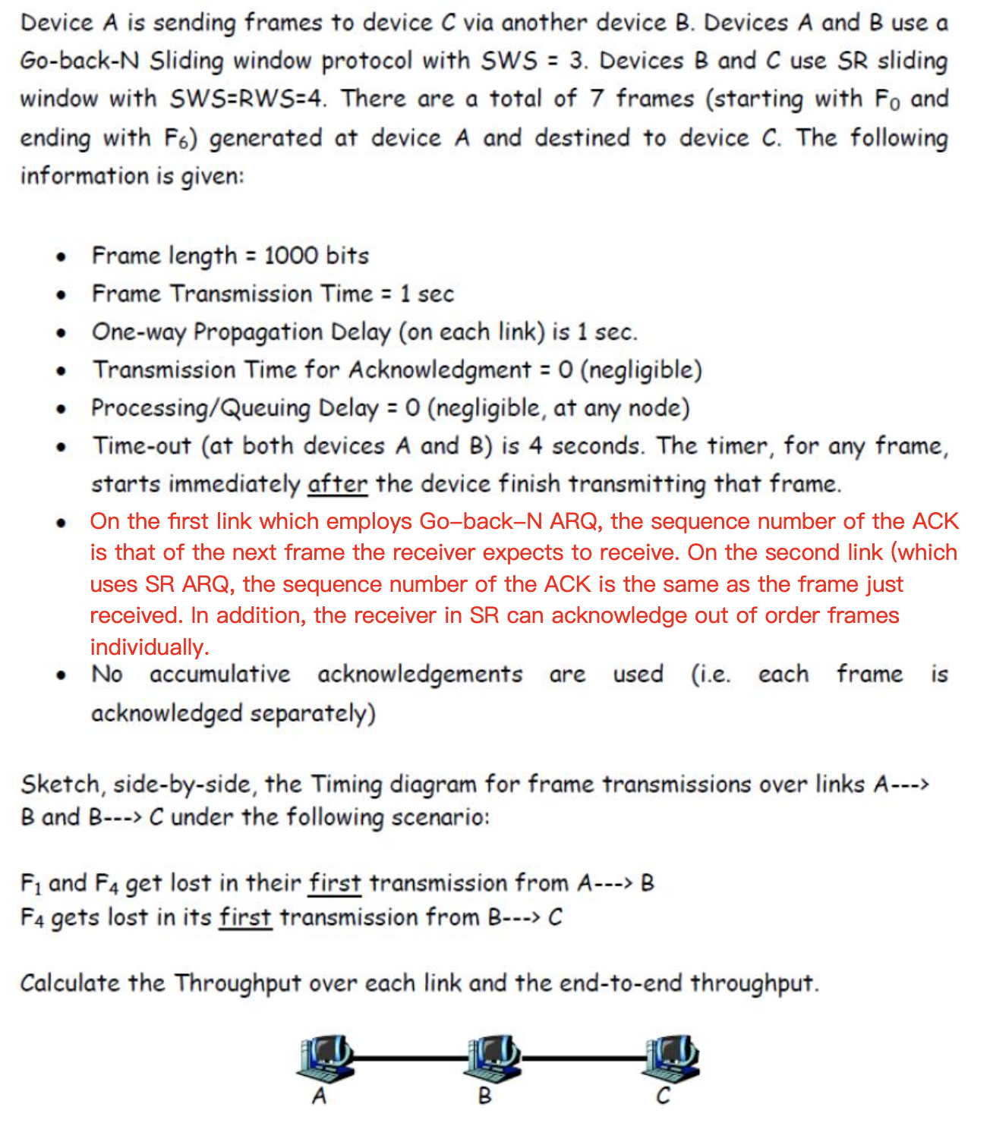

Slide 7
d_{p} = d_{t} = 1 sec
Go-Back-N
SWS=3, RWS=1
Selective Reject
SWS=RWS=4
A
B
C
0
1
2
3
4
5
F₀
F₁
F₁
F₂
F₀
ACK₁
F₂
F₃
F₃
ACK₁
ACK₀
6
7
8
9
10
F₁
ACK₁
F₂
F₃
F₁
F₄
ACK₂
F₂
F₅
ACK₃
F₃
F₄
ACK₄
ACK₁
F₅
11
12
13
14
15
F₆
ACK₂
F₆
ACK₄
ACK₃
F₄
ACK₄
F₅
16
17
18
19
20
21
22
23
24
25
26
F₆
F₄
ACK₅
F₅
ACK₆
F₆
F₄
ACK₇
ACK₅
ACK₆
F₄
ACK₄

Slide 8
A -> B Throughput = 7 x 1000 bits / 19 sec = 368.4 bps
B -> C Throughput = 7 x 1000 bits / 22 sec = 318.2 bps
A -> C Throughput = 7 x 1000 bits / 24 sec = 292 bps

