Slide 1


Week 15 Academic Writing
Style and Information Collection

Slide 2
Chapter one : style

Slide 3
Compare the style differences between the following passages：
Dear Professor,
Please find below my answers to your questions.
I think academic English and everyday English are different because they have very different goals. Lectures and seminars need a different approach from spoken English. And, of course, academic essay writing isn't the same as standard writing.
I think there are four main areas where I can see big differences between standard writing and academic writing. They are as follows:
You should not be subjective;
You should be more complex;·
You should have more structures;·
You should use the academic style and system.
Best wishes,
Sophia
“Academic English” is differentiated from “general English” in its focus on “those communication skills in English which are required for study purposes in formal education systems” (Jordan, 1997: 1). Within these systems, there are three main areas of focus: the lecture, the seminar and the essay, each of which has a specific set of subskills which are required for successful performance. It is essays where the most significant distinction between academic English and general English is made. Generally speaking, there are four main areas where differences between standard writing and academic writing can be observed: the inherent objectivity of academic writing, its complexity, its formality of structure and its adoption of academic style.

Slide 4

Conclusion：
Academic writing:
is more objective;
is more complex;
has a more formal structure;
uses more referencing.

Slide 5
Four of the most important features of Academic writing:
Objectivity;
Complexity;
Formality;
Referencing.

Slide 6
I. Objectivity
1. Phrases such as “I think” “I believe” and “in my opinion” should not be used in academic writing. For example:
Standard writing:
I think there are four main areas where I can see big differences between standard writing and academic writing.
Academic writing:
Generally speaking, there are four main areas where differences between standard writing and academic writing can be observed.

Slide 7
2. Three specific strategies for achieving objectivity
Strategy 1: Hedging language（缓和语言）increases the “distance” between the writer and the text, thereby creating more objectivity.
Hedging language refers to the use of cautious or tentative expressions like "possibly," "probably," "it seems," "it appears," "might," "could," "suggests," "indicates," and "tends to."
The purpose of hedging language is to:
Reduce the force of a statement（降低陈述的力度）
Show uncertainty or possibility（显示不确定性或可能性）
Avoid overgeneralization（避免过度概括）
Demonstrate academic caution（展示学术谨慎）

Slide 8
Example 1:
Without Hedging: "The results clearly indicate that the new drug is effective."
With Hedging: "The results suggest that the new drug may be effective."
Example 2:
Without Hedging: "The study proves that climate change is caused by human activity."
With Hedging: "The study indicates that climate change is likely influenced by human activity."

Slide 9
Strategy 2: Empty introductory phrases（空洞的引导短语）
provide a platform for objective statements.
"It is often said that..." / “人们常说……”
"There is evidence to suggest that..." / “有证据表明……”
"It has been noted that..." / “已经注意到……”
"It is generally believed that..." / “普遍认为……”
"Research has indicated that..." / “研究表明……”
Examples：
It has been widely observed that climate change patterns are becoming more erratic."
There is a general consensus that renewable energy sources are essential for sustainable development.

Slide 10
Strategy 3: The passive voice removes the need for a subject in the sentence。
The data were collected over a period of six months.
The experiment was conducted under controlled conditions to ensure accuracy.
The results were analyzed using statistical software to determine the significance of the findings.

Slide 11
II. Complexity
As a general principle, academic writing is more complex than other forms of writing. This is because academic writing often discusses difficult, challenging ideas which can only be expressed with particular grammar and language. This complexity may be seen in the following three aspects.

Slide 12
1. Formality of language
For example:
Standard writing: big differences
Academic writing: the most significant distinction
2. Grammatical Structures
Some grammatical forms appear more frequently in academic writing than in other forms of writing, like the passive voice, noun phrases and relative clauses.
For example: Academic writing: a specific set of subskills which are required for successful performance
3.Density of Language
This density can be achieved through a greater use of content words (such as verbs and nouns实词使用较多) rather than structure words (such as prepositions and conjunctions).
Standard writing: Academic English and everyday English are different... Academic writing: Academic English” is differentiated from “general English...
PS：实词 (Lexical/Content Words)虚词 (Function/Structure Words)

Slide 13
III. Academic Writing Has a More Formal Structure.
1. The text as a whole has a specific, formalized structure：
the introduction, main body and conclusion.
2. The text must have cohesion and coherence （“内聚”和“连贯”）：
it must link together clearly so that it is possible to follow the writer's argument.·
3. Paragraphs should be roughly of the same length throughout, so there is a good overall balance.
4. Paragraphs often follow a similar structure：
topic sentence, outline of argument, supporting evidence, short conclusion and transition to the next paragraph.

Slide 14
IV. Referencing
Building on the ideas of other people is one of the central features of academic writing.
In order to show where these ideas come from (and to avoid plagiarism抄袭), a reference system is used.
For example:
Standard writing: I think academic English and everyday English are different because they have very different goals.
Academic writing: “Academic English” is differentiated from “general English” in its focus on “those communication skills in English which are required for study purposes in formal education systems” (Jordan, 1971:1).(Adapted from C. Sowton. 2012. 50 Steps to Improving Your Academic Writing. Reading:Garnet Publishing.)

Slide 15
参考文献的格式
不同的引用风格有不同的要求，但大多数风格遵循以下基本顺序：
作者（Author）: 列出作者的姓氏和名字。如果有多个作者，通常按照他们在原始文献中出现的顺序列出。
出版年份（Year of Publication）: 列出文献的出版年份。
文献标题（Title of the Work）: 列出文献的标题。如果是文章，标题通常用双引号括起来；如果是书籍或报告，标题通常用斜体表示。
出版物名称（Name of the Journal or Book）: 列出文献所在的期刊或书籍的名称。期刊名称通常用斜体表示。
卷号和期号（Volume and Issue Number）: 如果是期刊文章，通常需要列出卷号（volume）和期号（issue）。
页码（Page Numbers）: 列出文献所在的起始和结束页码。
出版地和出版社（Place of Publication and Publisher）: 如果是书籍，通常需要列出出版地和出版社。
DOI或URL（DOI or URL）: 如果文献有DOI（数字对象标识符），通常优先列出DOI。如果没有DOI，可以列出文献的URL。
例如，按照APA风格，参考文献的格式可能如下：
Smith, J. A. (2020). The effects of climate change on agriculture. Journal of Environmental Studies, 45(3), 123-145. https://doi.org/10.1234/jes.2020.45.3.123

Slide 16
Exercise: Which of the italicized words in each sentence would be more suitable for an academic paper?
1) The government has made good/considerable progress in solving environmental problems
2) We got/obtained encouraging results
3) The results of a lot of/numerous different projects have been pretty good/encouraging
4) A loss of jobs is one of the things that will happen/consequences if the process is automated.
5) The future of Federal funding is up in the air/uncertain.

Slide 17
Chapter Two: Language Focus

Slide 18
A. Word choice
A single verb is preferable to a phrasal verb.
Less formal style: Researchers looked at the way strain builds up around a fault.
Academic style: Researchers observed the way strain accumulates around a fault.

Slide 19
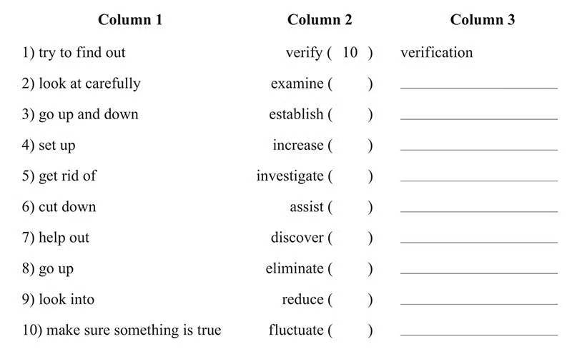
Match the informal expressions in the first column with the formal verbs in the second column. Then write the noun forms of these formal verbs in the third column. The first one is given as an example.

Slide 20
2 Rewrite the following sentences to make them more formal by substituting the italicized phrase with a single verb.
1) The implementation of computer-integrated-manufacturing (CIM) has brought about some serious problems.
2) The process should be done over until the desired results are achieved
3) Plans are being made to come up with a database containing detailed environmental information for the region.
4) Subtle changes in the earth's crust were picked up by these new devices.
5) Proposals to construct new nuclear reactors have met with great resistance from environmentalists

Slide 21
Reference answers
Resulted in
Repeated
Developed
Detected
Encountered
Engendered
Reiterated
Formulated
Ascertained
Confronted

Slide 22
B. Formal Grammar and Style
Academic writing should be complex , but it should not be complicated.
1. avoid contractions.
Export figures won't improve until the economy is stronger. (×)
Export figures will not improve until the economy is stronger. (√)
2. use the more appropriate formal negative forms.
The analysis didn't yield any new results. (×)
The analysis yielded no new results. (√)
The government didn't allocate much funding for the program. (×)
The government allocated little funding for the program. (√)
This problem doesn't have many viable solutions. (×)
This problem has few viable solutions. (√)

Slide 23
3. limit the use of “run on” expressions, such as “and so forth” and “etc.”.
These semiconductors can be used in robots, CD players, etc. (×)
These semiconductors can be used in robots, CD players, and other electronic devices. (√)
4. avoid addressing the reader as “you”.
For example:
You can see the results in Table 1. (×)
The results can be seen in Table 1. (√)
5. limit the use of direct questions.
For example:
What can be done to lower costs? (×)
We now need to consider what can be done to lower costs./We now need to consider how costs may be lowered. (√)

Slide 24
C. Linking Words and Flow
Sentences that are too short and poorly connected can be irritating to read.
Task: Rewrite the following paragraph into one with an easy flow.
A conjunction connects words, phrases, or clauses. It indicates the relationship between the elements. These elements connect. We often find the following thing. In only one single sentence a conjunction contains one or more ideas. These ideas may be equal or unequal in importance. Ideas are equal, and we call them coordinate ideas. For example, John studies electronics. Helen studies computing. These two sentences can become a compound sentence. It shows the relationship between the two ideas. We want to maintain the equality of the ideas. We call the clauses in the new sentence coordinate clauses.

Slide 25
写作的语言风格 1.人称的使用
避免使用第一第二人称
可以使用第三人称。

Slide 26
Rewrite the following sentences to make them more academic by avoiding first and second person pronouns.
1) I think that the methodology section is a hugely important part of your research proposal.
2) When you review literature, you should be aware that you need to identify existing gaps that your research intends to fill.
3) I chose this method because it was less complex.
4) My reading has shown that there are several reasons why plants are dispersed by ants.
5) The review of recent related literature could help you discover the latest facilities that are more efficient than earlier existing ones in carrying out your work.
6) I also found that the results of this study concurred with Berg's (1975) hypothesis that seeds are protected from fire through their burial in ants nests.

Slide 27
Reference answers：
The methodology section constitutes a crucial component of a research proposal.
In the process of reviewing literature, it is essential to identify existing gaps that the proposed research aims to address.
This method was selected due to its relative simplicity.
A comprehensive review of the literature indicates that there are several reasons for the dispersal of plants by ants.
A thorough examination of recent related literature may reveal the latest facilities that offer increased efficiency compared to previous methods in conducting such work.
The findings of this study align with Berg's (1975) hypothesis that seeds are safeguarded from fire through their burial in ant nests.

Slide 28
2. Nominalization
Rewrite the following sentences to make them more academic by using nominalization.
1) Many children experience worries when they go to school for the first time.
2) Crime was increasing rapidly and the police were becoming concerned.
3) Elephants argue over small concerns, just like humans.
4) We need to know which parts of our library are being used most extensively so that we can project what resources are most needed.
5) I know English well. I worked for three years in a factory in Shanghai. I think I am good enough for the job

Slide 29
Reference answers：
The experience of worry is common among children during their initial school attendance.
The rapid increase in crime and the growing concern among police officers were noted.
Disputes over minor issues among elephants mirror human behavior.
An assessment of the most frequently utilized sections of the library is necessary to predict the resources that will be in highest demand.
Proficiency in English, acquired through three years of employment in a Shanghai factory, suggests adequate qualification for the position.

