Slide 1
数智化实用英语写作Digital Intelligence Enhanced Practical English Writing
第一周 课程简介，智能化工具介绍及使用
Week 1 Course introduction & application of intelligent tools.

Slide 2
课程要求
准备一个课堂笔记本，记下所有课件上出现的生单词
根据学校要求，每周上课需要点名
使用教材《英语应用文写作》（可搜索电子版）
Prepare a classroom notebook to jot down all the unfamiliar words encountered during lectures.
According to our school policy, attendance must be recorded on a weekly basis.
The course textbook is "English practical Writing " (an e-version is available online).

Slide 3
Course Introduction
总评成绩包括（平时成绩60%+期末考试40%）
平时成绩包括（课程思政实践10%+课堂参与10%+课后作业20%+课堂测验10%+小组讨论10%）
Total score includes (Coursework grades 60% + final exam 40%).
Coursework grades include (course ideological and political practice 10% + classroom participation 10% + homework after class 20% + classroom test 10% + group discussion 10%).

Slide 4
考试题型
Exam Question Types:
Multiple Choice Fill-in-the-Blanks
Matching
Form-filling
Notes
Notice
Letter （Envelope and body of the letter）,
（PS. Address of Hangzhou Dianzi University in English.）
选词填空
匹配题
表格
留言条
通知
书信（信封与正文两部分）杭电英文地址

Slide 5
Content
英语写作基础-句子 | 实用文体写作-申请和简历
英语写作基础-篇章 | 实用文体写作-证书证明
写作风格-说明文、记叙文 | 实用文体写作-通告、请柬
写作风格-议论文 | 实用文体写作-旅游行程
英汉语言特点 | 学术写作与国际发表-结构格式
智能写作工具介绍 | 学术写作与国际发表-信息收集、语言风格
智能写作工具应用 | 综合实践与反馈
实用文体写作-书信 | 综合实践与反馈

Slide 6
Introduction and application of AI tools
国内部分免费AI工具
（讯飞星火，抖音豆包，天工，蓝心千询问，文心一言，通义千问，Kimi智能助手，）
Using AI as:
A source of information
A grammar checking tool
A text refining software

Slide 7
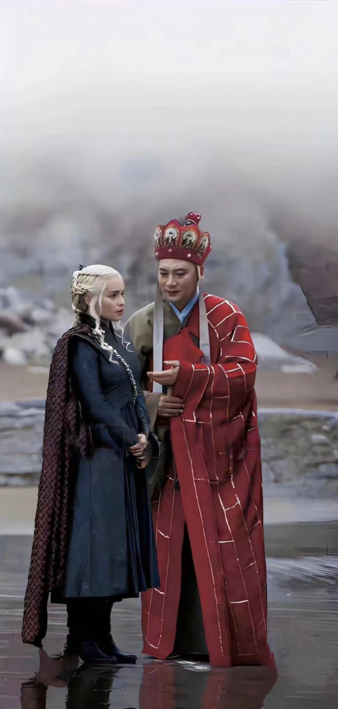
In the AI era, what you see may not be real, so it's important to maintain your own clear judgment!

Slide 8
Group Translation Exercise (20 minutes):
Divide the class into groups
Assign each group an AI tool.
Provide each group with the same article to translate into English using their assigned tool.
Instruct groups to focus on detecting any grammar errors
Ask groups to present their findings

Slide 9
Translation
站在江河入海的时代，回顾奔涌的历史长流，是蹈海踏浪而来的文明记忆。曾有人在黑夜里，擎起天地间的第一簇火种，曾有人在漫天星斗下，隔着山川湖海遥望。
人聚成邑，邑聚为国，曾有古国在大江大河间初铸辉煌，自九州之中，酿就四方众望、人心所向的风潮。
经夏商周而立秦汉，生长在世界东方的古代中国文明，跋涉数千年岁月而来，穿梭在生死枯荣的古文明之林间，历风尘霜雪而初心未改。
蹈瞠出一条，不同于世界其他文明体的发展道路，创造出灿烂盛大的中华文明。

Slide 10
Style Differentiation Exercise (20 minutes):
instruct groups to retranslate the text into various styles using their AI tool:
- Academic English
- College English Test Band 4 level
- Poetic style
- Colloquial style
- Humorous style
- Heartfelt style
- Professional workplace style

Slide 11
Emphasize the importance of word choice and sentence structure in conveying different styles effectively.
Groups will share their results, discussing the nuances in vocabulary and syntax that distinguish each style.

Slide 12
相处久了你会发现，人与人之间最大的吸引力，不是你的容貌，不是你的光环，而是你传递给对方的温暖和踏实，真诚和善良。
很多人把高情商理解为圆滑，世故，会说话，其实在我看来，真诚才是这个世界最高级的情商。
在与人交往，特别是向上社交中，其实不需要讨好和任何套路，你只需要真诚的呈现你自己就好。
你如果需要对方帮助，可以直接提出你的要求。呈现真实的你，让对方看到你的价值即可。

Slide 13
Ideological Content (5 minutes):
Assign a task where students must use English to introduce aspects of China's technological advancements that foster national pride.
Encourage students to think about how they can contribute to society within their professional fields.
Use an AI tool to correct any grammar errors in their writing.
Take a photo or screenshot of the corrected text and share it in a designated online group for feedback from peers and instructors.

Slide 14
China has made significant advancements in several areas of technology, surpassing some Western developed countries:
1. 5G Technology:
2. E-commerce like Alibaba's Taobao and JD.
3. Fintech: like Alipay and WeChat Pay
4. Artificial Intelligence: Baidu, Tencent, and iFlytek
5. Renewable Energy: China is the world's largest producer of solar panels and wind turbines.
6. High-speed Rail: China's high-speed rail network is the longest in the world, at speeds over 300 km/h (186 mph).
7. Telecommunications Satellites
8. Quantum Communications:
9. Biotechnology: gene editing and novel drugs and vaccines.
10. Electric Vehicles: like BYD and NIO (weilai)

Slide 15
After class task
write a short paragraph on how you envision creating value for society in your future careers, focusing on your specific fields of study.

