Slide 1

英文写作基础--句子 Fundamentals of English Writing ： Sentences

Slide 2




书写句子的原则：
完整 Completeness
正确 Correctness
清晰 Clarity
形象 Vividness
得体 Appropriateness
简洁 Conciseness

Slide 3
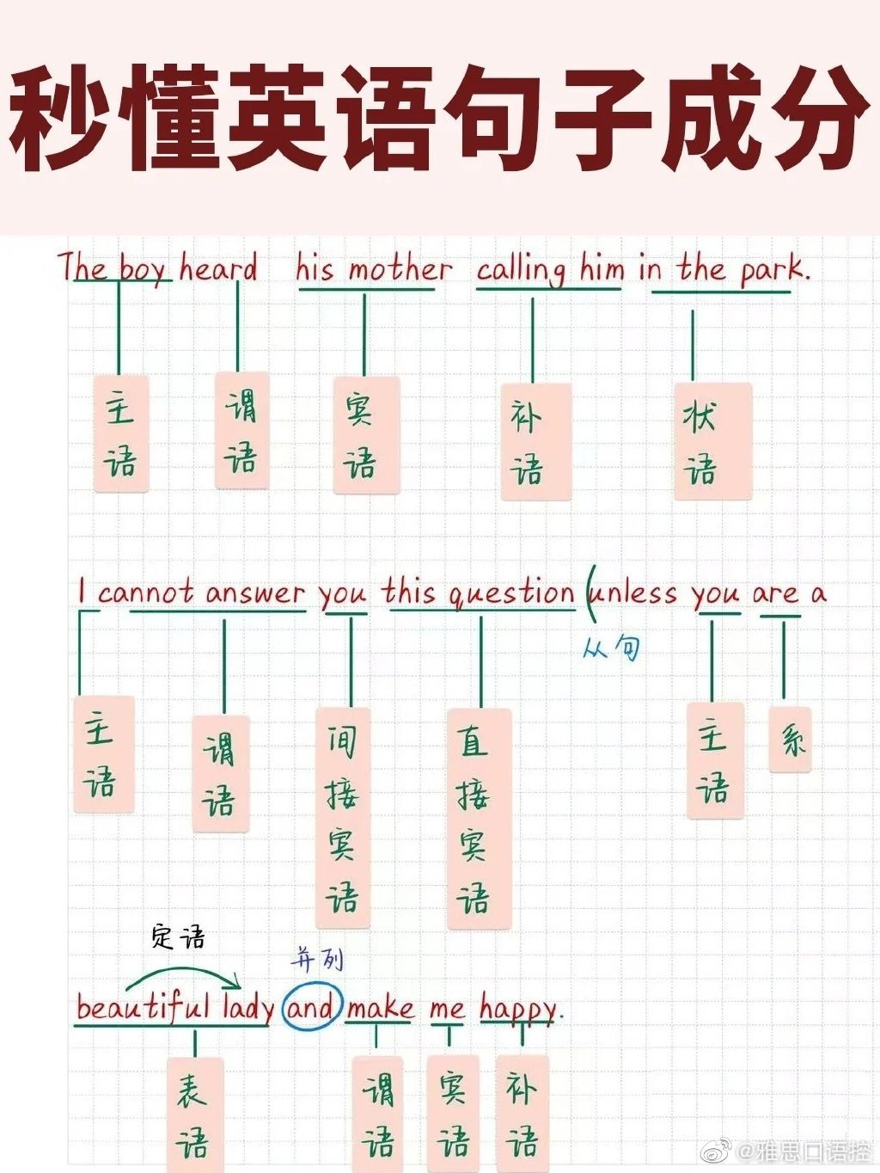
完整 Completeness
主语 +谓语（+宾语）
主语 +系动词+表语

Slide 4
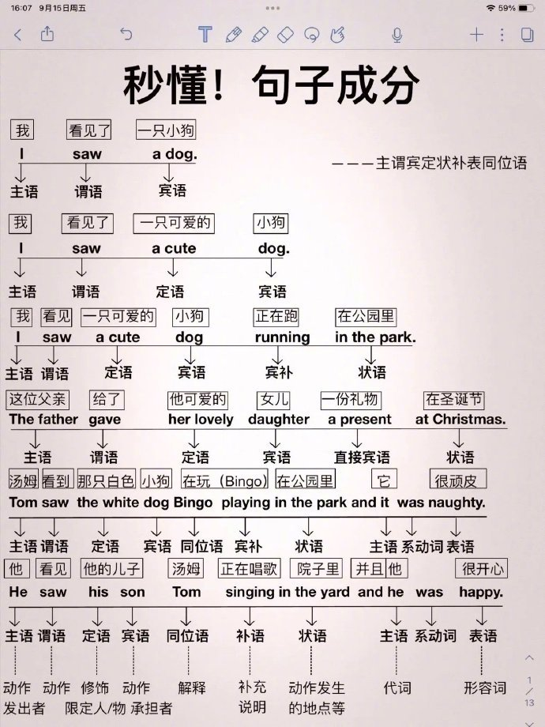

Slide 5
名词性从句及其例子：
主语从句（Subject Clause）：在句子中充当主语的名词性从句。
例子：What she said is true.
宾语从句（Object Clause）：在句子中充当宾语的名词性从句。
例子：I believe that he is honest.
表语从句（Predicative Clause）：在句子中充当表语的名词性从句，通常跟在系动词（如be, seem, become等）之后。
例子：The fact is that we have lost the game.
同位语从句（Appositive Clause）：对前面的名词进行解释或说明的名词性从句，通常跟在某些抽象名词（如fact, news, idea, belief等）之后。
例子：The news that he won the prize surprised everyone.

Slide 6
状语从句
时间状语从句：He came when I went out.
地点状语从句：Sit where you like.
原因状语从句：I didn’t go because I was afraid.
条件状语从句：If it rains, we’ll stay at home.”
目的状语从句：I’m saving my money so that I can buy a new car.
结果状语从句：He spoke so fast that we couldn’t understand him.
让步状语从句：Although he is rich, he is not happy.
比较状语从句：He is as tall as his brother.
She is taller than I expected.

Slide 7
定语从句
限制性定语从句（Restrictive Relative Clauses）：这类从句对先行词进行限制或定义，是句子意义不可缺少的部分。
例句：The books that are on the table are mine.
非限制性定语从句（Non-restrictive Relative Clauses）：这类从句提供额外信息，但不是先行词的必要特征，通常用逗号与主句隔开。
例句：My brother, who is a doctor, lives in Canada.
关系代词引导的定语从句：使用关系代词（如who, whom, whose, which, that）来引导。
例句：The man who is talking to John is my uncle.
关系副词引导的定语从句：使用关系副词（如where, when, why）来引导。
例句：This is the house where I was born.“
that"引导的定语从句："that"可以代替who, which, or whom，通常用于限制性定语从句中。
例句：The car that is parked outside is mine.

Slide 8
"which"引导的非限制性定语从句："which"用于非限制性定语从句，提供关于先行词的额外信息。
例句：She won a gold medal, which made her parents very proud.
"whose"引导的定语从句："whose"用于表示所有格关系。
例句：The boy whose father is a firefighter was late for school.
"as"引导的定语从句："as"有时用于引导定语从句，尤其是在固定表达中。
例句：Such information as is available indicates that the economy is growing.
"but"引导的定语从句："but"用于引导定语从句，表示对比。
例句：There are no words but what are used wrongly sometimes.

Slide 9
不定式作定语：用于表示目的或意图。例句：The opportunity to travel abroad is exciting.
动名词作定语：用于表示经常性或习惯性的动作。
例句：The swimming pool is closed for maintenance.
现在分词作定语：用于表示正在进行的动作或状态。
例句：The boy running in the park is my neighbor.
过去分词作定语：用于表示被动或完成的动作。
例句：The letter written by her was very touching.
不定式作状语：用于表示目的、原因或结果。
目的：He ran to catch the bus.
原因：She is happy to see you.
结果：Surprised to see him, she dropped her bag.
现在分词作状语：用于表示时间、原因、条件或伴随情况。
时间：Walking in the park, she met her old friend.
原因：Interested in the subject, he read the book carefully.
条件：Given more time, I could have done better.
主动 ing，被动用ed，将来时 to do

Slide 10
过去分词作状语：用于表示被动或完成的动作，通常与主句的主语有被动关系。
例句：Broken by the storm, the tree fell across the road.
不定式作补语：用于表示目的或结果，通常跟在某些动词后面。
例句：I found it difficult to solve the problem.
现在分词作补语：用于表示正在进行的动作或状态。
例句：I heard him singing in the next room.
过去分词作补语：用于表示被动或完成的动作。
例句：The door was left open.
不定式作宾语补足语：用于表示要执行的动作。
例句：I want you to help me with the project.
现在分词作宾语补足语：用于表示正在进行的动作。
例句：I heard her singing a song.
过去分词作宾语补足语：用于表示被动或完成的动作。
例句：The teacher found the exam well prepared.

Slide 11
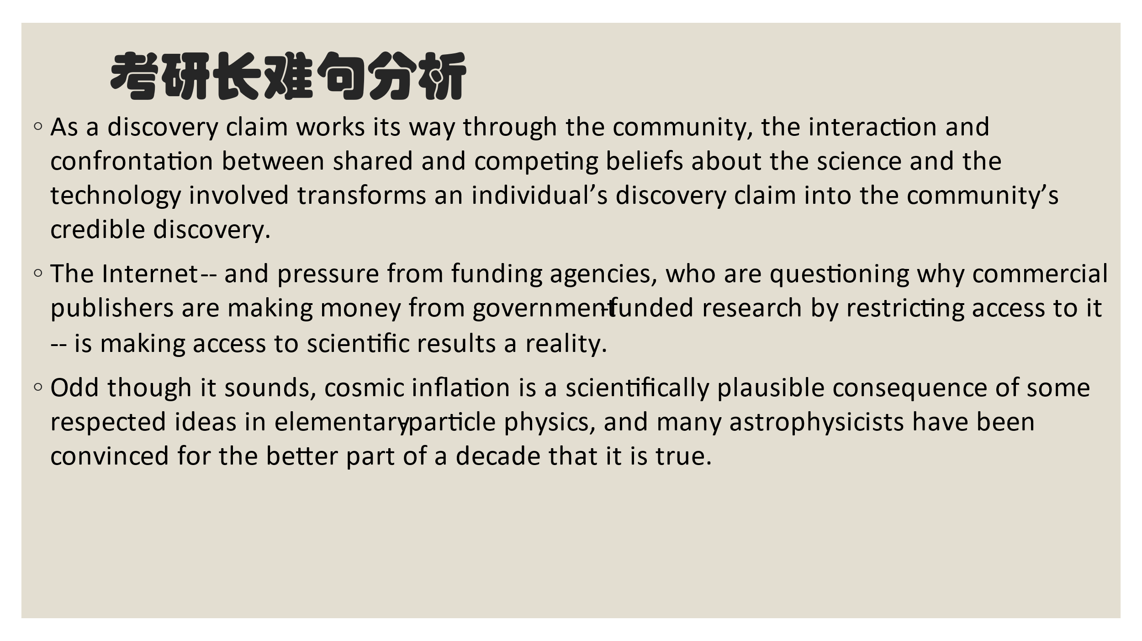
Exercise ： analyze the sentence structure

Slide 12
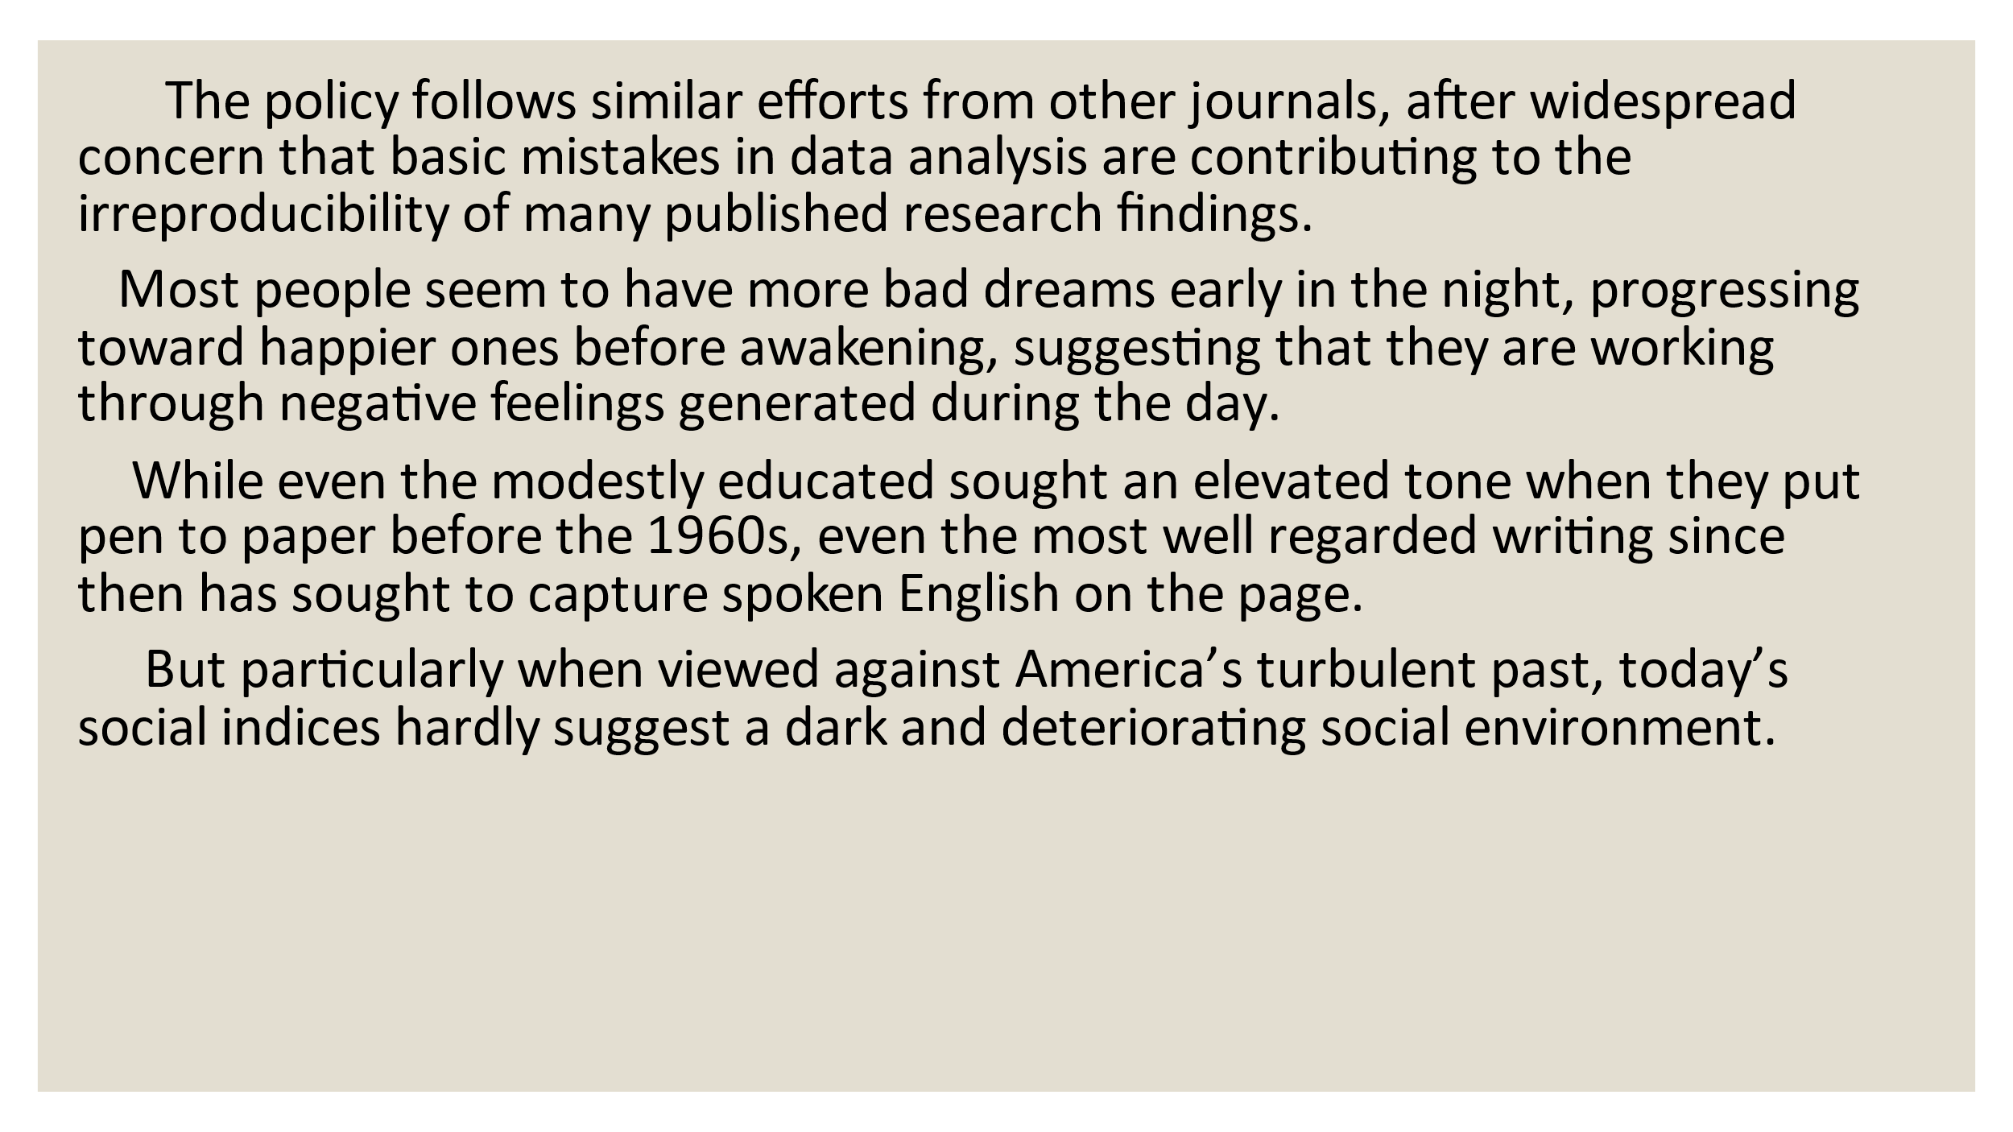

Slide 13
Group 1
Transportation: 交通方式
Vehicle: 车辆
Sedan: 轿车（一种四门、三厢的乘用车）
Toyota Camry Sedan: 丰田凯美瑞轿车，特定品牌和车型的轿车。
Group 2
Food: 食物
Fruit: 水果
Apple: 苹果
Granny Smith Apple: 格林史密斯苹果，特定品种的苹果。
Group 3
Building: 建筑物
Residence: 住宅
Apartment: 公寓（一种住宅形式，通常位于多层建筑内）
Penthouse Apartment: 顶层公寓，特定类型的豪华公寓。
Group 4
Animal: 动物
Mammal: 哺乳动物
Dolphin: 海豚
Bottlenose Dolphin: 瓶鼻海豚，特定种类的海豚。
Group 5
Plant: 植物
Tree: 树
Oak: 橡树（一种特定的树种）
Quercus robur: 英国栎，特定种类的橡树。
语言的精确度 Accuracy

Slide 14
英文的修辞手法
英语中有许多修辞手法，每种都能以独特的方式增强语言的表现力。以下是一些常见的修辞手法及其例句：
明喻（Simile）：通过使用“like”或“as”来比较两个不同事物的相似之处。
例句：Her smile was as warm as the spring sunshine.
隐喻（Metaphor）：直接将一个事物说成另一个事物，不需要使用“like”或“as”。
例句：Time is a thief, stealing every moment we have.
拟人（Personification）：赋予无生命的事物以人的特征。
例句：The wind whispered through the trees.
夸张（Hyperbole）：故意夸大事实，以产生强调效果。
例句：I'm so hungry I could eat a horse.
对比（Antithesis）：将两个相对或相反的概念并列在一起，以突出它们的差异。
例句：To be or not to be, that is the question.
排比（Parallelism）：在句子中使用相似的结构来表达相似的想法。
例句：We shall fight on the beaches, we shall fight on the landing grounds, we shall fight in the fields and in the streets.

Slide 15
讽刺（Irony）：表达与字面意思相反的意思，通常带有幽默或批评的意味。
例句：It's a fine day to catch a cold.
双关（Pun）：利用单词的多义性或发音相似性来产生幽默效果。
例句：I'm not a photographer, but I can picture us together.
设问（Rhetorical Question）：提出一个不需要回答的问题，以引起听众的思考。
例句：Who could have imagined such a turn of events?
渐进（Climax）：通过逐步增加句子的强度或重要性来构建紧张感。
例句：First we set out to find the truth, then to expose it, and finally to act upon it.
渐降（Anticlimax）：与渐进相反，通过降低句子的强度来产生反高潮效果。
例句：I fought my way through the jungle, battled wild beasts, and then tripped on a banana peel.
倒装（Inversion）：颠倒句子的正常语序，以产生强调或文学效果。
例句：Not a sound was heard; all was silent.
重复（Repetition）：重复单词或短语，以增强语言的节奏和强调。
例句：Freedom! Freedom! I can't be held down!
提喻（Synecdoche）：用部分代表整体或用整体代表部分。
例句：The White House is considering new policies. (在这里，“White House”代表美国政府)
悖论（Paradox）：看似矛盾却可能真实或有意义的陈述。
例句：Less is more.
英文的修辞手法

Slide 16
口语词汇 | 学术写作词汇
thing | object, entity
stuff | substance, material
get it | understand, comprehend
kind of | somewhat, to some extent
thing | device, gadget
gonna | going to
wanna | want to
sort of | rather, to some degree
people | individuals, populace
a lot of | numerous, a multitude of
语词汇 | 学术写作词汇
big | Considerable, extensive
important | Significant, vital
good | Superior, beneficial
bad | Adverse, detrimental
fast | Rapid, expeditious
slow | sluggish
make | Produce, generate
see | Observe, perceive
help | Assist, facilitate

Slide 17
口语词汇 | 学术写作词汇
use | Utilize, employ
show | Demonstrate, exhibit
change | Modify, alter
problem | issue dilemma
idea | Concept, notion
talk | Discuss, deliberate

Slide 18
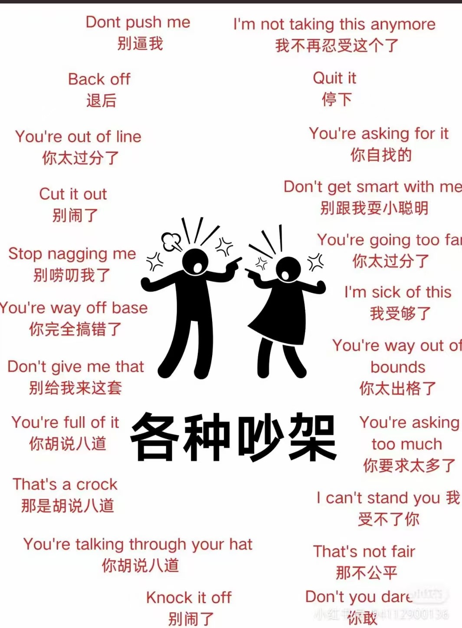
得体 Appropriateness

Slide 19
Group work
Using AI, within each group, three individuals will write a paragraph in different styles with the same content. Then, collect and organize synonyms from these three short essays that differ in style and formality.

Slide 20

Thank you!

