Slide 1
书信 letters
简介： 书信是日常生活中常用的文体，是用以交涉事宜、传达信息、交流思想、联络感情、增进了解的重要工具。英文书信分为两大类：私人信件和公务信件。
私人信件是指亲戚朋友之间的通信。这两类书信各有自己的格式。一般说来，私人信件不拘形式，信文多用手写，也可打印；
公务信件是单位与单位或单位与个人之间来往的书信，可能是推荐信、求职信、入学申请书、邀请信，或询问、答复、反映意见（如投诉信）等的信件。公务信件要求比较严格，必须遵循一定的格式。

Slide 2
英语书信的结构：
英文书信通常包括6个组成部分：
信头（heading，包括寄信人地址和日期);
信内地址（inside address，指收信人地址);
称呼（salutation）;
正文（body）;
结束语（complimentary close）;
签名（signature）;
有时候还包括附言（postscript）和 附件（attachment）。
在考试中，由于篇幅所限，只要求考生在书信中包
括日期，称呼、正文、结束语和签名五个部分。

Slide 3
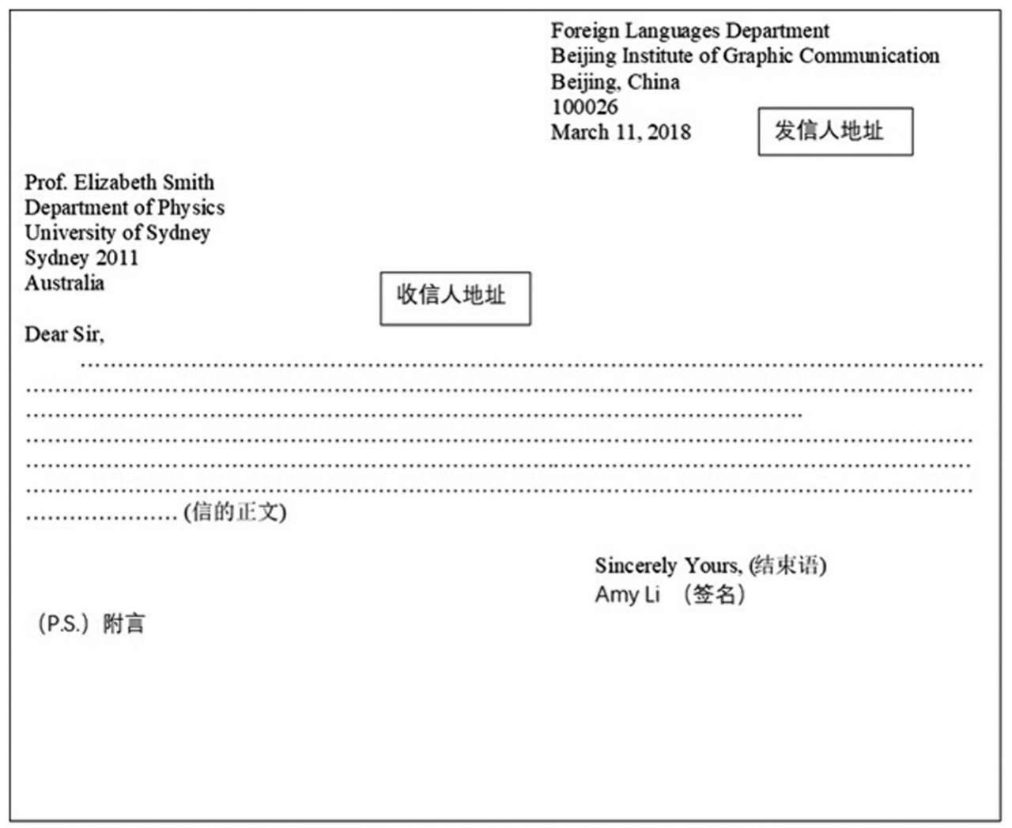
Lay-out of Business Letters

Slide 4
1. 信头（Heading）
信头是指发信人的地址和日期，通常写在第一页
的右上角。行首可以齐头写，也可以逐行缩进写。
地址的书写顺序由小到大：门牌号、街道、城市、
省（州）、邮编、国名，最后写发信日期。私人信
件一般只写寄信日期即可。例如：
123 Tianhe Road
Tianhe District, Guangzhou
Guangdong Province510650
P. R. C.
March 15, 2012

Slide 5
Road, street, block, lake, mount. Square,
District. County, city , province,
East west south north
Temple, palace, coach station, railway station, plaza,
Xiasha Higher Education Zone,

Slide 6
Hangzhou Dianzi University
Xiasha Higher Education Zone,
Hangzhou
Zhejiang Province, 310018,
People's Republic of China

Slide 7
发信日期的写法：
① 年份应完全写出，不能简写。
② 月份要用英文名称，不要用数字代替。
③ 月份名称多用公认的缩写式。但 May, June, July, 因为较短，不可缩写。
④ 写日期时，可用基数词1，2，3，4，5，……28，29，
30，31等，也可用序数词 lst, 2nd, 3rd, 4th,
5th, ……28th, 29th, 30th, 31st等。但最好用基数
词，简单明了。
日期可有下列几种写法：
① Oct. 20, 2004； ② 10 May., 2004；
③ 3rd June, 2004； ④ Sept. 16th, 2004。其中，①最为通用。

Slide 8
2. 信内地址（Inside Address）
信内地址要写收信人的姓名和地址。在公
务信件中要写明这一项，在私人信件中，这
一项常常省略。该项写在写信日期下一行的
左上角，格式与寄信人地址一样。

Slide 9
3 .称呼（Salutation）
称呼是对收信人的称谓，应与左边线对齐，写在收信人姓名、地址下面1-2行处。在称呼后，英国人常用逗号，美国人则常用冒号。在私人信件中可直呼收信人的名字，但公务信件中一定要写收信人的姓。大部分信件在称呼前加“Dear”。如： Dear Professor/Prof. Bergen: Dear Dr. Johnson, 对不相识的人可按性别称呼： Dear Sir: 或Dear Madam: Dear Ladies。 如果不知收信人的性别则可用Dear Sir or Madam:

Slide 10
3. 信的正文（Body of the Letter）
正文是书信的主体。与中文信件不同的是，英文书信的
正文的开头不是先写一些问候语，再阐明写信的目的，而是
直接说明写信人的身份及写信的目的，然后提出写信人的情
况、想法或要求，并加以必要的解释或说明。英文书信陈述
目的时，应该直截了当，意思明确，层次清楚，言简意赅。
书信正文的第一句话或第一段，通常被称为起首语。一般
说来，人们习惯用一些客套的写法作为书信正文的起始，即
先将对方来信的日期、主题加以简单描述，以便使对方一看
便知该信是回答哪一封信的。如果是第一次给别人写信，也
可用开头语作必要的自我介绍，并表明自己写信的主要目的。

Slide 11
正文写作格式：
正文的写作格式主要有英式和美式两种。
1)英式结构即缩进式结构，属于比较传统的结构,即每一段
的第一行都向里缩进4-8个字符，且所有段落的缩进距离必须
保持一致；称呼顶格写，落款则在中间偏右的位置。
2) 美式结构则是齐头式结构，其特点是所有段落的第一行
都顶格写，段与段之间空一行，另外称呼、落款等也都顶格
写。
商业信函以及电子邮件最好使用齐头式。

Slide 12
缩进式：
Oct. 20, 2004
Dear Kate,
I wonder if you can lend me your MLA Handbook for Academic Writing. I am in the process of writing my graduation thesis, and need to consult the book now and then for standard formatting. Thus I might need to keep the book for about a month and a half, and I hope that would not bring any inconvenience to you. I assure you that I will maintain the book in good condition.
If possible, please give me a call and I will come by your house to pick up the book. Thanks a lot.
Yours,
Judy

Slide 13
齐头式：
Oct. 20, 2004
Dear Kate,
I wonder if you can lend me your MLA Handbook for
Academic Writing. I am in the process of writing my
graduation thesis, and need to consult the book now and
then for standard formatting. Thus I might need to keep the
book for about a month and a half, and I hope that would not
bring any inconvenience to you. I assure you that I will
maintain the book in good condition.
If possible, please give me a call and I will come by your
house to pick up the book. Thanks a lot.
Yours,
Judy

Slide 14
4.结束语（Complimentary Close）
公务信件的结尾礼词包含两部分：发信人的结尾套语与署
名。结尾套语写在签名上面一行，第一个字母要大写，套语
结尾后面要加逗号。
在公务信件中，发信人常用的结尾套语有：Truly yours, Yours truly, Respectfully yours, Yours
respectfully, Faithfully yours, Yours faithfully, Sincerely
yours, Yours sincerely Yours truly, Yours 等。
私人信件中，发信人常用的结尾套语有：
Sincerely yours, Lovely yours, Your lovely, Your loving
son / daughter等。

Slide 15
5. 签名（Signature）
写信人的签名常位于结尾礼词正下方一二
行。除非是给很熟悉的人写信，签名一般须
写出全名。签名常常较潦草，不易辨认，因
此在签名的正下方须打印出全名。

Slide 16
stamp
writer’s full name
writer’s street address
writer’s city/state/zip code
writer’s country
(title) addressee’s full name
addressee’s street name
addressee’s city/state/zip code
addressee’s country

Slide 17
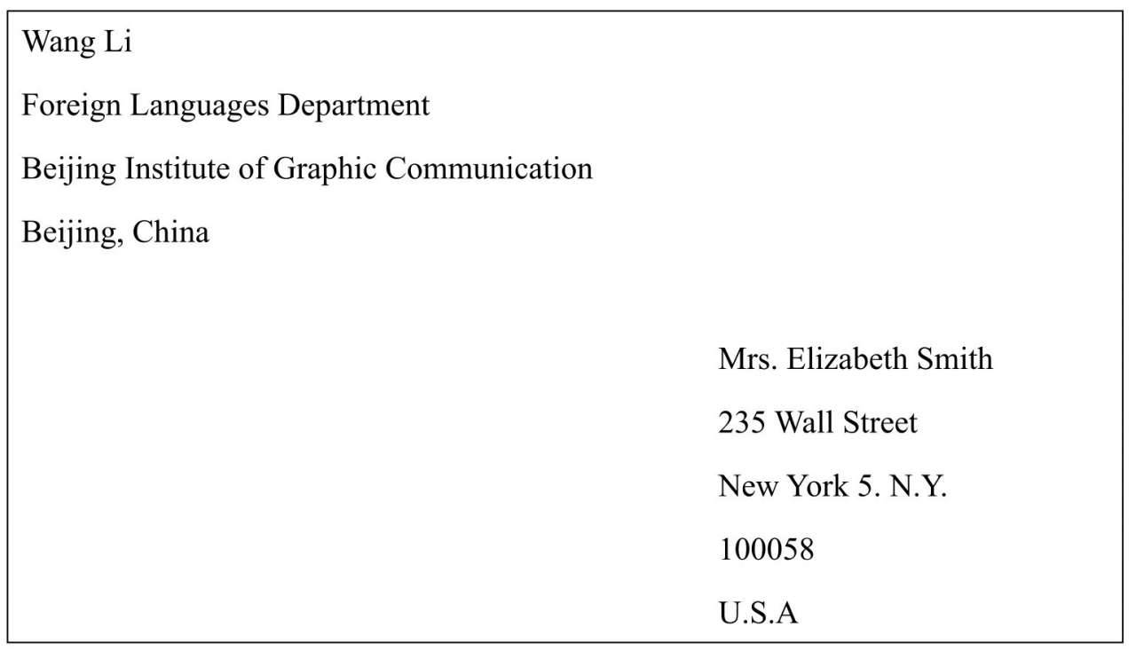
The Format of Letters
Lay-out of Envelops
考试要点
地址由小到大
收件人和发件人位置
中文地址翻译成英文
杭电英文地址地址
Stamp
发件人
收件人

Slide 18
一、 邀请信 (A Letter of Invitation)
二、 申请信 (A Letter of Application)
三、询问信 (A Letter of Inquiry)
四、 投诉信 (A Letter of Complaint)
五、道歉信 (A Letter of Apology) 六、 感谢信 (A Letter of Thanks)
七、祝贺信 (A Letter of Congratulation)
八 、请求信 (A Letter of Request)
九 、建议信 (A Letter of Advice)
十、辞职信 （ Letter of Resignation

Slide 19
一、 邀请信 (A Letter of Invitation)
(一) 邀请信的种类
英文邀请信可分为两种。一种是请柬(invitation card)，这是一种正规的邀请信，格式严谨而固定，一般适用于较庄重严肃的场合。另一种是一般的邀请信，适用于一些平常的事情的邀请，通常邀请人同被邀请人之间比较熟悉，这种邀请信具有简短、热情的特点。
（二）邀请信的写法
1.活动名称及目的
写明邀请对方参加什么活动，以及邀请的原因和目的等。
2.活动细节及注意事项
写明活动安排的细节及需要告诉对方的注意事项。诸如时间、地点、参加人员、人数，需要做些什么样的准备以及需要穿着什么的服饰。要求穿礼服时，须在请柬的右下角注明
dress：formal；较随意时可用：dress：informal。

Slide 20
March 23rd
Dear Mr. Harrison:
Our new factory will be commencing production on [April
10] and we should like to invite [you and your wife] to be
present at a celebration to mark the occasion.
As you will appreciate this is an important milestone for
this organization, and is the result of continued demand for
our products, both at home and overseas. We are inviting
all those individuals and trust that you will pay us the
compliments of accepting.
Please confirm that you will be able to attend by advising
us of your time —— we can arrange for you to be met. All
arrangements for your stay [overnight on April 10] will, of
course, be made by us at our expense.
Yours sincerely,
Li Ming

Slide 21
常用开头用语 I am writing to invite you to… I would like to see your presence at… I think it would be a good idea if you could participate in… I wonder if you could come… I would like you to come… How would you like to join us in…?
常用结尾用语 My family and I would feel honored if you could come. We would be looking forward to your participation in the party. I would like to meet you there and please let me know your decision. I really hope you can make it.
Would you please drop me a line to let me know if you can come?

Slide 22
邀请信的回复 邀请信的复信要求简明扼要，在书写时应注意以下几点： 1 接受邀请的复信中应重复写上邀请信中的某些内容，如
邀请年、月、日，星期几、几点钟等，如"I’ll be
delighted to attend your luncheon next Friday, May
the fifth, at twelve o’clock.“。 2 邀请信的复信中应明确表明接受邀请还是不接受邀请，
不能含乎其词，如不能写“I’ll come if I’m in town. ”这类的
话，以使得对方无法作出安排。在接受邀请的复信中，应对
受到邀请表示高兴。谢却的复信中应阐明不能应邀的原由。

Slide 23
你是一家公司的总经理，王志明。当地的一所技术学院6月18日给你部门写信，询问是否能考虑赞助他们将在今年夏天举办的为期一周的艺术节。今天(2011年6月20日)你给该校的校长写封回信，对他们的艺术节表示感兴趣并理解他们的需要，但是因为你们有固定的赞助预算，到明年才能考虑。建议明年再来信联系。最后预祝艺术节成功。
注意:必须包括对收信的称谓、写信日期、发信人的签名等基本格式。
Words for reference:
总经理 General Manager;为期一周的艺术节 one-week Art Festival;
固定的赞助预算 a fixed budget for sponsorship;
校长 principal;
赞助 sponsorship。

Slide 24
Response to An Invitation
20th June,2011
Dear Principal,
We have received your letter of June 18 asking if we can sponsor the one-week art festival you are going to hold this summer. We are very interested in the art festival and fully understand your needs. Unfortunately, as our company has a fixed budget for sponsorship
this year, we are unable to help you, and new items will not be considered until next year. So, we suggest you contact us again in the coming year. Still, we wish your festival a great success!
Yours sincerely,
Wang Zhiming
General Manager

Slide 25
Mr. and Mrs. Oliver Barrett III
request the pleasure of your company
at a dinner in celebration of
Mr. Barrett’s sixtieth birthday
Saturday, the sixth of March
at seven o’clock
Dover House, Ipswich, Massachusetts
R.S.V.P

Slide 26
Example 1 Formal Reply (Acceptance)
Mr. and Mrs. George Mailer
accept with pleasure
Mr. and Mrs. Robert Smith’s kind invitation to dinner
on Friday, March 26th, at seven o’clock.
17 Butter Place
March 22nd
Example 2 Formal Reply ( Decline )谢绝
Mr. and Mrs. George Mailer
present their compliments to Mr. and Mrs. Robert, and regret that a previous engagement prevents them from accepting the kind invitation to dinner on Friday, March 26th.
17 Butter Place
March 22nd

Slide 27
Invitation Format
Mr. and Mrs. Henry King request the pleasure of ____________________________’s company at ________ on _____, the ______ of _______ at ________o’clock (Address)

Slide 28
Mr. and Mrs. Henry King
request the pleasure of
Mr. and Mrs. George Smith’s
company at dinner
on Wednesday, July the first
at five o’clock p.m.
Lotus Hotel
R. S. V. P. Tel: 028-8882333

Slide 29
request the pleasure (or honor) of your company
R.S.V.P. = Répondez, s’il vous plait.
Reply if you please.
Please reply.

Slide 30
Mr. and Mrs. George Smith
accept with pleasure
Mr. and Mrs. Henry King’s kind invitation
to dinner
on Wednesday, July the first
at five o’clock p.m.
Lotus Hotel

Slide 31
Mr. and Mrs. George Smith
regret that a previous engagement
prevents their acceptance of
Mr. and Mrs. Henry King’s kind invitation to dinner
on Wednesday, July the first
at five o’clock p.m.
Lotus Hotel

Slide 32
Mrs. George Smith
accepts with pleasure
Mr. and Mrs. Henry King’s kind invitation
to dinner
on Wednesday, July the first
at five o’clock p.m.
Lotus Hotel
but regrets that Mr. Smith will be unable to attend

Slide 33
You are cordially invited to
a buffet reception
on Tuesday, November 6, 2005 at 6:30 p.m.
at the Shanghai Banquet Hall, 1333 Nanjing West Road
to celebrate the occasion of
the Shanghai Workshop on International Investment.
Cyrus R. Vance for the International Delegation

Slide 34
Mr. and Mrs. John Smith
request the honor of
Mr. & Mrs. Black’s presence
at the marriage of their daughter
Margaret
to
Mr. Donald Blaine
on Saturday, the eighth of July
at twelve o’clock
St. Stephen Catholic Church
New York
and afterwards at dinner
At the St.Moritz
Please reply to
35 Park Avenue

Slide 35
Mr. and Mrs. James Porter request the pleasure of your company at dinner on the Tenth Anniversary of their marriage on Saturday, the ninth of June at seven o’clock 85 Wilson Avenue R.S.V.P.

Slide 36
若干主要年份结婚周年纪念的名称： 1) 十年——锡婚 Tin Wedding 2) 二十年——瓷婚 China Wedding 3) 二十五年——银婚 Silver Wedding 4) 五十年——金婚 Golden Wedding 5) 六十年——钻石婚 Diamond Wedding

Slide 37
Mr. and Mrs. Edward Stone request the pleasure of your company at the christening of their son on Wednesday, March eighth at four o’clock at 25 Willow Street R.S.V.P.

Slide 38
Christening
baptism（基督教 洗礼）:
religious sacrament（圣礼） marked by splashing drops of water on the forehead of the recipient or soaking him in water to indicate atonement (赎回，偿还)for his sin and admission into the community of Christians.

Slide 39
Column A: Salutation
Dear Amy
Dear Mr. Smith
Dear Madam
Dear Sir
My dearest
Dear Anut Lucy
Dear Dr. John Baker
Dear Mom
Dear Little George
Dear Sir or Madam
Directions: Match the salutations in Column A with the addressees in Column B.
Column B: Addressee
Your teacher
An acquaintance
A woman you don’t know personally
A very close friend
A man you don’t know personally
Your mother
A friend
Your cousin
Somebody whose gender you don’t know
A relative

Slide 40
1-5 G B C E D 6-10 J A F H I

