Slide 1
目录
层次框图
安装与使用
Memory
Sdma
程序对象与执行对象
AQL队列
信号与同步

Slide 2
框图
用户编写的运行在GPU上的程序，包括GPU支持的指令，和运行时定义的函数（如shuffle, atomic 等）
用户编写的运行在CPU上的程序，包括显存访问，launch kernel 等函数
host程序
kernel程序
应用程序
用户编写
可理解为运行时接口，Hip/ocl只是为了提供不同的语法，方便用户使用开发的warpper
为用户host程序提供接口，包括显存访问，launch kernel，同步等操作。同时还提供编译链调用接口
运行时
用户空间
HIP
OPENCL
HCC
LLMV
真正的运行时
基础运行时，为实现”大一统”创建，向上提供CPU/GPU/APU的结点和访存统一，kernel的二进制文件解析，AQL和SDMA/RDMA队列的组包，节点同步等操作的基础API
HSA
Thunk layer：内核空间到用户空间的接口，调用驱动层提供的Ioctrl，向上提供统一的内存管理, queue管理等
KMT
驱动
内核空间
AMDKFD
硬件
GPU

Slide 3
使用
HSa
预安装
apt-get install libpciaccess-dev
apt-get install pciutils-dev
下载代码
git clone https://github.com/RadeonOpenCompute/ROCR-Runtime.git
编译库
cd ROCR-Runtime/src & mkdir build & cd build
cmake ../ & make -j16
替换
sudo cp build/libhsa-runtime64.so* /opt/rocm/lib
链接
hsa-runtime64
Notes:
sudo apt install libelf-dev
/usr/lib/x86_64-linux-gnu/libelf.a

Slide 4
使用
KMT
预安装
apt-get install libpciaccess-dev
apt-get install pciutils-dev
下载代码
git clone https://github.com/RadeonOpenCompute/ROCT-Thunk-Interface.git
编译库：
cd ROCT-Thunk-Interfaces & mkdir build & cd build
cmake ../ & make -j16
mkdir lib & cp libhsakmt.so* ../lib
设置kmt库路径：
export LIBHSAKMT_PATH=/home/feifei/ROCT-Thunk-Interface/
或者替换：sudo cp build/libkmthsa.so* /opt/rocm/lib

Slide 5
使用
KMT gTEST
编译测试代码：
cd .. & cd tests/kfdtest/ & mkdir build &cd build
cmake & make -j16
运行测试：
. ./kfdtest --gtest_list_tests
./kfdtest --gtest_filter=KFDMemeoryTest.MapMemoryToGPU

Slide 6
初始化
HSA
HSA环境由单例core::Runtime::runtime_singleton_维护。管理loader, context, 和agent
HSA初始化从用户调用has_init() API开始。
amd::Load(): 负责发现Agent和memory以及Link（这里load是加载的意思）
amd::hsa::loader::Loader::Create(): 负责创建loader和context（这里loader是code loader）
管理agent memory region
hsa_init()
runtime_singleton_->Acquire()
runtime_singleton_->Load()
amd::Load()
BuildTopology()
DiscoverGpu()
new GpuAgent()
InitRegionList()
amd::hsa::loader::Loader::Create()
new AmdHsaCodeLoader()
runtime_singleton_->RegisterAgent()
InitCacheList()
LoadExtensions()
创建code loader和context
注册agent
Notes:
Runtime_singletion 含有一个 loader_
Loader_ 含有多个 excuter, 类型为 Executable
一个executer 含有多个

Slide 7
初始化
KMT
KMT初始化从HSA调用hsaKmtOpenKFD () API开始。
打开kfd设备：/dev/kfd
topology_sysfs_get_system_props()：读取系统属性（节点个数，版本，名称）
/sys/devices/virtual/kfd/kfd/topology/nodes
/sys/devices/virtual/kfd/kfd/topology/system_properties
fmm_init_process_apertures()：获取各节点memory和vm属性（见内存管理）
init_process_doorbells()：为各节点准备doorbell描述符空间（并不真正分配doorbell）
hsaKmtOpenKFD()
topology_sysfs_get_system_props()
fmm_init_process_apertures()
init_process_doorbells()

Slide 8
目录
memory
概述
初始化
Allocate
相关操作
Allocate device
Allocate GTT
Allocate userptr
总结

Slide 9
memory
概述
显存简单的可以分成三种，
Remote（GTT）：就是cpu的memory，然后通过gart表映射到gpu让gpu访问。
Local visible：有pcie的地址，doorbell也分在这里，cpu可以直接访问，map动作只是简单的返回地址。
Local invisible (Device)：没有pcie地址的，map的时候驱动会分一段cpu memory，操作完unmap再拷贝回去

Slide 10
memory
概述
CPU
虚拟地址
CPU
物理地址
GPU
虚拟地址
GPU
物理地址
MMU
GPUVM

Slide 11
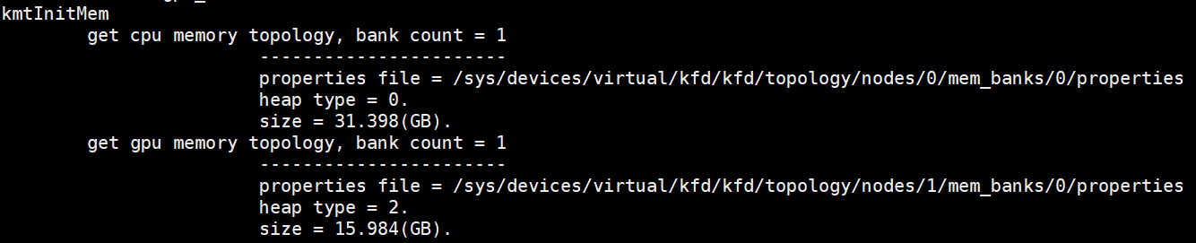
memory
概述
读取物理内存属性
在KMT的fmm_init_process_apertures() 中完成，（主要获得heap type属性）
/sys/devices/virtual/kfd/kfd/topology/nodes/[nodeIdx]/mem_banks/[bankIdx]/properties
heap_type = 0：HSA_HEAPTYPE_SYSTEM表示CPU系统内存
heap_type= 2：HSA_HEAPTYPE_FRAME_BUFFER_PRIVATE表示GPU显存

Slide 12
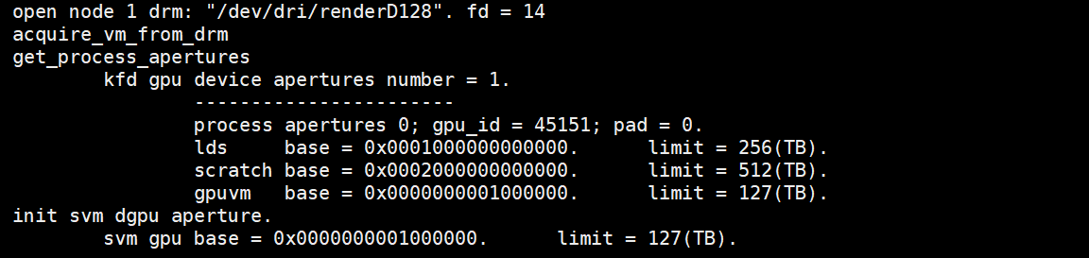
memory
KMT VM初始化
KMT中VM初始化由fmm_init_process_apertures()完成。KFD是利用DRM的VM
打开drm设备：/dev/dri/renderD128
kfd驱动从drm获取vm aperture：KMD aperture
kmt从kfd获取vm aperture：UMD aperture
填充gpuvm aperture

Slide 13
MEMORY
HSA Ageng memory初始化
填充 HsaMemoryProperties
HeapTypet = HSA_HEAPTYPE_FRAME_BUFFER_PRIVATE
GpuAgent::InitRegionList()
hsaKmtGetNodeMemoryProperties()
填充agent的regions_和local_region_变量
GPU节点只有一个MemoryBank(region)
属性为HAS_HEAPTYPE_FRAM_BUFFER_PRIVATE
判断为 LocalMemory
填充该region的mem_flag用于alloc()
fine_grain = false
full_profile = false
mem_flag_.NoSubstitute = 1
mem_flag_.HostAccess = 0
mem_flag_. NonPaged = 1
mem_flag_. CoarseCrain = 1
IsLocalMemory() = true
new MemoryRegion()
regions_ = region
local_regions_ = region
Notes:
properties_.NumMemoryBanks 是从 “vim /sys/devices/virtual/kfd/kfd/topology/nodes/1/properties” 读取 “mem_banks_count”
properties_. NumMemoryBanks = 1
hsaKmtGetNodeMemoryProperties() 从 “/sys/devices/virtual/kfd/kfd/topology/nodes/1/mem_banks/0/properties” 读取

Slide 14
MEMORY
HSA Ageng cache初始化
GpuAgent::InitCacheList()
hsaKmtGetNodeCacheProperties ()
填充 CacheProperties
填充agent的caches_变量
GPU节点有92个Cache
属性为Instruction将被忽略
Vega20 有76个cache
60个L1 cache 大小为16KB
16个L1 cache 大小为4KB
忽略Instruction属性的cache
cache_props_ = cache
Notes:
properties_.NumCaches 是从 “vim /sys/devices/virtual/kfd/kfd/topology/nodes/1/properties” 读取 “caches_count”
properties_.NumCaches = 92
hsaKmtGetNodeMemoryProperties() 从 “/sys/devices/virtual/kfd/kfd/topology/nodes/1/caches/xxx/properties” 读取

Slide 15
memory
allocate
包括以下操作：
在vm aperture上分配空间：匿名mmap，获得addr_user_handle
让KFD在GPUVM上分配空间：ioctrl
输入addr_user_handle
输入user_ptr
返回buffer_handle
mmap到drm
map to GPU：ioctrl
输入： buffer_handle
CPU
虚拟地址
CPU
物理地址
GPU
虚拟地址
GPU
物理地址
MMU
GPUVM
Vm_obj
Drm fd
fmm_allocate_device()
__fmm_allocate_device()
aperture_allocate_area()
mmap_aperture_allocate_aligned()
aperture allocate area
fmm_allocate_memory_object()
Ioctl(AMDKFD_IOC_ALLOC_MEMORY_OF_GPU)
map offset to drm
create vm object

Slide 16
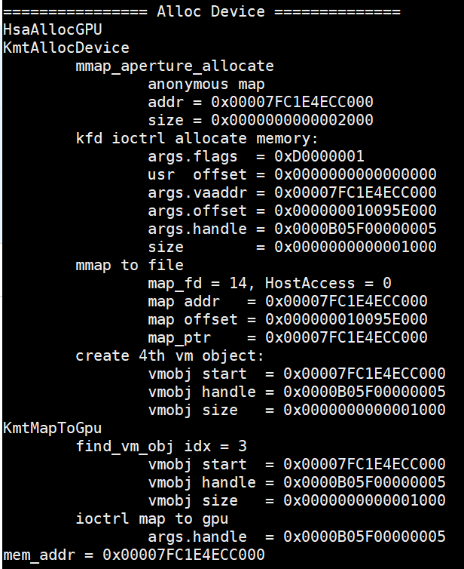
Memory
Allocate device
cpu virtual
mem_size
1. aperture allocated
User device handle
mem_addr
CPU
GPU
gpu virtual
gpu physical
mem_size
mem_size
mem_addr
vm_obj.handle
2. IOC_ALLOC_MEMORY_OF_GPU
4. IOC_MAP_MEMORY_TO_GPU
handle
map_offset
vm_obj.handle
Notes:
1. mem_addr : 进程虚拟地址
2. map_offset: 相对kfd_fd的偏移地址，分配GPUVER
3. map to file : 将进程虚拟地址和文件偏移地址关联
4. 填写GPUVM<->GPUPHY映射表，并传给GPU

Slide 17
Memory
Allocate device
user app
region->Allocate()
AllocateKfdMemory()
hsaKmtAllocMemory()
fmm_allocate_device()
aperture allocate area
MakeKfdMemoryResident()
Ioctl(AMDKFD_IOC_ALLOC_MEMORY_OF_GPU)
hsa_memory_allocate()
GPUVM:
ioc_flag |= KFD_IOC_ALLOC_MEM_FLAGS_VRAM;
ioc _flag |= KFD_IOC_ALLOC_MEM_FLAGS_EXECUTABLE;
ioc _flag |= KFD_IOC_ALLOC_MEM_FLAGS_NO_SUBSTITUTE
GPU:
IsLocalMemory = true;
IsSystem = false;
fine_grain = false;
mem_flag.HostAccess = 0;
mem_flag.NonPaged = 1;
mem_flag.NoSubstitute = 1; Mem_flag.CoarseGrain = 1;
mem_flag.executeAccess = 0;
mem_flag.AQLQueueMemory = 0;
create vm object
runtime_singleton_->AllocateMemory()
map offset to drm
alloc_flags = AllocateNoFlags
map_fd = kfd_fd / drm_fd ?
port = PORT_NONE
flag = MAP_PRIVATE | MAP_FIXED
hsaKmtMapMemoryToGPUNodes()
fmm_map_to_gpu()
Ioctl(AMDKFD_IOC_MAP_MEMORY_TO_GPU)

Slide 18
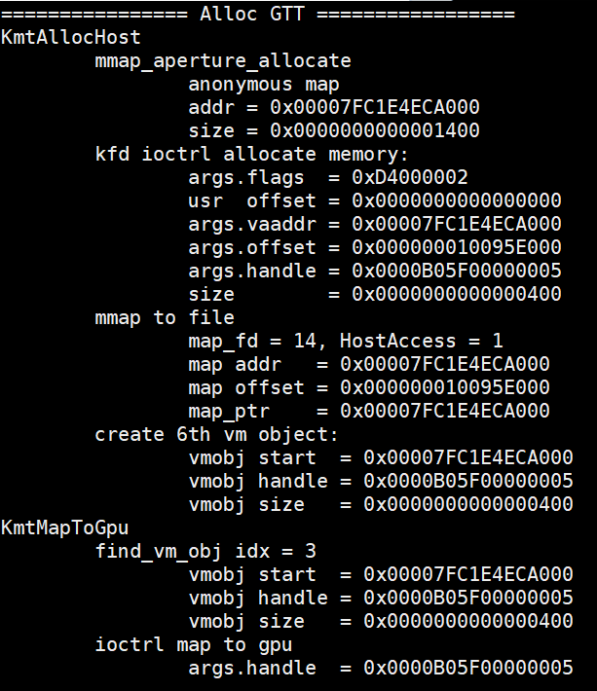
Memory
Allocate gtt
cpu virtual
KFD
ringbuffer_size
ringbuffer_size
1. aperture allocated
mem_addr
User ringbuffer_address
mem_addr
map_offset
3. mmap
CPU
GPU
gpu virtual
gpu physical
ringbuffer_size
ringbuffer_size
mem_addr
vm_obj.handle
2. IOC_ALLOC_MEMORY_OF_GPU
4. IOC_MAP_MEMORY_TO_GPU
handle
map_offset
vm_obj.handle
Notes:
第三步mmap()是把kfd_fd文件，偏移map_offset处， mmio_size大小的内容，映射到mem_addr内存地址。

Slide 19
内存分配
HARDWARE QUEUE MALLOC
hsaKmtCreateQueue()
allocate queue
allocate_exec_aligned_memory_gpu()
hsaKmtAllocMemory()
fmm_allocate_host()
DeviceLocal = nonPage = false
fmm_allocate_host_gpu()
aperture allocate area
allocate_exec_aligned_memory()
allocate ctx switch
DeviceLocal = nonPage = false
GTT:
ioc_flag |= KFD_IOC_ALLOC_MEM_FLAGS_GTT;
ioc _flag |= KFD_IOC_ALLOC_MEM_FLAGS_EXECUTABLE;
ioc _flag |= KFD_IOC_ALLOC_MEM_FLAGS_COHERENT;
Ioctl(AMDKFD_IOC_ALLOC_MEMORY_OF_GPU)
CPU:
NodeId = 0
DeviceLocal = false;
IsSystem = true;
fine_grain = true;
mem_flag.HostAccess = 1;
mem_flag.NonPaged = 0;
Mem_flag.CoarseGrain = 0;
mem_flag.executeAccess = 1;
mem_flag.NoSubstitute = 1;
mem_flag.AQLQueueMemory = 0;
create vm object
map offset to drm
hsaKmtMapMemoryToGPUNodes()
fmm_map_to_gpu()
Ioctl(AMDKFD_IOC_MAP_MEMORY_TO_GPU)
Notes:
与GPU分配CPU内存相同

Slide 20
Memory
总结
 | 位置 | NodeId | HostAccess | NonPaged
user | GPUVM | GpuId | 0 | 1
Ring buffer | GTT | 0 | 1 | 0
Eop buffer | GPUVM | GpuId | 0 | 1
Doorbell | GPUVM
kmt_queue | GTT |  | 1 | 0
Context switch | GTT |  | 1 | 0
Event | GTT | 0 | 1 | 1
MMIO | MMIO

Slide 21
内存分配
Ringbuffer malloc
AllocRegisteredRingBuffer()
region->Allocate()
AllocateKfdMemory()
hsaKmtAllocMemory()
fmm_allocate_host()
alloc_flags = AllocateExecutable
MakeKfdMemoryResident()
fmm_allocate_host_gpu()
aperture allocate area
runtime_singleton_->system_allocator()
CPU:
NodeId = 0
IsLocalMemory = false;
IsSystem = true;
fine_grain = true;
mem_flag.HostAccess = 1;
mem_flag.NonPaged = 0; Mem_flag.CoarseGrain = 0;
mem_flag.executeAccess = 1;
mem_flag.NoSubstitute = 1;
mem_flag.AQLQueueMemory = 0;
Ioctl(AMDKFD_IOC_ALLOC_MEMORY_OF_GPU)
GTT:
ioc_flag |= KFD_IOC_ALLOC_MEM_FLAGS_GTT;
ioc _flag |= KFD_IOC_ALLOC_MEM_FLAGS_EXECUTABLE;
ioc _flag |= KFD_IOC_ALLOC_MEM_FLAGS_COHERENT;
runtime_singleton_->system_allocator_
create vm object
runtime_singleton_->AllocateMemory()
map offset to drm
hsaKmtMapMemoryToGPUNodes()
fmm_map_to_gpu()
Ioctl(AMDKFD_IOC_MAP_MEMORY_TO_GPU)
map_fd = kfd_fd / drm_fd ?
port = PORT_READ | PORT_WRITE
flag = MAP_SHARED | MAP_FIXED
Notes:
每个queue分配一个ringbuffer

Slide 22
Memory allocated
RINGBUFFER malloc
cpu virtual
KFD
ringbuffer_size
ringbuffer_size
1. aperture allocated
mem_addr
User ringbuffer_address
mem_addr
map_offset
3. mmap
CPU
GPU
gpu virtual
gpu physical
ringbuffer_size
ringbuffer_size
mem_addr
vm_obj.handle
2. IOC_ALLOC_MEMORY_OF_GPU
4. IOC_MAP_MEMORY_TO_GPU
handle
map_offset
vm_obj.handle
Notes:
第三步mmap()是把kfd_fd文件，偏移map_offset处， mmio_size大小的内容，映射到mem_addr内存地址。

Slide 23
内存分配
HARDWARE QUEUE MALLOC
hsaKmtCreateQueue()
allocate queue
allocate_exec_aligned_memory_gpu()
hsaKmtAllocMemory()
fmm_allocate_host()
DeviceLocal = nonPage = false
fmm_allocate_host_gpu()
aperture allocate area
allocate_exec_aligned_memory()
allocate ctx switch
DeviceLocal = nonPage = false
GTT:
ioc_flag |= KFD_IOC_ALLOC_MEM_FLAGS_GTT;
ioc _flag |= KFD_IOC_ALLOC_MEM_FLAGS_EXECUTABLE;
ioc _flag |= KFD_IOC_ALLOC_MEM_FLAGS_COHERENT;
Ioctl(AMDKFD_IOC_ALLOC_MEMORY_OF_GPU)
CPU:
NodeId = 0
DeviceLocal = false;
IsSystem = true;
fine_grain = true;
mem_flag.HostAccess = 1;
mem_flag.NonPaged = 0;
Mem_flag.CoarseGrain = 0;
mem_flag.executeAccess = 1;
mem_flag.NoSubstitute = 1;
mem_flag.AQLQueueMemory = 0;
create vm object
map offset to drm
hsaKmtMapMemoryToGPUNodes()
fmm_map_to_gpu()
Ioctl(AMDKFD_IOC_MAP_MEMORY_TO_GPU)
Notes:
与GPU分配CPU内存相同

Slide 24
Memory allocated
Queue eop MALLOC
hsaKmtCreateQueue()
allocate_exec_aligned_memory()
hsaKmtAllocMemory()
fmm_allocate_device()
aperture allocate area
Ioctl(AMDKFD_IOC_ALLOC_MEMORY_OF_GPU)
allocate eop buffer
allocate_exec_aligned_memory_gpu()
GPUVM:
ioc_flag |= KFD_IOC_ALLOC_MEM_FLAGS_VRAM;
ioc _flag |= KFD_IOC_ALLOC_MEM_FLAGS_EXECUTABLE;
ioc _flag |= KFD_IOC_ALLOC_MEM_FLAGS_NO_SUBSTITUTE
DeviceLocal = nonPage = true
create vm object
GPU:
NodeId = gpuId;
DeviceLocal = true;
fine_grain = false;
mem_flag.HostAccess = 0;
mem_flag.NonPaged = 1;
mem_flag.NoSubstitute = 1; Mem_flag.CoarseGrain = 1;
mem_flag.executeAccess = 1;
mem_flag.AQLQueueMemory = 0;
map offset to drm
hsaKmtRegisterMemoryToNodes()
fmm_register_memory()
vm_obj->user_ptr
hsaKmtMapMemoryToGPUNodes()
fmm_map_to_gpu()
_fmm_map_to_gpu_userptr()
_fmm_map_to_gpu()
Ioctl(AMDKFD_IOC_MAP_MEMORY_TO_GPU)
Notes:
与分配GPU显存相同

Slide 25
Memory allocated
EVENT MALLOC
hsaKmtCreateEvent()
allocate_exec_aligned_memory()
aperture allocate area
NodeId = 0
nonPage = true
DeviceLocal = false
GTT:
ioc_flag |= KFD_IOC_ALLOC_MEM_FLAGS_GTT;
ioc_flag |= KFD_IOC_ALLOC_MEM_FLAGS_EXECUTABLE;
ioc_flag |= KFD_IOC_ALLOC_MEM_FLAGS_NO_SUBSTITUTE
Ioctl(AMDKFD_IOC_ALLOC_MEMORY_OF_GPU)
allocate_exec_aligned_memory_gpu()
create vm object
CPU:
NodeId = 0
DeviceLocal = false;
fine_grain = true;
mem_flag.HostAccess = 1;
mem_flag.NonPaged = 1;
Mem_flag.CoarseGrain = 0;
mem_flag.executeAccess = 1;
mem_flag.NoSubstitute = 1;
mem_flag.AQLQueueMemory = 0;
map offset to drm
hsaKmtAllocMemory()
fmm_allocate_device()
hsaKmtMapMemoryToGPUNodes()
fmm_map_to_gpu()
Ioctl(AMDKFD_IOC_MAP_MEMORY_TO_GPU)
Notes:
与分配GPU显存相同

Slide 26
Memory allocated
DOORBELL MAP
GPUVM:
ioc_flag |= KFD_IOC_ALLOC_MEM_FLAGS_DOORBELL; ioc_flag |= KFD_IOC_ALLOC_MEM_FLAGS_WRITABLE;
ioc_flag |= KFD_IOC_ALLOC_MEM_FLAGS_COHERENT;
aperture allocate area
Ioctl(AMDKFD_IOC_ALLOC_MEMORY_OF_GPU)
create vm object
hsaKmtCreateQueue()
fmm_allocate_doorbell()
map offset to drm
map_doorbell()
fmm_map_to_gpu()
Ioctl(AMDKFD_IOC_MAP_MEMORY_TO_GPU)
map_doorbell_dgpu()
Notes:
与分配GPU显存相同

Slide 27
Memory allocated
Doorbell MAP
cpu virtual
Kfd_fd
doorbell_size
doorbell_size
1. aperture allocated
mem_addr
User doorbell_address
mem_addr
doorbell_offset
doorbell_offset
3. mmap
CPU
GPU
gpu virtual
gpu physical
doorbell_size
doorbell_size
mem_addr
vm_obj.handle
2. IOC_ALLOC_MEMORY_OF_GPU
4. IOC_MAP_MEMORY_TO_GPU
handle
map_offset
vm_obj.handle
Notes:
doorbell_offset from IOC_CREATE_QUEUE
doorbell_addr = mem_addr

Slide 28
Memory allocated
MMIO MAP
MMIO:
ioc_flag |= KFD_IOC_ALLOC_MEM_FLAGS_MMIO_REMAP;
ioc_flag |= KFD_IOC_ALLOC_MEM_FLAGS_WRITABLE;
ioc_flag |= KFD_IOC_ALLOC_MEM_FLAGS_COHERENT;
aperture allocate area
Ioctl(AMDKFD_IOC_ALLOC_MEMORY_OF_GPU)
create vm object
map_mmio()
__fmm_allocate_device()
map offset to drm
fmm_map_to_gpu()
Ioctl(AMDKFD_IOC_MAP_MEMORY_TO_GPU)
Notes:
与分配GPU显存相同

Slide 29
Memory allocated
MMIO MAP
cpu virtual
KFD_FD
page_size
page_size
1. aperture allocated
mem_addr
User mmio_address
mem_addr
map_offset
3. mmap
CPU
GPU
gpu virtual
gpu physical
page_size
page_size
mem_addr
vm_obj.handle
2. IOC_ALLOC_MEMORY_OF_GPU
4. IOC_MAP_MEMORY_TO_GPU
handle
map_offset
vm_obj.handle
Notes:
Mmio_size = page_size

Slide 30
目录
sdma
概述
初始化
HAS SDMA COPY
SDMA QUEUE
SDMA PACKET

Slide 31
sdma
概述
num_sdma_engines和num_sdma_queues_per_engine从/sys/devices/virtual/kfd/kfd/topology/nodes/[nodeIdx]/properties中读取
Host到device的拷贝，用SDMA，device到device的拷贝使用kernel
Sdma支持写，拷贝和atomic操作

Slide 32
SDMA
blit初始化
GpuAgen->PostToolsInit()
blit[] = CreateBlitSdma()
sdma = new BlitSdmaV4()
HwIndexMonotonic = true
SizeToCountOffset = -1
InitDma()
blit[] = CreateBlitKernel ()
sdma->Initialize()
queue_start_addr_ = runtime_singleton_->system_allocator()
kQueueSize = 1MB
AllocateExecutable
hsaKmtCreateQueue()
HSA_QUEUE_SDMA
signals_[0]/[1] = new InterruptSignal()
Notes:
包括3个blit实例：cpu2gpu, gpu2cpu和gpu2gpu
Blit可以选择sdma也可以选择kernel。而sdma到ram只有两个channel，kernel有32个channel，所以kernel会更快
如果选择sdma, 则每个sdma实例会新建自己的queue,并分配自己的packet buffer。QueueSize = 1MB; QueueType = HAS_QUEUE_SDMA;
如果选择kernel, 则可以为blit指定queue

Slide 33
SDMA copy
Sdma copy
BuildCopyCommand()
AcquireWriteAddress()
user app
hsa_memory_copy()
SubmitBlockingCommand()
BuildPollCommand()
runtime_singleton_->CopyMemory()
SubmitCommand()
gpu_agent->DmaCopy()
BuildHdpFlushCommand()
SubmitLinearCopyCommand()
BuildAtomicDecrementCommand()
ReleaseWriteAddress()
UpdateWriteAndDoorbellRegister()

Slide 34
SDMA
Sdma queue
Sdma queue不需要分配eop, ctx_switch_buffer
Sdma queue type = KFD_IOC_QUEUE_TYPE_SDMA
Ringbuffer size 可以分配1MB，随意设置

Slide 35
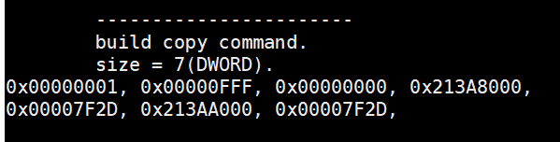
SDMA
Sdma packet格式
DW0: HEARDER
op(dw[7:0]): 1=SDMA_OP_COPY; 2=SDMA_OP_WRITE
subop(dw[15:8]): 0=LINEAR
DW1: COUNT
byte_to_copy(dw1[21:0])
DW2: PARAMETER
Dst_swap(dw[17:16])
Src_swap(dw[25:24])
DW3: SRC_ADDR_LO
DW4: SRC_ADDR_HI
DW6: DST_ADDR_LO
DW7: DST_ADDR_HI
Dword 0
Dword 6

Slide 36
目录

Slide 37
signal
初始化
allocate_exec_aligned_memory_gpu()
CreateEvent()
hsaKmtCreateEvent()
HSA_EVENTTYPE_SIGNAL
ManualReset = false
Ioctl(AMDKFD_IOC_CREATE_EVENT)
hsa_queue_create()
new AqlQueue()
IsSignaled = false
hsa_signal = new DefaultSignal ()
hsa_signal = new InterruptSignal()
hsa_signal = new DefaultSignal ()
hsa_signal_create()
hsa_amd_signal_create()
hsa_signal = new InterruptSignal()
queue->completion_signal = signal
Notes:
core::g_use_interrupt_wait = 1. use interrupt signal

Slide 38
signal
operation
StoreRelaxed()
signal.value = value
hsa_signal_store_relaxed()
SetEvent()
hsaKmtSetEvent()
Ioctl(AMDKFD_IOC_SET_EVENT)
hsa_signal_wait_acquire()
WaitAcquire()
WaitRelaxed()
hsaKmtWaitOnEvent()
Ioctl(AMDKFD_IOC_WAIT_EVENTS)
Notes:
Default signal don’t use kmt ioctl

Slide 39
目录

Slide 40
Code object
Load elf object, create code object
user app
code->InitAsHandle()
img->initAsBuffer()
pullElf()
get elf header
load segments
hsa_executable_load_code_object()
LoadSegments()
load string table
LoadCodeObject()
LoadSymbol()
load sections
new AmdHsaCode * code()
GElfImage * img
load symbols
ApplyRelocations()
Notes:
1. load code bin file to elf object GElfImage * img
2. load img to code object AmdHsaCode * code
3. create executable from code
address is the code_handle that we use
https://www.man7.org/linux/man-pages/man5/elf.5.html

Slide 41
Code object
Create executable from code object
user app
code->InitAsHandle()
hsa_executable_load_code_object()
LoadSegments()
SegmentAlloc()
LoadSegmentV2()
Memcpy()
LoadCodeObject()
LoadSymbol()
address = SymbolAddress()
new AmdHsaCode * code()
GElfImage * img
Memcpy()
ApplyRelocations()
Notes:
1. load code bin file to elf object GElfImage * img
2. load img to code object AmdHsaCode * code
3. create executable from code
address is the code_handle that we use
https://www.man7.org/linux/man-pages/man5/elf.5.html

Slide 42
Loader & execute obj
create
amd::hsa::loader::Loader::Create()
loader_ = new AmdHsaCodeLoader()
find cpu agent and system region
hsa_code_object_deserialize()
allocate device(code_obj_size)
memcpy to device(code_obj_size)
user app
hsa_executable_create()
hsa_executable_create_alt()
CreateExecutable()
executables.push new ExecutableImpl()

Slide 43
Code obj & execute obj
user app
kernel_symbol = hsa_executable_get_symbol(“kernel_name”)
code_handle = hsa_executable_symbol_get_info(kernel_symbol , HSA_EXECUTABLE_SYMBOL_INFO_KERNEL_OBJECT)
aql_queue->kernel_object = code_handle
Notes:
kernel_symbol = hsa_executable_get_symbol(“kernel_name”)
code_handle = hsa_executable_symbol_get_info(kernel_symbol, HSA_EXECUTABLE_SYMBOL_INFO_KERNEL_OBJECT)
code_handle = address
aql_queue->kernel_object = code_handle

Slide 44
执行队列流程
hsa_queue_create()
hsa_queue_t * queue
Init()
hsa_signal_create()
hsa_signal_t signal
hsa_queue_add_write_index_relaxed()
packet_index
InitDispatch()
aql = queue->base_address + packet_index
init aql
aql->completion_signal = signal
LoadCodeObjectFromFile()
hsa_code_object_deserialize()
hsa_code_object_t code_object
hsa_executable_create()
hsa_executable_t executable
hsa_executable_load_code_object()
Load code_object to executable
SetupExecutable()
hsa_executable_freeze()
Freeze executable
hsa_executable_get_symbol()
hsa_executable_symbol_t kernel_symbol
Set up aql
aql->kernel_object = code_handle
Fill kernel arg buffer
aql->kernarg_address = kernarg
Setup()
Set up aql
aql->grid_size_x/y/z; aql->workgroup_size_x/y/z
RunDispatch()
hsa_signal_store_relaxed()
queue->doorbell_signal
Wait()
hsa_signal_wait_acquire()
signal

Slide 45
queue
hsa_executable_create()
core::InterruptSignal::CreateEvent()
InterruptSignal::CreateEvent()
hsaKmtCreateEvent()
type = HAS_EVENTTYPE_SIGNAL
signal = new core::InterruptSignal()
manual_reset = false
queue_inactive_signal = signal
hsa_amd_signal_async_handler()
hsa_signal_create()
hsa_amd_signal_create()
new core::DefaultSignal()
Notes:
sudo apt install libelf-dev
/usr/lib/x86_64-linux-gnu/libelf.a

Slide 46
context
用户不可见
在runtime_singleton中的变量，变量名为loader_context_，类型为LoaderContext，继承自Context。用来维护给elf的segment提供访存的函数，实例只在runtime单例中存在

Slide 47
loader
用户不可见，实例只在runtime单例中存在
在runtime_singleton中的变量，变量名为loader_，类型为AmdHsaCodeLoader，继承自amd::hsa::loader::Loader。
在初始化时由amd::has::loader::Loader::Create()函数创建，讲runtime_singleton中的contex变量传入。
用来管理所有executable对象

Slide 48
Code_object
用户维护变量，用户可见类型为hsa_code_object_t。内部就是一个指针，与内部的AmdHsaCode类型无关
实际就是编译后二进制文件拷贝到CPU端内存的指针，该内存需要通过KMT分配，GPU可读取。
用户读取二进制文件，赋值给code_object。然后调用hsa_executable_load_code_object()函数，将code_object加载到executable对象。

Slide 49
Kernel符号
用户维护变量，类型为hsa_executable_symbol_t，即elf的符号类型，内部类型为loader::Symbol。
executable对象通过解析二进制文件获得kernel符号
用户通过hsa_executable_get_symbol()函数从executable中获得kernel符号对象
然后通过hsa_executable_symbol_get_info(HSA_EXECUTABLE_SYMBOL_INFO_KERNEL_OBJECT)函数，获得kernel可执行二进制的地址，最后给到aqlpacket的kernel_object指针

Slide 50
executable
用户维护变量，用户可见类型为hsa_executable_t，内部类型为ExecutableImpl，继承自Executable。
内部维护
AmdHsaCode对象。
ExecutableObject对象的队列objects
LoadedCodeObjectImpl对象的队列loaded_code_objects
ProgramSymbolMap类型的program_symbols_，符号map
用户通过hsa_executable_create()函数创建。该函数调用runtime_singleton_.loader_->CreateExecutable()函数。该函数新建Exceutable对象，并压入loader_的executables队列。

Slide 51
executable
加载code_object
用户调用hsa_executable_load_code_object()函数将code_object对象加载到executable对象。该函数调用executable对象的LoadCodeObject()函数。
LoadCodeObject()函数接收code_object对象，即二进制程序指针，然后创建AmdHsaCode()对象，也就是自身的code变量。
创建LoadedCodeObjectImpl对象，并压入objects和loaded_code_objects队列
LoadSegments()
LoadSymbol()：加载kernel符号
新建KernelSymbol符号，加入program_symbols_的map变量
Kernel符号对象用于后继给aql包赋值
ApplyRelocations()

Slide 52
Kernel加载流程
initial
读取二进制文件
创建执行对象
加载CodeObj
获取kernel符号
获取kernel地址

