Slide 1
目录
层次框图
安装与使用
Memory
Sdma
程序对象与执行对象
AQL队列
信号与同步

Slide 2
框图
用户编写的运行在GPU上的程序，包括GPU支持的指令，和运行时定义的函数（如shuffle, atomic 等）
用户编写的运行在CPU上的程序，包括显存访问，launch kernel 等函数
host程序
kernel程序
应用程序
用户编写
可理解为运行时接口，Hip/ocl只是为了提供不同的语法，方便用户使用开发的warpper
为用户host程序提供接口，包括显存访问，launch kernel，同步等操作。同时还提供编译链调用接口
运行时
用户空间
HIP
OPENCL
HCC
LLMV
真正的运行时
基础运行时，为实现”大一统”创建，向上提供CPU/GPU/APU的结点和访存统一，kernel的二进制文件解析，AQL和SDMA/RDMA队列的组包，节点同步等操作的基础API
HSA
Thunk layer：内核空间到用户空间的接口，调用驱动层提供的Ioctrl，向上提供统一的内存管理, queue管理等
KMT
驱动
内核空间
AMDKFD
硬件
GPU

Slide 3
使用
HSa
预安装
apt-get install libpciaccess-dev
apt-get install pciutils-dev
下载代码
git clone https://github.com/RadeonOpenCompute/ROCR-Runtime.git
编译库
cd ROCR-Runtime/src & mkdir build & cd build
cmake ../ & make -j16
替换
sudo cp build/libhsa-runtime64.so* /opt/rocm/lib
链接
hsa-runtime64
Notes:
sudo apt install libelf-dev
/usr/lib/x86_64-linux-gnu/libelf.a

Slide 4
使用
KMT
预安装
apt-get install libpciaccess-dev
apt-get install pciutils-dev
下载代码
git clone https://github.com/RadeonOpenCompute/ROCT-Thunk-Interface.git
编译库：
cd ROCT-Thunk-Interfaces & mkdir build & cd build
cmake ../ & make -j16
mkdir lib & cp libhsakmt.so* ../lib
设置kmt库路径：
export LIBHSAKMT_PATH=/home/feifei/ROCT-Thunk-Interface/
或者替换：sudo cp build/libkmthsa.so* /opt/rocm/lib

Slide 5
使用
KMT gTEST
编译测试代码：
cd .. & cd tests/kfdtest/ & mkdir build &cd build
cmake & make -j16
运行测试：
. ./kfdtest --gtest_list_tests
./kfdtest --gtest_filter=KFDMemeoryTest.MapMemoryToGPU

Slide 6
使用
driver
代码位置：/usr/src/amdgpu-version/
编译与安装：
su
dkms remove amdgpu/version --all
dkms install amdgpu/version --force
reboot
打印：
dmesg –w&
dmesg –C: 清空dmesg
驱动状态：dkms status以及lsmod | grep amdgpu
加载驱动：sudo modprobe amdgpu
更新驱动：apt-get remove rocm-dkms & apt-get install rocm-dkms

Slide 7
初始化
HSA
HSA环境由单例core::Runtime::runtime_singleton_维护。管理loader, context, 和agent
HSA初始化从用户调用has_init() API开始。
amd::Load(): 负责发现Agent和memory以及Link（这里load是加载的意思）
amd::hsa::loader::Loader::Create(): 负责创建loader和context（这里loader是code loader）
管理agent memory region
hsa_init()
runtime_singleton_->Acquire()
runtime_singleton_->Load()
amd::Load()
BuildTopology()
DiscoverGpu()
new GpuAgent()
InitRegionList()
amd::hsa::loader::Loader::Create()
new AmdHsaCodeLoader()
runtime_singleton_->RegisterAgent()
InitCacheList()
LoadExtensions()
创建code loader和context
注册agent
Notes:
Runtime_singletion 含有一个 loader_
Loader_ 含有多个 excuter, 类型为 Executable
一个executer 含有多个

Slide 8
初始化
KMT
KMT初始化从HSA调用hsaKmtOpenKFD () API开始。
打开kfd设备：/dev/kfd
topology_sysfs_get_system_props()：读取系统属性（节点个数，版本，名称）
/sys/devices/virtual/kfd/kfd/topology/nodes
/sys/devices/virtual/kfd/kfd/topology/system_properties
fmm_init_process_apertures()：获取各节点memory和vm属性（见内存管理）
init_process_doorbells()：为各节点准备doorbell描述符空间（并不真正分配doorbell）
hsaKmtOpenKFD()
topology_sysfs_get_system_props()
fmm_init_process_apertures()
init_process_doorbells()

Slide 9
目录
memory
概述
初始化
Allocate
相关操作
Allocate device
Allocate GTT
Allocate userptr
总结

Slide 10
memory
概述
显存简单的可以分成三种，
Remote（GTT）：就是cpu的memory，然后通过gart表映射到gpu让gpu访问。
Local visible：有pcie的地址，doorbell也分在这里，cpu可以直接访问，map动作只是简单的返回地址。
Local invisible (Device)：没有pcie地址的，map的时候驱动会分一段cpu memory，操作完unmap再拷贝回去

Slide 11
memory
概述
DRAM
HVA
HPA
USER
MMU
HPA
IOMMU
CPU
GPU
HBM
BUS_ADDR
BIS_ADDR
DVA
DPA
DVA
SP
GPUVM
CP
GPUVM
DPA
SDMA
Notes:
iova->[IOMMU] ->hpa
gpu virtual -> [GPUVM] ->gpu physical
bus address 1.1 (iommu=off) = cpu physical
bus address=GPA 1.2(iommu=on) (iova) ->[IOMMU] ->hpa

Slide 12
memory
概述
fine-grained memory
is directly accessible to all the agents in the system at the same time
Host memory
System coherence events only at kernel start and end
coarse-grained memory
may be accessible to multiple agents, but never at the same time
Device memory
System coherence happen at the points in the kernel the programmer requests it

Slide 13
memory
概述
IOMMU(or GART in amd)
map device dma address to host physical address
map interruput
无iommu：设备可以通过dma访问全部host地址
有iommu：驱动控制设备dma地址通过iommu映射到某块物理内存

Slide 14
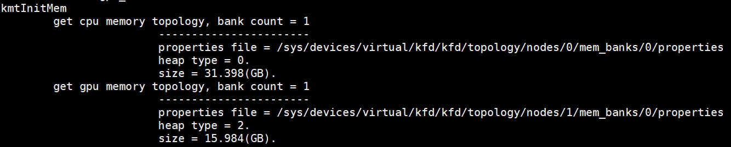
memory
概述
读取物理内存属性
在KMT的fmm_init_process_apertures() 中完成，（主要获得heap type属性）
/sys/devices/virtual/kfd/kfd/topology/nodes/[nodeIdx]/mem_banks/[bankIdx]/properties
heap_type = 0：HSA_HEAPTYPE_SYSTEM表示CPU系统内存
heap_type= 2：HSA_HEAPTYPE_FRAME_BUFFER_PRIVATE表示GPU显存

Slide 15
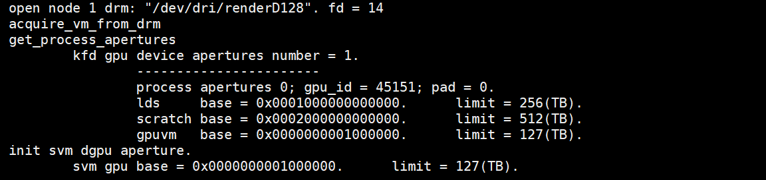
memory
KMT VM初始化
KMT中VM初始化由fmm_init_process_apertures()完成。KFD是利用DRM的VM
打开drm设备：/dev/dri/renderD128
kfd驱动从drm获取vm aperture：KMD aperture
kmt从kfd获取vm aperture：UMD aperture
填充gpuvm aperture

Slide 16
MEMORY
HSA Ageng memory初始化
填充 HsaMemoryProperties
HeapTypet = HSA_HEAPTYPE_FRAME_BUFFER_PRIVATE
GpuAgent::InitRegionList()
hsaKmtGetNodeMemoryProperties()
填充agent的regions_和local_region_变量
GPU节点只有一个MemoryBank(region)
属性为HAS_HEAPTYPE_FRAM_BUFFER_PRIVATE
判断为 LocalMemory
填充该region的mem_flag用于alloc()
fine_grain = false
full_profile = false
mem_flag_.NoSubstitute = 1
mem_flag_.HostAccess = 0
mem_flag_. NonPaged = 1
mem_flag_. CoarseCrain = 1
IsLocalMemory() = true
new MemoryRegion()
regions_ = region
local_regions_ = region
Notes:
properties_.NumMemoryBanks 是从 “vim /sys/devices/virtual/kfd/kfd/topology/nodes/1/properties” 读取 “mem_banks_count”
properties_. NumMemoryBanks = 1
hsaKmtGetNodeMemoryProperties() 从 “/sys/devices/virtual/kfd/kfd/topology/nodes/1/mem_banks/0/properties” 读取

Slide 17
MEMORY
HSA Ageng cache初始化
GpuAgent::InitCacheList()
hsaKmtGetNodeCacheProperties ()
填充 CacheProperties
填充agent的caches_变量
GPU节点有92个Cache
属性为Instruction将被忽略
Vega20 有76个cache
60个L1 cache 大小为16KB
16个L1 cache 大小为4KB
忽略Instruction属性的cache
cache_props_ = cache
Notes:
properties_.NumCaches 是从 “vim /sys/devices/virtual/kfd/kfd/topology/nodes/1/properties” 读取 “caches_count”
properties_.NumCaches = 92
hsaKmtGetNodeMemoryProperties() 从 “/sys/devices/virtual/kfd/kfd/topology/nodes/1/caches/xxx/properties” 读取

Slide 18
memory
allocate
包括以下操作：
在vm aperture上分配空间：匿名mmap，获得addr_user_handle
让KFD在GPUVM上分配空间：ioctrl
输入addr_user_handle
输入user_ptr
返回buffer_handle
mmap到drm
map to GPU：ioctrl
输入： buffer_handle
CPU
虚拟地址
CPU
物理地址
GPU
虚拟地址
GPU
物理地址
MMU
GPUVM
Vm_obj
Drm fd
fmm_allocate_device()
__fmm_allocate_device()
aperture_allocate_area()
mmap_aperture_allocate_aligned()
aperture allocate area
fmm_allocate_memory_object()
Ioctl(AMDKFD_IOC_ALLOC_MEMORY_OF_GPU)
map offset to drm
create vm object

Slide 19
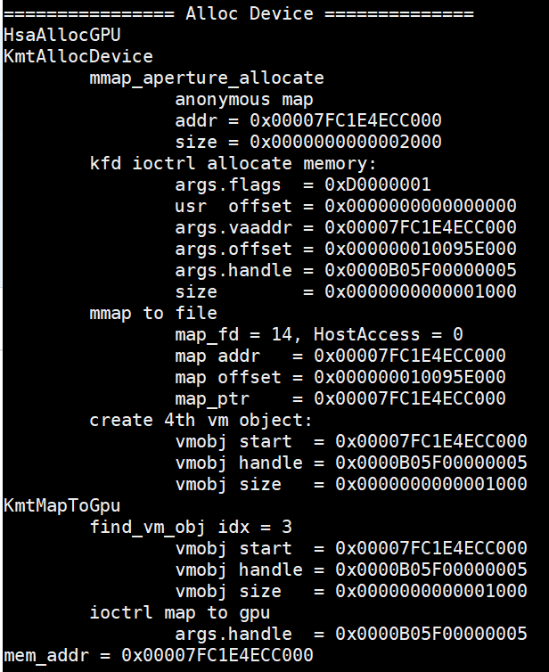
Memory
Allocate device
cpu virtual
mem_size
1. aperture allocated
User device handle
mem_addr
CPU
GPU
gpu virtual
gpu physical
mem_size
mem_size
mem_addr
vm_obj.handle
2. IOC_ALLOC_MEMORY_OF_GPU
4. IOC_MAP_MEMORY_TO_GPU
handle
map_offset
vm_obj.handle
Notes:
1. mem_addr : 进程虚拟地址
2. map_offset: 相对kfd_fd的偏移地址，分配GPUVER
3. map to file : 将进程虚拟地址和文件偏移地址关联
4. 填写GPUVM<->GPUPHY映射表，并传给GPU

Slide 20
Memory
Allocate device
user app
region->Allocate()
AllocateKfdMemory()
hsaKmtAllocMemory()
fmm_allocate_device()
aperture allocate area
MakeKfdMemoryResident()
Ioctl(AMDKFD_IOC_ALLOC_MEMORY_OF_GPU)
hsa_memory_allocate()
GPUVM:
ioc_flag |= KFD_IOC_ALLOC_MEM_FLAGS_VRAM;
ioc _flag |= KFD_IOC_ALLOC_MEM_FLAGS_EXECUTABLE;
ioc _flag |= KFD_IOC_ALLOC_MEM_FLAGS_NO_SUBSTITUTE
GPU:
IsLocalMemory = true;
IsSystem = false;
fine_grain = false;
mem_flag.HostAccess = 0;
mem_flag.NonPaged = 1;
mem_flag.NoSubstitute = 1; Mem_flag.CoarseGrain = 1;
mem_flag.executeAccess = 0;
mem_flag.AQLQueueMemory = 0;
create vm object
runtime_singleton_->AllocateMemory()
map offset to drm
alloc_flags = AllocateNoFlags
map_fd = kfd_fd / drm_fd ?
port = PORT_NONE
flag = MAP_PRIVATE | MAP_FIXED
hsaKmtMapMemoryToGPUNodes()
fmm_map_to_gpu()
Ioctl(AMDKFD_IOC_MAP_MEMORY_TO_GPU)

Slide 21
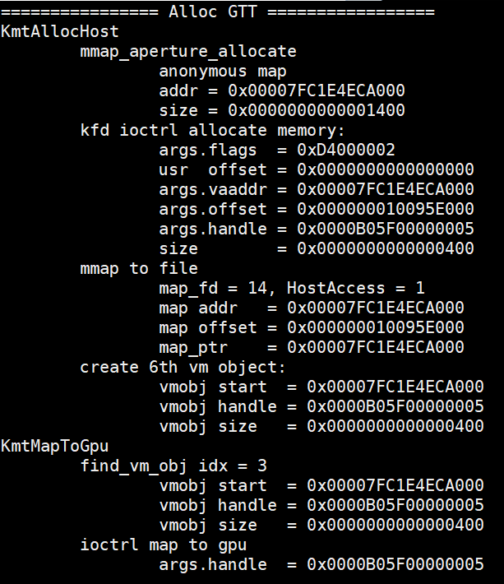
Memory
Allocate gtt
cpu virtual
KFD
ringbuffer_size
ringbuffer_size
1. aperture allocated
mem_addr
User ringbuffer_address
mem_addr
map_offset
3. mmap
CPU
GPU
gpu virtual
gpu physical
ringbuffer_size
ringbuffer_size
mem_addr
vm_obj.handle
2. IOC_ALLOC_MEMORY_OF_GPU
4. IOC_MAP_MEMORY_TO_GPU
handle
map_offset
vm_obj.handle
Notes:
第三步mmap()是把kfd_fd文件，偏移map_offset处， mmio_size大小的内容，映射到mem_addr内存地址。

Slide 22
内存分配
HARDWARE QUEUE MALLOC
hsaKmtCreateQueue()
allocate queue
allocate_exec_aligned_memory_gpu()
hsaKmtAllocMemory()
fmm_allocate_host()
DeviceLocal = nonPage = false
fmm_allocate_host_gpu()
aperture allocate area
allocate_exec_aligned_memory()
allocate ctx switch
DeviceLocal = nonPage = false
GTT:
ioc_flag |= KFD_IOC_ALLOC_MEM_FLAGS_GTT;
ioc _flag |= KFD_IOC_ALLOC_MEM_FLAGS_EXECUTABLE;
ioc _flag |= KFD_IOC_ALLOC_MEM_FLAGS_COHERENT;
Ioctl(AMDKFD_IOC_ALLOC_MEMORY_OF_GPU)
CPU:
NodeId = 0
DeviceLocal = false;
IsSystem = true;
fine_grain = true;
mem_flag.HostAccess = 1;
mem_flag.NonPaged = 0;
Mem_flag.CoarseGrain = 0;
mem_flag.executeAccess = 1;
mem_flag.NoSubstitute = 1;
mem_flag.AQLQueueMemory = 0;
create vm object
map offset to drm
hsaKmtMapMemoryToGPUNodes()
fmm_map_to_gpu()
Ioctl(AMDKFD_IOC_MAP_MEMORY_TO_GPU)
Notes:
与GPU分配CPU内存相同

Slide 23
Memory
总结
 | 位置 | NodeId | HostAccess | NonPaged
user | GPUVM | GpuId | 0 | 1
Ring buffer | GTT | 0 | 1 | 0
Eop buffer | GPUVM | GpuId | 0 | 1
Doorbell | GPUVM
kmt_queue | GTT |  | 1 | 0
Context switch | GTT |  | 1 | 0
Event | GTT | 0 | 1 | 1
MMIO | MMIO

Slide 24
内存分配
Ringbuffer malloc
AllocRegisteredRingBuffer()
region->Allocate()
AllocateKfdMemory()
hsaKmtAllocMemory()
fmm_allocate_host()
alloc_flags = AllocateExecutable
MakeKfdMemoryResident()
fmm_allocate_host_gpu()
aperture allocate area
runtime_singleton_->system_allocator()
CPU:
NodeId = 0
IsLocalMemory = false;
IsSystem = true;
fine_grain = true;
mem_flag.HostAccess = 1;
mem_flag.NonPaged = 0; Mem_flag.CoarseGrain = 0;
mem_flag.executeAccess = 1;
mem_flag.NoSubstitute = 1;
mem_flag.AQLQueueMemory = 0;
Ioctl(AMDKFD_IOC_ALLOC_MEMORY_OF_GPU)
GTT:
ioc_flag |= KFD_IOC_ALLOC_MEM_FLAGS_GTT;
ioc _flag |= KFD_IOC_ALLOC_MEM_FLAGS_EXECUTABLE;
ioc _flag |= KFD_IOC_ALLOC_MEM_FLAGS_COHERENT;
runtime_singleton_->system_allocator_
create vm object
runtime_singleton_->AllocateMemory()
map offset to drm
hsaKmtMapMemoryToGPUNodes()
fmm_map_to_gpu()
Ioctl(AMDKFD_IOC_MAP_MEMORY_TO_GPU)
map_fd = kfd_fd / drm_fd ?
port = PORT_READ | PORT_WRITE
flag = MAP_SHARED | MAP_FIXED
Notes:
每个queue分配一个ringbuffer

Slide 25
Memory allocated
RINGBUFFER malloc
cpu virtual
KFD
ringbuffer_size
ringbuffer_size
1. aperture allocated
mem_addr
User ringbuffer_address
mem_addr
map_offset
3. mmap
CPU
GPU
gpu virtual
gpu physical
ringbuffer_size
ringbuffer_size
mem_addr
vm_obj.handle
2. IOC_ALLOC_MEMORY_OF_GPU
4. IOC_MAP_MEMORY_TO_GPU
handle
map_offset
vm_obj.handle
Notes:
第三步mmap()是把kfd_fd文件，偏移map_offset处， mmio_size大小的内容，映射到mem_addr内存地址。

Slide 26
内存分配
HARDWARE QUEUE MALLOC
hsaKmtCreateQueue()
allocate queue
allocate_exec_aligned_memory_gpu()
hsaKmtAllocMemory()
fmm_allocate_host()
DeviceLocal = nonPage = false
fmm_allocate_host_gpu()
aperture allocate area
allocate_exec_aligned_memory()
allocate ctx switch
DeviceLocal = nonPage = false
GTT:
ioc_flag |= KFD_IOC_ALLOC_MEM_FLAGS_GTT;
ioc _flag |= KFD_IOC_ALLOC_MEM_FLAGS_EXECUTABLE;
ioc _flag |= KFD_IOC_ALLOC_MEM_FLAGS_COHERENT;
Ioctl(AMDKFD_IOC_ALLOC_MEMORY_OF_GPU)
CPU:
NodeId = 0
DeviceLocal = false;
IsSystem = true;
fine_grain = true;
mem_flag.HostAccess = 1;
mem_flag.NonPaged = 0;
Mem_flag.CoarseGrain = 0;
mem_flag.executeAccess = 1;
mem_flag.NoSubstitute = 1;
mem_flag.AQLQueueMemory = 0;
create vm object
map offset to drm
hsaKmtMapMemoryToGPUNodes()
fmm_map_to_gpu()
Ioctl(AMDKFD_IOC_MAP_MEMORY_TO_GPU)
Notes:
与GPU分配CPU内存相同

Slide 27
Memory allocated
Queue eop MALLOC
hsaKmtCreateQueue()
allocate_exec_aligned_memory()
hsaKmtAllocMemory()
fmm_allocate_device()
aperture allocate area
Ioctl(AMDKFD_IOC_ALLOC_MEMORY_OF_GPU)
allocate eop buffer
allocate_exec_aligned_memory_gpu()
GPUVM:
ioc_flag |= KFD_IOC_ALLOC_MEM_FLAGS_VRAM;
ioc _flag |= KFD_IOC_ALLOC_MEM_FLAGS_EXECUTABLE;
ioc _flag |= KFD_IOC_ALLOC_MEM_FLAGS_NO_SUBSTITUTE
DeviceLocal = nonPage = true
create vm object
GPU:
NodeId = gpuId;
DeviceLocal = true;
fine_grain = false;
mem_flag.HostAccess = 0;
mem_flag.NonPaged = 1;
mem_flag.NoSubstitute = 1; Mem_flag.CoarseGrain = 1;
mem_flag.executeAccess = 1;
mem_flag.AQLQueueMemory = 0;
map offset to drm
hsaKmtRegisterMemoryToNodes()
fmm_register_memory()
vm_obj->user_ptr
hsaKmtMapMemoryToGPUNodes()
fmm_map_to_gpu()
_fmm_map_to_gpu_userptr()
_fmm_map_to_gpu()
Ioctl(AMDKFD_IOC_MAP_MEMORY_TO_GPU)
Notes:
与分配GPU显存相同

Slide 28
Memory allocated
EVENT MALLOC
hsaKmtCreateEvent()
allocate_exec_aligned_memory()
aperture allocate area
NodeId = 0
nonPage = true
DeviceLocal = false
GTT:
ioc_flag |= KFD_IOC_ALLOC_MEM_FLAGS_GTT;
ioc_flag |= KFD_IOC_ALLOC_MEM_FLAGS_EXECUTABLE;
ioc_flag |= KFD_IOC_ALLOC_MEM_FLAGS_NO_SUBSTITUTE
Ioctl(AMDKFD_IOC_ALLOC_MEMORY_OF_GPU)
allocate_exec_aligned_memory_gpu()
create vm object
CPU:
NodeId = 0
DeviceLocal = false;
fine_grain = true;
mem_flag.HostAccess = 1;
mem_flag.NonPaged = 1;
Mem_flag.CoarseGrain = 0;
mem_flag.executeAccess = 1;
mem_flag.NoSubstitute = 1;
mem_flag.AQLQueueMemory = 0;
map offset to drm
hsaKmtAllocMemory()
fmm_allocate_device()
hsaKmtMapMemoryToGPUNodes()
fmm_map_to_gpu()
Ioctl(AMDKFD_IOC_MAP_MEMORY_TO_GPU)
Notes:
与分配GPU显存相同

Slide 29
Memory allocated
DOORBELL MAP
GPUVM:
ioc_flag |= KFD_IOC_ALLOC_MEM_FLAGS_DOORBELL; ioc_flag |= KFD_IOC_ALLOC_MEM_FLAGS_WRITABLE;
ioc_flag |= KFD_IOC_ALLOC_MEM_FLAGS_COHERENT;
aperture allocate area
Ioctl(AMDKFD_IOC_ALLOC_MEMORY_OF_GPU)
create vm object
hsaKmtCreateQueue()
fmm_allocate_doorbell()
map offset to drm
map_doorbell()
fmm_map_to_gpu()
Ioctl(AMDKFD_IOC_MAP_MEMORY_TO_GPU)
map_doorbell_dgpu()
Notes:
与分配GPU显存相同

Slide 30
Memory allocated
Doorbell MAP
cpu virtual
Kfd_fd
doorbell_size
doorbell_size
1. aperture allocated
mem_addr
User doorbell_address
mem_addr
doorbell_offset
doorbell_offset
3. mmap
CPU
GPU
gpu virtual
gpu physical
doorbell_size
doorbell_size
mem_addr
vm_obj.handle
2. IOC_ALLOC_MEMORY_OF_GPU
4. IOC_MAP_MEMORY_TO_GPU
handle
map_offset
vm_obj.handle
Notes:
doorbell_offset from IOC_CREATE_QUEUE
doorbell_addr = mem_addr

Slide 31
Memory allocated
MMIO MAP
MMIO:
ioc_flag |= KFD_IOC_ALLOC_MEM_FLAGS_MMIO_REMAP;
ioc_flag |= KFD_IOC_ALLOC_MEM_FLAGS_WRITABLE;
ioc_flag |= KFD_IOC_ALLOC_MEM_FLAGS_COHERENT;
aperture allocate area
Ioctl(AMDKFD_IOC_ALLOC_MEMORY_OF_GPU)
create vm object
map_mmio()
__fmm_allocate_device()
map offset to drm
fmm_map_to_gpu()
Ioctl(AMDKFD_IOC_MAP_MEMORY_TO_GPU)
Notes:
与分配GPU显存相同

Slide 32
Memory allocated
MMIO MAP
cpu virtual
KFD_FD
page_size
page_size
1. aperture allocated
mem_addr
User mmio_address
mem_addr
map_offset
3. mmap
CPU
GPU
gpu virtual
gpu physical
page_size
page_size
mem_addr
vm_obj.handle
2. IOC_ALLOC_MEMORY_OF_GPU
4. IOC_MAP_MEMORY_TO_GPU
handle
map_offset
vm_obj.handle
Notes:
Mmio_size = page_size

Slide 33
目录
sdma
概述
初始化
HAS SDMA COPY
SDMA QUEUE
SDMA PACKET
HSA kernel COPY

Slide 34
sdma
概述
num_sdma_engines和num_sdma_queues_per_engine从/sys/devices/virtual/kfd/kfd/topology/nodes/[nodeIdx]/properties中读取
Host到device的拷贝，用SDMA，device到device的拷贝使用kernel
Sdma支持写，拷贝和atomic操作

Slide 35
SDMA
blit初始化
GpuAgen->PostToolsInit()
blit[] = CreateBlitSdma()
sdma = new BlitSdmaV4()
HwIndexMonotonic = true
SizeToCountOffset = -1
InitDma()
blit[] = CreateBlitKernel ()
sdma->Initialize()
queue_start_addr_ = runtime_singleton_->system_allocator()
kQueueSize = 1MB
AllocateExecutable
hsaKmtCreateQueue()
HSA_QUEUE_SDMA
signals_[0]/[1] = new InterruptSignal()
Notes:
包括3个blit实例：cpu2gpu, gpu2cpu和gpu2gpu
Blit可以选择sdma也可以选择kernel。而sdma到ram只有两个channel，kernel有32个channel，所以kernel会更快
如果选择sdma, 则每个sdma实例会新建自己的queue,并分配自己的packet buffer。QueueSize = 1MB; QueueType = HAS_QUEUE_SDMA;
如果选择kernel, 则可以为blit指定queue

Slide 36
SDMA copy
Sdma copy
BuildCopyCommand()
AcquireWriteAddress()
user app
hsa_memory_copy()
SubmitBlockingCommand()
BuildPollCommand()
runtime_singleton_->CopyMemory()
SubmitCommand()
gpu_agent->DmaCopy()
BuildHdpFlushCommand()
SubmitLinearCopyCommand()
BuildAtomicDecrementCommand()
ReleaseWriteAddress()
UpdateWriteAndDoorbellRegister()

Slide 37
SDMA
Sdma queue
Sdma queue不需要分配eop, ctx_switch_buffer
Sdma queue type = KFD_IOC_QUEUE_TYPE_SDMA
Ringbuffer size 可以分配1MB，随意设置

Slide 38
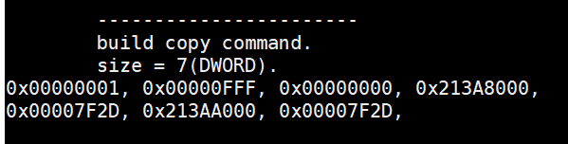
SDMA
Sdma packet格式
DW0: HEARDER
op(dw[7:0]): 1=SDMA_OP_COPY; 2=SDMA_OP_WRITE
subop(dw[15:8]): 0=LINEAR
DW1: COUNT
byte_to_copy(dw1[21:0])
DW2: PARAMETER
Dst_swap(dw[17:16])
Src_swap(dw[25:24])
DW3: SRC_ADDR_LO
DW4: SRC_ADDR_HI
DW6: DST_ADDR_LO
DW7: DST_ADDR_HI
Dword 0
Dword 6

Slide 39
Memory copy
Copy kernel
If ((src & 0x3) == (dst & 0x3)) use aligned copy
Kernel name = “CopyAligned”
Global size = CU_num * 64 * 4
Group size = 64
4 copy phase:
1st phase : copy from addr to 256 Byte aligned
2nd phase: dwordx4 copy till last whole block fit, unroll = 4
Every thread load 4 dword
Every group copy 64 * 4(instr_width) * unroll dword
Every iteration load global_size * 4(instr_width) * unroll dwords
3rd phase: dword copy till last whole block fit, dword aligend
4th phase: byte copy till end

Slide 40
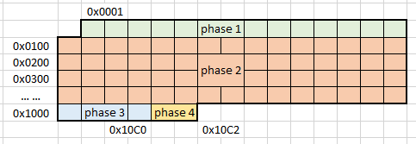
Memory copy
Copy kernel
Copy src addr = 0x0001 ~ 0x10C2
Unroll = 1
Block copy aligne = 64 * 4 = 256 byte
Block copy aligne start
copy size per block
Block copy aligne end
dword aligned end

Slide 41
目录

Slide 42
signal
初始化
allocate_exec_aligned_memory_gpu()
CreateEvent()
hsaKmtCreateEvent()
HSA_EVENTTYPE_SIGNAL
ManualReset = false
Ioctl(AMDKFD_IOC_CREATE_EVENT)
hsa_queue_create()
new AqlQueue()
IsSignaled = false
hsa_signal = new DefaultSignal ()
hsa_signal = new InterruptSignal()
hsa_signal = new DefaultSignal ()
hsa_signal_create()
hsa_amd_signal_create()
hsa_signal = new InterruptSignal()
queue->completion_signal = signal
Notes:
core::g_use_interrupt_wait = 1. use interrupt signal

Slide 43
signal
operation
StoreRelaxed()
signal.value = value
hsa_signal_store_relaxed()
SetEvent()
hsaKmtSetEvent()
Ioctl(AMDKFD_IOC_SET_EVENT)
hsa_signal_wait_acquire()
WaitAcquire()
WaitRelaxed()
hsaKmtWaitOnEvent()
Ioctl(AMDKFD_IOC_WAIT_EVENTS)
Notes:
Default signal don’t use kmt ioctl

Slide 44
目录

Slide 45
Code object
Load elf object, create code object
user app
code->InitAsHandle()
img->initAsBuffer()
pullElf()
get elf header
load segments
hsa_executable_load_code_object()
LoadSegments()
load string table
LoadCodeObject()
LoadSymbol()
load sections
new AmdHsaCode * code()
GElfImage * img
load symbols
ApplyRelocations()
Notes:
1. load code bin file to elf object GElfImage * img
2. load img to code object AmdHsaCode * code
3. create executable from code
address is the code_handle that we use
https://www.man7.org/linux/man-pages/man5/elf.5.html

Slide 46
Code object
Create executable from code object
user app
code->InitAsHandle()
hsa_executable_load_code_object()
LoadSegments()
SegmentAlloc()
LoadSegmentV2()
Memcpy()
LoadCodeObject()
LoadSymbol()
address = SymbolAddress()
new AmdHsaCode * code()
GElfImage * img
Memcpy()
ApplyRelocations()
Notes:
1. load code bin file to elf object GElfImage * img
2. load img to code object AmdHsaCode * code
3. create executable from code
address is the code_handle that we use
https://www.man7.org/linux/man-pages/man5/elf.5.html

Slide 47
Loader & execute obj
create
amd::hsa::loader::Loader::Create()
loader_ = new AmdHsaCodeLoader()
find cpu agent and system region
hsa_code_object_deserialize()
allocate device(code_obj_size)
memcpy to device(code_obj_size)
user app
hsa_executable_create()
hsa_executable_create_alt()
CreateExecutable()
executables.push new ExecutableImpl()

Slide 48
Code obj & execute obj
user app
kernel_symbol = hsa_executable_get_symbol(“kernel_name”)
code_handle = hsa_executable_symbol_get_info(kernel_symbol , HSA_EXECUTABLE_SYMBOL_INFO_KERNEL_OBJECT)
aql_queue->kernel_object = code_handle
Notes:
kernel_symbol = hsa_executable_get_symbol(“kernel_name”)
code_handle = hsa_executable_symbol_get_info(kernel_symbol, HSA_EXECUTABLE_SYMBOL_INFO_KERNEL_OBJECT)
code_handle = address
aql_queue->kernel_object = code_handle

Slide 49
执行队列流程
hsa_queue_create()
hsa_queue_t * queue
Init()
hsa_signal_create()
hsa_signal_t signal
hsa_queue_add_write_index_relaxed()
packet_index
InitDispatch()
aql = queue->base_address + packet_index
init aql
aql->completion_signal = signal
LoadCodeObjectFromFile()
hsa_code_object_deserialize()
hsa_code_object_t code_object
hsa_executable_create()
hsa_executable_t executable
hsa_executable_load_code_object()
Load code_object to executable
SetupExecutable()
hsa_executable_freeze()
Freeze executable
hsa_executable_get_symbol()
hsa_executable_symbol_t kernel_symbol
Set up aql
aql->kernel_object = code_handle
Fill kernel arg buffer
aql->kernarg_address = kernarg
Setup()
Set up aql
aql->grid_size_x/y/z; aql->workgroup_size_x/y/z
RunDispatch()
hsa_signal_store_relaxed()
queue->doorbell_signal
Wait()
hsa_signal_wait_acquire()
signal

Slide 50
queue
hsa_executable_create()
core::InterruptSignal::CreateEvent()
InterruptSignal::CreateEvent()
hsaKmtCreateEvent()
type = HAS_EVENTTYPE_SIGNAL
signal = new core::InterruptSignal()
manual_reset = false
queue_inactive_signal = signal
hsa_amd_signal_async_handler()
hsa_signal_create()
hsa_amd_signal_create()
new core::DefaultSignal()
Notes:
sudo apt install libelf-dev
/usr/lib/x86_64-linux-gnu/libelf.a

Slide 51
context
用户不可见
在runtime_singleton中的变量，变量名为loader_context_，类型为LoaderContext，继承自Context。用来维护给elf的segment提供访存的函数，实例只在runtime单例中存在

Slide 52
loader
用户不可见，实例只在runtime单例中存在
在runtime_singleton中的变量，变量名为loader_，类型为AmdHsaCodeLoader，继承自amd::hsa::loader::Loader。
在初始化时由amd::has::loader::Loader::Create()函数创建，讲runtime_singleton中的contex变量传入。
用来管理所有executable对象

Slide 53
Code_object
用户维护变量，用户可见类型为hsa_code_object_t。内部就是一个指针，与内部的AmdHsaCode类型无关
实际就是编译后二进制文件拷贝到CPU端内存的指针，该内存需要通过KMT分配，GPU可读取。
用户读取二进制文件，赋值给code_object。然后调用hsa_executable_load_code_object()函数，将code_object加载到executable对象。

Slide 54
Kernel符号
用户维护变量，类型为hsa_executable_symbol_t，即elf的符号类型，内部类型为loader::Symbol。
executable对象通过解析二进制文件获得kernel符号
用户通过hsa_executable_get_symbol()函数从executable中获得kernel符号对象
然后通过hsa_executable_symbol_get_info(HSA_EXECUTABLE_SYMBOL_INFO_KERNEL_OBJECT)函数，获得kernel可执行二进制的地址，最后给到aqlpacket的kernel_object指针

Slide 55
executable
用户维护变量，用户可见类型为hsa_executable_t，内部类型为ExecutableImpl，继承自Executable。
内部维护
AmdHsaCode对象。
ExecutableObject对象的队列objects
LoadedCodeObjectImpl对象的队列loaded_code_objects
ProgramSymbolMap类型的program_symbols_，符号map
用户通过hsa_executable_create()函数创建。该函数调用runtime_singleton_.loader_->CreateExecutable()函数。该函数新建Exceutable对象，并压入loader_的executables队列。

Slide 56
executable
加载code_object
用户调用hsa_executable_load_code_object()函数将code_object对象加载到executable对象。该函数调用executable对象的LoadCodeObject()函数。
LoadCodeObject()函数接收code_object对象，即二进制程序指针，然后创建AmdHsaCode()对象，也就是自身的code变量。
创建LoadedCodeObjectImpl对象，并压入objects和loaded_code_objects队列
LoadSegments()
LoadSymbol()：加载kernel符号
新建KernelSymbol符号，加入program_symbols_的map变量
Kernel符号对象用于后继给aql包赋值
ApplyRelocations()

Slide 57
Kernel加载流程
initial
读取二进制文件
创建执行对象
加载CodeObj
获取kernel符号
获取kernel地址

