Slide 1
Weekly
Delivery item ww49/50：FFT plan.xlsx (sharepoint.com)
WW49: bluestein: study and analysis CS_KERNEL_COPY_R_TO_CMPLX, CS_KERNEL_CHIRP, CS_KERNEL_PAD_MUL
2250: bluestein: study and analysis CS_KERNEL_FFT_MUL, CS_KERNEL_RES_MUL, CS_KERNEL_COPY_CMPLX_TO_HERM
Fei –

Slide 2
Weekly
Bluestein study
Bluestein study:
Formula
MATLAB Demo
Gpu code
Optimization

Slide 3





Weekly
Bluestein study
workflow

Slide 4
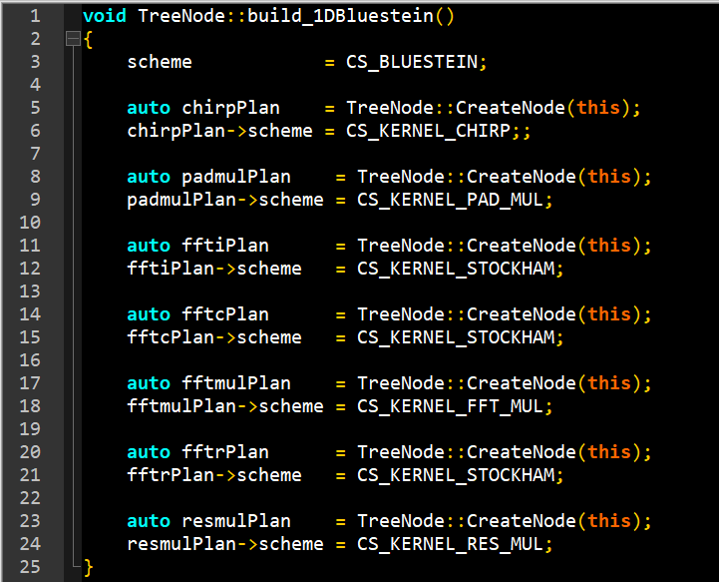
Weekly
chirp(n)
（1）
Bluestein study
x(n)
p0(n)
q(n)
r(n)
plannode
（2）
F
（4）
（1）
p(n)
F
（3）
（2）
fft_p(n)
fft_q(n)
（3）
（4）
（5）
（5）
fft_conv_pq(n)
（6）
-1
F
（6）
（7）
conv_pq(n)
（7）
fft_x(n)

Slide 5
Weekly
Bluestein study
Kernel args
 | Length | N | M | numof | count
CS_KERNEL_CHIRP | length[0] | length[0] | lengthBlue
CS_KERNEL_PAD_MUL | length[] | length[0] | lengthBlue | lengthBlue
CS_KERNEL_STOCKHAM | [lengthBlue, length]
CS_KERNEL_STOCKHAM | lengthBlue
CS_KERNEL_FFT_MUL | [lengthBlue, length] | length[0] | lengthBlue | lengthBlue
CS_KERNEL_STOCKHAM | [lengthBlue, length]
CS_KERNEL_RES_MUL | Length[] | length[0] | lengthBlue | length[0]

Slide 6

Weekly
Bluestein study
generate chirp
Host side: Generate large twiddle table
Min step phase = 1 / fft_len
Device side: Use lookup table to guarantee precision
Kernel: chirp_device
Workload:
group_size = 64
global_size = bluestein_len – fft_len
Every thread process 1 or 2 element
N = Nx
M = bluestein_len
chirp
0
0
chirp
chirp
0
0
chirp
global size

Slide 7
Weekly
Bluestein study
Vector multiplication
Kernel: mul_device
group_size = 64
global_size = batch * number_of_row
Every thread process one complex multiplication
 | CS_KERNEL_PAD_MUL | CS_KERNEL_FFT_MUL | CS_KERNEL_RES_MUL
scheme | 1 | 0 | 2
N | length[0] | length[0] | length[0]
M | lengthBlue | lengthBlue | lengthBlue
input | = bufIn0 | = bufIn0 + M | = bufIn0
output | = bufOut0 + M | = bufOut0 + 2 * M | = bufOut0
Chirp addr | = output | = output | = input = chirp buffer
Input addr | = input | = input | = input + 2*M = conv_pq buffer
Output addr | = output + M = q | = output | = output

Slide 8
Weekly
Next todo:
Delivery item ww51:
bluestein: propose possible solution
JIRA: Parallelize Bluestein algorithm: http://ontrack-internal.amd.com/browse/SWDEV-256507

Slide 9
Weekly
Delivery item ww 51：FFT plan.xlsx (sharepoint.com)
bluestein: propose possible solution
parallelize Bluestein algorithm
JIRA: Parallelize Bluestein algorithm: http://ontrack-internal.amd.com/browse/SWDEV-256507
Bluestein computes the FFT via a convolution, which is computed via an FFT on data that may be extended with zeros to a convenient size. This data is convolved with a chirp signal.
The performance of the algorithm may be improved by using different streams to set up the separate buffers that are to be convolved.

Slide 10
Weekly
chirp(n)
Bluestein study
（1）
Plannode
Only step (4) could be parallelized with step (2) and step (3)
x(n)
p0(n)
q(n)
r(n)
（2）
p(n)
F
（4）
F
（3）
（1）
fft_p(n)
fft_q(n)
（2）
（5）
（3）
fft_conv_pq(n)
（4）
-1
F
（6）
（5）
conv_pq(n)
（6）
（7）
（7）
fft_x(n)

Slide 11
Weekly
parallelize Bluestein algorithm
Parallelized step (4) with step (2) and step (3)
Chirp(1)
pad_mul(2)
fft(3)
fft(4)
fft_mul(5)
fft(6)
res_mul(7)
Default stream
event1
Stream 1:
Chirp(1)
pad_mul(2)
fft(3)
fft_mul(5)
fft(6)
res_mul(7)
Stream 2:
fft(4)
event2

Slide 12
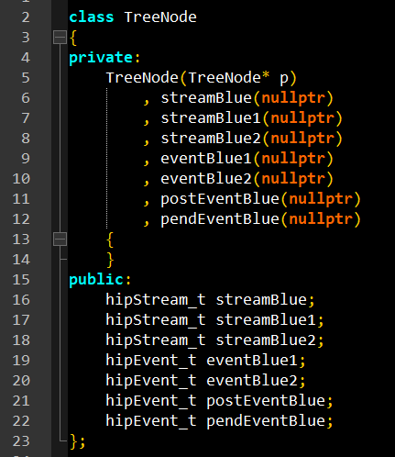
Weekly
parallelize Bluestein algorithm 1
Add event and stream for TreeNode

Slide 13
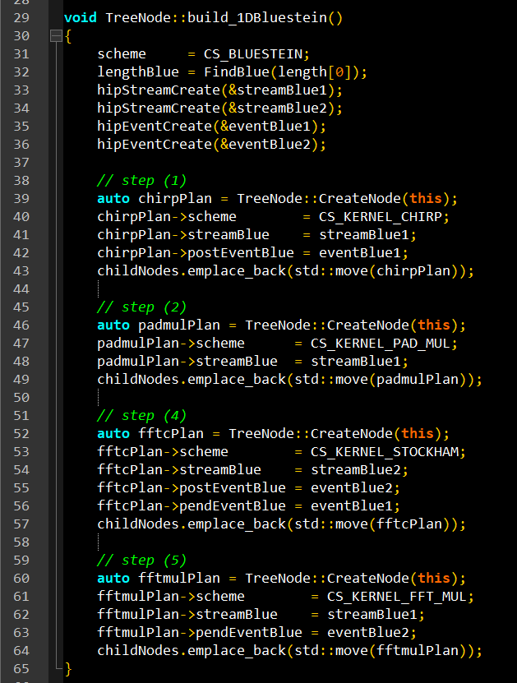
Weekly
parallelize Bluestein algorithm 2
create event and stream during building plan
Set execute stream for sub node
set post event to event1 for sub step (1)
Set post event to event2 for sub step (4)
Set pend event to event1 for sub step(4)
Set pend event to event2 for sub step(5)

Slide 14
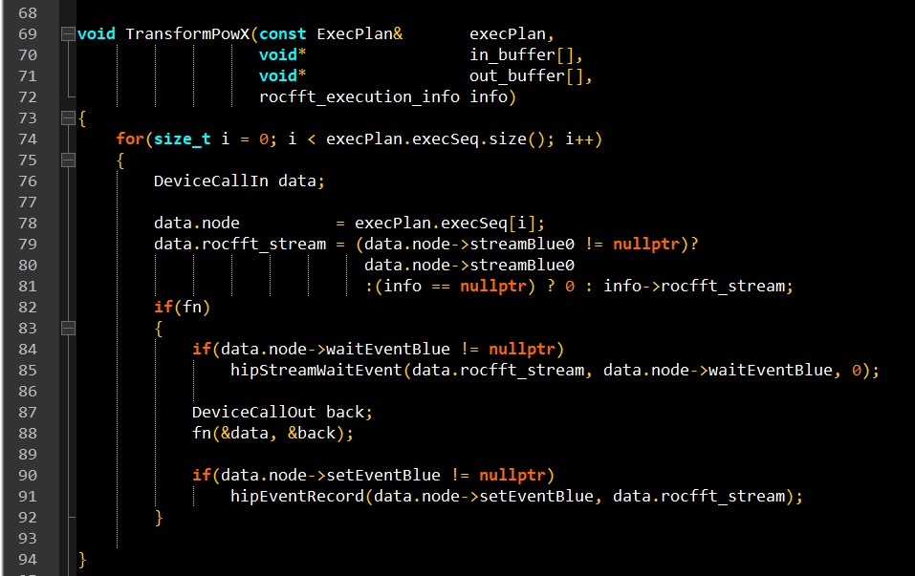
Weekly
parallelize Bluestein algorithm 3
During kernel execution
Wait event before launch kernel if pendEvent is not nullptr
Set event after launch kernel if postEvent is not nullptr

Slide 15
Weekly
parallelize Bluestein algorithm
FFT length = 2039
batch size = 2400
Duration : 1.429ms -> 1.475ms

Slide 16
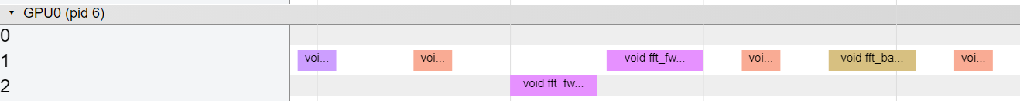
Weekly
Perf drop:
Sub step (4) only do 1 batch fft: 14us
Pend event is too expensive: 33us
Launch kernel : 5us
Switch kernel : 8us
Even if we don’t pend event, we could only save (14 + 5 + 5) – (8 + 8) = 8us
8us
5us
14us
33us

