Slide 1
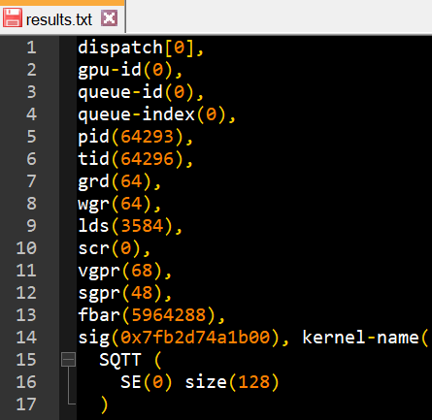
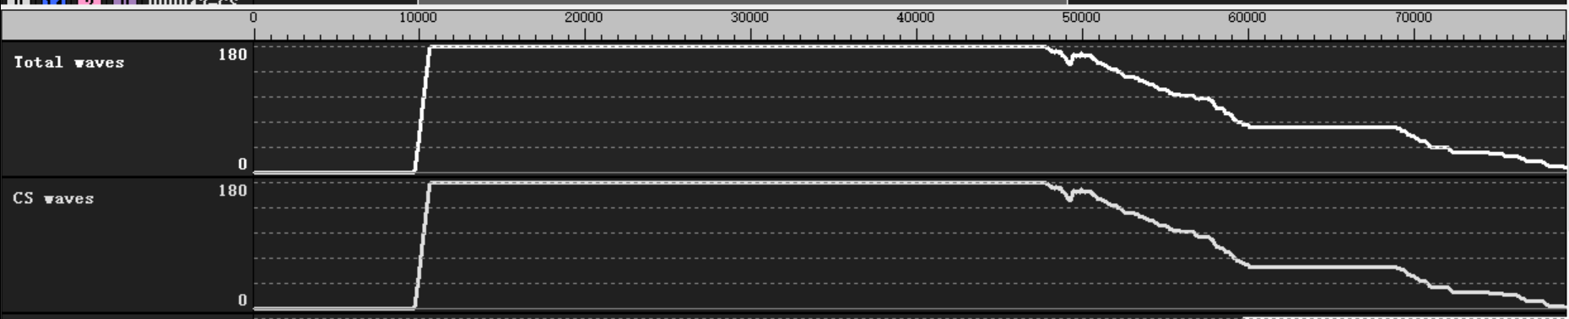
Weekly
Delivery item 1：
  analysis with radix16 vgpr consumption for size 4096
    JIRA：Analyze and improve butterfly performance
    Dump info :
      rocprof -i input.txt -d ./ ./rocfft_test
      rpl_data_201112_014912_64111/input1_results_201112_014912/results.txt
    1d c2c 4096len kernel:
      fft_fwd_op_len4096
      group size = 256 (4 wave)
      lds = 4096DW (4 group per CU at most, 4 wave per SIMD)
      VGPR = 68 (3 wave per SIMD, 3 group per CU at most)
    If launch 4 group per CU
      Batch = 4 * CU_NUM
      Only 3 group inflight
      12 wave inflight per CU

Slide 2
Weekly
Delivery item 1：
  Analysis vgpr usage for all size in the JIRA
    LDS: 16K DW per CU
    VGPR: 16K DW per SIMD, 64 thread per WAVE, 256 VGPR per thread
length | radix | VGPR | LDS(DW) | grp_size/ Wave | grp_lmt_lds (CU) | wv_lmt_vgpr (SIMD) | gpr_lmt_vgpr (CU) | Best Vgpr usage / (reduce) / group num
112 | 7 | 68 | 896 | 64 / 1 | 18 | 3 | 12 | 51 (17) / 20
512 | 8 | 40 | 512 | 64 / 1 | 32 | 6 | 24 | 32 (8) / 32
2187 | 3 | 48 | 2187 | 243 / 4 | 7 | 5 | 5 | 36 (12) / 7
3125 | 5 | 120 | 3125 | 128 / 2 | 5 | 2 | 4 | 85 (35) / 6
4096 | 16 | 68 | 4096 | 256 / 4 | 4 | 3 | 3 | 64 (4) / 4

Slide 3
Weekly
Delivery item 2：
  memory pattern( fft_op_kernel )
    JIRA: Check the impact of global memory access pattern for FFT kernels
      Check global memory channel conflict for below problem:
      1. How does it affect 1d fft kernels with various radixes?
        We would like to check 2^9,..., 2^13 and 3^8, 3^9
      2. How does it affect batched 1d fft kernel?
        We would like to check all pow-of-2 with large batch run
        How does it affect non-unit stride fft kernels(low priority)?
    fft_op_kernel global mem operation:
      fft input data load
      twiddle factor load
      result data write (mult-dim fft will be different due to transpose-fused fft_op_kernel)
    L2 channel width = 64 DW
    L2 channel number = 16

Slide 4
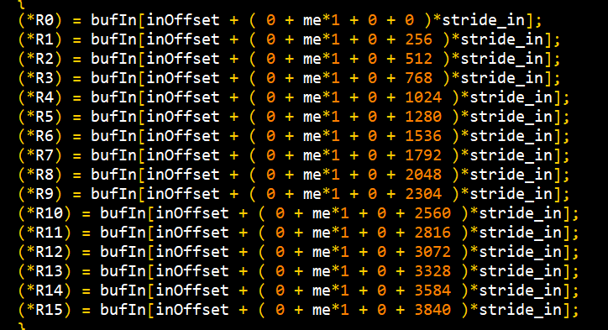
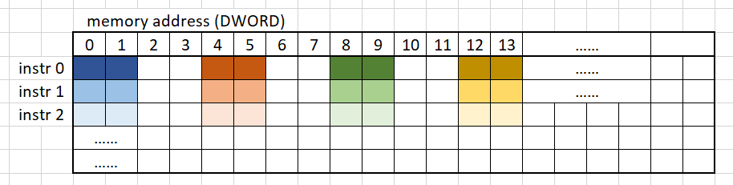
Weekly
Delivery item 2：memory pattern
  FFT input data load:
    Read address
      Addr = offset + (threadIdx + radix ^ 2 * instr_n) * stride_in
      Offset = batch start addr
    Behavior
      Every thread read one element(float2) per instruction
      Adjacent thread load adjacent element only for stride = 1.
      Instruction number = radix
      Instruction stride = radix^2 * stride
    Conclusion :
      fft length and batch won’t effect glb mem behavior
      Radix only effect instruction number
      stride_in * elem_width = chan_width * chan_num
      will cause channel conflict
stride_in
radix^2 * stride
element width

Slide 5
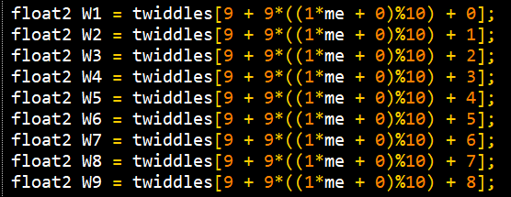
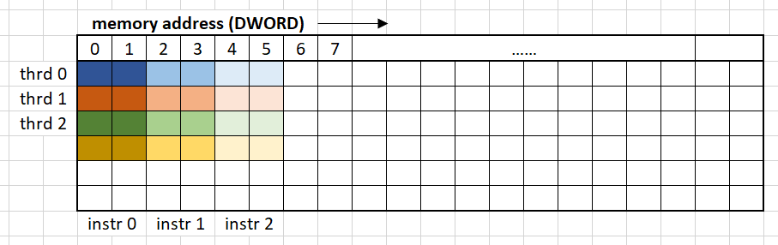
Weekly
Delivery item 2：memory pattern
  Twiddle factor load:
    Read address
      offset + radix * (threadIdx_x) % radix ^ pass_n + instr_n
    Behavior
      Every thread read one element(float2) per instruction
      thread stride = radix.
      Instruction number = radix
      Instruction stride = element
    Conclusion :
      fft batch and stride won’t effect glb mem behavior
      Because radix <= 16.
      thread_stride = radix * element <= 32
      thread_stride always less than chan_width * chan_num
      Twiddle factor load won’t have channel conflict .
radix

Slide 6
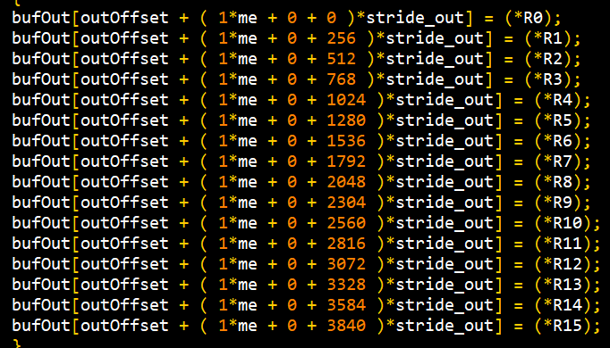
Weekly
Delivery item 2：memory pattern
  FFT result write:
    Write address
      addr = offset + (threadIdx + radix ^ 2 * instr_n) * stride_out
      Offset = batch start addr
    Behavior
      Every thread write one element(float2) per instruction
      Adjacent thread write adjacent element only for stride = 1.
      Instruction number = radix
      Instruction stride = radix^2 * stride
    Conclusion :
      fft length and batch won’t effect glb mem behavior
      Radix only effect instruction number
      stride_out * elem_width = chan_width * chan_num
      will cause channel conflict
stride_out
radix^2 * stride
element width

Slide 7
Weekly
NEXT TODO:
  Delivery WW47
  butterfly: propose possible solution (radix16, radix5)

